Slide 1
ST425 Group Assignment
GROUP 12
KANG, JOON HYEOK / QUIGLEY, RYAN GAN, LU / ERTEKIN, CEYLIN

Slide 2
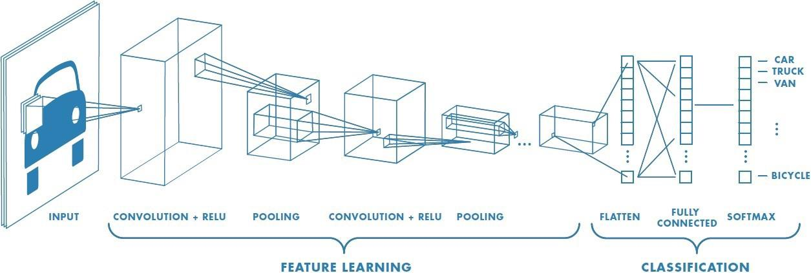
Convolutıonal neural network (CNN) – Overview
Specific class of Neural Network
Designed to capture spatial information from image and video data.
Traditional applications: Object detection, autonomous driving, medical image classification.
Recent applications: Natural language processing, time series forecasting (especially in finance and healthcare).
Lecun et al (1998) implemented the first working CNN on the MNIST dataset for handwritten number recognition.
A CNN attempts to identify the individual features of a dataset, which, when aggregated, capture the collective features of the dataset.

Slide 3
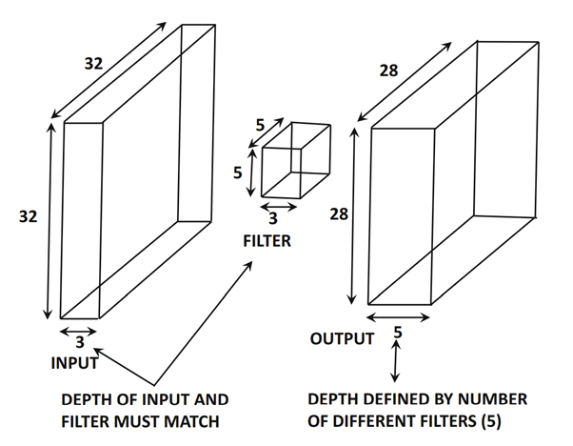
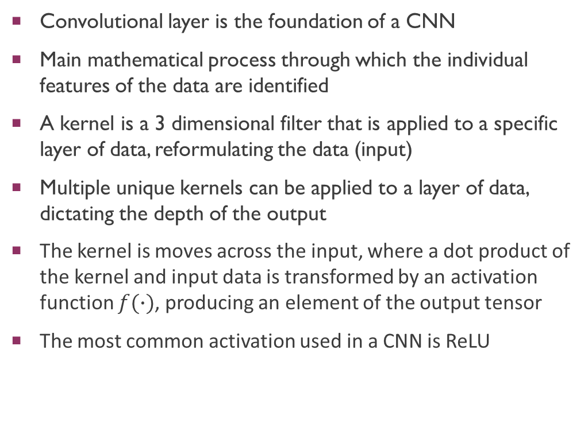
Convolutional Layers
Convolutional layer is the foundation of a CNN
Main mathematical process through which the individual features of the data are identified
A kernel is a 3 dimensional filter that is applied to a specific layer of data, reformulating the data (input)
Multiple unique kernels can be applied to a layer of data, dictating the depth of the output
The kernel is moves across the input, where a dot product of the kernel and input data is transformed by an activation function $f(∙)$, producing an element of the output tensor
The most common activation used in a CNN is ReLU

Slide 4
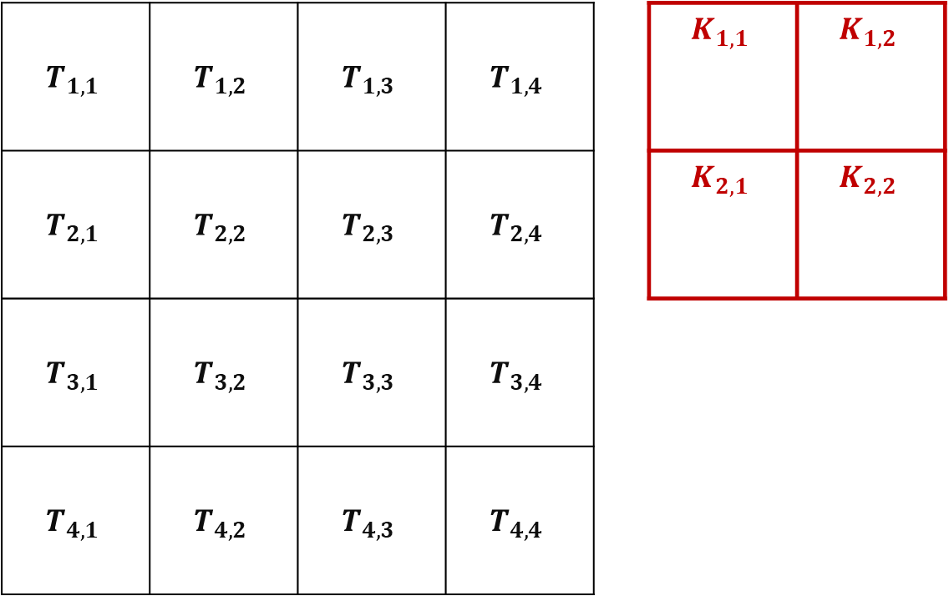
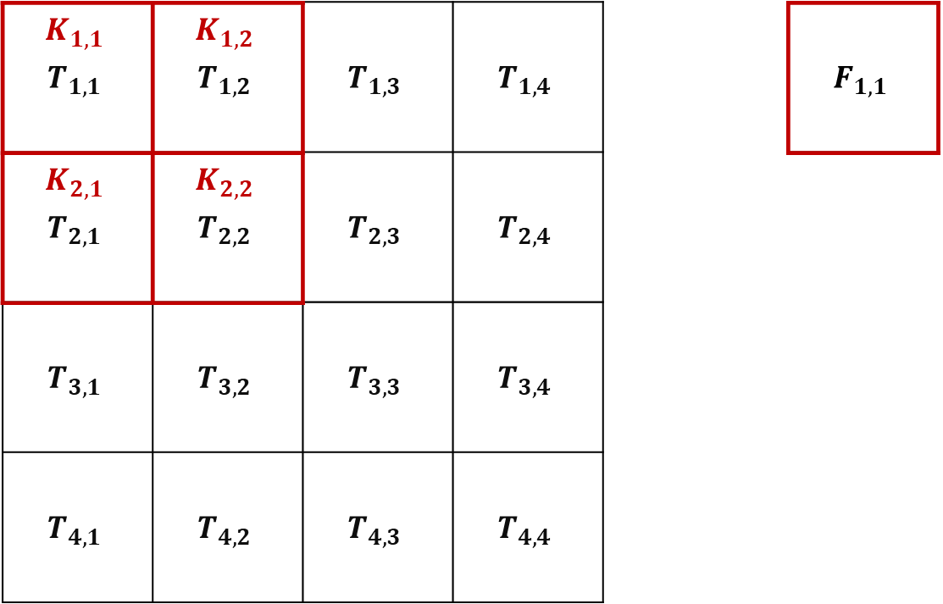
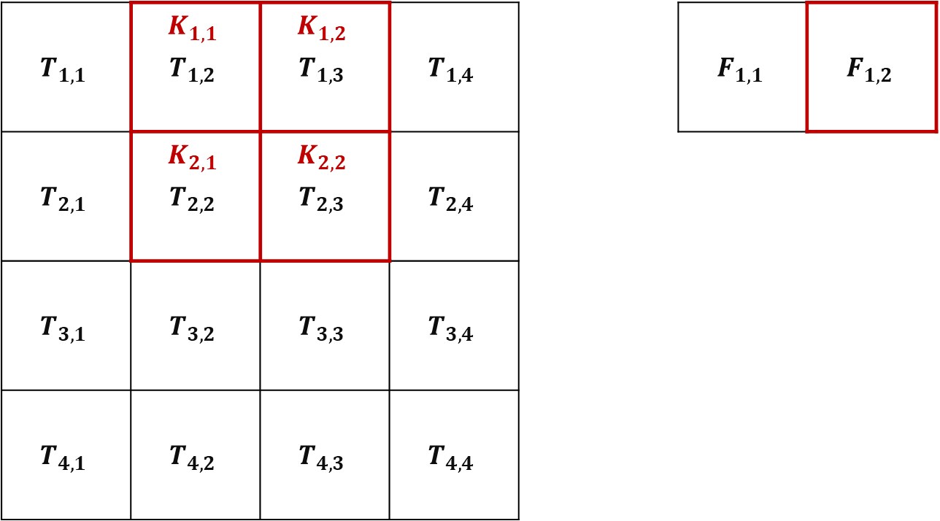
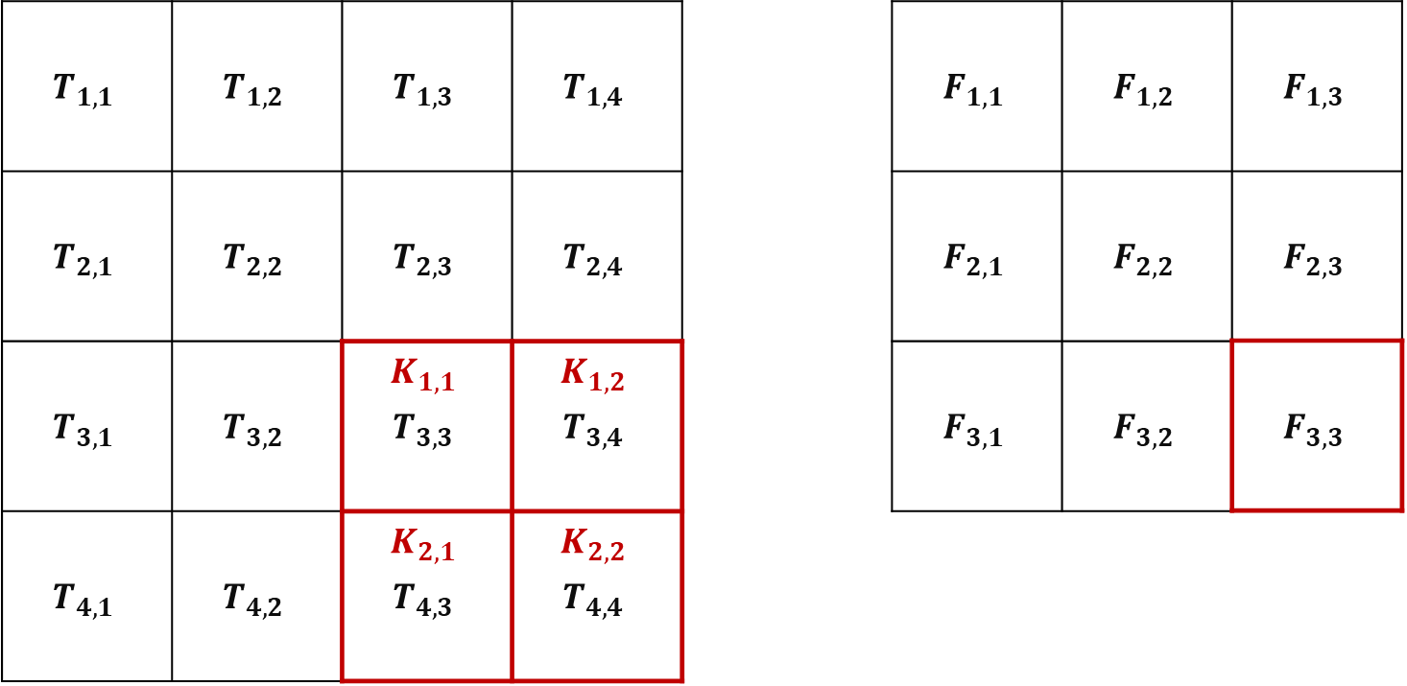
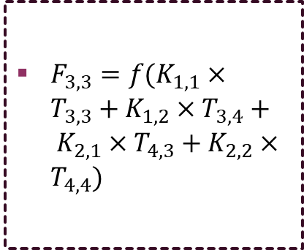
Convolutional Layers - Visual Example
Convolution operations move horizontally and then vertically, once all horizontal convolutions have been performed
$F_{3,3}=f(K_{1,1}×T_{3,3}+K_{1,2}×T_{3,4}+ K_{2,1}×T_{4,3}+K_{2,2}×T_{4,4})$
…

Slide 5
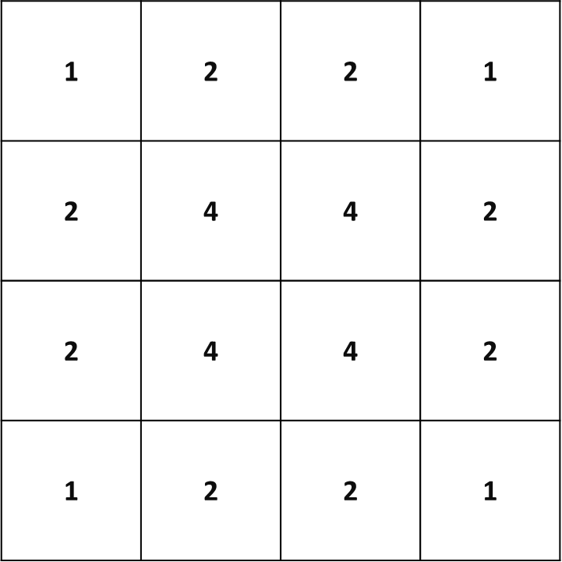
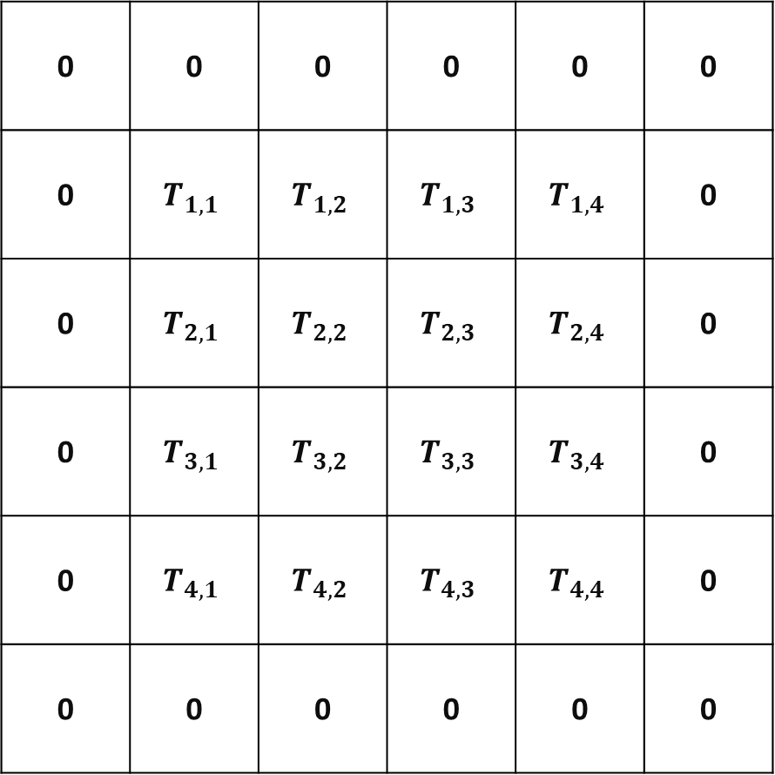
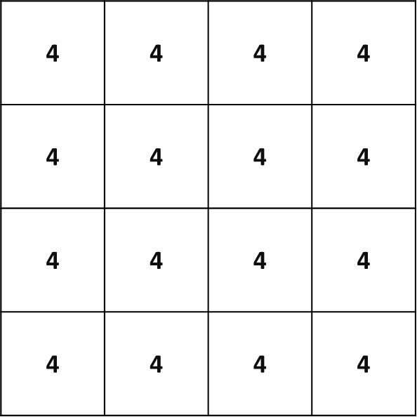
Padding
Represents the frequency at which input elements appear in the output.
With no padding, elements on the outside of the input appear less frequently in the output
Features at the outside will be given less weight and thus reduce prediction ability
Padding adds zero’s to the outside of the input
Frequency at which inputs appear in the output are equal

Slide 6
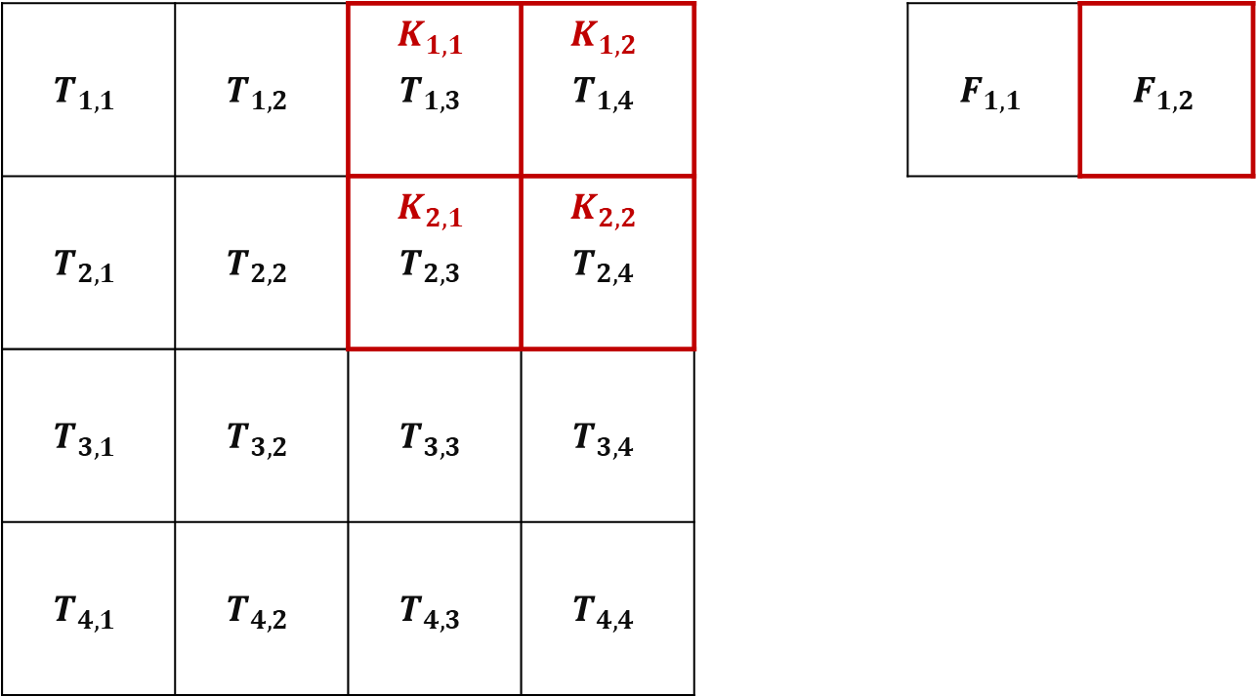
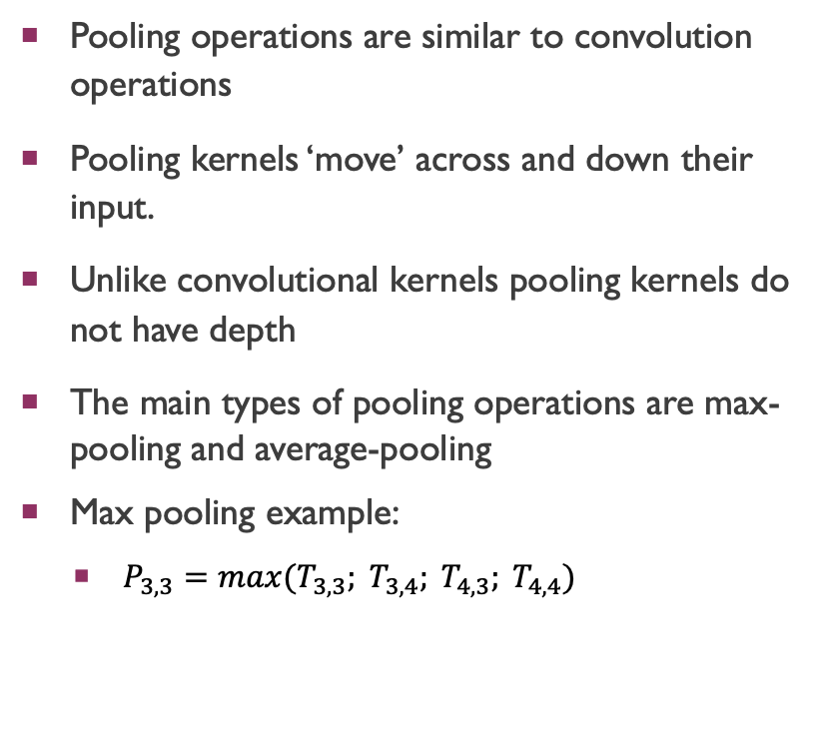
Pooling
Strides
The ‘stride’ describes the movement of the convolutional and pooling kernels
A single stride kernel is one which moves across and down the input one element at a time
For example: A 2 stride convolution …
Pooling operations are similar to convolution operations
Pooling kernels ‘move’ across and down their input.
Unlike convolutional kernels pooling kernels do not have depth
The main types of pooling operations are max-pooling and average-pooling
Max pooling example:
$P_{3,3}=max(T_{3,3}; T_{3,4}; T_{4,3}; T_{4,4})$

Slide 7

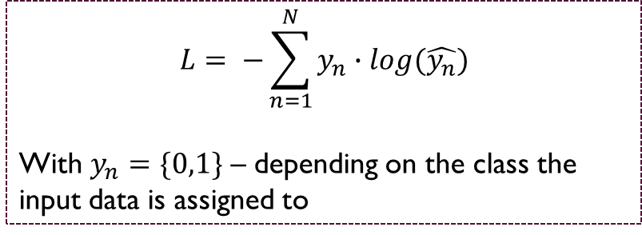
training
A CNN is trained by minimising a loss function through a process known as backpropagation
In the case of a univariate classification CNN, a cross entropy loss function is used
Weights in convolution kernels are updated through backpropagation
This process is normally done in batches of data and is repeated multiple times over the training data
$$L= −\sum_{n=1}^{N}{y_{n}}∙log(\hat{y_{n}})$$
With $y_{n}=\{0,1\}$ – depending on the class the input data is assigned to
$W_{i}= W_{i}+ \frac{∂L}{∂W_{i}}∙C$

Slide 8
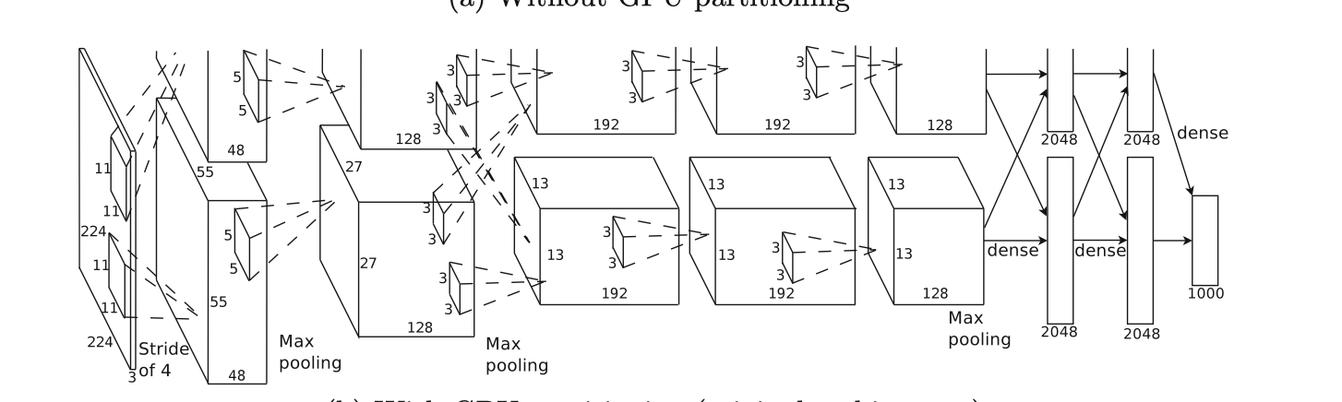
Example - AlexNet:
AlexNet was developed to demonstrate the importance of depth to a CNN’s prediction ability
Makes use of ReLU activation function
Split into 2 parts to enable parallel computing
One of the first CNN’s to make use of GPU’s

Slide 9
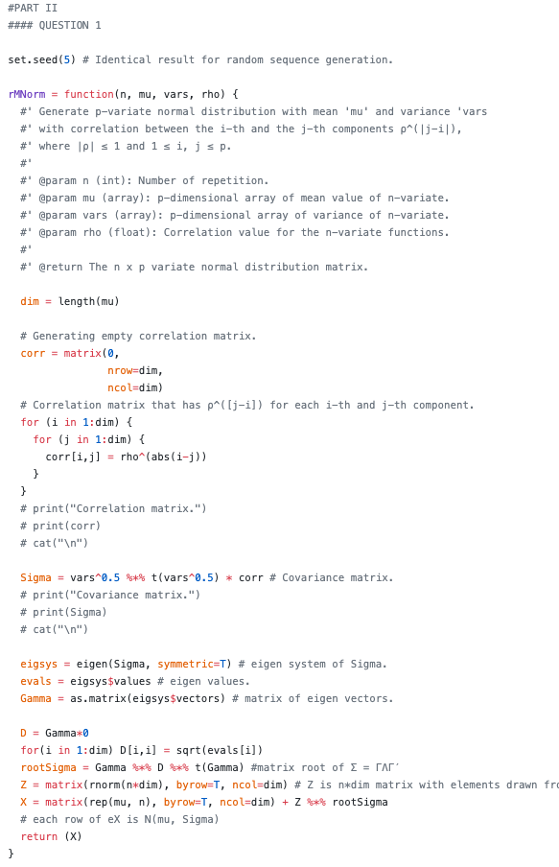
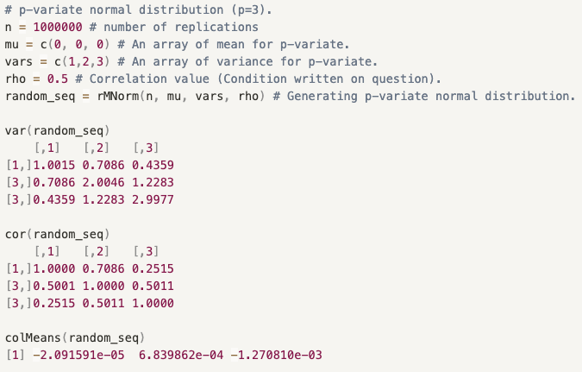



Q1
Constructed a function that takes (refer to docstring for details):
n: Number of iteration
mu: a ‘p’-dimension array of mean values
vars: a ‘p’–dimension array of diagonal elements of covariance matrix
rho: correlation coefficient
Returns:
p-variate normal distribution with mean $µ = (µ_{1}, · · · , µ_{p})$ , variance of the j-th component $σ_{j}^{2}$ , and correlation between the i-th and the j-th components $ρ^{|j−i|}$, where |ρ| ≤ 1 and 1 ≤ i, j ≤ p.
Use p=3 as an example
$$\left[\begin{matrix}1 & ρ^{|2−1|} & ρ^{|3−1|} \\ ρ^{|1−2|} & 1 & ρ^{|3−2|} \\ ρ^{|1−3|} & ρ^{|2−3|} & 1\end{matrix}\right]$$
$$\left[\begin{matrix}σ_{1}σ_{1} & σ_{2}σ_{1}ρ^{|2−1|} & σ_{3}σ_{1}ρ^{|3−1|} \\ σ_{1}σ_{2}ρ^{|1−2|} & σ_{2}σ_{2} & σ_{3}σ_{2}ρ^{|3−2|} \\ σ_{1}σ_{3}ρ^{|1−3|} & σ_{2}σ_{3}ρ^{|2−3|} & σ_{3}σ_{3}\end{matrix}\right]$$

Slide 10
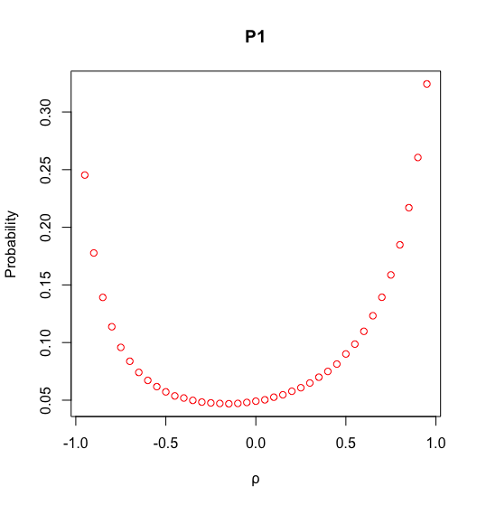
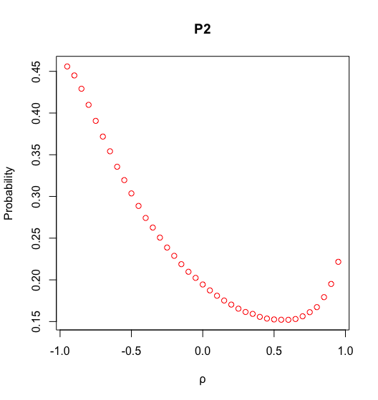
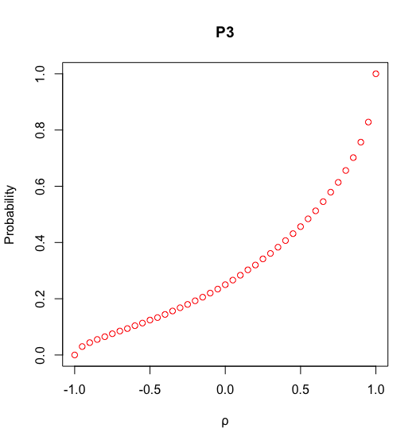
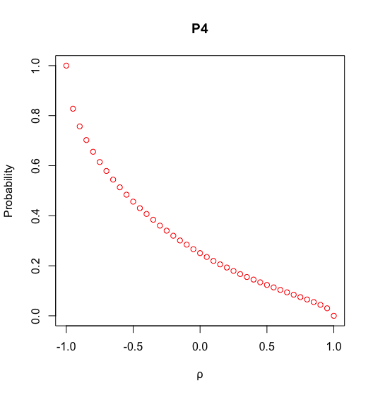

Q2-3
P1: - Probability function has the local minimum around 𝝆=-0.3 with a convex shape.
P2: - Probability function peaks at correlation value -1 and reaches to the minimum at 0.5 but slowly picks up again as correlation increases.
- Probability function increases as the correlation evolves from -1 to 1. Given conditional probability requires $X_{2}$ as well as $X_{1}\&X_{3}$ be greater than 0, negative correlation will be less likely to suffice the condition.
- This is opposite to P3, negative correlation will be more likely to suffice the condition that $X_{2}$ has opposite direction compared to both $X_{1}\&X_{3}$

Slide 11
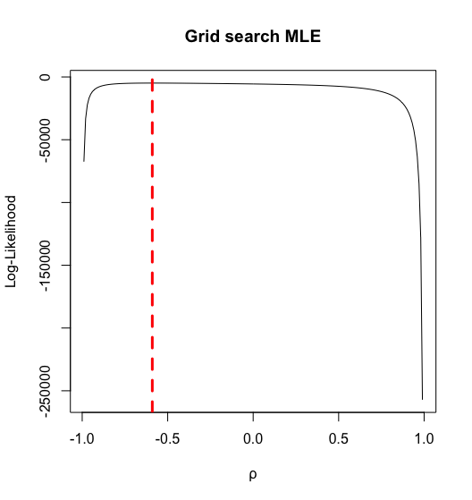




Q4
In order to retrieve the optimal parameter coefficients, grid search algorithm is implemented. This method is an exhaustive approach which consumes more time & energy compared to other optimization algorithm. Despite this, grid search algorithm has a strength that the results can be explained in an intuitive manner.
From the likelihood function for multivariate normal distribution, we can get the first derivative of multivariate normal distribution MLE with μ is maximized when:
Hence, μ is simply the average values of distribution.
Using grid search algorithm, 𝝆 value is assigned with MLE value for each iteration (from -0.99 to 0.99 with 0.01 increment). Based on this result, we concluded that correlation value with -0.59 reaches the highest MLE value.
Result:

