Slide 1
ST425 Group Assignment
GROUP 12
KANG, JOON HYEOK / QUIGLEY, RYAN GAN, LU / ERTEKIN, CEYLIN

Slide 2
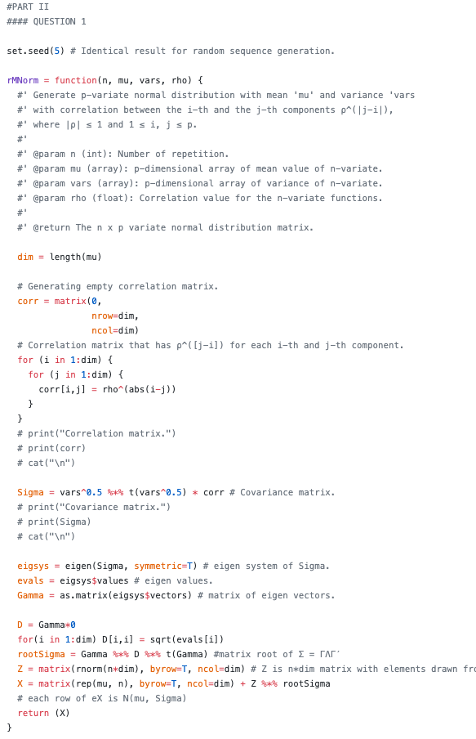
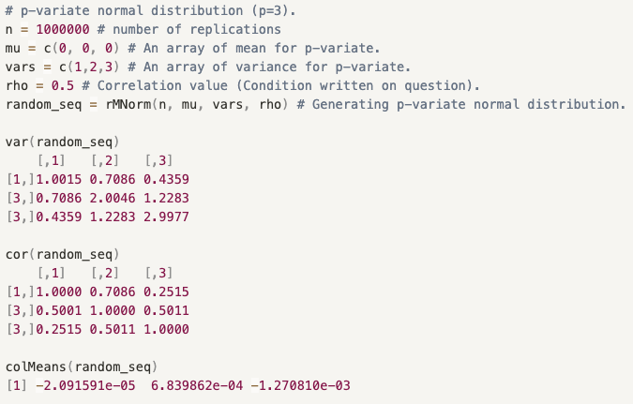



Q1
Constructed a function that takes (refer to docstring for details):
n: Number of iteration
mu: a ‘p’-dimension array of mean values
vars: a ‘p’–dimension array of diagonal elements of covariance matrix
rho: correlation coefficient
Returns:
p-variate normal distribution with mean $µ = (µ_{1}, · · · , µ_{p})$ , variance of the j-th component $σ_{j}^{2}$ , and correlation between the i-th and the j-th components $ρ^{|j−i|}$, where |ρ| ≤ 1 and 1 ≤ i, j ≤ p.
$$\left[\begin{matrix}1 & ρ^{|2−1|} & ρ^{|3−1|} \\ ρ^{|1−2|} & 1 & ρ^{|3−2|} \\ ρ^{|1−3|} & ρ^{|2−3|} & 1\end{matrix}\right]$$
$$\left[\begin{matrix}σ_{1}σ_{1} & σ_{2}σ_{1}ρ^{|2−1|} & σ_{3}σ_{1}ρ^{|3−1|} \\ σ_{1}σ_{2}ρ^{|1−2|} & σ_{2}σ_{2} & σ_{3}σ_{2}ρ^{|3−2|} \\ σ_{1}σ_{3}ρ^{|1−3|} & σ_{2}σ_{3}ρ^{|2−3|} & σ_{3}σ_{3}\end{matrix}\right]$$

Slide 3
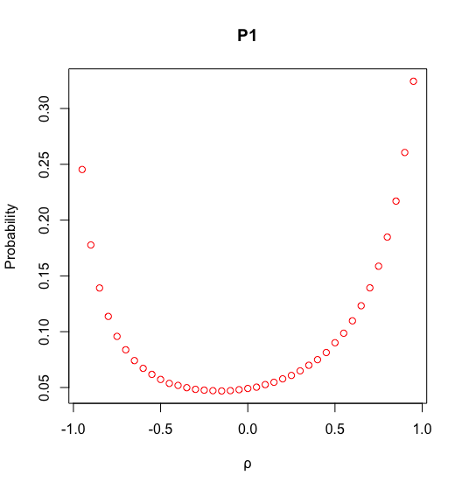
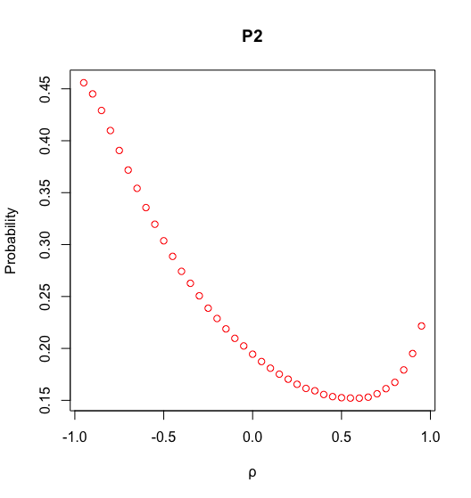
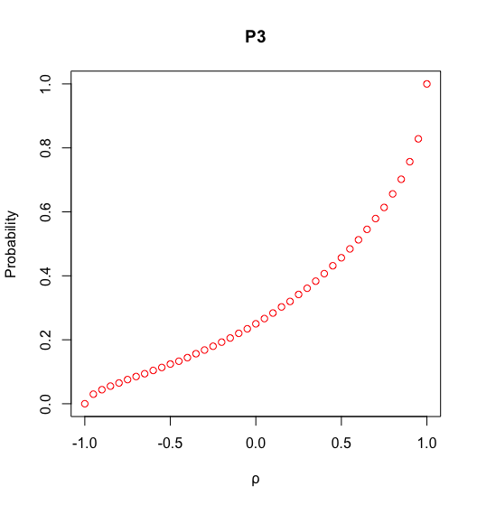
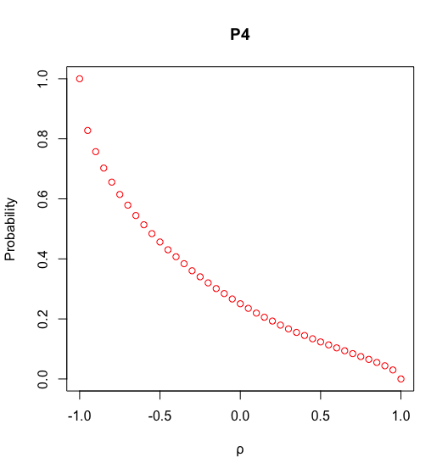

Q2-3
P1: - Probability function has the local minimum around 𝝆=-0.3 with a convex shape.
P2: - Probability function peaks at correlation value -1 and reaches to the minimum at 0.5 but slowly picks up again as correlation increases.
- Probability function increases as the correlation evolves from -1 to 1. Given conditional probability requires $X_{2}$ as well as $X_{1}\&X_{3}$ be greater than 0, negative correlation will be less likely to suffice the condition.
- This is opposite to P3, negative correlation will be more likely to suffice the condition that $X_{2}$ has opposite direction compared to both $X_{1}\&X_{3}$

Slide 4
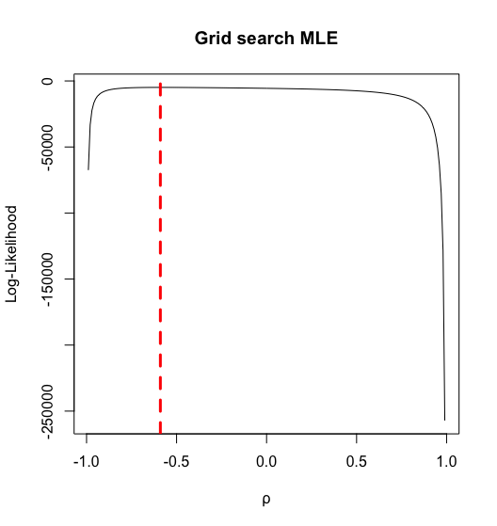



Q4
In order to retrieve the optimal parameter coefficients, grid search algorithm is implemented. This method is an exhaustive approach which consumes more time & energy compared to other optimization algorithm. Despite this, grid search algorithm has a strength that the results can be explained in an intuitive manner.
First derivative of multivariate normal distribution MLE with μ is maximized when: Hence, μ is simply the average values of distribution.
Using grid search algorithm, 𝝆 value is assigned with MLE value for each iteration (from -0.99 to 0.99 with 0.01 increment). Based on this result, we concluded that correlation value with -0.59 reaches the highest MLE value.
Result:

