Slide 1
Generate initial particles
Simulate all the movements
Calculate the weight value
Particles to be resampling

Slide 2
v
v
v
0 pw[1] pw[1]+pw[2] … pw[1]+…+pw[400]=1
px[1]
px[2]
px[k]

Slide 3
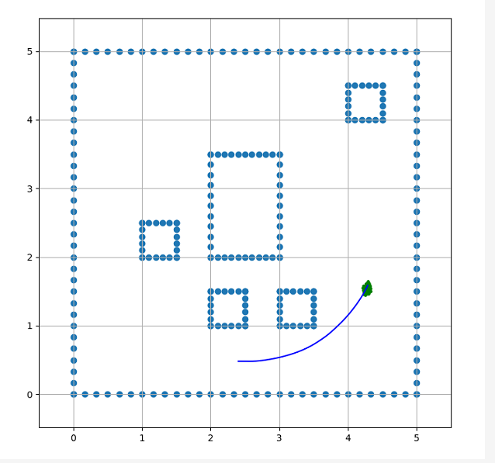


Add error

Slide 4
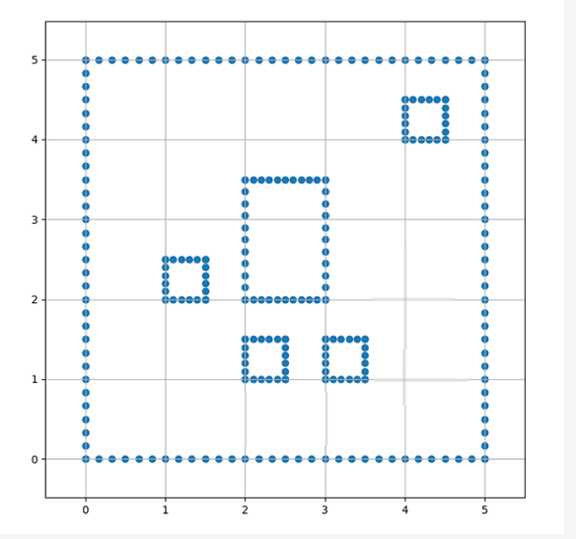

$$θ$$

