Slide 1
SEMINAR · NIT SRINAGAR · 2025–26
AI-Powered
Reverse Engineering
How AI accelerates binary analysis — with video games as the case study
Ankrit Jarngal · 2023BSE028 · CSE
Notes:
Open with topic and identity. Keep it calm.

Slide 2
AI-POWERED REVERSE ENGINEERING
02 / 09
01 BACKGROUND
Reverse engineering recovers meaning
from compiled software.
You start with a finished binary — not source code.
The goal is to understand structure and behavior,
then modify it carefully when needed.
Not rewriting from scratch. Interpreting what already exists.
Notes:
Define RE for a CSE audience. Stress: not rewriting from scratch.

Slide 3
AI-POWERED REVERSE ENGINEERING
03 / 09
01 BACKGROUND
The classical pipeline
Disassemble → decompile → understand. Tools are strong. Humans are the bottleneck.
Manual naming and structure recovery is where most time is lost.
Notes:
Walk the classical pipeline. Point at Manual Analysis as the costly step.

Slide 4
AI-POWERED REVERSE ENGINEERING
04 / 09
02 AI-ASSISTED RE
AI sits on top of classical tools.
It does not replace them.
LLM layer
Tool bridges
Verify loop
Rename, explain, and refine
pseudo-code into readable form.
Connect models to Ghidra / IDA
so agents can query the binary.
Propose → check against bytes
→ retry until evidence holds.
Notes:
Define AI-assisted RE as a layer, not a replacement.

Slide 5
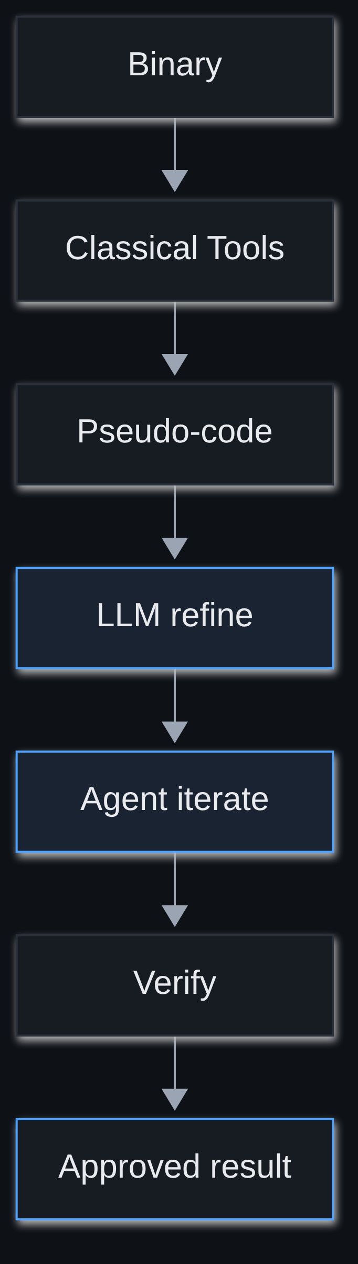
AI-POWERED REVERSE ENGINEERING
05 / 09
02 AI-ASSISTED RE
What got faster
Readable drafts in minutes,
not weeks of renaming.
Agent loops automate
try → check → fix.
Same tools. Compressed time.
Verification still required.
Notes:
Explain speed: renaming, agent loops, verification still required.

Slide 6
AI-POWERED REVERSE ENGINEERING
06 / 09
03 CASE STUDY
Case study: modifying compiled
video games without source.
Games ship as closed, optimized binaries with thin official APIs.
Deep changes need reverse engineering of the executable itself.
Recent work combines systems from different games at runtime —
not by rewriting engines, but by bridging two live compiled processes.
AI made that glue work comparatively practical.
Notes:
Introduce games as closed binaries — avoid brand-name dumping.

Slide 7
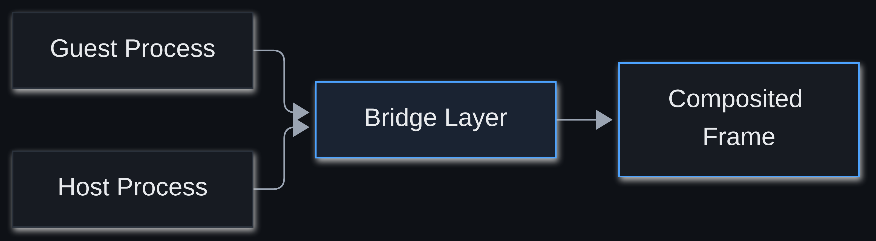
AI-POWERED REVERSE ENGINEERING
07 / 09
03 CASE STUDY
How the bridge works
Guest and host stay as real binaries. A thin bridge exchanges camera,
collision, and events over shared memory — then composites one frame.
AI drafts hooks and protocols. Classical RE validates the bytes.
Notes:
Explain host/guest/bridge simply using the diagram.

Slide 8
AI-POWERED REVERSE ENGINEERING
08 / 09
04 LIMITS
Faster is not unrestricted.
Correctness
Hard defenses
AI can invent plausible but wrong logic. Verify against the binary.
Obfuscation and packing still break many automated approaches.
Legal lines
Responsibility
Copyright and license terms still apply to commercial assets.
Serious work stays offline. Do not ship proprietary files.
Notes:
Cover correctness, defenses, legal, responsibility.

Slide 9
AI-POWERED REVERSE ENGINEERING
09 / 09
05 TAKEAWAY
AI compresses the reverse-engineering
bottleneck. It does not erase it.
Classical tools measure the bytes. LLMs draft the meaning.
Humans — and verification oracles — decide what ships.
Thank you · Ankrit Jarngal · 2023BSE028 · CSE · NIT Srinagar
Notes:
Close on the thesis. Invite questions.

