Slide 1
PROJECT PRESENTATION
Medical Visual Question Answering for Chest X-rays
A knowledge-grounded approach with CheXagent-2-3b: literature review, baseline tests and retrieval-augmented design
Supervisor Dr. Snober Mushtaq
Students Ankrit (Enrollment 2023BCSE028) Hirdyansh (Enrollment 2023BCSE036)
Department of Computer Science and Engineering
Notes:
Title slide. The institution name and date can be added once the official format is supplied.

Slide 2
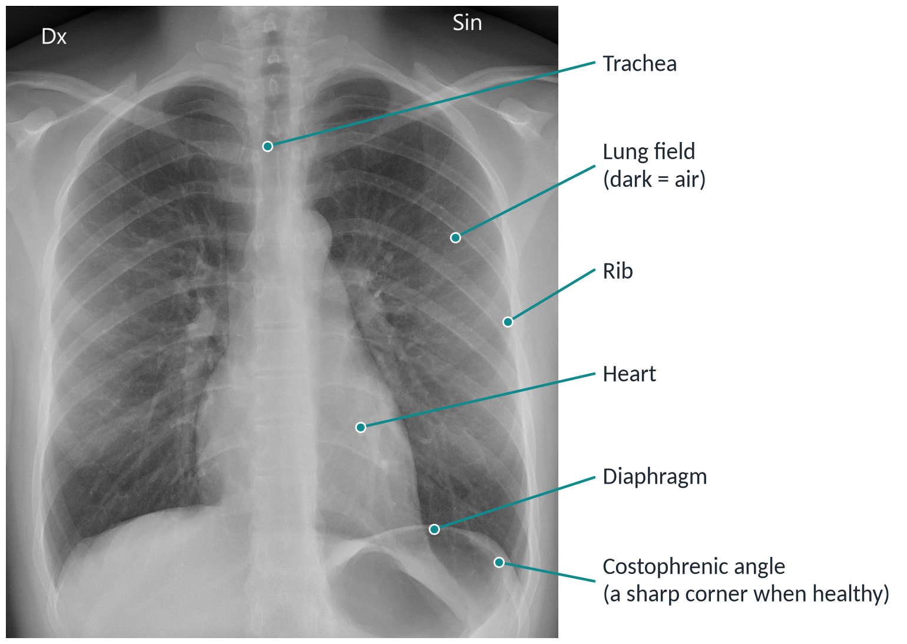
A chest X-ray is a shadow picture: dark means air, white means dense tissue
Four findings used in this project
Cardiomegaly
Heart wider than half the chest
Pleural effusion
Fluid blunts the corner at the lung base
Pneumothorax
Dark area with no lung markings
Atelectasis
Collapsed lung looks whiter
Photograph: M. Haggstrom, Wikimedia Commons, CC0 (normal PA chest X-ray). Findings: standard radiology teaching material.
2
Notes:
Real, normal frontal (PA) chest radiograph. Dx and Sin are Italian for right and left: the patient's right appears on the image's left. The four findings are the ones that appear most in the question sets.

Slide 3
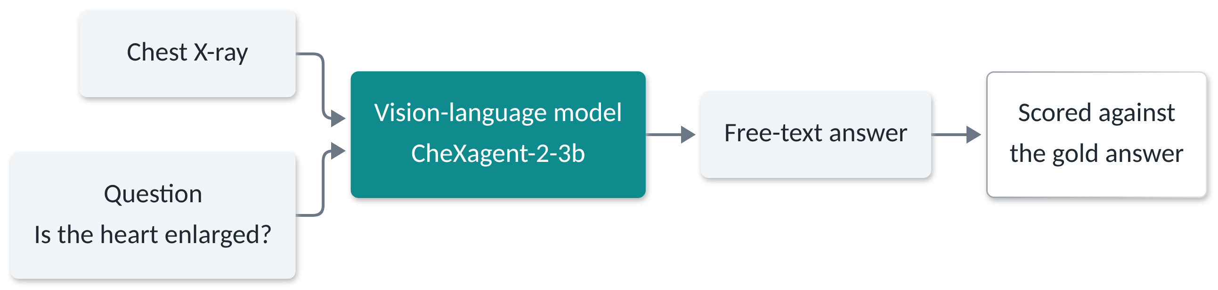
Medical VQA: show the model an X-ray and a question, then check its free-text answer
Perception
Can the model see the finding?
Is there an effusion? Which side? Is the heart enlarged?
Knowledge
Does the model know the disease?
What causes it? What are the symptoms? How is it treated?
Datasets: SLAKE and VQA-RAD, chest X-ray questions only. Model: StanfordAIMI/CheXagent-2-3b.
3
Notes:
Two kinds of difficulty are kept separate on purpose; most later results depend on that split.

Slide 4
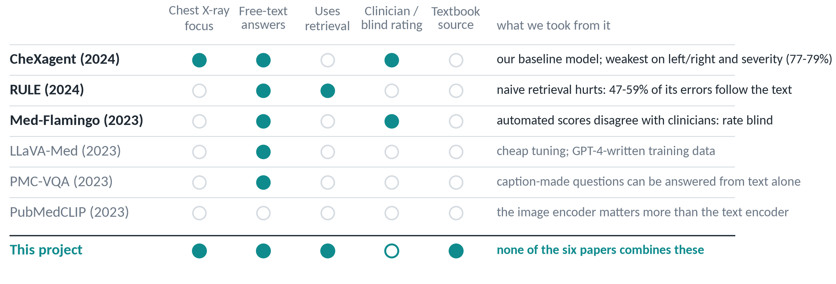
Of six papers reviewed, three shaped the project; none combines retrieval with chest X-rays
CheXagent is our baseline, RULE warns about retrieval, Med-Flamingo says to rate answers by hand.
Chen et al. 2024 (CheXagent); Xia et al. 2024 (RULE); Moor et al. 2023 (Med-Flamingo); Eslami et al. 2023 (PubMedCLIP); Li et al. 2023 (LLaVA-Med); Zhang et al. 2023 (PMC-VQA).
4
Notes:
Bold rows are the three papers that changed our plan. The others gave context. The bottom row states the gap among the papers we reviewed; the hollow circle means the blind rating is planned, not yet done.

Slide 5
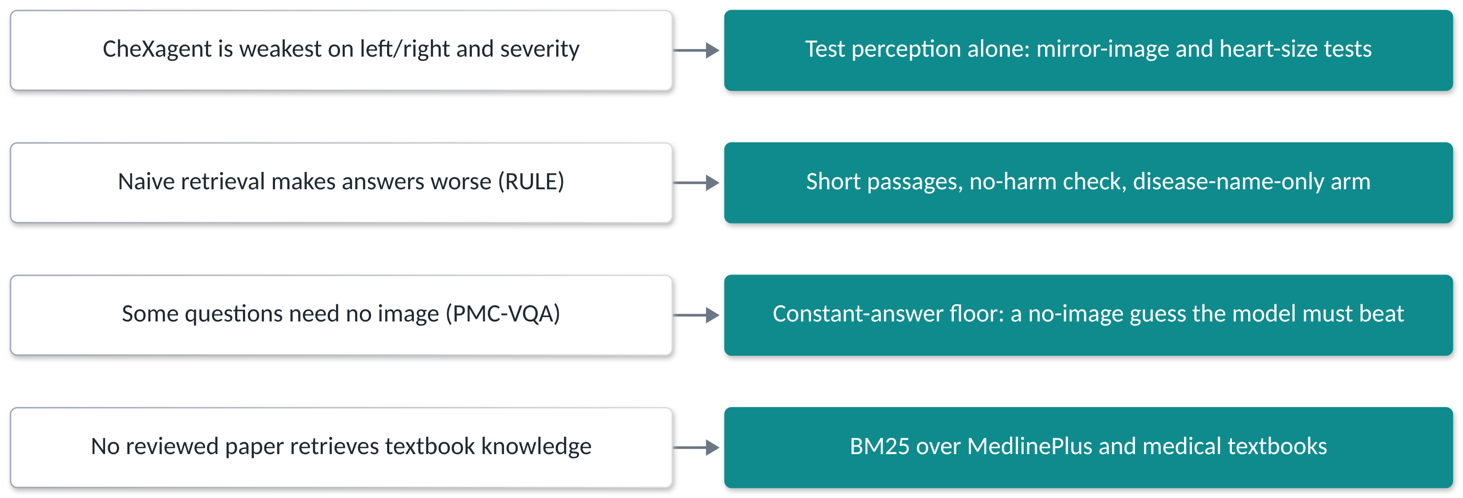
Each finding in the literature became a concrete design decision
What the papers show
What we decided to do
Research question: can retrieved textbook knowledge make a chest X-ray model answer knowledge questions better?
CheXagent: 77-79% on fine-grained reasoning. RULE: naive retrieval over-trust. PMC-VQA: many questions answerable from text.
5
Notes:
This slide bridges the literature review and the experiments.

Slide 6
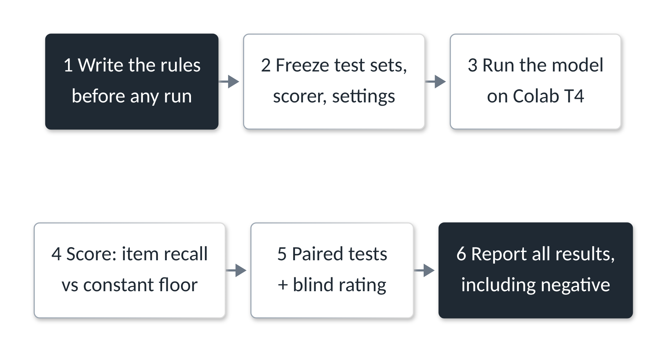
Rules are written before any run, and negative results are reported
219
130
baseline questions
knowledge questions
140
120
left / right questions
mirror-image pairs
47
130
heart-size questions
images with a disease label
Pre-registration: test sets, scorer and success conditions were frozen first, then amended in writing when needed.
docs/evaluation_protocol.md and docs/phase2_rag_plan.md. Scorer: item recall v2; floor: most common gold answer.
6
Notes:
Item recall is used because exact match is too strict for free text. The constant-answer floor asks whether a system that ignores the image and always writes the common answer would do just as well.

Slide 7
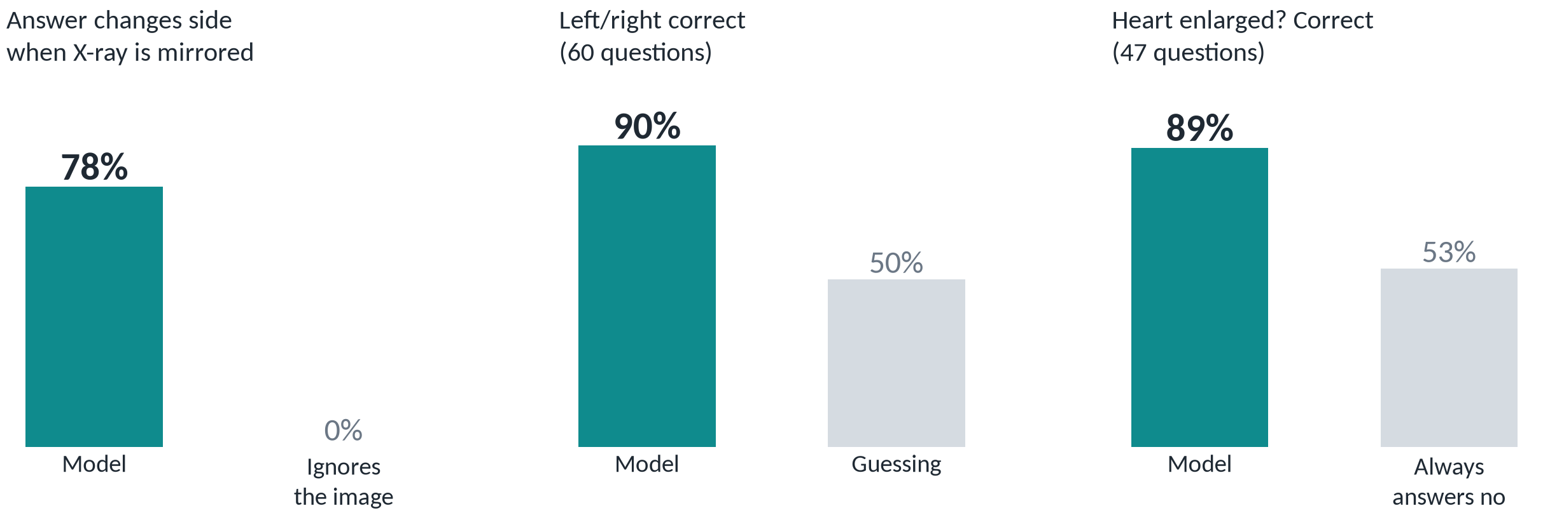
Reading the X-ray: the model's left/right and heart-size answers follow the image
Mirroring the X-ray flips the answer in 78% of pairs (95% CI 69-85%). Left/right 90% correct; enlarged hearts found in 17 of 22, normal hearts called normal 25 of 25.
Colab T4, 13 Nov 2026, notebook 03, 788 generations. Data: results/run_6_with_image/. Plain wording; 120 mirror pairs, 60 side questions, 47 heart questions.
7
Notes:
Mirror test: each question asked on the original X-ray and on its mirror image; a model that reads laterality should change its answer. Heart size: 17 of 22 enlarged hearts found and 25 of 25 normal hearts called normal. CheXagent's training data includes SLAKE and VQA-RAD, so these are not clean held-out tests; the heart sensitivity rests on 22 positive questions.

Slide 8
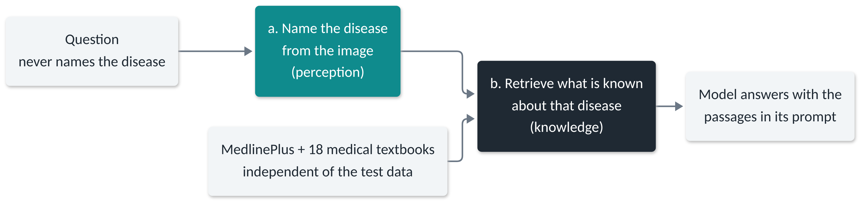
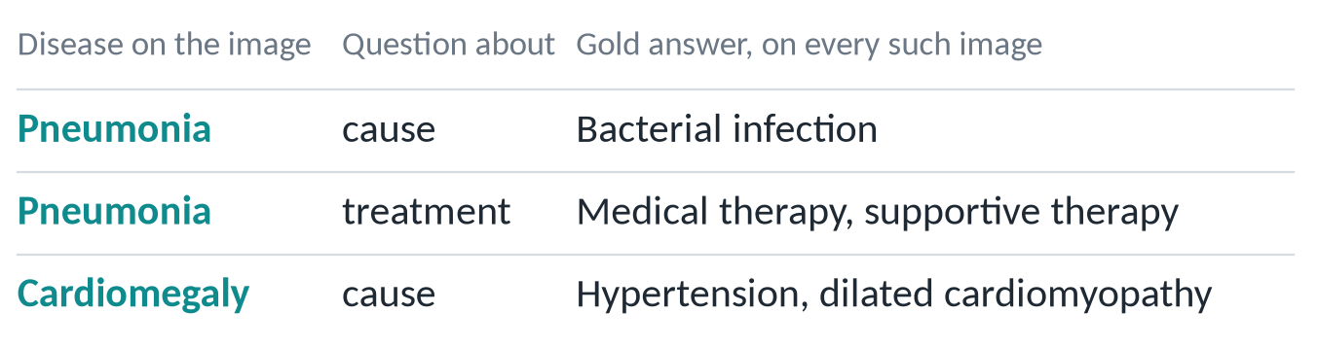
Phase 2 design: first name the disease from the image, then retrieve what is known about it
Why two steps: the answer depends only on the disease
Corpora: MedlinePlus (US National Library of Medicine, public domain) and medical textbooks (MedRAG); our own BM25 search.
8
Notes:
SLAKE's knowledge answers are a lookup keyed by the disease, and the question never names it. The textbooks are copyrighted, so they are downloaded at run time and never committed to the repository.

Slide 9
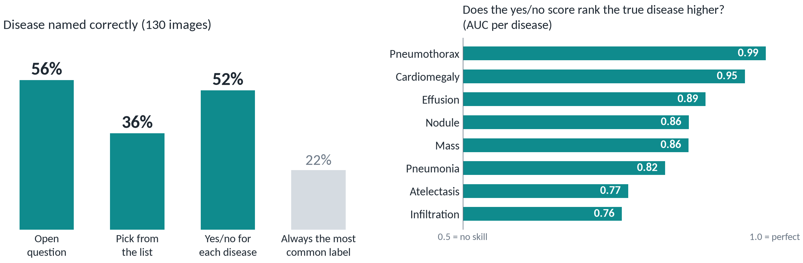
Step one works: the model names the disease from the X-ray well above chance
Always guessing the most common disease gets 22%. The model gets 52-56%; the yes/no method ranks the true disease high for all eight (AUC 0.76-0.99).
Colab T4, 13 Nov 2026, notebook 04. 130 SLAKE chest X-rays with a disease label (8 diseases). Data: results/run_7_disease_with_image/.
9
Notes:
Three ways of asking: an open question, picking one name from a list of 15, and a yes/no question for each of the 15 names (the name with the highest yes-minus-no score wins). The method used downstream was fixed in advance as the one with the best accuracy on the 20 validation images: yes/no for each disease (55%, against 45% and 30%). Open questions score highest overall (56%) but only 30% on the validation images. Weak spots: the yes/no method never predicted pneumonia, and open questions found atelectasis in only 1 of 21 images. SLAKE training images are probably in CheXagent's training data, and 20 validation images make the choice noisy.

Slide 10
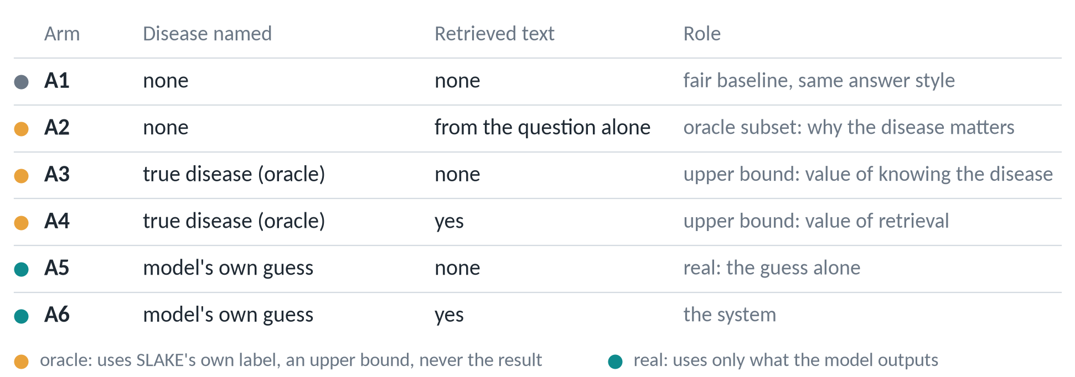
Six arms separate what retrieval adds from what knowing the disease adds
Success needs more than a score gain: the system (A6) must beat both the fair baseline (A1) and the guess alone (A5).
docs/phase2_rag_plan.md and Amendment 5 of the evaluation protocol.
10
Notes:
Oracle arms use SLAKE's own disease label, which a real system would not have, so they are never reported as the result.

Slide 11
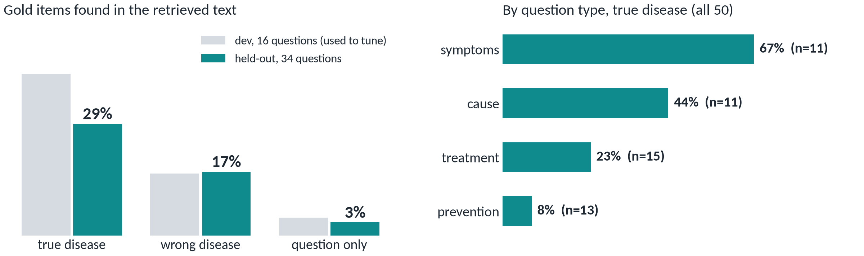
Retrieval check, run without any model: the corpus holds the answer mainly when the disease is right
Held-out: 29% of gold items found with the true disease, 17% with a wrong disease, 3% from the question alone.
Strict coverage: gold item words inside one sentence of the retrieved text. 50 oracle-evaluable questions; setting frozen on 16 dev questions.
11
Notes:
This is an upper limit on what retrieval can give. Prevention answers such as 'keep healthy' are generic and almost never match a source.

Slide 12
References
[1] Chen Z., Varma M., Delbrouck J.-B., et al. CheXagent: Towards a Foundation Model for Chest X-Ray Interpretation. arXiv:2401.12208, 2024.
[2] Xia P., Zhu K., Li H., et al. RULE: Reliable Multimodal RAG for Factuality in Medical Vision Language Models. EMNLP, 2024.
[3] Moor M., Huang Q., Wu S., et al. Med-Flamingo: a Multimodal Medical Few-shot Learner. ML4H, PMLR, 2023.
[4] Eslami S., Meinel C., de Melo G. PubMedCLIP: How Much Does CLIP Benefit VQA in the Medical Domain? Findings of EACL, 2023.
[5] Li C., Wong C., Zhang S., et al. LLaVA-Med: Training a Large Language-and-Vision Assistant for Biomedicine in One Day. NeurIPS D&B, 2023.
[6] Zhang X., Wu C., Zhao Z., et al. PMC-VQA: Visual Instruction Tuning for Medical Visual Question Answering. arXiv:2305.10415, 2023.
[7] Liu B., Zhan L.-M., Xu L., et al. SLAKE: A Semantically-Labeled Knowledge-Enhanced Dataset for Medical VQA. IEEE ISBI, 2021.
[8] Lau J. J., Gayen S., Ben Abacha A., Demner-Fushman D. A dataset of clinically generated visual questions and answers about radiology images. Scientific Data, 2018.
[9] Xiong G., Jin Q., Lu Z., Zhang A. Benchmarking Retrieval-Augmented Generation for Medicine (MedRAG). Findings of ACL, 2024.
[10] Robertson S., Zaragoza H. The Probabilistic Relevance Framework: BM25 and Beyond. Foundations and Trends in IR, 2009.
[11] Haggstrom M. Normal posteroanterior (PA) chest radiograph (X-ray). Wikimedia Commons, CC0.
12
Notes:
Full reference list; the same entries are in the project report.

