Slide 1



Analysis of Algorithms
Adopted/Modified from the textbook Data Structures and Algorithms in Java, 6th edition, by M. T. Goodrich, R. Tamassia, and M. H. Goldwasser, Wiley, 2014
Input
Algorithm
Output

Slide 2
Running Time
Most algorithms transform input objects into output objects.
The running time of an algorithm typically grows with the input size.
Average case time is often difficult to determine.
We focus on the worst case running time.
Easier to analyze
Crucial to applications such as games, finance and robotics

Slide 3
Efficiency of Algorithms --importance
Algorithms for solving the same problem can differ dramatically in their efficiency, i.e., running time.
much more significant than the differences due to hardware and software.
Comparison of two sorting algorithms (n=10⁶ numbers):
Insertion sort: c₁n²
Merge sort: c₂n (lg n)
Best programmer (c₁=2), machine language, one billion/second computer.
Bad programmer (c₂=50), high-language, ten million/second computer.
2 (10⁶)² instructions/10⁹ instructions per second = 2000 seconds.
50 (10⁶ lg 10⁶) instructions/10⁷ instructions per second ≈ 100 seconds.
Thus, merge sort on B is 20 times faster than insertion sort on A!
If sorting ten million number, 2.3 days VS. 20 minutes.

Slide 4
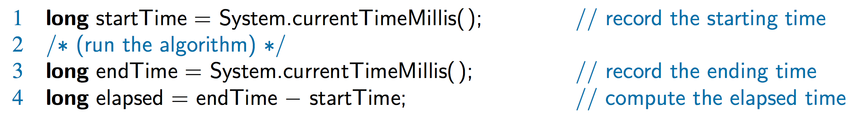
Experimental Studies
Write a program implementing the algorithm
Run the program with inputs of varying size and composition, noting the time needed:
Plot the results

Slide 5

Limitations of Experiments
It is necessary to implement the algorithm, which may be difficult
Results may not be indicative of the running time on other inputs not included in the experiment.
In order to compare two algorithms, the same hardware and software environments must be used

Slide 6
Theoretical Analysis
Uses a high-level description of the algorithm instead of an implementation
Characterizes running time as a function of the input size, n
Takes into account all possible inputs
Allows us to evaluate the speed of an algorithm independent of the hardware/software environment

Slide 7
Pseudocode
High-level description of an algorithm
More structured than English prose
Less detailed than a program
Preferred notation for describing algorithms
Hides program design issues

Slide 8
Pseudocode Details
Control flow
if … then … [else …]
while … do …
repeat … until …
for … do …
Indentation replaces braces
Method declaration
Algorithm method (arg [, arg…])
Input …
Output …
Method call
method (arg [, arg…])
Return value
return expression
Expressions:
Assignment
Equality testing
n² Superscripts and other mathematical formatting allowed

Slide 9
The Random Access Machine (RAM) Model
A RAM consists of
A CPU
An potentially unbounded bank of memory cells, each of which can hold an arbitrary number or character
Memory cells are numbered and accessing any cell in memory takes unit / constant time
2
1
0
Parallel multi-processor access model: PRAM

Slide 10
Seven Important Functions
Θ(1), Θ(lg n), Θ(√n),Θ(n), Θ(nlg n), Θ(n²), Θ(n³), Θ(2^{n}), Θ(n!)
Seven functions that often appear in algorithm analysis:
Constant ≈ 1
Logarithmic ≈ log n
Linear ≈ n
N-Log-N ≈ n log n
Quadratic ≈ n²
Cubic ≈ n³
Exponential ≈ 2^{n}
In a log-log chart, the slope of the line corresponds to the growth rate

Slide 11
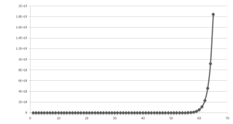
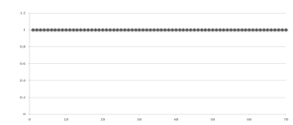
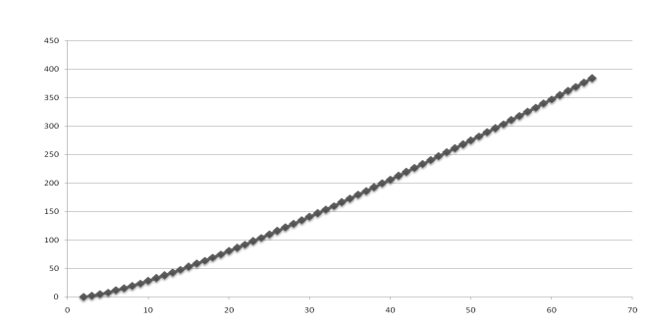
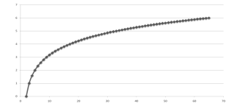
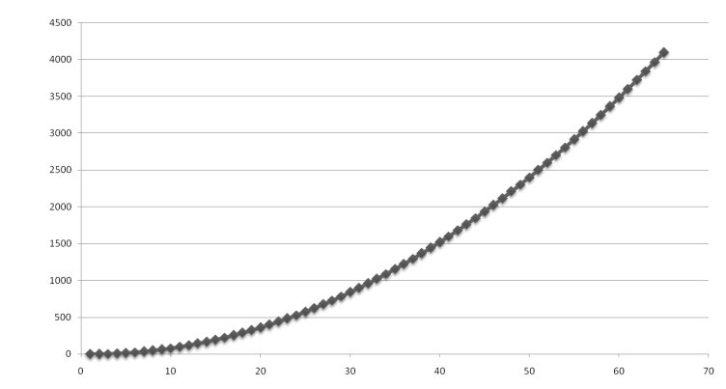
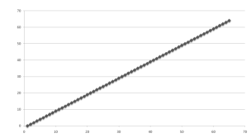
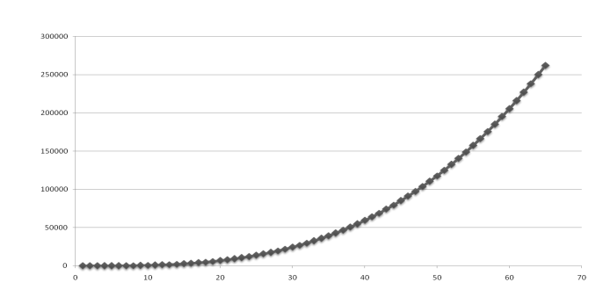
Functions Graphed Using “Normal” Scale
Slide by Matt Stallmann included with permission.
g(n) = n lg n
g(n) = 1
g(n) = 2^{n}
g(n) = n²
g(n) = lg n
g(n) = n
g(n) = n³

Slide 12
Primitive Operations
Basic computations performed by an algorithm
Identifiable in pseudocode
Largely independent from the programming language
Exact definition not important (we will see why later)
Assumed to take a constant amount of time in the RAM model
Examples:
Evaluating an expression
Comparing a pair of values
Assigning a value to a variable
Indexing into an array
Calling a method
Returning from a method

Slide 13
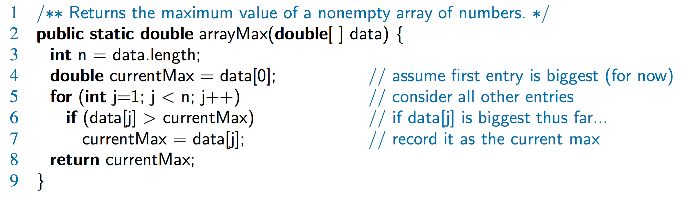
Counting Primitive Operations
By inspecting the pseudocode, we can determine the maximum number of primitive operations executed by an algorithm, as a function of the input size
Step 3: 2 ops, 4: 2 ops, 5: 2n ops, 6: 2n ops, 7: 0 to n ops, 8: 1 op

Slide 14
Estimating Running Time
Algorithm arrayMax executes 5n + 5 primitive operations in the worst case, 4n + 5 in the best case. Define:
a = Time taken by the fastest primitive operation
b = Time taken by the slowest primitive operation
Let T(n) be worst-case time of arrayMax. Then a (4n + 5) ≤ T(n) ≤ b(5n + 5)
Hence, the running time T(n) is bounded by two linear functions

Slide 15
Growth Rate of Running Time
Changing the hardware/ software environment
Affects T(n) by a constant factor, but
Does not alter the growth rate of T(n)
The linear growth rate of the running time T(n) is an intrinsic property of algorithm arrayMax

Slide 16
Why Growth Rate Matters
Slide by Matt Stallmann included with permission.
if runtime is... | time for n + 1 | time for 2 n | time for 4 n
c lg n | c lg (n + 1) | c (lg n + 1) | c(lg n + 2)
c n | c (n + 1) | 2c n | 4c n
c n lg n | ~ c n lg n + c n | 2c n lg n + 2cn | 4c n lg n + 4cn
c n² | ~ c n² + 2c n | 4c n² | 16c n²
c n³ | ~ c n³ + 3c n² | 8c n³ | 64c n³
c 2^{n} | c 2 ^{n+1} | c 2 ^{2n} | c 2 ^{4n}
runtime
quadruples
when problem
size doubles

Slide 17
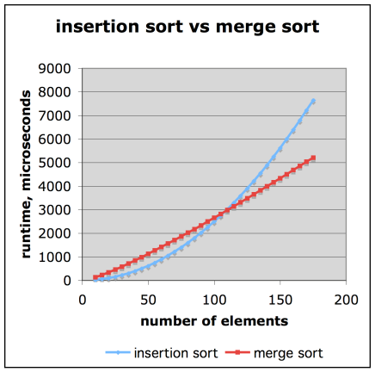
Comparison of Two Algorithms
insertion sort is
n² / 4
merge sort is
2 n lg n
sort a million items?
insertion sort takes
roughly 70 hours
while
merge sort takes
roughly 40 seconds
This is a slow machine, but if
100 x as fast then it’s 40 minutes
versus less than 0.5 seconds

Slide 18
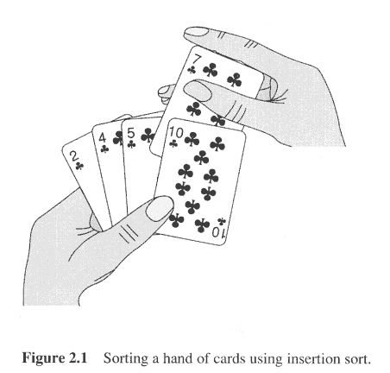
Insertion sort similar to sorting cards

Slide 19
Insertion Sort Algorithm (cont.)
INSERTION-SORT(A)
for j = 2 to length[A]
do key ← A[j]
//insert A[j] to sorted sequence A[1..j-1]
i ← j-1
while i >0 and A[i]>key
do A[i+1] ← A[i] //move A[i] one position right
i ← i-1
A[i+1] ← key

Slide 20
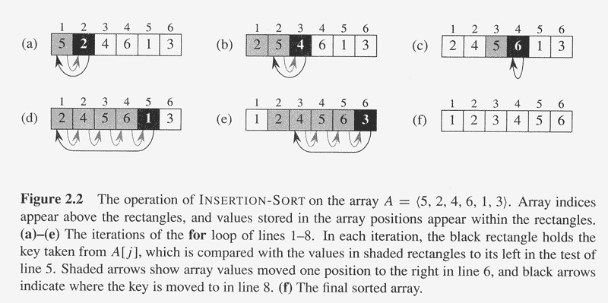
Example of Insertion Sort

Slide 21
Constant Factors
The growth rate is not affected by
constant factors or
lower-order terms
Examples
10²n + 10⁵ is a linear function
10⁵n² + 10⁸n is a quadratic function

Slide 22
Big-Oh Notation
Given functions f(n) and g(n), we say that f(n) is O(g(n)) if there are positive constants c and n₀ such that
f(n) ≤ cg(n) for n ≥ n₀
Example: 2n + 10 is O(n)
2n + 10 ≤ cn
(c − 2) n ≥ 10
n ≥ 10/(c − 2)
Pick c = 3 and n₀ = 10

Slide 23
Big-Oh Example
Example: the function n² is not O(n)
n² ≤ cn
n ≤ c
The above inequality cannot be satisfied since c must be a constant

Slide 24
More Big-Oh Examples
7n - 2
7n-2 is O(n)
need c > 0 and n₀ ≥ 1 such that 7 n - 2 ≤ c n for n ≥ n₀
this is true for c = 7 and n₀ = 1
3 n³ + 20 n² + 5
3 n³ + 20 n² + 5 is O(n³)
need c > 0 and n₀ ≥ 1 such that 3 n³ + 20 n² + 5 ≤ c n³ for n ≥ n₀
this is true for c = 4 and n₀ = 21
3 log n + 5
3 log n + 5 is O(log n)
need c > 0 and n₀ ≥ 1 such that 3 log n + 5 ≤ c log n for n ≥ n₀
this is true for c = 8 and n₀ = 2

Slide 25
Big-Oh and Growth Rate
The big-Oh notation gives an upper bound on the growth rate of a function
The statement “f(n) is O(g(n))” means that the growth rate of f(n) is no more than the growth rate of g(n)
We can use the big-Oh notation to rank functions according to their growth rate
 | f(n) is O(g(n)) | g(n) is O(f(n))
g(n) grows more | Yes | No
f(n) grows more | No | Yes
Same growth | Yes | Yes

Slide 26
Big-Oh Rules
If is f(n) a polynomial of degree d, then f(n) is O(n^{d}), i.e.,
Drop lower-order terms
Drop constant factors
Use the smallest possible class of functions
Say “2n is O(n)” instead of “2n is O(n²)”
Use the simplest expression of the class
Say “3n + 5 is O(n)” instead of “3n + 5 is O(3n)”

Slide 27
Asymptotic Algorithm Analysis
The asymptotic analysis of an algorithm determines the running time in big-Oh notation
To perform the asymptotic analysis
We find the worst-case number of primitive operations executed as a function of the input size
We express this function with big-Oh notation
Example:
We say that algorithm arrayMax “runs in O(n) time”
Since constant factors and lower-order terms are eventually dropped anyhow, we can disregard them when counting primitive operations

Slide 28
Computing Prefix Averages
We further illustrate asymptotic analysis with two algorithms for prefix averages
The i-th prefix average of an array X is average of the first (i + 1) elements of X:
A[i] = (X[0] + X[1] + … + X[i])/(i+1)
Computing the array A of prefix averages of another array X has applications to financial analysis

Slide 29
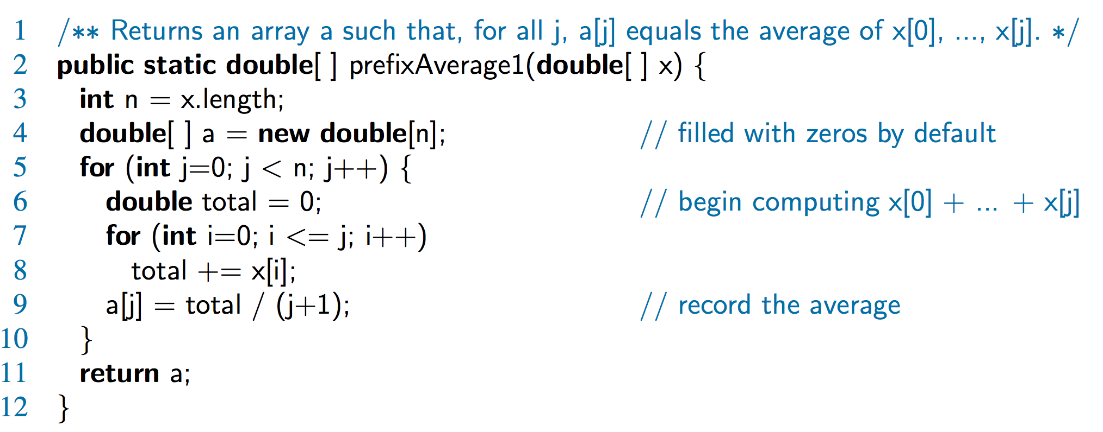
Prefix Averages (Quadratic)
The following algorithm computes prefix averages in quadratic time by applying the definition

Slide 30
Arithmetic Progression
The running time of prefixAverage1 is O(1 + 2 + …+ n)
The sum of the first n integers is n(n + 1) / 2
There is a simple visual proof of this fact
Thus, algorithm prefixAverage1 runs in O(n²) time

Slide 31
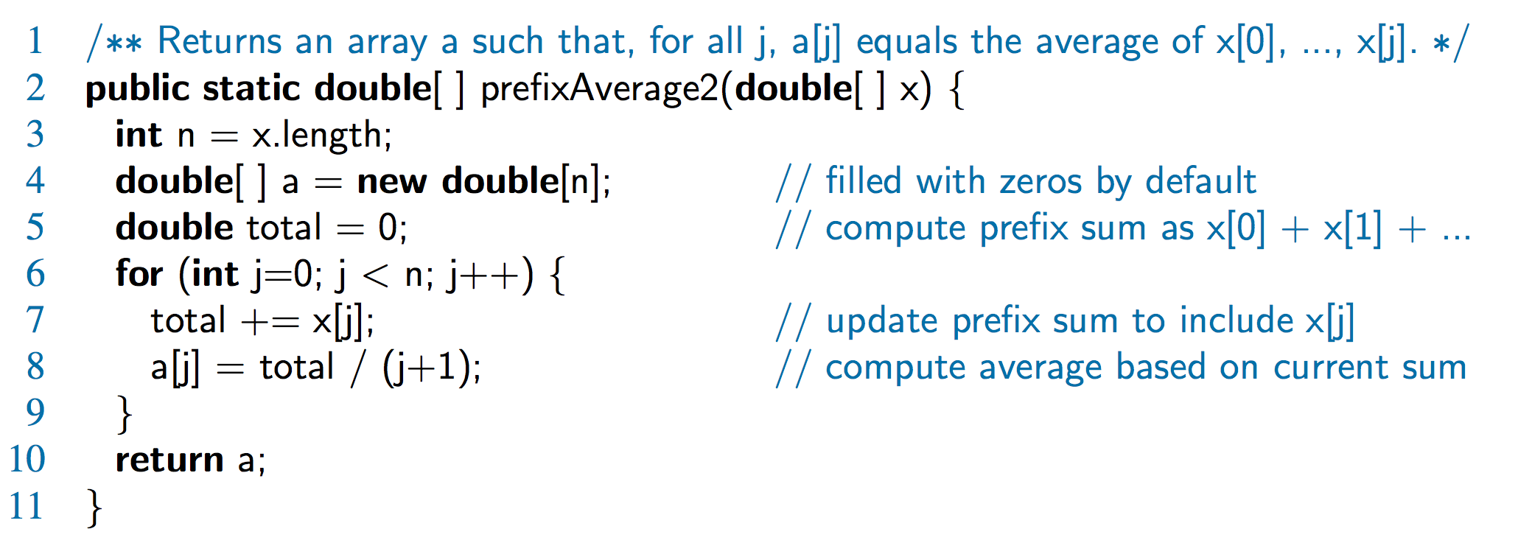
Prefix Averages 2 (Linear)
The following algorithm uses a running summation to improve the efficiency
Algorithm prefixAverage2 runs in O(n) time!

Slide 32
How about computing the prefix sum of a given integer array A
A=[5, -10, 7, -2, 8, 9] → [5, -5, 2,0, 8, 17]
Algorithm 1:
for (int i=0;i<A.length;i++){ //i=0,1,…,A.length-1
int psum=0;
for (int j=0;j<=i;i++) //j=0,...,i
psum+=A[j];
Output psum;
}
How many total + operations:
1+2+…+n-1= n(n-1)/2
If n=10⁶, n(n-1)2=10⁶*5*10⁵
Algorithm 2:
int psum=0;
for (int i=0;i<A.length;i++){
psum+=A[i];
Output psum;
}
How many total + operations:
1+1+…+1 = n
If n=10⁶, still 10⁶
Then, Algorithm 1?
One day: 86,400 second.
More than 5 days.
If this algorithm 2 runs at 1 second

Slide 33
Math you need to Review
Summations
Powers
Logarithms
Proof techniques
Basic probability
Properties of powers:
a^{(b+c)} = a^{b}a ^{c}
a^{bc} = (a^{b})^{c}
a^{b} /a^{c} = a^{(b-c)}
b = a ^{log}_{a}^{b}
b^{c} = a ^{c*log}_{a}^{b}
Properties of logarithms:
log_{b}(xy) = log_{b}x + log_{b}y
log_{b} (x/y) = log_{b}x - log_{b}y
log_{b}xa = alog_{b}x
log_{b}a = log_{x}a/log_{x}b

Slide 34
Relatives of Big-Oh
big-Omega
f(n) is Ω(g(n)) if there is a constant c > 0 and an integer constant n₀ ≥ 1 such that
f(n) ≥ c g(n) for n ≥ n₀
big-Theta
f(n) is Θ(g(n)) if there are constants c’ > 0 and c’’ > 0 and an integer constant n₀ ≥ 1 such that
c’g(n) ≤ f(n) ≤ c’’g(n) for n ≥ n₀
Asymptotic notations: O, Θ, Ω, o, ω.

Slide 35
Intuition for Asymptotic Notation
big-Oh
f(n) is O(g(n)) if f(n) is asymptotically less than or equal to g(n)
big-Omega
f(n) is Ω(g(n)) if f(n) is asymptotically greater than or equal to g(n)
big-Theta
f(n) is Θ(g(n)) if f(n) is asymptotically equal to g(n)

Slide 36
Example Uses of the Relatives of Big-Oh
5n² is Ω(n²)
f(n) is Ω(g(n)) if there is a constant c > 0 and an integer constant n₀ ≥ 1 such that f(n) ≥ c g(n) for n ≥ n₀
let c = 5 and n₀ = 1
5n² is Ω(n)
f(n) is Ω(g(n)) if there is a constant c > 0 and an integer constant n₀ ≥ 1 such that f(n) ≥ c g(n) for n ≥ n₀
let c = 1 and n₀ = 1
5n² is Θ(n²)
f(n) is Θ(g(n)) if it is Ω(n²) and O(n²). We have already seen the former, for the latter recall that f(n) is O(g(n)) if there is a constant c > 0 and an integer constant n₀ ≥ 1 such that f(n) < c g(n) for n ≥ n₀
Let c = 5 and n₀ = 1

Slide 37
Best, worst, and average case running time --insertion sort
O(n)
Best case:
Worst case:
Average case: Any/random other case or average over all cases
Difficult to determine, since so many cases and random cases
Using probability, still O(n²)
Talking about complexity, normally means worse case running time
Upper bound, easy to determine, average case is normally same as worse case
Seven growth rates:
Very critical in USACO competition.
Theoretically, O(2^{n}), exponential, is very bad.
In addition, complexity has another usage: space complexity.
How much memory space an algorithm needs.
Very critical in USACO competition.
the given elements are already sorted
the given elements are reversely sorted
O(n²)
O(1), O(log(n)), O(n), O(nlog(n)), O(n²),O(n³), O(2^{n}).

