Slide 1
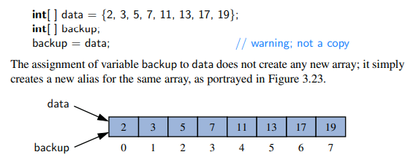
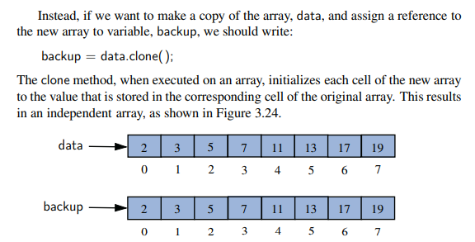
Array and Cryptography
Array, an ordered set of elements of same type
2-dimentional or multi-dimentional array
Array copy
(shallow):
-- Array copy
(deep, clone)

Slide 2
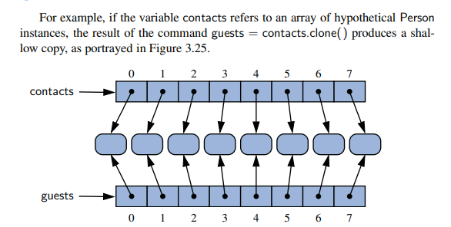
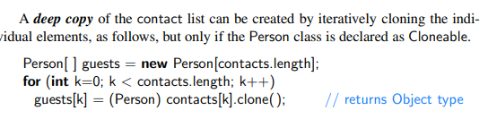
Cloning data structure

Slide 3

Simple Cryptography with Character Arrays
This field involves the process of encryption, in which a message, called the plaintext, is converted into a scrambled message, called the ciphertext. Likewise, cryptography studies corresponding ways of performing decryption, turning a ciphertext back into its original plaintext
First cipher: Caesar cipher, which is named after Julius Caesar, an ancient Roma emperor.
The Caesar cipher involves replacing each letter in a message with the letter that is three letters after it in the alphabet. So, in an English message, we might replace each A with D, each B with E, each C with F, and so on.
We continue this approach all the way up to W, which is replaced with Z. Then, we let the substitution pattern wrap around, so that we replace X with A, Y with B, and Z with C

Slide 4
Converting Between Strings and Character Arrays
Given a string S, we can create a new character array matching S by using the method, S.toCharArray( ).
For example, if S="bird", the method returns the character array A={'b', 'i', 'r', 'd'}.
Conversely, there is a form of the String constructor that accepts a character array as a parameter.
For example, with character array A={'b', 'i', 'r', 'd'}, the syntax new String(A) produces "bird".

Slide 5
Manipulating characters
Given a letter between A to Z such as ‘D’ or ‘Y’, how to get the cipher letter such as ‘G’ or ‘B’?
ASCII codes:
A: 65, B: 66, …, Z: 90.
a: 97, b: 98, …, z:122.
‘G’ = (char) (’D’ + 3), ‘B’=(char)((‘Y’+3)-26), due to ‘Y’+3> ‘Z’
In general, given ?, to get its letter $ three positions after it, if ((char)(?+3)>’Z’) $=(char)(?+3-26) else $=(char)(?+3);
How to combine these two cases together according to mathematical theory?
For ‘B’=(char)((‘Y’+3)-26), first get ‘Y’-’A’ to get its difference, then +3, to wrap back, modulus 26, i.e., (‘Y’-’A’+3) %26, which is 1. Change back to B, as ‘B’ =(char)(1+’A’). Thus, ‘B’=(char)((‘Y’- ’A’+3) %26 + ’A’).
For ‘G’ = (char) (’D’ + 3), if we do (‘D’-’A’+3) % 26, here % 26 will have no effect and we will have the same result as ‘D’-’A’+3. so ‘G’=(char)((‘D’-’A’+3) %26 +’A’). This will be same as ‘Y’ to ‘B’.
As a result, for any letter ?, its cipher text letter $ will be computed uniformly as $=(char)((? – ‘A’ +3 ) % 26 + ‘A’)
How to convert a capital letter such as ‘G’ to its small letter ‘g’?
‘g’ = (char)((‘G’- ’A’) + ’a’),
In general, convert a capital letter ? Into a small letter $ by $=(char)(?-’A’+’a’)
Conversely, how to convert a small letter ? Into its corresponding capital letter $?
$=(char)((?-’a’) + ’A’);

Slide 6
Caesar cipher encryption and decryption
char [] plaintext=“HELLO WORLD”.toCharArray();
char [] ciphertext=new char[plaintext.length];
Encryption:
for (int i=0;i<plaintext.length;i++)
If((char)(plaintext[i] + 3)>’Z’)
ciphertext[i]= (char)((plaintext[i] + 3-26));
else ciphertext[i]= (char)((plaintext[i] + 3))
Any issue with it?
Not consider punctuations. How?
Add condition: if ( ‘A’<=plaintext[i]<=‘Z’) …
Otherwise, ciphertext[i] = plaintext[i];
Using %26 for encryption
If (plaintext[i]>=‘a’ && plaintext[i]<=‘z’) // small letter
ciphertext[i]=(char)( (plaintext[i]-’a’+3) %26+’a’);
else
If (plaintext[i]>=‘A’ && plaintext[i]<=‘Z’) // capital letter
ciphertext[i]=(char)( (plaintext[i]-’A’+3) % 26 +’A’);
else //non letters, keep them
ciphertext[i]=plaintext[i];
Decryption:
for (int i=0;i<ciphertext.length;i++)
If ((char)(ciphertext[i] - 3)<‘A’)
plaintext[i]= (char)((ciphertext[i] – 3+26);
else plaintext[i]= (char)((ciphertext[i] – 3);
To consider punctuations:
If (ciphertext[i]<‘A’ || ciphertext[i]>’Z’)
Plaintext[i]=ciphertext[i];
Using %26 for decryption
If (ciphertext[i]>=‘a’ && ciphertext[i]<=‘z’) // small letter
plaintext[i]=(char)( (ciphertext[i]-’a’-3 +26 ) %26+’a’);
else
If (ciphertext[i]>=‘A’ && ciphertext[i]<=‘Z’) // capital letter
plaintext[i]=(char)( (ciphertext[i]-’A’+3+26) % 26 +’A’);
else //non letters, keep them
plaintext[i]=ciphertext[i];

Slide 7
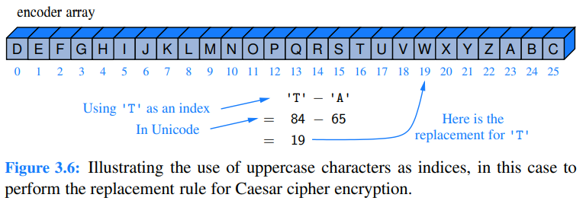
Using Character Arrays as Replacement Codes
If numbering letters like array indices, so that A is 0, B is 1, C is 2, and so on,
How to: ‘A’-’A’, ‘B’-’A’, or ?-’A’ to get its index.
then can represent the replacement rule as a character array, encoder, such that A is mapped to encoder[0], B is mapped to encoder[1], and so on.
Then, to find a replacement for a character in Caesar cipher, need to map the characters from A to Z to the respective numbers from 0 to 25.
rely on the fact that characters are represented in Unicode by integer code points, and the code points for the uppercase letters of the Latin alphabet are consecutive (similarly for lowercase letters).
Moreover, Java allows to “subtract” two characters from each other, with an integer result equal to their separation distance in the encoding.
Given a variable c that is known to be an uppercase letter, the Java computation, j = c − 'A' produces the desired index j.
As a sanity check, if character c is 'A', then j = 0. When c is 'B', the difference is 1. In general, the integer j that results from such a calculation can be used as an index into our precomputed encoder array, as illustrated in Figure 3.6

Slide 8
Encryption using encoder array
Once you have this array, the encryption will be:
if (plaintext[i]>=‘a’ && plaintext[i]<=‘z’) ciphertext[i]=encoder[plaintext[i]-’a’); else
If((plaintext[i]>=‘A’ && plaintext[i]<=‘Z’) ciphertext[i]=encoder[plaintext[i]-’A’); else
ciphertext[i]=plaintext[i];
What is the decryption array?
How about shift more position other than 3?
Example ciphertext: JBCRCLQRWCRVNBJENBWRWN
Plaintext: astitchintimesavesnine
Shift 9 positions.
Moreover, if given a random encoder array, such as
N | R | Y | A | H | P | O | G | Z | Q | W | B | T | S | F| L | X | C | V |M | U | E | K | J | D | I
i.e., a to X, b to N, .., z to I, this general case is called substitution cipher.
How to implement it?
Exercises: see the class website (normally due two weeks later).

Slide 9
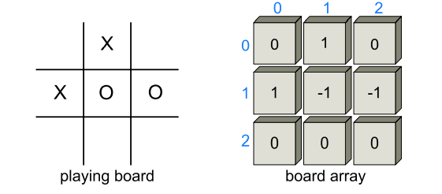
Two or multiple dimensional array
Tic-Tac-Toe
Tic-Tac-Toe is a game played in a three-by-three board. Two players—X and O—alternate in placing their respective marks in the cells of this board, starting with player X. If either player succeeds in getting three of his or her marks in a row, column, or diagonal, then that player wins.

