Slide 1
Bit operations and bitmask
Bit operations <<, >>, |, &, ^:
*2, /2, 2^k,
test/get/set/clear a bit k,
get a bit mask 0..01..10..0 (from i to j)
test/get/set/clear bits from i to j.
get the least significant bit (LSB)
x & (-x) or x ^ ( x & (x-1))
clear LSB: x=x-(x&(-x)) or x=x & (x-1)
How to get the most significant bit (MSB)??
x ^ (x-1) +1 >>1
n is a number in 64 bit, O(64) or O(log(64))=O(6).
Bitmasks as a state in complete search/DP

Slide 2
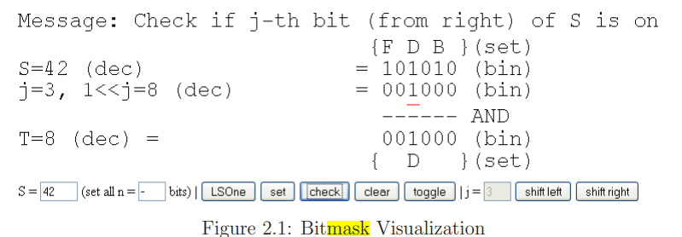
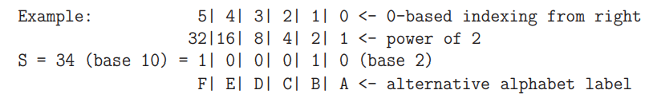
Examples
Representation: A 32 (or 64)-bit signed integer for up to 32 (or 64) items.
integer S = 34 or 100010 in binary also represents a small set {1, 5} with a 0-based indexing scheme in increasing digit significance (or {B, F} using the alternative alphabet label) because the second and the sixth bits (counting from the right) of S are on.
Go to complete search with pruning slides

Slide 3
Backtracking with Bitmask --The N-Queens Problem, Revisited
UVa 11195: Given an n × n chessboard (3 <n< 15) where some of the cells are bad (queens cannot be placed on those bad cells), how many ways can you place n queens in the chessboard so that no two queens attack each other? Note: Bad cells cannot be used to block queens’ attack.
The recursive backtracking code that we have presented before is not fast enough for n = 14 and no bad cells, the worst possible test case for this problem.
The sub-O(n!) solution presented earlier is still OK for n = 8 but not for n = 14.
The major issue with the previous n-queens code is that it is quite slow when checking whether the position of a new queen is valid since we compare the new queen’s position with the previous c-1 queens’ positions
see function bool place(int r, int c)

Slide 4
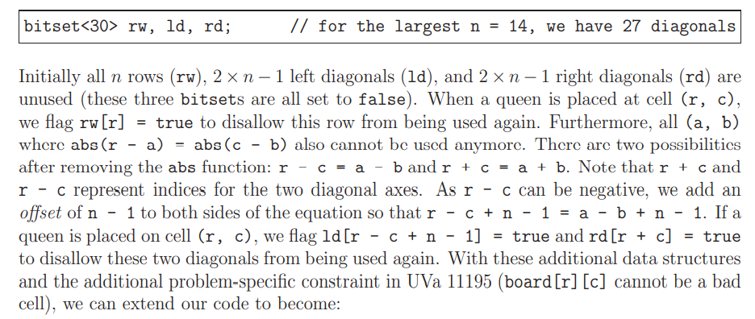
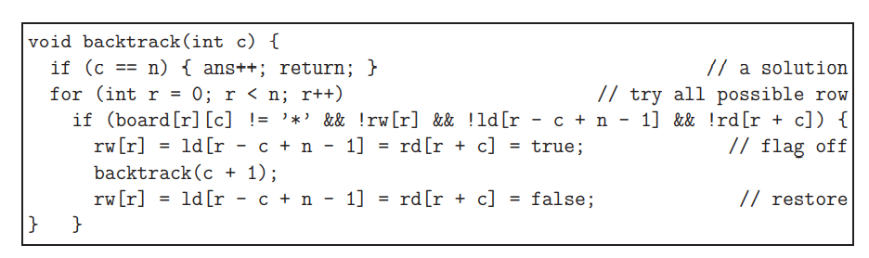
The N-Queens Problem, Revisited (cont.)
store the same information with three boolean arrays (e.g., bitsets for C++):
Unfortunately, the program using bitsets: rw, ld, and rd will still obtain a TLE for some test cases.
We can replace bitsets with bitmask, but still has a TLE problem.

Slide 5
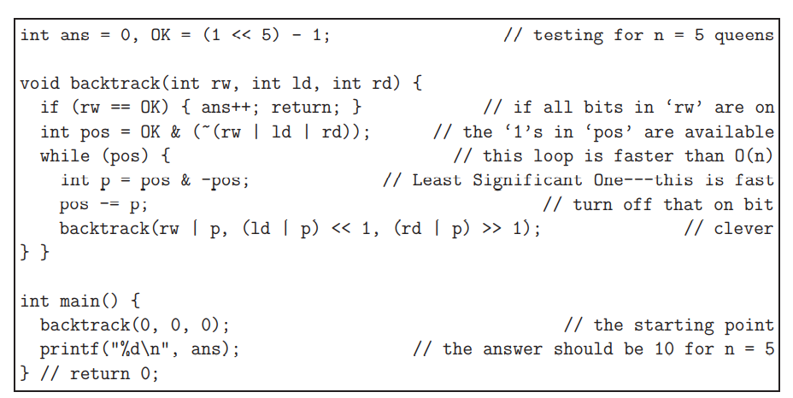
The N-Queens Problem, Revisited (cont.)
Fortunately, there is a better way to use these row, left diagonal, and right diagonal checks.
straightforwardly use three bitmasks for rw, ld, and rd to represent the state of the search.
The on bits in bitmasks rw, ld, and rd describe which rows are attacked in the next column, due to row, left diagonal, or right diagonal attacks from previously placed queens, respectively.
Since we consider one column at a time, there will only be n possible left/right diagonals, hence we can have three bitmasks of the same length of n bits
This version is efficient enough without TLE.

Slide 6
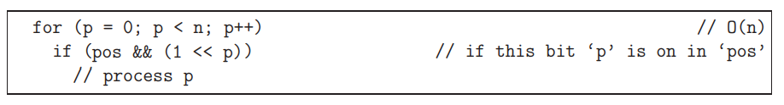
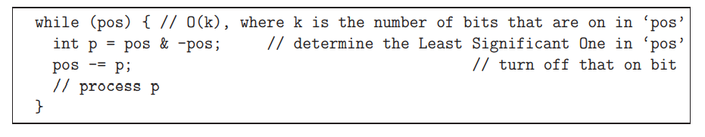

Complete search using bitmask
Complete Search (the recursive backtracking) will try all possible rows (that is, all the on bits in variable pos) of a certain column one by one.
When using bitmask, two ways to explore all the on bits of a bitmask
As the recursive backtracking goes deeper, less and less rows are available for selection.
i.e., k is becoming smaller and smaller. Thus, the second one is more efficient.

Slide 7
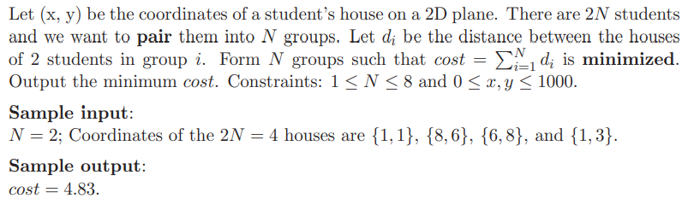
DP with Bitmask
Some of the modern DP problems require a (small) set of Boolean as one of the parameters of the DP state. This is another situation where bitmask technique can be useful
Minimum weight perfect matching on a small general weighted graph
In the general case, this problem is hard. However, if the input size is small,
up to M=2N ≤ 20, then DP with bitmask solution can be used.

Slide 8
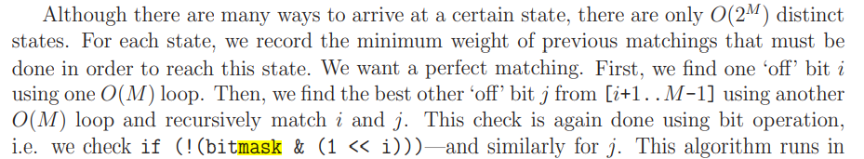

Prefect minimum match
The matching state is represented by a bitmask.
for example when M = 6.
start with a state where nothing is matched yet, i.e. bitmask=000000. If item 0 and item 2 are matched, we can turn on two bits (bit 0 and bit 2) at the same time via this simple bit operation, i.e. bitmask | (1 << 0) | (1 << 2), thus the state becomes bitmask=000101.
If from this state, item 1 and item 5 are matched next, the state will become bitmask=100111.
The perfect matching is obtained when the state is all ‘1’s, in this case: bitmask=111111.

Slide 9
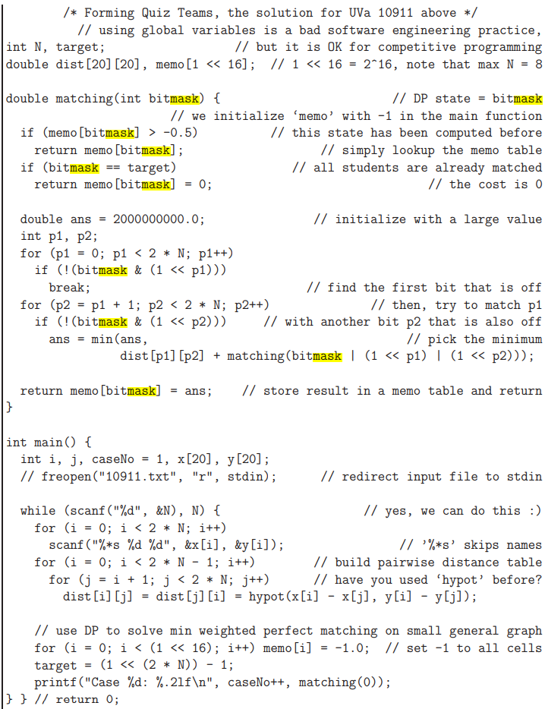

Slide 10
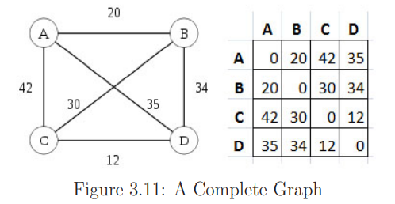
DP with bitmask (another example)
Traveling Salesman Problem (TSP)
Given n cities and their pairwise distances in the form of a matrix dist of size n × n, compute the cost of making a tour that starts from any city s, goes through all the other n − 1 cities exactly once, and finally returns to the starting city s.
Find a minimum tour
A-B-C-D-A is one of the minimum tours
with a cost of 20+30+12+35 = 97
Brute force solution:
Try all the possible tours to find the minimum.
n! Or (n-1)! If symmetry is considered.
When n=12, 11! ≈ 40M.
Larger than 12 will result in TLE.
How about DP solution?
Overlapping: sub-tours is clearly overlapping
A − B − C−(n − 3) other cities that finally return to A
A−C −B−the same (n−3) other cities that also return to A
If we can avoid re-computing the lengths of such sub-tours, we can save a lot of computation time.
What is the state or parameters ?
The last city/vertex visited pos and
Something that we may have not seen before
Or to say in the other way, a subset of visited cities.
Bitmask of length n, each bit representing a city.
To check whether a bit is on or off, using mask & (1<<i). To set the bit, use mask |= (1<<i)

Slide 11
How to code it?
Recursive function: tsp(pos, mask)
Initialize tsp(pos, 2^{n} -1) = dist(pos,0) for all pos
// all cities have been visited, return to starting city 0
2^{n} -1 is in fact all n bits are 1, like (1<<n) -1
tsp(pos, mask) = min(dist[pos][nxt] + tsp(nxt, mask | (1 << nxt)))
// ∀ nxt ∈ [0..n-1], nxt != pos, and (mask & (1 << nxt)) is 0 (turned off)
// We basically tries all possible next cities that have not been visited before at each step
Initial call:
tsp(0,1)
Complexity:
How many distinct states?
O(n*2^{n}), pos: n cities; mask: 2^{n} --remember 2^{n} other cities that have been visited in each tour
In each step of computing minimum:
O(n)
Thus, total: O(n²2^{n}).
Thus, can solve the problem with the number of cities upto n ≈ 16
as 16² × 2¹⁶ ≈ 17M. Previously, n can only be upto 11.
TSP problem is itself a NP-Complete problem, thus, no efficient algorithm (i.e., polynomial time algorithm) for it

