Slide 1
Computational Geometry
Cancer concept with cancer implementations

Slide 2
Topics
Area
Shoelace (common)
Heron’s Formula (rare)
Lines
Intersections
Coordinate bashing
Pythagorean Theorem

Slide 3
Basic Structure
We can represent computational geometry using structs to make it more human readable. Structs have essentially no overhead as they are processed during compile time.
Personally, I use this method to better organize and understand different geometric concepts in my code.
struct Point { int x, y; };
struct Line { Point a, b; };
struct Polygon { vector<Point> points; };

Slide 4
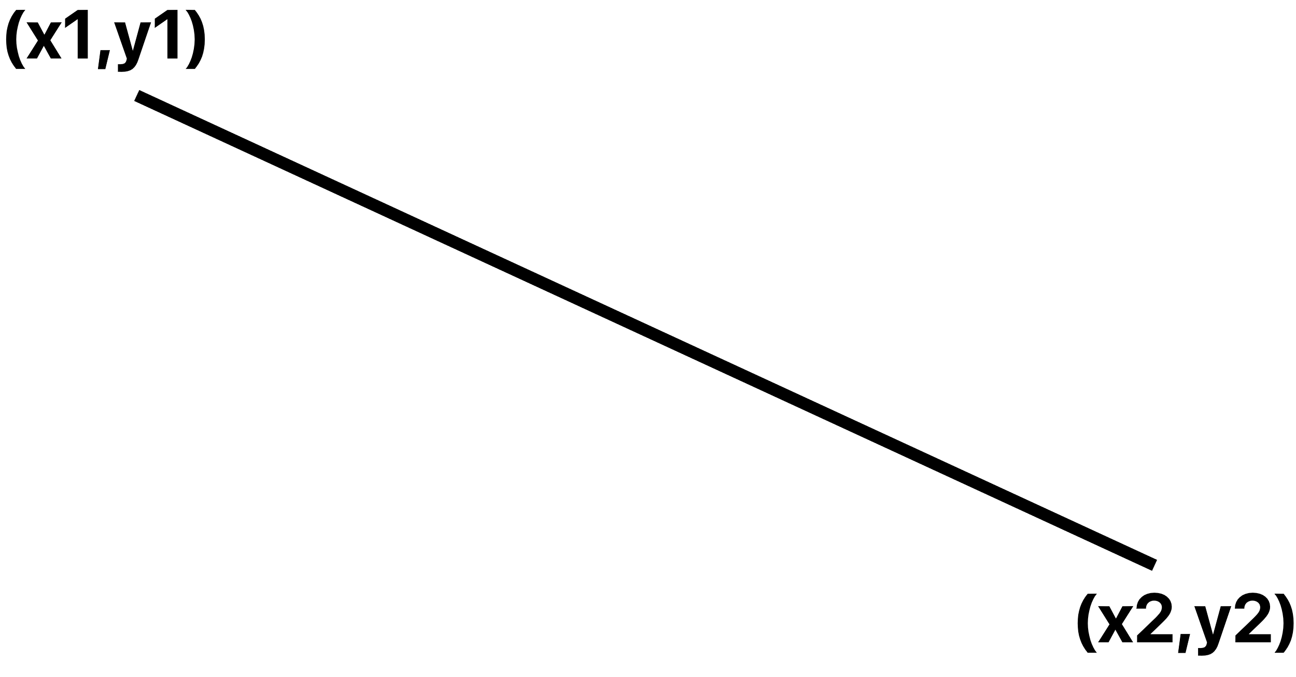
Euclidean Distance
Literally just Pythagorean Theorem
Notes:
Be careful of floating-point precision errors because they do cause cancer.
If you’re only comparing distances, you can remove the square root.
double distance(Point a, Point b) { return sqrt((a.x-b.x)*(a.x-b.x) + (a.y-b.y)*(a.y-b.y)); }

Slide 5
Heron’s Formula
(x1,y1)
a
s(s-a)(s-b)(s-c)
double heron (Point p1, Point p2, Point p3) { double a=distance(p1,p2); double b=distance(p2,p3); double c=distance(p3,p1); double s=(a+b+c)/2; return sqrt(s*(s-a)*(s-b)*(s-c)); }
c
(x2,y2)
b
Fun fact: the C++ compiler is optimized so there is no difference in using temporary variables a, b, c rather than including all the calls in the return statement.
But we don’t want to deal with floating point numbers?
What about other polygons?
(x3,y3)

Slide 6
Shoelace
x1
y1
(x1,y1)
x2
y2
= |(
x1×y2+x2×y3+x3×y1
)
a
-(
y1×x2+y2×x3+y3×x1
)|
x3
y3
c
(x2,y2)
x1
y1
b
double shoelace3 (Point p1, Point p2, Point p3) { double temp1=p1.x*p2.y+p2.x+p3.y+p3.x*p1.y; double temp2=p1.y*p2.x+p2.y*p3.x+p3.y*p1.x; return abs(temp1-temp2)/2; }
(x3,y3)

Slide 7
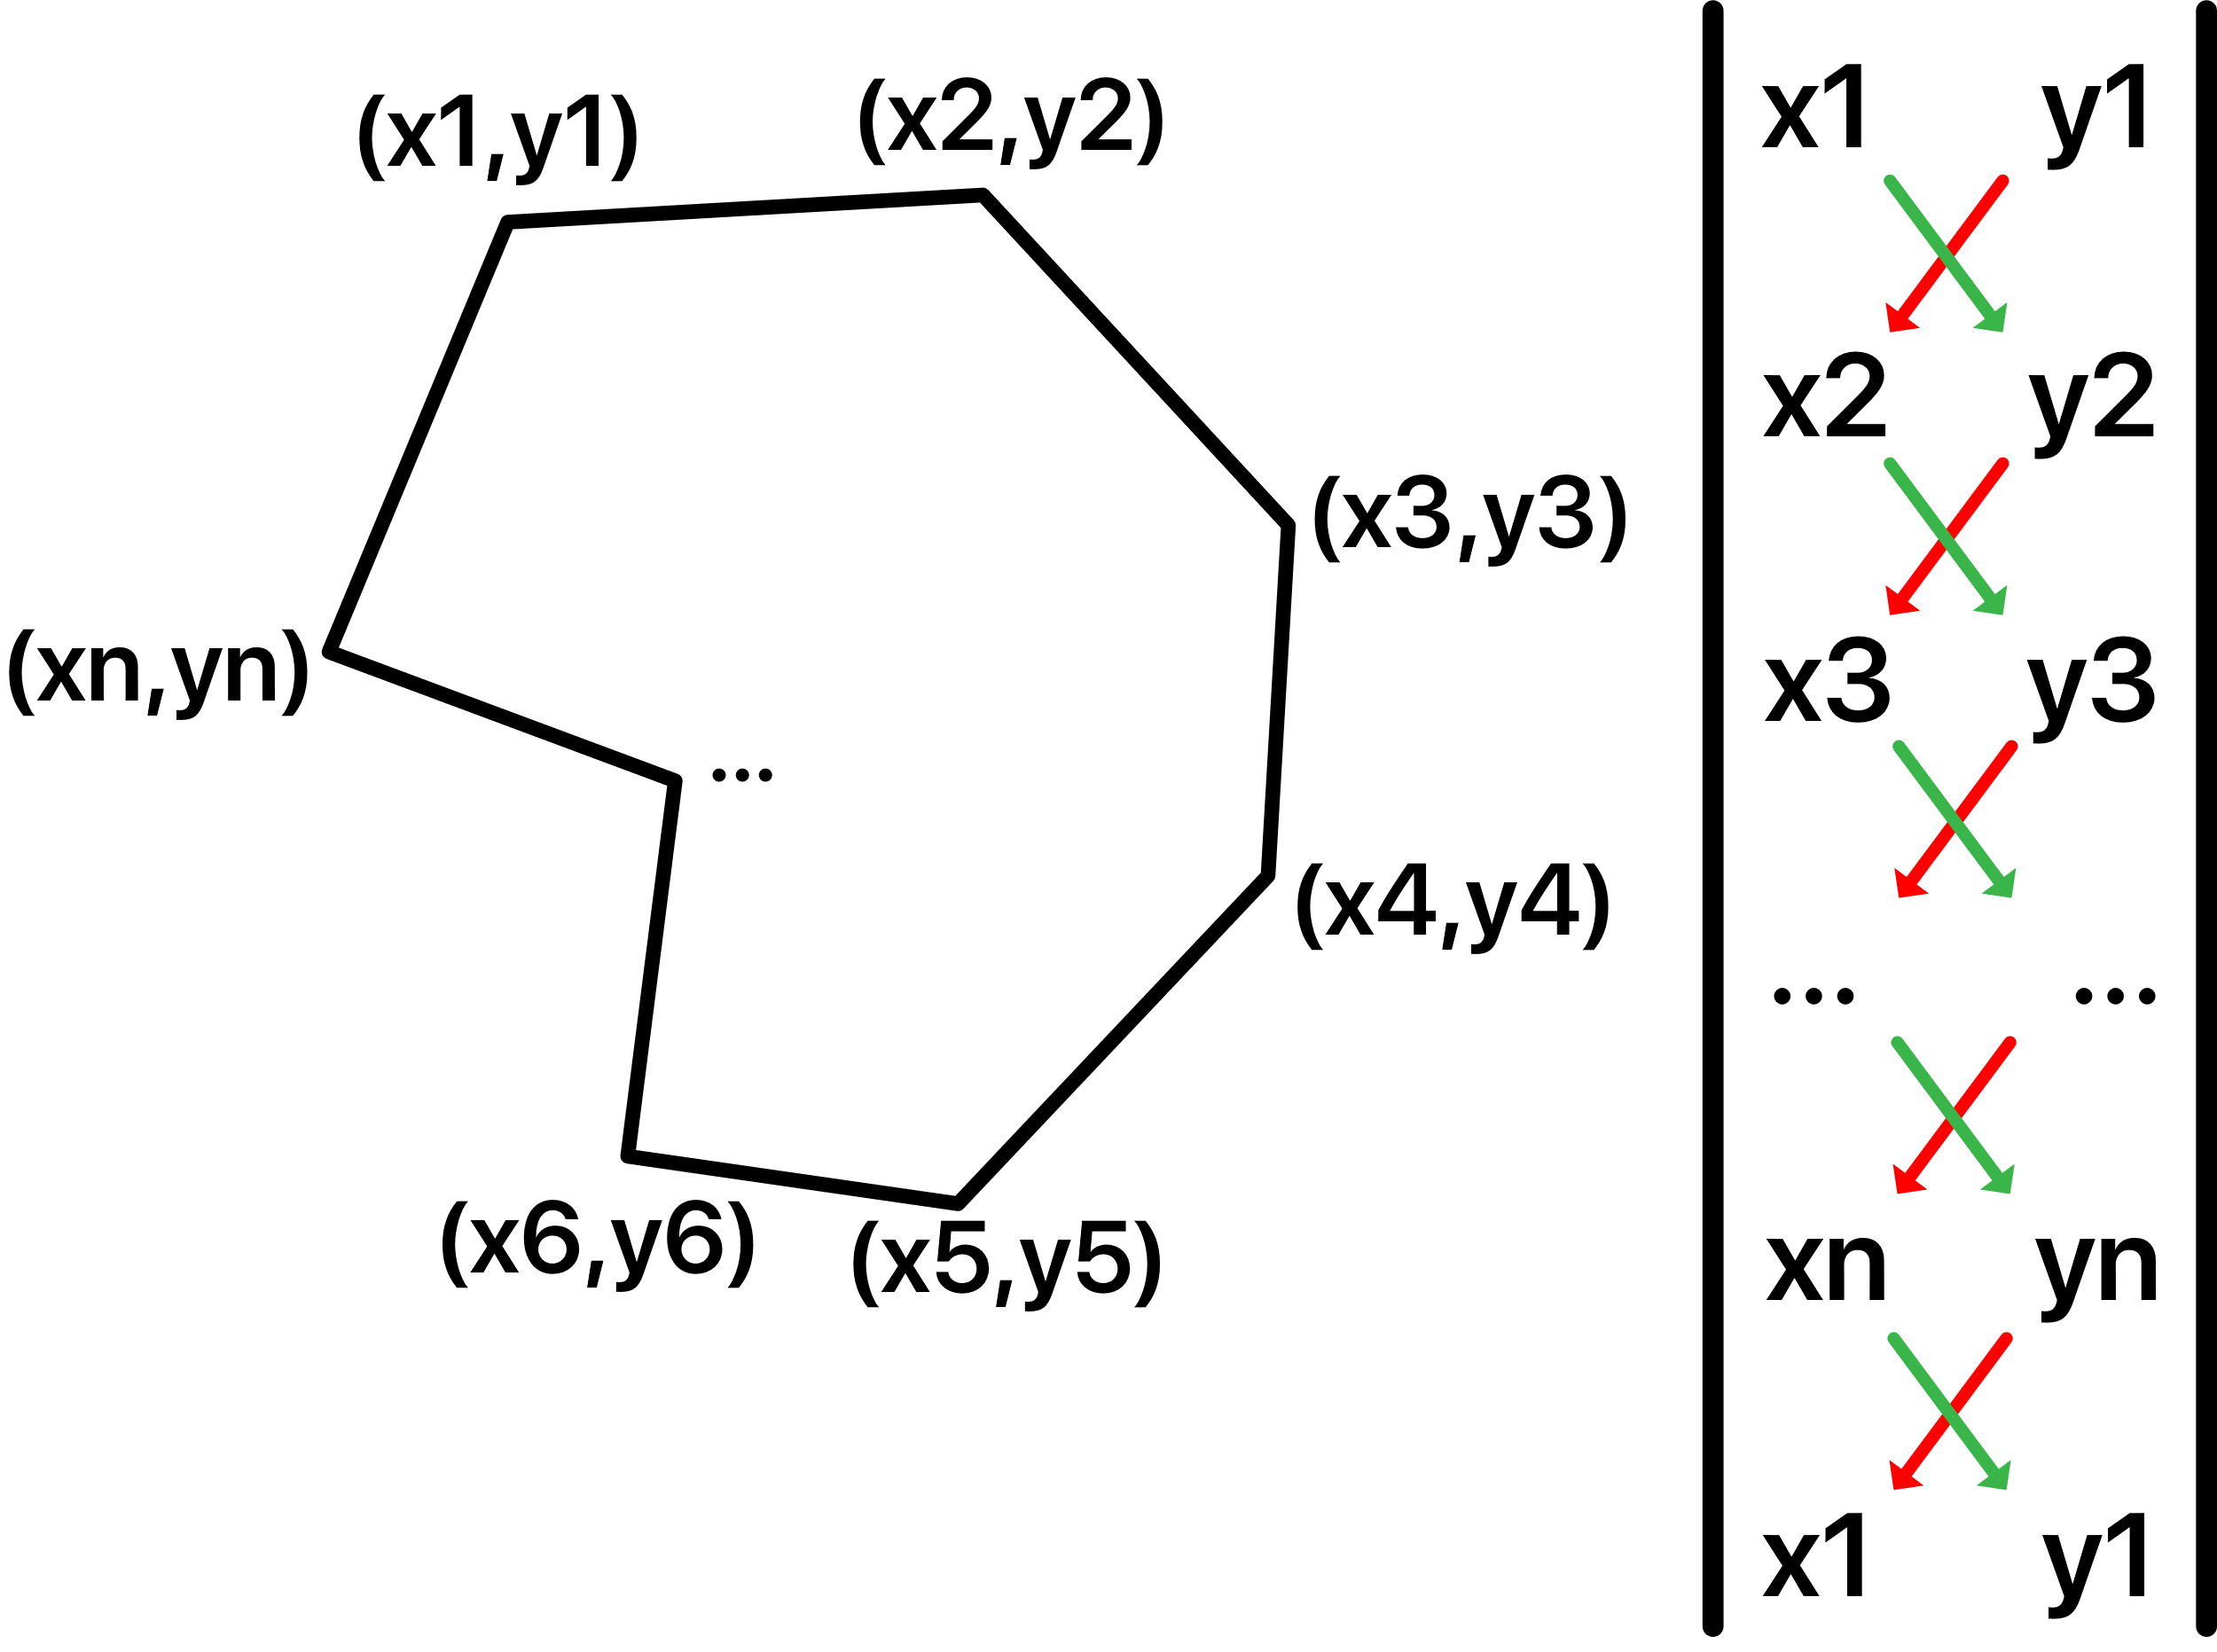
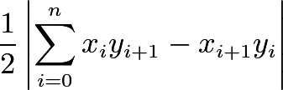
Shoelace Generalized
double shoelace(Polygon p) { double temp1=0; int n=p.points.size(); for (int i=0; i<n; i++) { temp1+=p.points[i].x * p.points[(i+1)%n].y -p.points[(i+1)%n].x *p.points[i].y; } return abs(temp1)/2; }

Slide 8
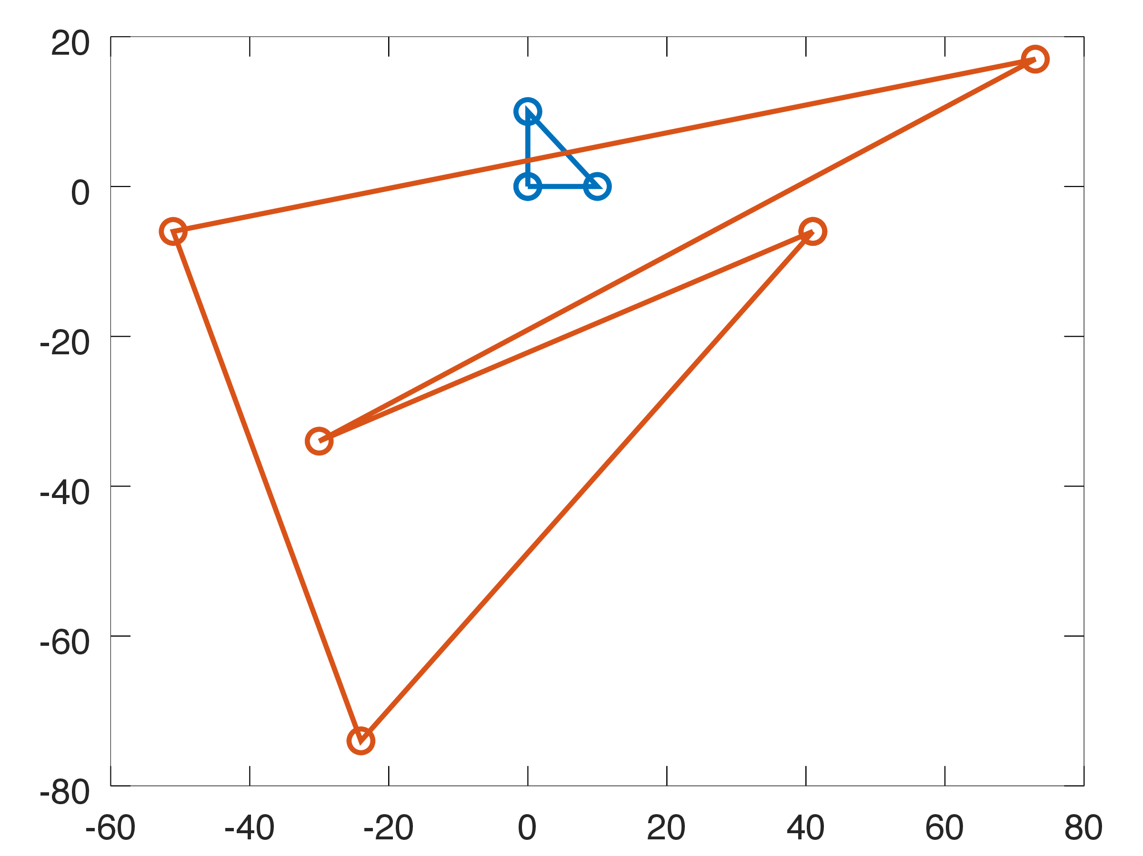
Example – “Polygon Area”
“Compute the area of a simple polygon, and the direction (clockwise or counterclockwise) in which its vertices are given.”
Sample Input:
3
0 0
10 0
0 10
5
41 -6
-24 -74
-51 -6
73 17
-30 -34
0
Sample Output:
CCW 50.0
CW 3817.5
Source - Kattis: https://open.kattis.com/problems/polygonarea

Slide 9
using namespace std; #include <bits/extc++.h> struct Point { int x, y; Point(int a, int b) { x=a,y=b; } }; struct Polygon { vector<Point> points; }; double shoelace(Polygon p) { double temp1=0; int n=p.points.size(); for (int i=0; i<n; i++) { int j=(i+1)%n; temp1+=p.points[i].x * p.points[j].y -p.points[j].x * p.points[i].y; } return temp1/2; } int main() { int N; while (cin >> N && N!=0) { Polygon p; for (int i=0; i<N; i++) { int a, b; cin >> a >> b; p.points.push_back(Point(a,b)); } double res=shoelace(p); cout << setprecision(1); cout << fixed; if (res<0) cout << "CW " << abs(res) << endl; else cout << "CCW " << abs(res) << endl; } }

Slide 10
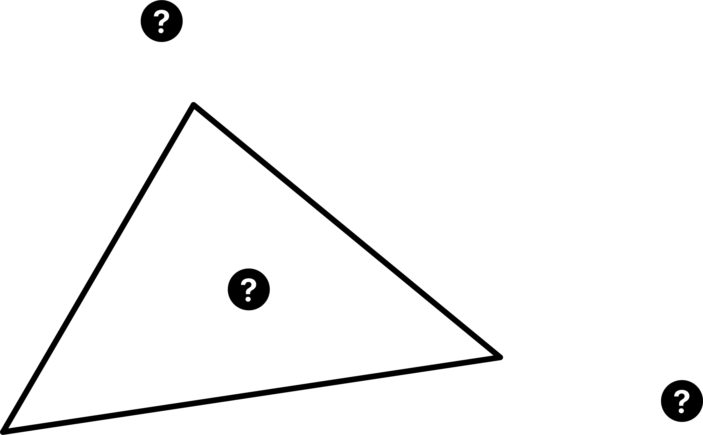
USACO Open 2021 – Permutation (Gold)
We’ve seen it before, but one of the most important parts is determining where a point is relative to a triangle.
Determine of a point is inside the triangle
Determine which point in the original triangle should be replaced to form a larger triangle.

Slide 11
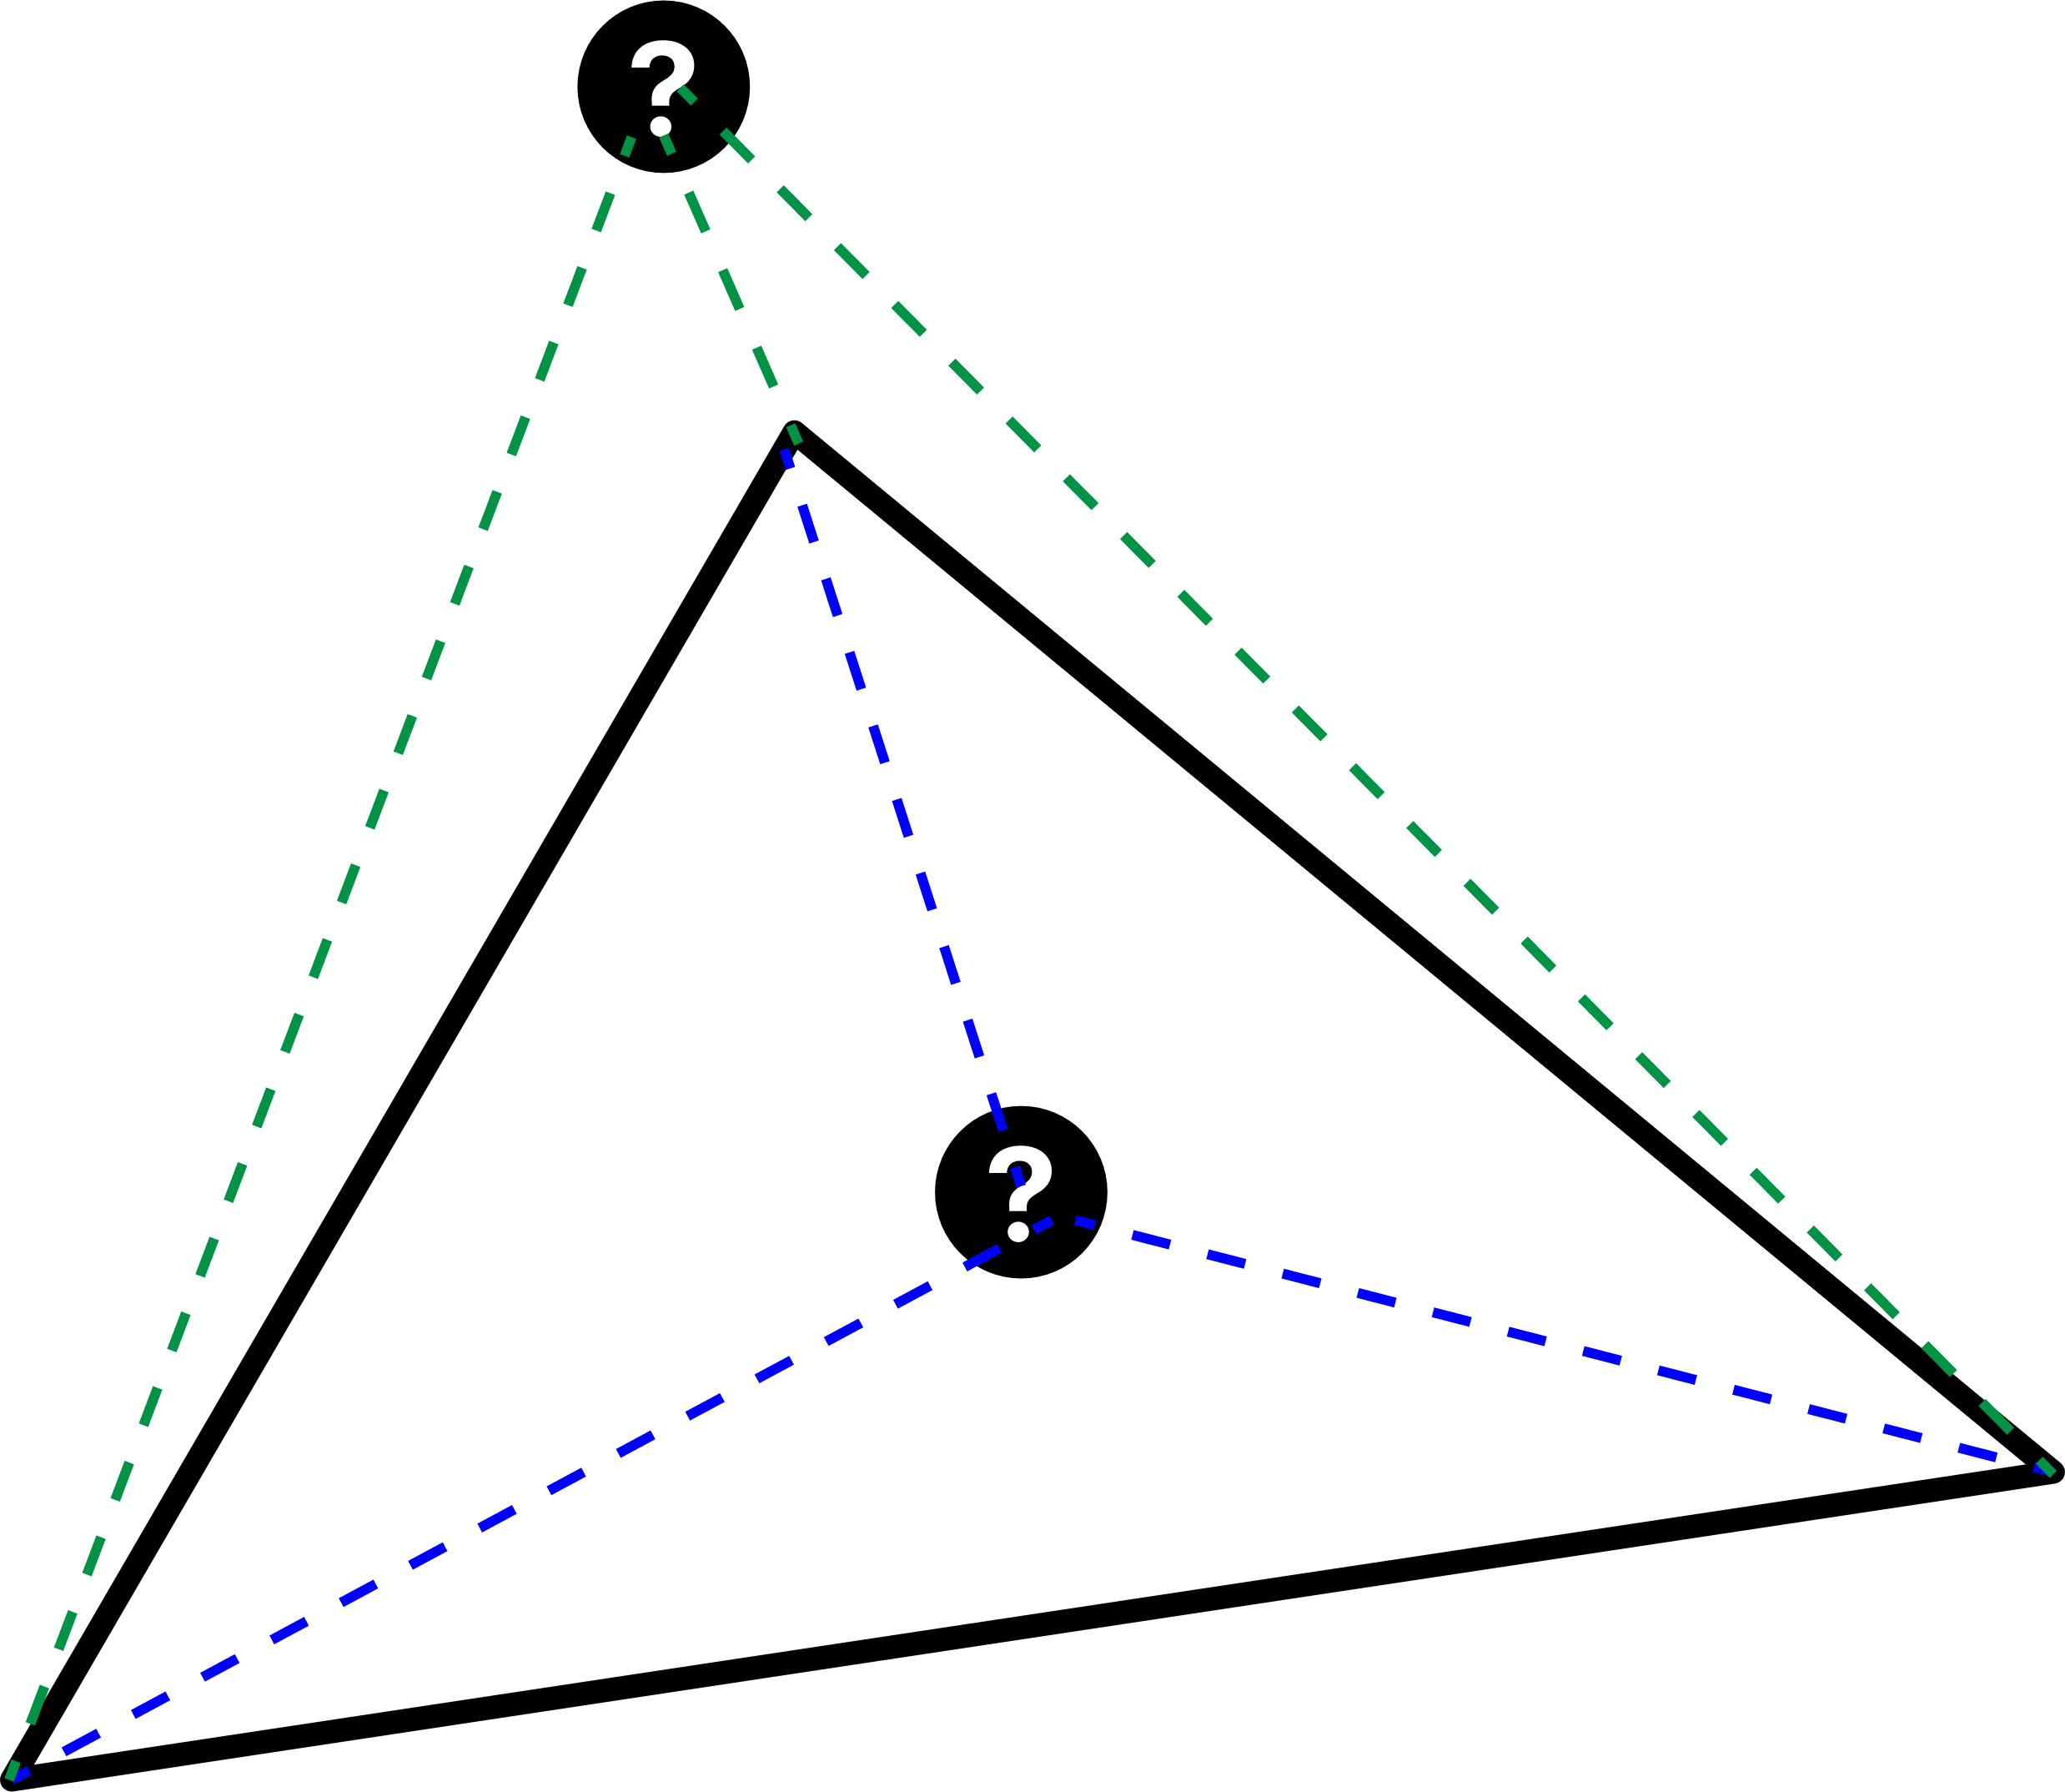
Permutation – Point inside triangle
A point is on the inside if and only if the 3 smaller areas equals the larger area.
struct Triangle { Point p1,p2,p3;
//Direct implementation of Shoelace Theorem without /2 long long area(Point p1, Point p2, Point p3) {
long long temp1=p1.x*p2.y+p2.x+p3.y+p3.x*p1.y; long long temp2=p1.y*p2.x+p2.y*p3.x+p3.y*p1.x; return abs(temp1-temp2); } bool inTriangle(const Point& a) { ll all=area(p1,p2,p3); ll a1=area(a,p2,p3); ll a2=area(p1,a,p3); ll a3=area(p1,p2,a); return all==a1+a2+a3;
//abs(all-a1-a3-a3)<0.001 if it’s floating point } };
p2
p3
Note that to decrease the risk of floating-point precision errors, we don’t use doubles at all.
p1

Slide 12
Permutation – Point to remove
We compare areas again…but this time how do know which 3 points make a triangle?
?

Slide 13
Permutation – Point to remove
We compare areas again…but this time how do know which 3 points make a triangle?
?
typedef long long ll;
short checkpoint(Triangle tri, Point p) { //Whichever one is the biggest is not the pair. ll temp1=tri.area(tri.p2,tri.p3,p); //exclude point 1 ll temp2=tri.area(tri.p1,tri.p3,p); //exclude point 2 ll temp3=tri.area(tri.p1,tri.p2,p); //exclude point 3 if (temp3>temp2 and temp3>temp1) return 3; if (temp2>temp1 and temp2>temp3) return 2; if (temp1>temp2 and temp1>temp3) return 1; cerr << "Same Areas" << endl; exit(0); }
p3
p2
p1

Slide 14
Sorting Points Clockwise
We find a central point, calculate the angle of each of the other points with respect to that point, then sort by the angle.
2 options: centroid or leftmost point (demo). Let that be p
Centroid: average of all x and y coordintates
For each point x_{i}:
Calculate the angle with respect to p using arctan. In competitive programming, use atan2() for higher reliability than atan(). Also, atan2() supports computing angle from -180 to 180 degrees, but atan() only supports -90 to 90 degrees.
Associate this angle with point x_{i}
Sort by calculated angle
Notes:
This method is not complete yet.

Slide 15
Sorting Points Example
1
6
4
10
2
7
3
5
9
8

