Slide 1
Binary Lifting/Doubling technique
Given a tree and a node, find its kth ancestor.
Its parent is its 1st ancestor
Its grandparent is its 2nd ancestor
….
Naïve solution: if there is a parent pointer, travel upward from the node k times, complexity?
Given two nodes, find their lowest common ancestor:
Their common ancestor most close to them.
Naïve solution: O(n).
But using binary lifting or doubling technique, all of them can be done in O(log(n)).
The technique requires preprocessing the tree in O(N log N) using dynamic programming.

Slide 2
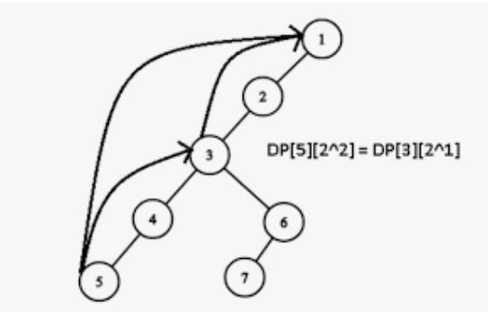
Binary Lifting
dp[i][j]: the 2^{j}th ancestor of node i.
dp[5][0]=5’s 2⁰ ancestor=5’s parent=4
dp[4][0]=3
dp[3][0]=2
dp[2][0]=1
dp[1][0]=-1;
dp[5][2]= dp[3][1] = dp[dp[5][1]][1]
dp[1][1]=-1
dp[2][1]=2’s 2¹th ancestor
=2’s 1th ancestor’s 1th ancestor
=dp[dp[2][0]][0]
=dp[1][0]=-1
dp[3][1]=3’s 2¹th ancestor
=3’s 1th ancestor’s 1th ancestor
=dp[dp[3][0]][0]
=dp[2][0]=1
dp[4][1]=dp[dp[4][0]][0]=dp[3][0]=2
dp[5][1]=dp[dp[5][0]][0]=dp[4][0]=3
dp[1][2]=1’s 2²th ancestor
=1’s 2¹th ancestor’s 2¹th ancestor
=dp[dp[1][1]][1]=-1
dp[2][2]=2’s 2²th ancestor
=2’s 2¹th ancestor’s 2¹th ancestor
=dp[dp[2][1]][1]=-1
dp[3][2]=dp[dp[3][1]][1]=dp[1][1]=-1
dp[4][2]=dp[dp[4][1]][1]=dp[2][1]=-1
dp[5][2]=dp[dp[5][1]][1]=dp[3][1]=1
In general: dp[i][j]=dp[dp[i][j-1]][j-1]
i.e., i’s 2^{j}th ancestor is i’s 2^{j-1}th ancestor’s 2^{j-1}th ancestor. (2^{j-1}*2^{j-1}=2^{j})

Slide 3
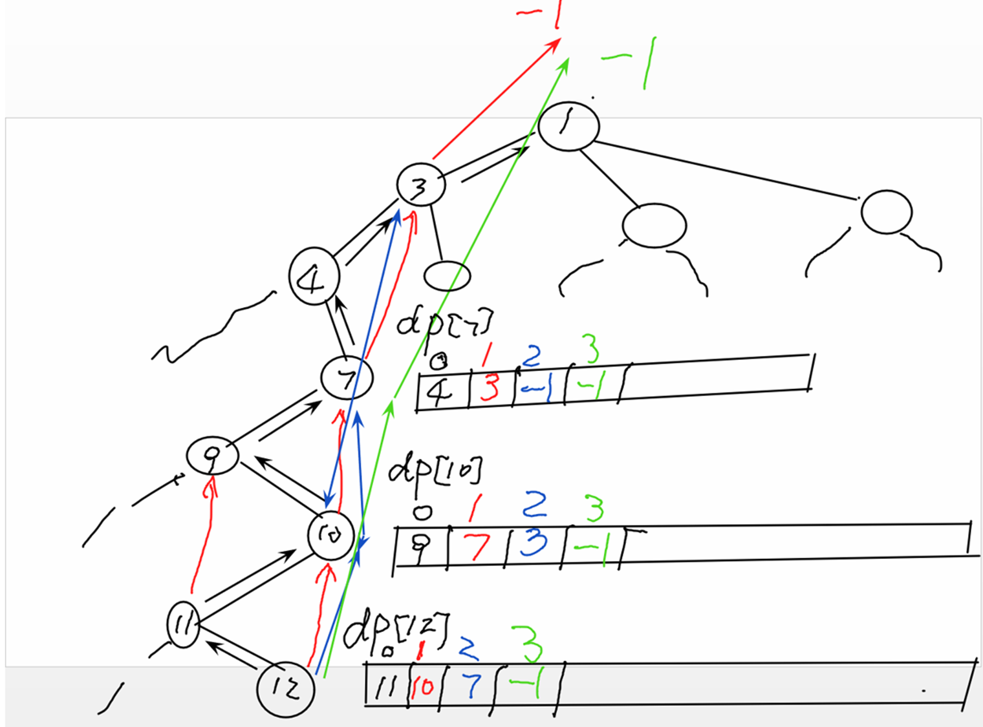

Slide 4
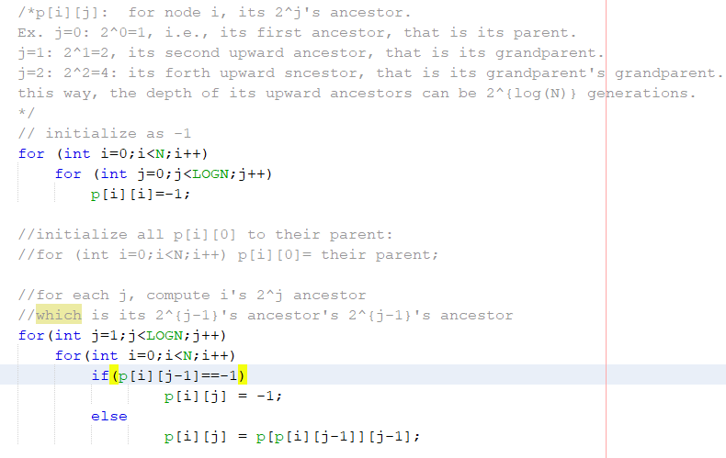
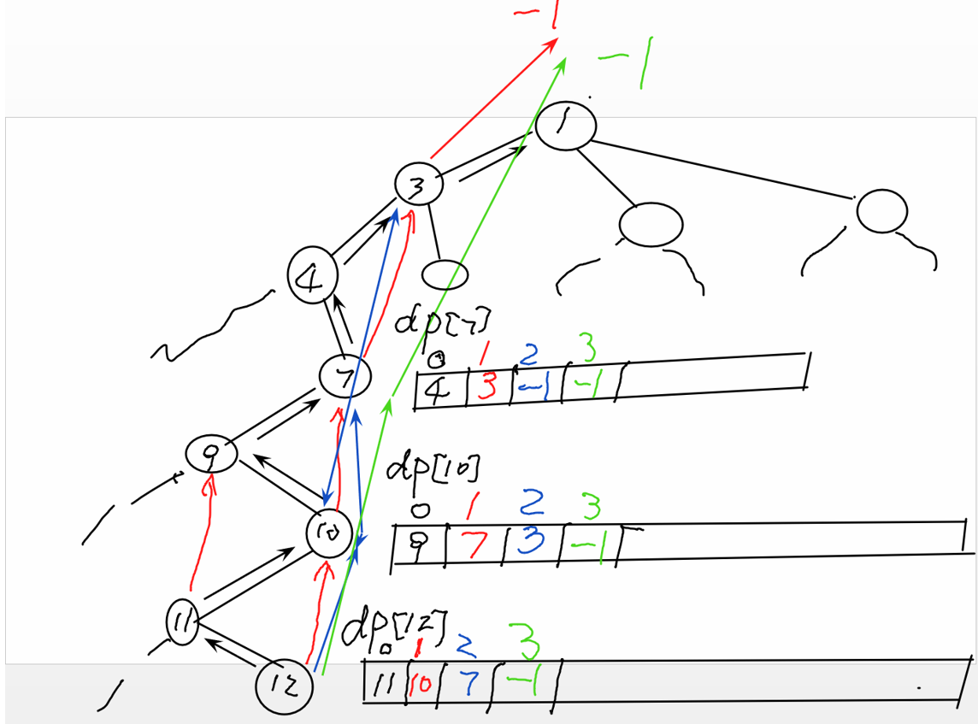

Slide 5
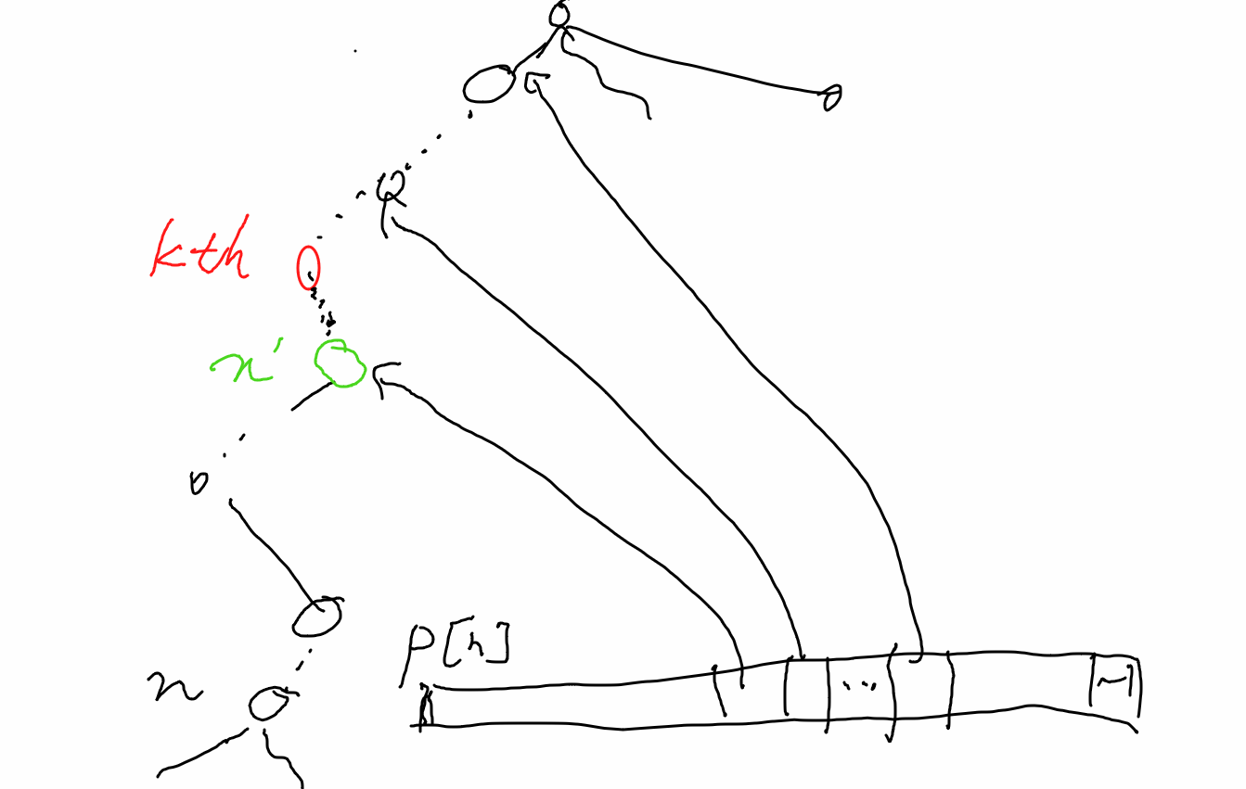

Slide 6
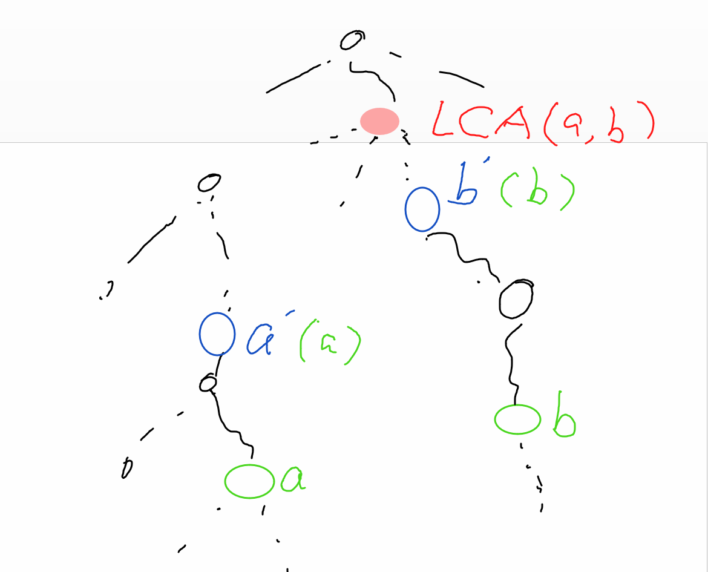

Slide 7
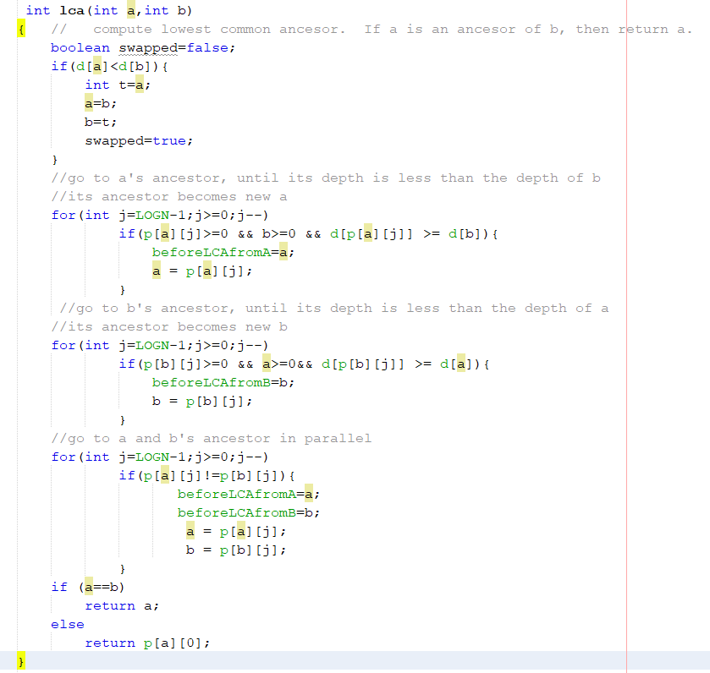

Slide 8
The path length between two nodes
Path_length(A,B)= depth(A)+depth(B) -2*depth(LCA(A,B))

Slide 9
The binary representation of an integer
(155)₁₀= (10011011)₂ = 2⁷+ 2⁴+ 2³+ 2¹+ 2⁰
Bitmasks
Representing sets
How to compute y=x^{c} mod n? Suppose x,c,n are positive integers.
Native solution
Improved
Efficient one

Slide 10
Modular exponentiation-- x^{c} mod n
Using c-1 traditional modular multiplications,
the exponential complexity in term of k.
Using square-and-multiply algorithm:
Very efficient, O((log₂^{c})k²).
Write down c in binary representation (in fact it is!)
Initialize z = 1
From the highest bit to the lowest bit
Perform z = z² mod n
If the bit is 1 then perform z = (z × x) mod n
Return z.

