Slide 1
Linked Lists
Slides are modified from the lecture slides with the textbook Data Structures and Algorithms in Java, 6th edition, by M. T. Goodrich, R. Tamassia, and M. H. Goldwasser, Wiley, 2014
Singly Linked lists
Doubly linked lists
Circular linked lists
Concrete Implementation of a linked list class in Java
Differences between linked lists and Array
Linked list examples in three languages:
https://www.geeksforgeeks.org/linked-list-set-1-introduction/

Slide 2
Singly Linked List
A singly linked list is a concrete data structure consisting of a sequence of nodes, starting from a head pointer
Each node stores
element
link to the next node
next
element
node
head
∅
A
B
C
D

Slide 3
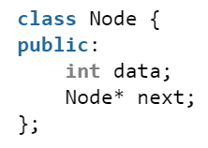
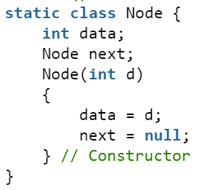
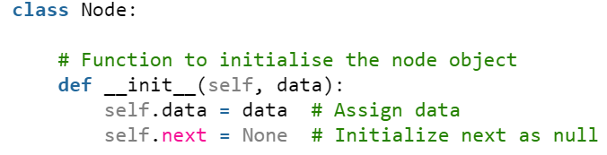
Recursive structure/class
In C++:
In Java:
data
next
In Python:
Node
head
Λ
Java: null
C++: null / NULL
Ptython: none
A
B
C
D

Slide 4
Linked list examples in three languages
https://www.geeksforgeeks.org/linked-list-set-1-introduction/

Slide 5
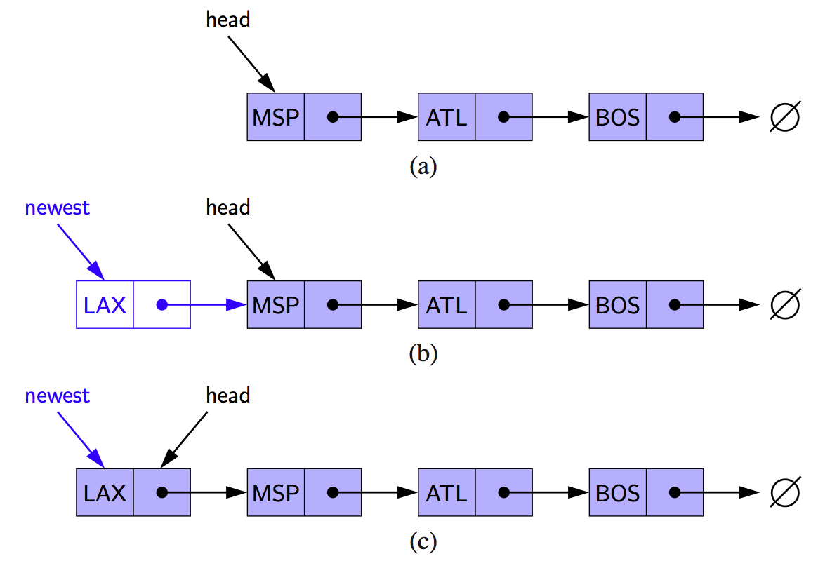
Inserting at the Head
Pseudo-Code:
newest.next=head;
Head=newest;
Node newest=new Node(LAX)
newest.next=head;
Head=newest;
Allocate new node
Insert new element
Have new node point to old head
Update head to point to new node

Slide 6
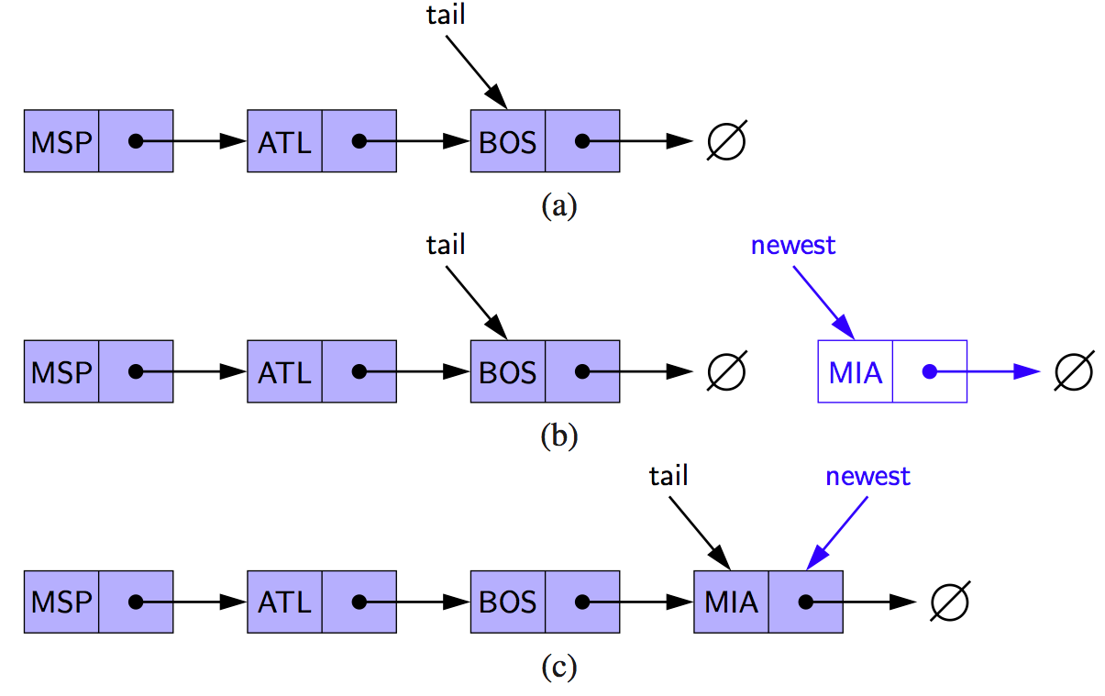
Inserting at the Tail
Pseudo-Code:
Node newest=new Node(MIA)
tail.next=newest;
Allocate a new node
Insert new element
Have new node point to null
Have old last node point to new node
Update tail to point to new node
Node newest=new Node(MIA)
Node tail=head;
while(tail.next!=null)
tail=tail.next;
tail.next=newest;

Slide 7
Implement a Linked List class in Java Assume integer type
Instance variable:
Node head;
void insertAtHead(int data)
void append(int data), i.e., void insertAtTail(int data)
int getFirst()
int getElement(int n)
int removeFirst()
int removeLast()
Methods:
More methods?
int size()
boolean isEmpty()
Additional methods?
void insertAt(int n,int data)
int remove(int n)
…

Slide 8
Abstract Data Type (ADT) and Dynamic Array
A generic LinkedList for any type (of data)?
Called ADT.
Java provides LinkedList<E> already.
Efficiency?
Slow!
Comparison with an array:
A[n] to get any n^{th} element is fast in
constant time O(1).
but no insertion and removal with fixed array size.
Solution/substitute?
ArrayList<E>: a dynamic array
1. have the efficiency of an array, i.e., average cost/running time
of a sequence of inserting, removing and getting-value operation
is constant (i.e., O(1)). Called amortized efficiency.
2. have the dynamics of a LinkedList, i.e., being able to insertion, removal,
and allowing the size of array to change.

Slide 9
Exceptions vs. Returning Null
Attempting the execution of an operation of an ADT may sometimes cause an error condition
Java supports a general abstraction for errors, called exception
An exception is said to be “thrown” by an operation that cannot be properly executed
In our LinkedList ADT, we do not use exceptions
Instead, we allow operations pop and top to be performed even if the linkedList is empty
For an empty LinkedList, remove and get simply return null

Slide 10
Doubly Linked List
A doubly linked list can be traversed forward and backward
Nodes store:
element
link to the previous node
link to the next node
Special trailer and header nodes
prev
next
element
node
header
nodes/positions
trailer
elements

Slide 11
Insertion
Insert a new node, q, between p and its successor.
p
A
B
C
p
A
B
q
C
X
p
q
A
B
X
C

Slide 12
Deletion
Remove a node, p, from a doubly linked list.
p
A
B
C
D
A
B
C
p
D
A
B
C

Slide 13
Circular Linked List
A singly linked list is a concrete data structure consisting of a sequence of nodes, starting from a head pointer
Each node stores
element
link to the next node
next
element
node
head
A
B
C
D

Slide 14
Applications of linked lists
Implementation of stack and quene
Representation of tree structure and graph structure
Dynamic memory allocation :
We use linked list of free blocks.
Maintaining directory of names
Image viewer –
Previous and next images are linked, hence can be accessed by next and previous button.

Slide 15
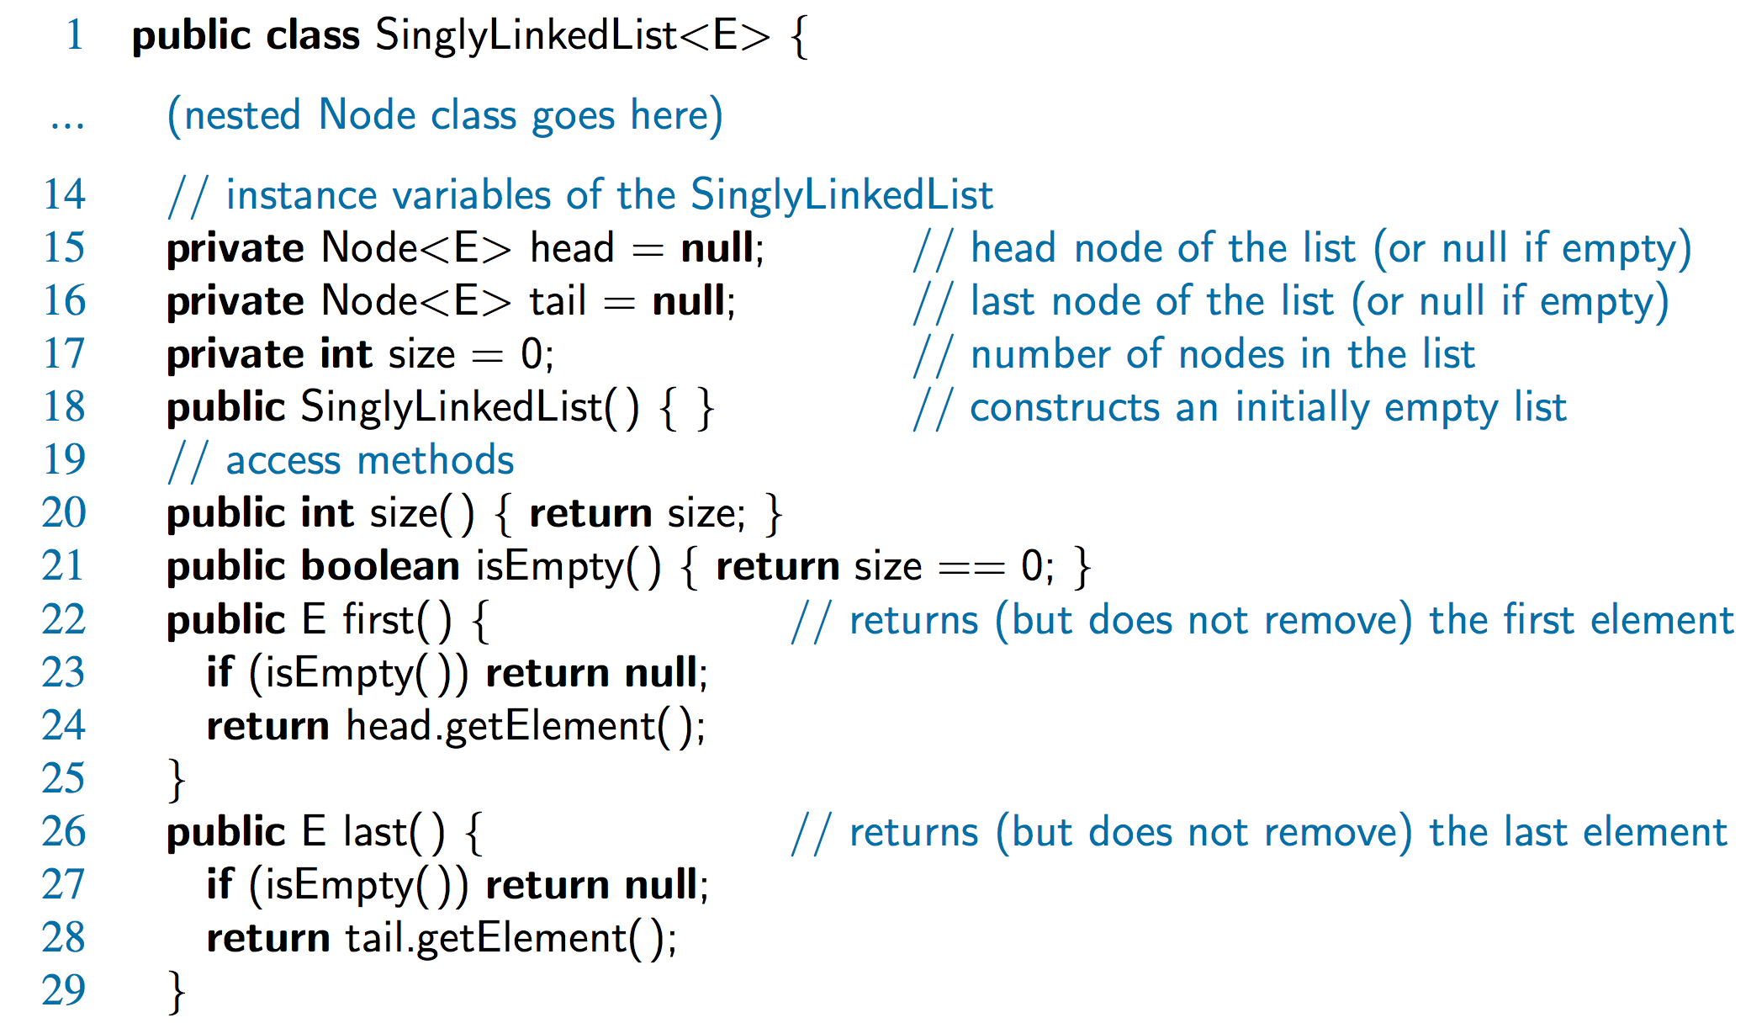
Accessor Methods

Slide 16
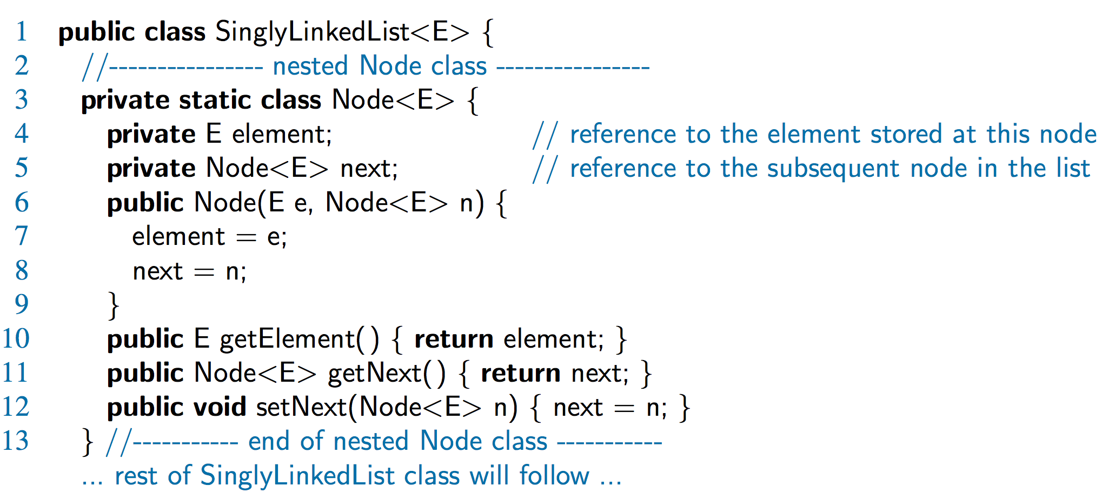
A Nested Node Class

Slide 17
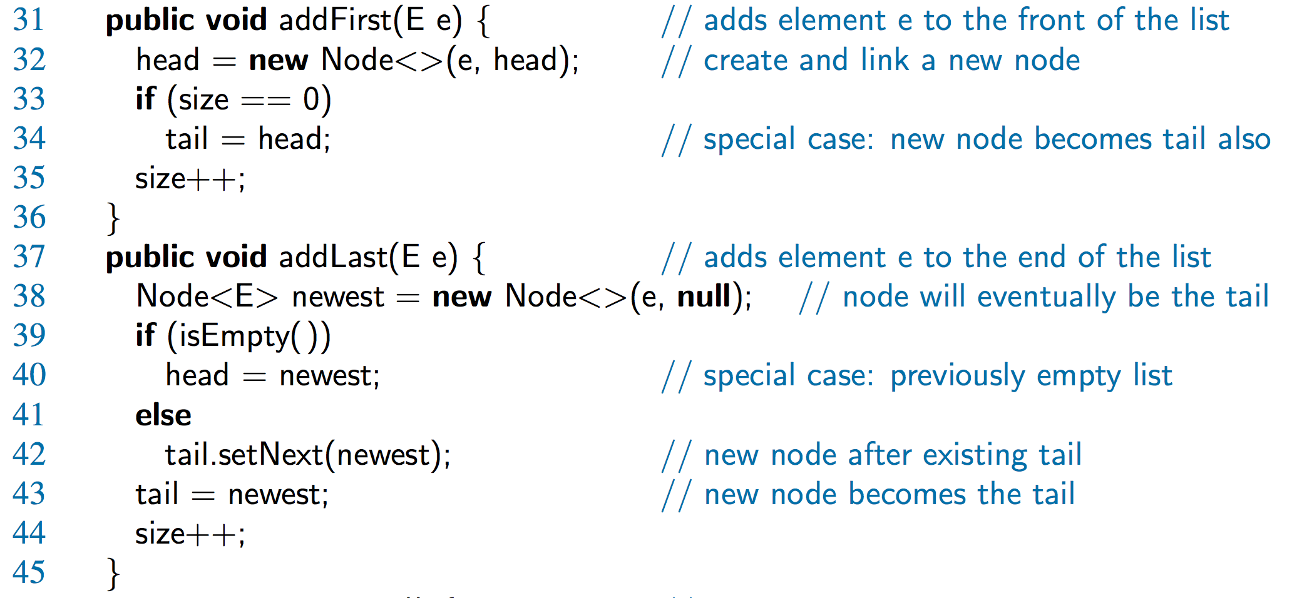
Java Methods

Slide 18
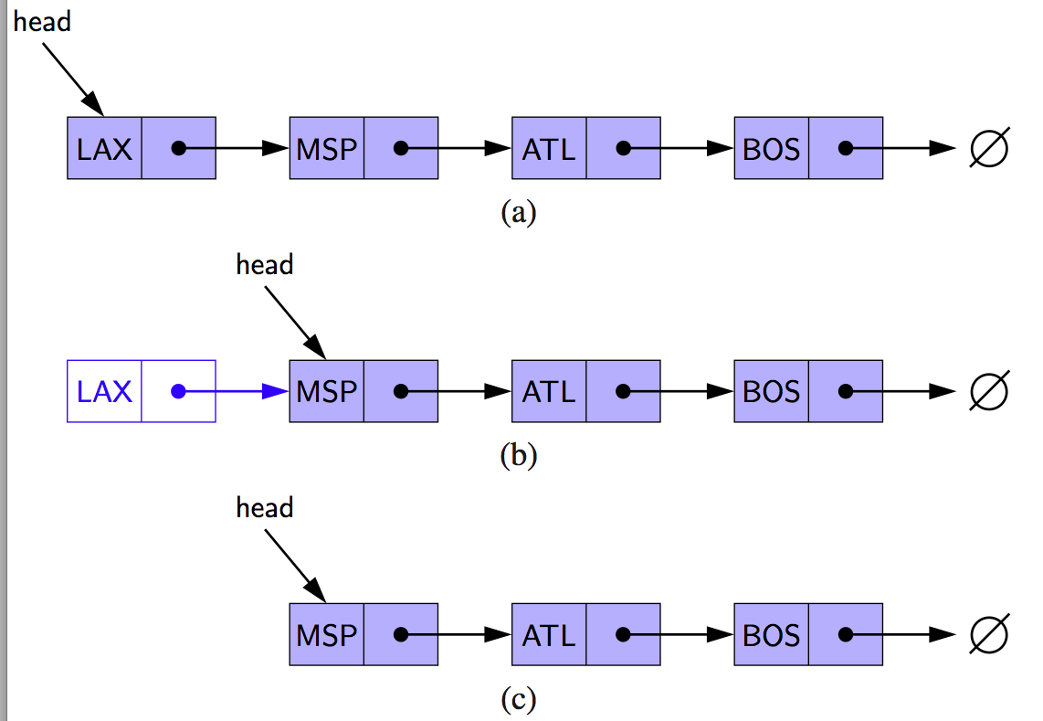
Removing at the Head
Update head to point to next node in the list
Allow garbage collector to reclaim the former first node

Slide 19
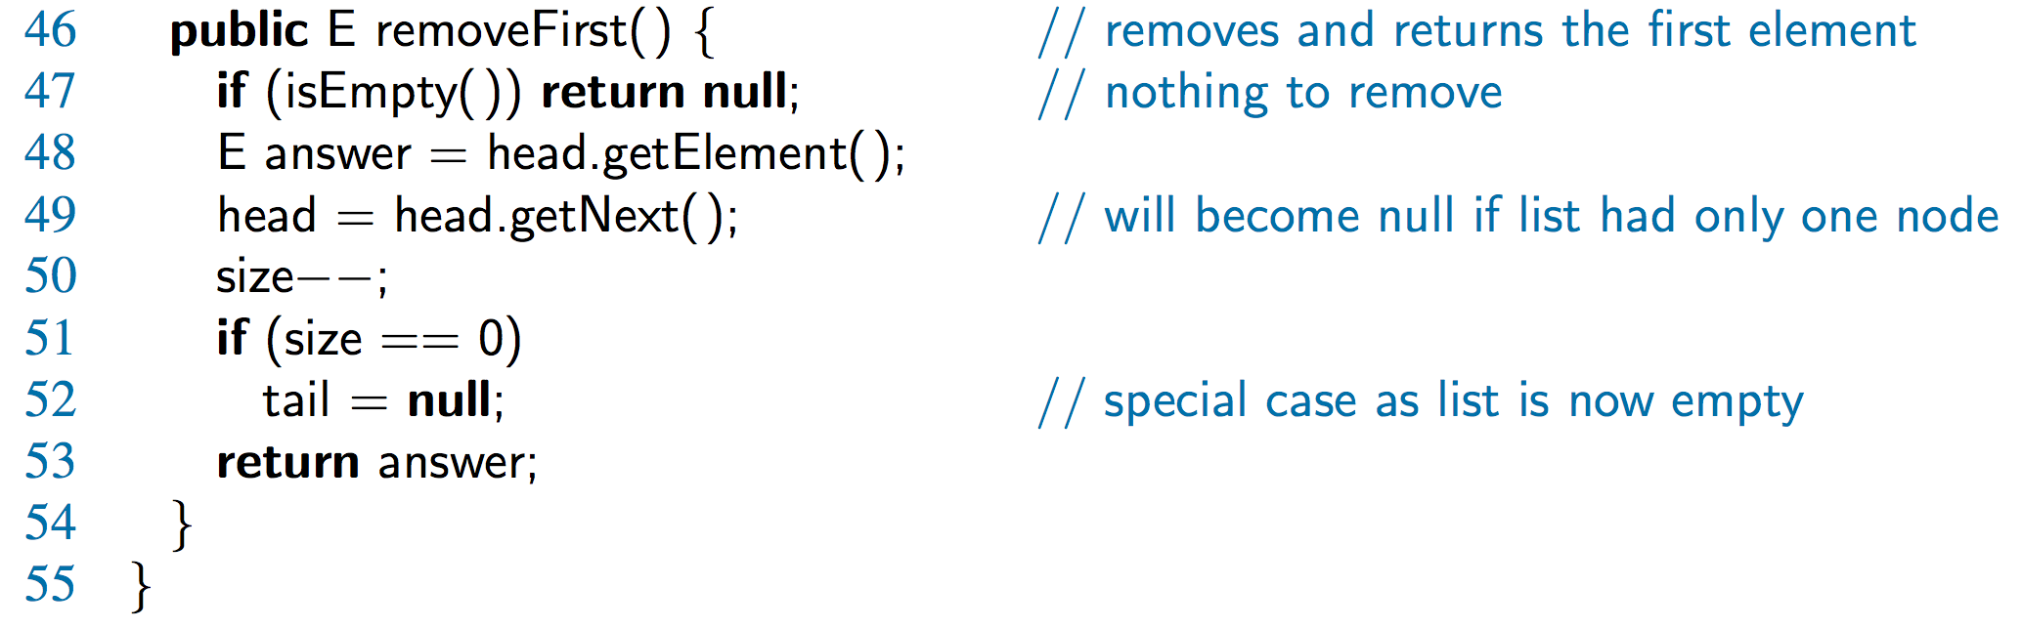
Java Method

Slide 20
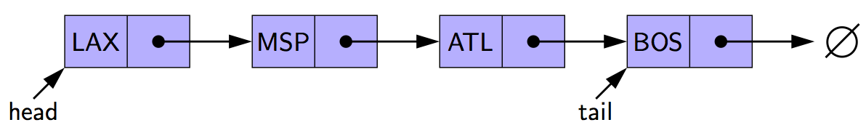
Removing at the Tail
Removing at the tail of a singly linked list is not efficient!
There is no constant-time way to update the tail to point to the previous node

