Slide 1
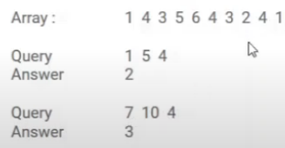
Look at some problems:
Problem 1: Given an array of N elements and you have to answer Q queries of the form L, R, K , To Count the numbers smaller than K in range L to R.
Of course, there are different variants for this query, such as >=, or =
Problem 2: given an array of size N and Q queries of form L,R, find the number of unique elements in each range L and R.
Query 1, 5, answer is: 5
Query 2 ,7, answer: 2
Problem 3: Hackerrank.com, Coloring Tree.

Slide 2
Merge Sort Tree
We learned segment tree, but that does not work efficiently for those queries.
Merge sort tree:
Allows to answer such queries in O((log(n)²) time.
The idea is to build a segment tree but each node is a sorted vector or an sorted array list.
The building is similar to merge sort and has the complexity O(nlog(n)).
The query process is similar to the (sum, max, min) query in segment tree having O(log(n)). In addition, it will take an additional binary search to find the number of values less than k or equal to k, which is another O(log(n)). Thus, total O(log(n)²).
Note: Merge Sort Tree is not efficient for update.

Slide 3
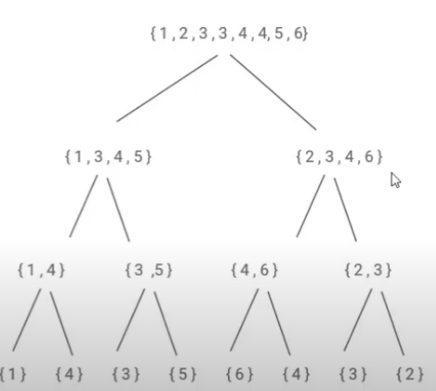
Examples

Slide 4
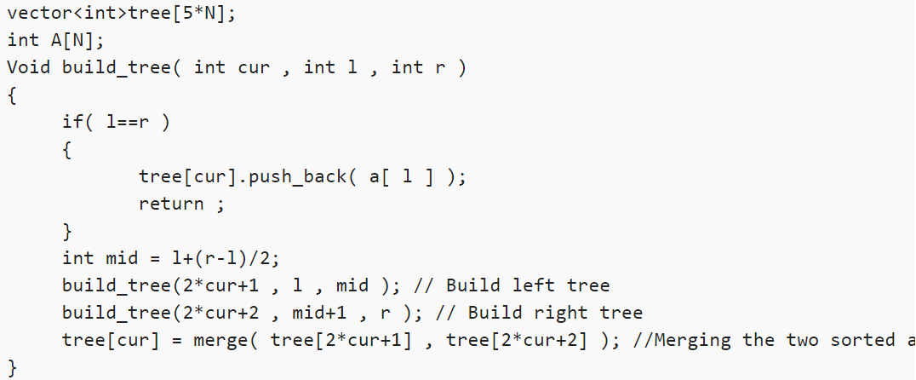
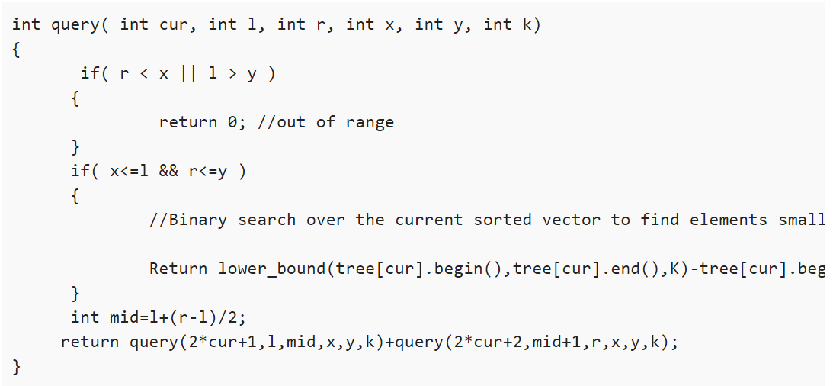
Implementation

