Slide 1
Non comparison sort
Comparison sort:
Lower bound: Ω(nlgn).
Non comparison sort:
Counting sort, bucket sort, radix sort

Slide 2
Counting Sort
Assumption: n input numbers are integers in range [0,k], k=O(n).
Idea:
Determine the number of elements less than x, for each input x.
Place x directly in its position.

Slide 3
COUNTING-SORT(A,B,k)
for i←0 to k
do C[i] ←0
for j ←1 to length[A]
do C[A[j]] ←C[A[j]]+1
// C[i] contains number of elements equal to i.
for i ←1 to k
do C[i]=C[i]+C[i-1]
// C[i] contains number of elements ≤ i.
for j ←length[A] downto 1
do B[C[A[j]]] ←A[j]
C[A[j]] ←C[A[j]]-1

Slide 4
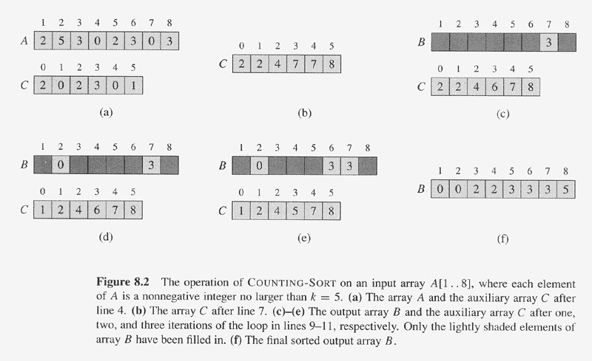
Example of Counting Sort

Slide 5
Analysis of COUNTING-SORT(A,B,k)
for i←0 to k Θ(k)
do C[i] ←0 Θ(1)
for j ←1 to length[A] Θ(n)
do C[A[j]] ←C[A[j]]+1 Θ(1) (Θ(1) Θ(n)= Θ(n))
// C[i] contains number of elements equal to i. Θ(0)
for i ←1 to k Θ(k)
do C[i]=C[i]+C[i-1] Θ(1) (Θ(1) Θ(n)= Θ(n))
// C[i] contains number of elements ≤ i. Θ(0)
for j ←length[A] downto 1 Θ(n)
do B[C[A[j]]] ←A[j] Θ(1) (Θ(1) Θ(n)= Θ(n))
C[A[j]] ←C[A[j]]-1 Θ(1) (Θ(1) Θ(n)= Θ(n))
Total cost is Θ(k+n), suppose k=O(n), then total cost is Θ(n). Beat Ω(nlg n).

Slide 6
Bucket-Sort and Radix-Sort
Presentation for use with the textbook Data Structures and Algorithms in Java, 6th edition, by M. T. Goodrich, R. Tamassia, and M. H. Goldwasser, Wiley, 2014
1, c
3, a
3, b
7, d
7, g
7, e
∅
∅
∅
∅
∅
∅
∅
B
0
1
2
3
4
5
6
7
8
9

Slide 7
Bucket-Sort
Let be S be a sequence of n (key, element) items with keys in the range [0, N − 1]
Bucket-sort uses the keys as indices into an auxiliary array B of sequences (buckets)
Phase 1: Empty sequence S by moving each entry (k, o) into its bucket B[k]
Phase 2: For i = 0, …, N − 1, move the entries of bucket B[i] to the end of sequence S
Analysis:
Phase 1 takes O(n) time
Phase 2 takes O(n + N) time
Bucket-sort takes O(n + N) time
^{Algorithm bucketSort(S):}
Input: Sequence S of entries with integer keys in the range [0, N − 1] Output: Sequence S sorted in nondecreasing order of the keys
let B be an array of N sequences, each of which is initially empty
^{for each entry e in S do}
^{k = the key of e}
^{remove e from S}
insert e at the end of bucket B[k]
^{for i = 0 to N−1 do}
^{for each entry e in B[i] do}
^{remove e from B[i]}
^{insert e at the end of S}

Slide 8
Example
Key range [0, 9]
7, d
1, c
3, a
7, g
3, b
7, e
Phase 1
1, c
3, a
3, b
7, d
7, g
7, e
B
0
1
2
3
4
5
6
7
8
9
∅
∅
∅
∅
∅
∅
∅
Phase 2
1, c
3, a
3, b
7, d
7, g
7, e

Slide 9
Properties and Extensions
Key-type Property
The keys are used as indices into an array and cannot be arbitrary objects
No external comparator
Stable Sort Property
The relative order of any two items with the same key is preserved after the execution of the algorithm
Extensions
Integer keys in the range [a, b]
Put entry (k, o) into bucket B[k − a]
String keys from a set D of possible strings, where D has constant size (e.g., names of the 50 U.S. states)
Sort D and compute the rank r(k) of each string k of D in the sorted sequence
Put entry (k, o) into bucket B[r(k)]

Slide 10
Lexicographic Order
A d-tuple is a sequence of d keys (k₁, k₂, …, k_{d}), where key k_{i} is said to be the i-th dimension of the tuple
Example:
The Cartesian coordinates of a point in space are a 3-tuple
The lexicographic order of two d-tuples is recursively defined as follows
(x₁, x₂, …, x_{d}) < (y₁, y₂, …, y_{d}) ⇔ x₁ < y₁ ∨ x₁ = y₁ ∧ (x₂, …, x_{d}) < (y₂, …, y_{d})
i.e., the tuples are compared by the first dimension, then by the second dimension, etc.

Slide 11
Lexicographic-Sort
Let C_{i} be the comparator that compares two tuples by their i-th dimension
Let stableSort(S, C) be a stable sorting algorithm that uses comparator C
Lexicographic-sort sorts a sequence of d-tuples in lexicographic order by executing d times algorithm stableSort, one per dimension
Lexicographic-sort runs in O(dT(n)) time, where T(n) is the running time of stableSort
Algorithm lexicographicSort(S)
Input sequence S of d-tuples Output sequence S sorted in lexicographic order
for i ← d downto 1
stableSort(S, C_{i})
Example:
(7,4,6) (5,1,5) (2,4,6) (2, 1, 4) (3, 2, 4)
(2, 1, 4) (3, 2, 4) (5,1,5) (7,4,6) (2,4,6)
(2, 1, 4) (5,1,5) (3, 2, 4) (7,4,6) (2,4,6)
(2, 1, 4) (2,4,6) (3, 2, 4) (5,1,5) (7,4,6)

Slide 12
Radix-Sort
Radix-sort is a specialization of lexicographic-sort that uses bucket-sort as the stable sorting algorithm in each dimension
Radix-sort is applicable to tuples where the keys in each dimension i are integers in the range [0, N − 1]
Radix-sort runs in time O(d( n + N))
Algorithm radixSort(S, N)
Input sequence S of d-tuples such
that (0, …, 0) ≤ (x₁, …, x_{d}) and (x₁, …, x_{d}) ≤ (N − 1, …, N − 1) for each tuple (x₁, …, x_{d}) in S Output sequence S sorted in lexicographic order
for i ← d downto 1
bucketSort(S, N)

Slide 13
Radix-Sort for Binary Numbers
Consider a sequence of n b-bit integers x = x_{b − 1} … x₁x₀
We represent each element as a b-tuple of integers in the range [0, 1] and apply radix-sort with N = 2
This application of the radix-sort algorithm runs in O(bn) time
For example, we can sort a sequence of 32-bit integers in linear time
Algorithm binaryRadixSort(S)
Input sequence S of b-bit integers Output sequence S sorted
replace each element x of S with the item (0, x)
for i ← 0 to b − 1
replace the key k of each item (k, x) of S with bit x_{i} of x
bucketSort(S, 2)

Slide 14
Example
Sorting a sequence of 4-bit integers
1001
0010
1001
1001
0001
0010
1110
1101
0001
0010
1101
1001
0001
0010
1001
0001
1101
0010
1101
1101
1110
0001
1110
1110
1110

Slide 15
Bucket Sort
Assumption: uniform distribution
Input numbers are uniformly distributed in [0,1).
Suppose input size is n.
Idea:
Divide [0,1) into n equal-sized subintervals (buckets).
Distribute n numbers into buckets
Expect that each bucket contains few numbers.
Sort numbers in each bucket (insertion sort as default).
Then go through buckets in order, listing elements,

Slide 16
BUCKET-SORT(A)
n ←length[A]
for i ←1 to n
do insert A[i] into bucket B[⎣nA[i]⎦]
for i ←0 to n-1
do sort bucket B[i] using insertion sort
Concatenate bucket B[0],B[1],…,B[n-1]

Slide 17
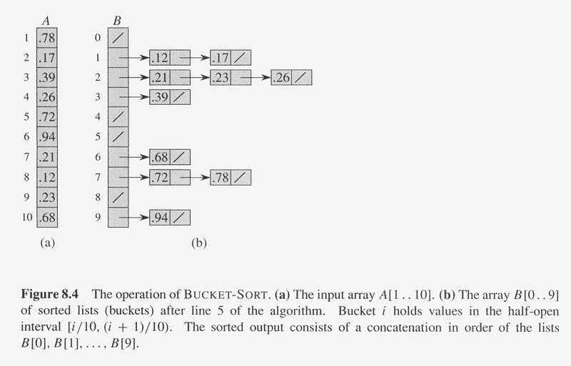
Example of BUCKET-SORT

Slide 18
Analysis of BUCKET-SORT(A)
n ←length[A] Ω(1)
for i ←1 to n O(n)
do insert A[i] into bucket B[⎣nA[i]⎦] Ω(1) (i.e. total O(n))
for i ←0 to n-1 O(n)
do sort bucket B[i] with insertion sort O(n_{i}²) (∑_{i=0}^{n-1} O(n_{i}²))
Concatenate bucket B[0],B[1],…,B[n-1] O(n)
Where n_{i} is the size of bucket B[i].
Thus T(n) = Θ(n) + ∑_{i=0}^{n-1} O(n_{i}²)
= Θ(n) + nO(2-1/n) = Θ(n). Beat Ω(nlg n)

