Slide 1
Number of inversions
Given a sequence of n numbers a₁, a₂,…, a_{i},…, a_{n}, an inversion is a pair of a_{i} and a_{j}, such that i<j but a_{i}>a_{j}.
Ex. 5,1,6,3,4,2
<5, 1> is an inversion, <5,3>, <5,4>, <5,2> are also inversions.
<6,3>, <6,4>, <6,3>, …. <4,2> are all inversions.
In many applications and contests, they are useful.
How to compute the number of inversions?
For each, search the rest to find and count the inversions
Complexity:
O(n²).
Can we do better?
O(nlog(n))
Based on merge sort
USACO 2019 US Open Contest, Gold Problem 3. Balancing Inversions

Slide 2
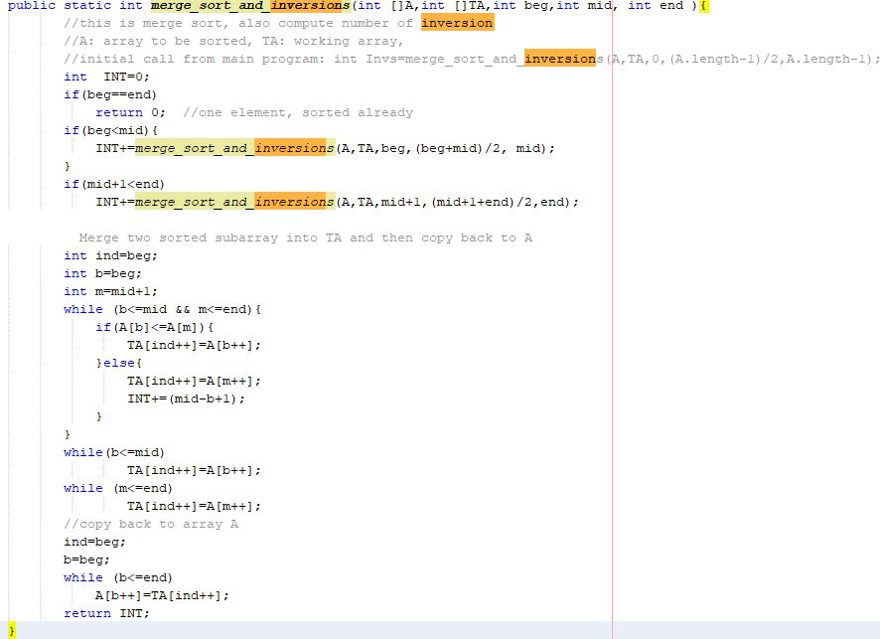
Merge-sort based #inversion

