Slide 1
Ordered Statistic Tree
Given an array of integers with limited range (e.e.g, 0 to 1000000). We need to implement an Order statistic tree using fenwick tree.
It should support four operations: Insert, Delete, Select and Rank. Here n denotes the size of Fenwick tree and q denotes number of queries.
Each query should be one of the following 4 operations.
insertElement(x) – Insert element x into Fenwick tree, with O(log n) worst case time complexity
deleteElement(x) – Delete element x from fenwick tree, with O(log n) worse case time complexity
findKthSmallest(k) – Find the k-th smallest element stored in the tree, with O(log n * log n) worst case time complexity
findRank(x) – Find the rank of element x in the tree, i.e. its index in the sorted list of elements of the tree, with O(log n) time complexity
Notes: previously, we discussed ordered statistic tree using Red-Black tree.
It is a general one without limitation on values of elements.

Slide 2
Main idea
The idea is to create a BIT of size with maximum limit. We insert an element in BIT using it as an index.
When we insert an element x, we increment values of all ancestors of x by 1.
To delete an element, we decrement values of ancestors by 1.
We basically call standard function update() of BIT for both insert and delete.
To find rank, we simply call standard function sum() of BIT.
To find k-th smallest element, we do binary search in BIT.

Slide 3
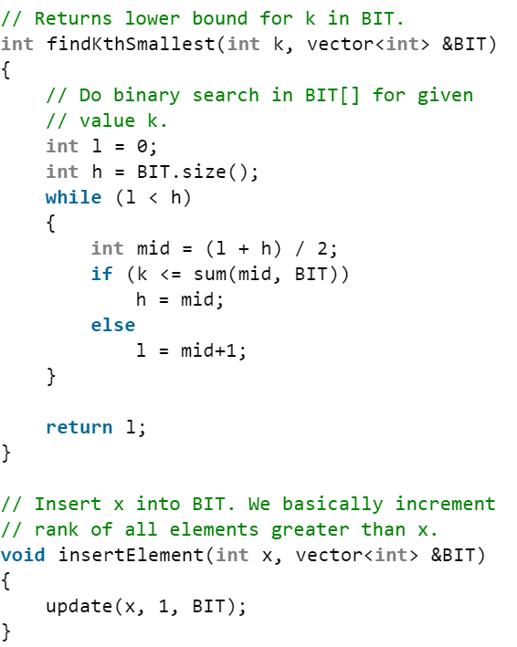
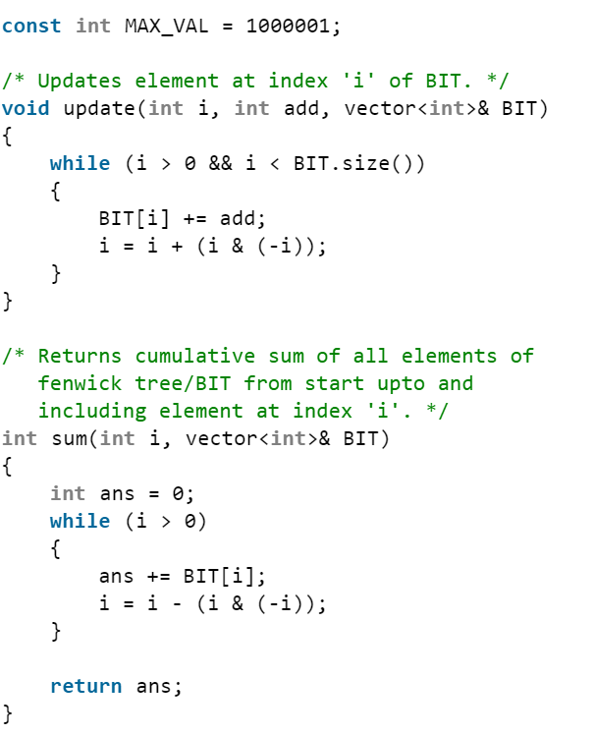

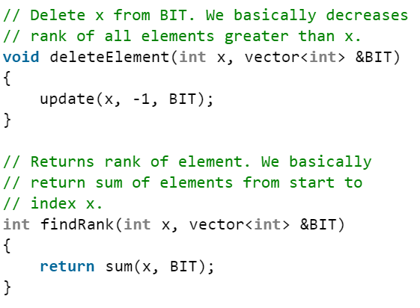
So, O(log²(n))

Slide 4
USACO problems
USACO 2021 Open (April 2021) Golden P1: United Cows of Farmer John

