Slide 1
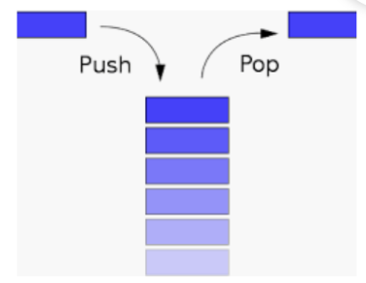
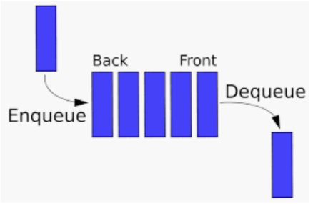
Stack and Queue
LinkedList: add/insert and remove/delete at both ends, i.e., head and tail.
Stack: one of the most important DSs
Very simply
First-in-last out or last-in-first-out
One end is fixed and the other end changes
E.g., whenever pushing an item in, place on top
Whenever, pop an item out, take the one from top
One of the most important applications of stack
Recursive function is implemented by stack.
Every recursive function can be converted into /implemented by using iteration plus a stack.
Queue:
First-in-first-out or last-in-last-out
Both ends move toward to the same direction.
When adding one item, always add at one end
When remove one item, always remove from the other end.

Slide 2
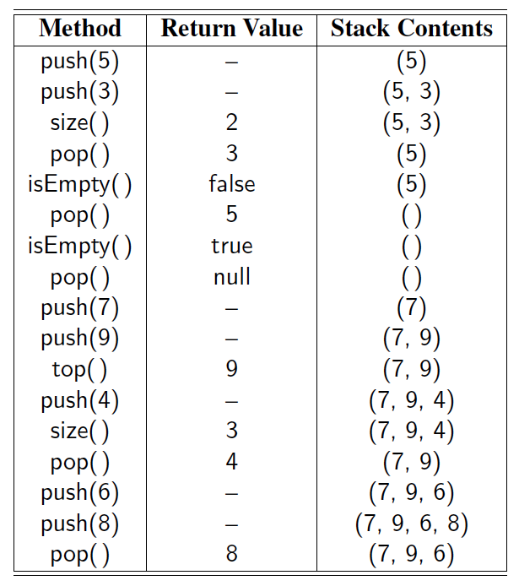
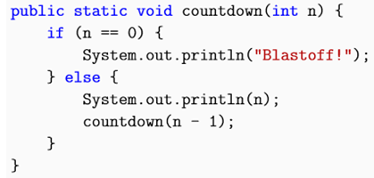
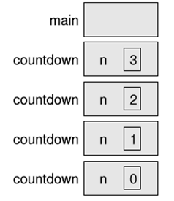
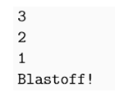
Stack: implementation class
Suppose integer stack
Instance variables:
int s=new int[MAXSIZE]
int top=0;
Methods:
boolean isEmpty()
int size()
void push(int a)
int pop() //remove the top and return its value
Int top() //get and return the value of the top element if exist, but not remove.
In Java: Stack<E> where E is the type of stack elements.
boolean isEmpty()
void push(E e): put e on the top of stack (when not full).
If full, create a new array of large size and copy and push
E pop(): remove and return the top element when not empty, otherwise, return null.
Other methods:
int size()
E top(): return the top element when not empty, otherwise, null.
How to implement an ADT Stack<E> class (by yourself)?
By Array
Pay attention to fix size of array which is the maximum of the stack.
By Linked List. //really easy.
Many languages including Java provide Stack<E> class already.
Applications:
Parenthesis matching (( )(( ))), similarly, html <tag> matching
How about this: ( )(( )){([( )])}
Arithmetic expression evaluation: 14 – 3 * 2 + 7 = (14 – (3 * 2) ) + 7, any idea?
Recursive function is essentially implemented using stack.
Machine cannot directly run recursive function. Compiler help implement recursive function using stack.
For any recursive function, you can (should be able to) convert it into non-recursive function using iteration and stack.
We will see some examples soon, particularly, when learn Tree structure.
Example:

Slide 3
Algorithm on an Example Expression
Slide by Matt Stallmann included with permission.
Operator ≤ has lower precedence than +/–
14 ≤ 4 – 3 * 2 + 7
4
–
14
≤
3
*
$
$
4
–
7
$
14
≤
false
+
-2
+
5
+
14
≤
14
≤
2
2
3
*
3
*
6
4
–
4
–
4
–
-2
+
14
≤
14
≤
14
≤
14
≤

Slide 4
LeetCode: Evaluate Reverse Polish Notation
Evaluate the value of an arithmetic expression in Reverse Polish Notation. (Writing “2 3 +” instead “2+3”.) Valid operators are +, -, *, /. Each operand may be an integer or another expression.
Note:
Division between two integers should truncate toward zero.
The given RPN expression is always valid. That means the expression would always evaluate to a result and there won't be any divide by zero operation.

Slide 5
Evaluate Reverse Polish Notation: Examples
Input: ["4", "2", "1", "+", "-", "3", "*"] Output: 3
Explanation: ((4 - (2 + 1)) * 3) = 3
Input: ["4", "13", "5", "/", "+"] Output: 6
Explanation: (4 + (13 / 5)) = 6

Slide 6
Applications of Stacks
Direct applications
Page-visited history in a Web browser
Undo sequence in a text editor
Chain of method calls in the Java Virtual Machine
Recursive method and its recursive calls are implemented using stack
Indirect applications
Auxiliary data structure for algorithms
Component of other data structures

Slide 7
Queue
Main functions
enqueue(object): inserts an element at the end of the queue
object dequeue(): removes and returns the element at the front of the queue
Auxiliary queue operations:
object first(): returns the element at the front without removing it
int size(): returns the number of elements stored
boolean isEmpty(): indicates whether no elements are stored
Boundary cases:
Attempting the execution of dequeue or first on an empty queue returns null
About enqueue(object)
If using an underlying array and when full,
throws an exception
return false, thus, boolean enqueue(object)
If using linked list, it normally has no full issue, as long as computer memory allocated to the program is still available.

Slide 8
Applications of Queues
Direct applications
Waiting lists, bureaucracy
Access to shared resources (e.g., printer)
Multiprogramming
Indirect applications
Auxiliary data structure for algorithms
Component of other data structures

Slide 9
Stack and queue
How to use stack to implement a queue?
Given stack with push and pop, how to implement enquene and dequeue for a queue?
Two stacks Stack s1, s2;
enqueue(object):
s1.push(object)
object dequeue()
if (s2.isEmpty()) while (!s1.isEmpty()) s2.push(s1.pop());
if (!s2.isEmpty()) s2.pop();
Complexity/running time:
enqueue: O(1) , since only one push which takes constant time
dequeue: O(n), when s2 is empty, where n is the number of items on s1. O(1), in all other times.
Amortized complexity/running time
Consider a sequence of enqueue and dequene operations (assuming n enquene operations)
Consider each of n items which are pushed into the queue
Each item will be pushed into s1, then popped from s1 and pushed into s2 and popped from s2
Thus, total 2 pushes and 2 pops.
All n items will have total 2n pushes and 2n pops among at most 2n enqueue and dequene operations.
Thus, on average, an operation of euqueue or dequene is O(4n/2n)=O(2) (i.e., O(1)).
How to use queue to implement stack?
Given queue with enqueue and dequeue, how to implement push and pop for a stack?
Two queues q1 and q2,
push(object):
q1.enqueue(object)
object pop():
while(q1.size()>1) q2.enqueue(q1.dequeue())
swap names of q1 and q2
If (q2.size()==1) q2.dequeue();
Complexity/running time:
push: O(1), since only one enqueue which takes constant time.
pop: O(n-1) (i.e., O(n)) where n is number of items in q1.
thus, implement a stack using two queues will be inefficient, even though the other direction is efficient.

Slide 10
The issues when implementing queue using array
When implementing a stack using array, only one end moves
But when implementing a queue using array,
both ends move and can move out of the right end of array even though the left end of the array has empty cells.
using the array in a circular manner
i.e., wrapped around.

Slide 11
Array-based Queue
Use an array of size N in a circular fashion
Two variables keep track of the front and size
f index of the front element
sz number of stored elements
When the queue has fewer than N elements, array location r = (f + sz) mod N is the first empty slot past the rear of the queue
normal configuration
Q
0
1
2
f
r
wrapped-around configuration
Q
0
1
2
r
f

Slide 12
Double-ended queue --deque
A more general ADT than both stack and queue
Can perform insertion and deletion from both front and back of the queue, of course, query from both ends too.
efficient—O(1)
In some applications:
Restaurant waiting line :
Normally, first comes (in) and first served (out)
But when a customer is removed from the list and is being taken to a table, and it turns out a table is not available, thus, the customer will need to insert back to the front of the waiting line.
When a customer at the end of the waiting line becomes impatient and asks to leave the line (i.e., removed from the end of the waiting line).
Of course, can be used as either a stack or a queue
In C++, deque class.
In Java, Deque, it is an interface and in java.util package

Slide 13
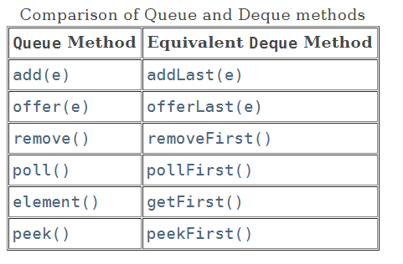
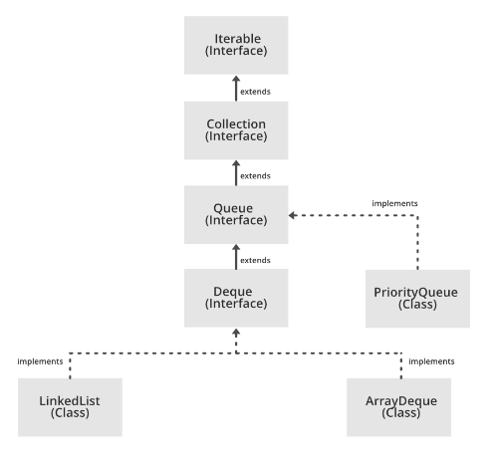
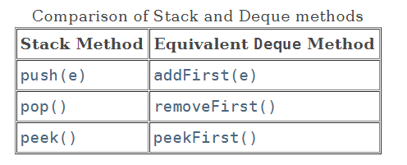
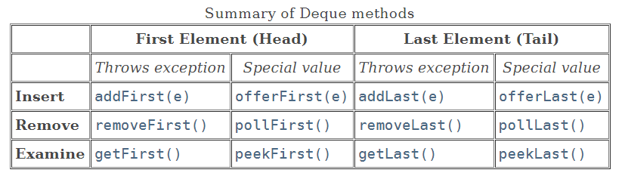
Java Deque
Deque, an interface

Slide 14
Java Deque (Cont.)
ArrayDeque, a class implementing Deque interface.
In java.util package
E.g., Deque<String> dq = new ArrayDeque<String>();
Comparisons:
ArrayList, a class implementing List,
Internally implemented as dynamic array.
Amortized cost or average complexity is O(1) for accessing an element in any index.
normally used as a queue
In order to synchronizing concurrently modification to ArrayList by multiple threads, external codes need to be used.
Vector, similarly as ArrayList, but internally synchronized for multiple threads
LinkedList: a class implementing Deque
Internally implemented as double linked list.
Accessing the ith element needs to go through the list, so O(n).
Can be used as a deque or a queue
E.g., Deque<String> dq = new LinkedList<String>();
PriorityQueue: a class implementing Queue interface.
O(log(n)).

