Slide 1
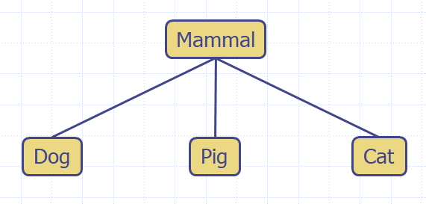
Trees
Linear data structures
Array, linked list, stack, queue
Even two or multiple dimensional arrays
grid-type structure
An important data structure
Non linear but hierarchical.
A recursive data structure
Thus, many tree algorithms can easily be implemented recursively
A special category: binary tree
Binary search tree
Tree representations, algorithms and their complexities.

Slide 2
What is a Tree
In computer science, a tree is an abstract model of a hierarchical structure
A tree consists of nodes with a parent-child relation
Applications:
Organization charts
File systems
Programming environments
Computers”R”Us
Sales
Manufacturing
R&D
US
International
Laptops
Desktops
Europe
Asia
Canada

Slide 3
Tree Terminology
Root: node without parent (A)
Internal node: node with at least one child (A, B, C, F)
External node (a.k.a. leaf ): node without children (E, I, J, K, G, H, D)
Ancestors of a node: parent, grandparent, grand-grandparent, etc.
Depth of a node: number of ancestors
Height of a tree: maximum depth of any node (3)
Descendant of a node: child, grandchild, grand-grandchild, etc.
Subtree: tree consisting of a node and its descendants
A
subtree
B
C
D
E
F
G
H
I
J
K

Slide 4
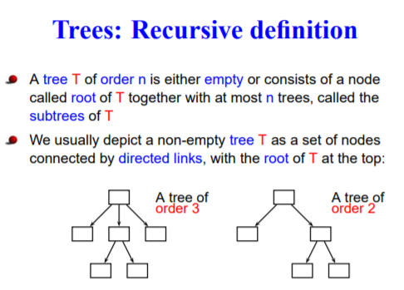

Slide 5
Tree ADT
We use positions to abstract nodes
Generic methods:
integer size()
boolean isEmpty()
Iterable positions()
Accessor methods:
position root()
position parent(p)
Iterable children(p)
Integer numChildren(p)
Query methods:
boolean isInternal(p)
boolean isExternal(p)
boolean isRoot(p)
Additional update methods may be defined by data structures implementing the Tree ADT

Slide 6
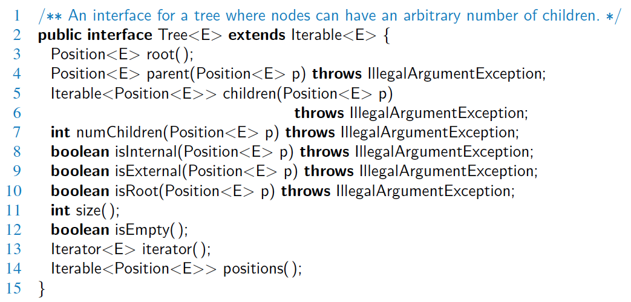
Java Interface
Methods for a Tree interface:

Slide 7
Preorder Traversal
Algorithm preOrder(v)
visit(v)
for each child w of v
preorder (w)
A traversal visits the nodes of a tree in a systematic manner
In a preorder traversal, a node is visited before its descendants
Application: print a structured document
What is its non-recursive traversal?
push v into stack
while stack is not empty
v=pop stack and visit (v)
for each child w of v
push w into stack
1
Its complexity?
O(n)
Make Money Fast!
2
5
9
1. Motivations
2. Methods
References
3
4
6
7
8
1.1 Greed
1.2 Avidity
2.1 Stock Fraud
2.2 Ponzi Scheme
2.3 Bank Robbery

Slide 8
Postorder Traversal
Algorithm postOrder(v)
for each child w of v
postOrder (w)
visit(v)
In a postorder traversal, a node is visited after its descendants
Application: compute space used by files in a directory and its subdirectories
9
cs16/
8
3
7
homeworks/
programs/
todo.txt 1K
1
2
4
5
6
h1c.doc 3K
h1nc.doc 2K
DDR.java 10K
Stocks.java 25K
Robot.java 20K

Slide 9
Binary Trees
A binary tree is a tree with the following properties:
Each internal node has at most two children (exactly two for proper binary trees)
The children of a node are an ordered pair
We call the children of an internal node left child and right child
Alternative recursive definition: a binary tree is either
a tree consisting of a single node, or
a tree whose root has an ordered pair of children, each of which is a binary tree
Applications:
arithmetic expressions
decision processes
searching
A
B
C
D
E
F
G
H
I

Slide 10
Arithmetic Expression Tree
Binary tree associated with an arithmetic expression
internal nodes: operators
external nodes: operands
Example: arithmetic expression tree for the expression (2 × (a − 1) + (3 × b))
+
×
×
2
−
3
b
a
1

Slide 11
Decision Tree
Binary tree associated with a decision process
internal nodes: questions with yes/no answer
external nodes: decisions
Example: dining decision
Want a fast meal?
Yes
No
How about coffee?
On expense account?
Yes
No
Yes
No
Starbucks
Chipotle
Gracie’s
Café Paragon

Slide 12
Properties of Proper Binary Trees
Notation
n number of nodes
e number of external nodes
i number of internal nodes
h height
Properties:
e = i + 1
n = 2e − 1
h ≤ i
h ≤ (n − 1)/2
e ≤ 2^{h}
h ≥ log₂ e
h ≥ log₂ (n + 1) − 1

Slide 13
BinaryTree ADT
The BinaryTree ADT extends the Tree ADT, i.e., it inherits all the methods of the Tree ADT
Additional methods:
position left(p)
position right(p)
position sibling(p)
The above methods return null when there is no left, right, or sibling of p, respectively
Update methods may be defined by data structures implementing the BinaryTree ADT

Slide 14
Inorder Traversal
In an inorder traversal a node is visited after its left subtree and before its right subtree
Application: draw a binary tree
x(v) = inorder rank of v
y(v) = depth of v
Algorithm inOrder(v)
if left (v) ≠ null
inOrder (left (v))
visit(v)
if right(v) ≠ null
inOrder (right (v))
6
2
8
1
4
7
9
3
5

Slide 15
Three traversals relationship
Given the preorder traversal node sequence and the postorder traversal node sequence, can the binary tree be uniquely determined?
Given the preorder traversal node sequence and the inorder traversal node sequence, can the binary tree be uniquely determined?
How about postorder and inorder?
NO!
YES!
YES!

Slide 16
Print Arithmetic Expressions
Specialization of an inorder traversal
print operand or operator when visiting node
print “(“ before traversing left subtree
print “)“ after traversing right subtree
Algorithm printExpression(v)
if left (v) ≠ null print(“(’’)
inOrder (left(v))
print(v.element ())
if right(v) ≠ null
inOrder (right(v))
print (“)’’)
+
×
×
2
−
3
b
((2 × (a − 1)) + (3 × b))
a
1

Slide 17
Evaluate Arithmetic Expressions
Specialization of a postorder traversal
recursive method returning the value of a subtree
when visiting an internal node, combine the values of the subtrees
Algorithm evalExpr(v)
if isExternal (v)
return v.element ()
else
x ← evalExpr(left(v))
y ← evalExpr(right(v))
◊ ← operator stored at v
return x ◊ y
+
×
×
2
−
3
2
5
1

Slide 18
Linked Structure for Trees
A node is represented by an object storing
Element
Parent node
Sequence of children nodes
Node objects implement the Position ADT
∅
B
∅
∅
A
D
F
B
A
D
F
C
E
∅
∅
C
E

Slide 19
Linked Structure for Binary Trees
A node is represented by an object storing
Element
Parent node
Left child node
Right child node
Node objects implement the Position ADT
∅
B
∅
∅
B
A
D
A
D
∅
∅
∅
∅
C
E
C
E

Slide 20
Array-Based Representation of Binary Trees
Nodes are stored in an array A
0
A
A
B
D
…
G
H
…
1
2
0
1
2
9
10
B
D
Node v is stored at A[rank(v)]
rank(root) = 0
if node is the left child of parent(node), rank(node) = 2 ⋅ rank(parent(node)) + 1
if node is the right child of parent(node), rank(node) = 2 ⋅ rank(parent(node)) + 2
3
4
5
6
E
F
C
J
9
10
G
H

