Slide 1
Augmenting data structures
Augment an existing data structure to apply to a new problem.
Red-black tree as an example.

Slide 2
Dynamic order statistic (ith element)
Chapter 9, O(n) algorithm
Red-black tree gives a total order via inorder traversal, i.e., reflecting the rank of an element.
  Two additional operations:
    Find ith smallest element.
    Find the rank of an element.
How to modify it?
Add a field, size in every node, i.e., size[x] is the size of the subtree
rooted at x, including x.
So assume sentinel’s size size[NIL]=0, then,
size[x]=size[left[x]]+size[right[x]]+1.
If so, easy to find the ith element, or the rank of an element in log(n) time.
(page 304, 305).
How to maintain size field during insertion or deletion?

Slide 3
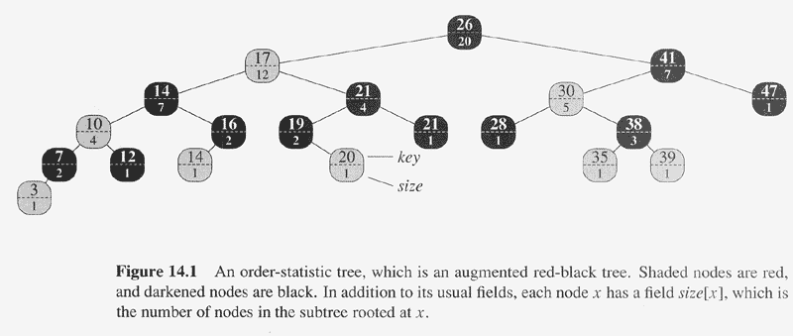
Copyright © The McGraw-Hill Companies, Inc. Permission required for reproduction or display.

Slide 4
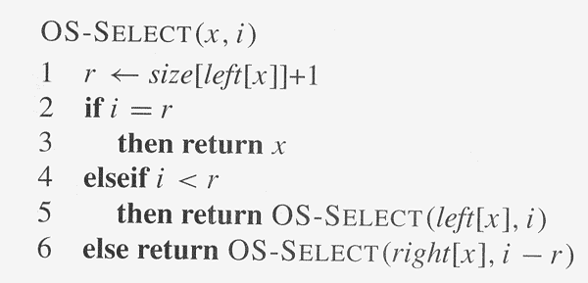
Copyright © The McGraw-Hill Companies, Inc. Permission required for reproduction or display.

Slide 5
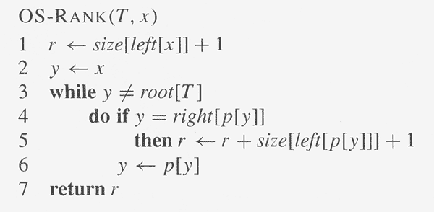
Copyright © The McGraw-Hill Companies, Inc. Permission required for reproduction or display.
Loop invariant: at start of each iteration, r is the rank of key[x] in the subtree rooted at y.

Slide 6
Insertion operation
Same two passes:
  Insert x into tree, by going down, increase size by 1 for each node visited.
  Modify the color and rotation by going up.
    Only the rotation will affect the size of some nodes,
    Fortunately, local modification.
Same for deletion operation.

Slide 7
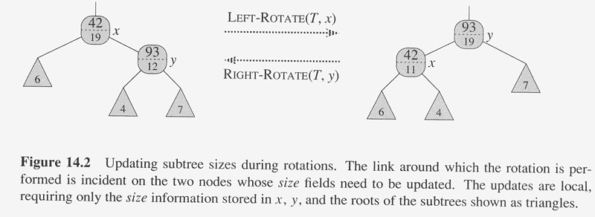
Copyright © The McGraw-Hill Companies, Inc. Permission required for reproduction or display.
How to modify the size field of left-rotation:
size[y]=size[x],
size[x]=size[left[x]]+size[left[y]]+1.

Slide 8
How to augment a data structure
Choosing an underlying DS
Determining additional information to be maintained in the underlying DS
Verifying that the additional information can be maintained for the basic modification operations on the underlying DS
Developing new operations

Slide 9
Augmenting a red-black tree
Theorem 14.1 (page 309):
  Let f be a field that augments a red-black tree T of n nodes, and suppose the f of a node x can be computed using only the information in node x, left[x], right[x], including f[left[x]] and f[right[x]]. Then we can maintain all values of f in all nodes during insertion and deletion without asymptotically affecting the O(log(n)).

Slide 10
Interval tree: dynamic set of intervals
Intervals
Closed intervals, open intervals, half-intervals.
New operations:
  INTERVAL-INSERT(T,x), x=[t1,t2].
  INTERVAL-DELETE(T,x), x=[t1,t2].
  INTERVAL-SEARCH(T,i), return a pointer x such that the interval of x overlaps with i.

Slide 11
How to implement?
Select a underlying DS, red-back tree
  The node x contains interval int[x], and the low[int[x]] is the node’s key.
Additional information: max
Maintain the information:
  max[x]=max(high[int[x]],max[left[x]],max[right[x]]).
  By Theorem 14.1, can be done in log(n).
Implementation of INTERVAL-SEARCH.

Slide 12
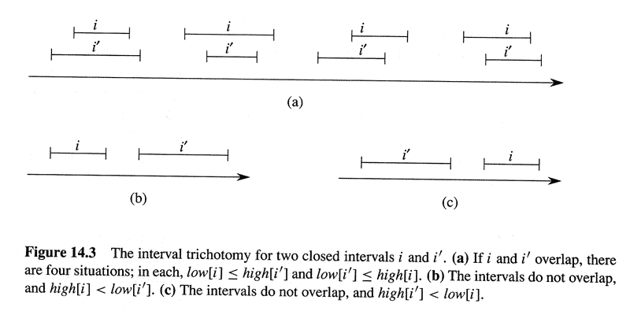
Copyright © The McGraw-Hill Companies, Inc. Permission required for reproduction or display.

Slide 13
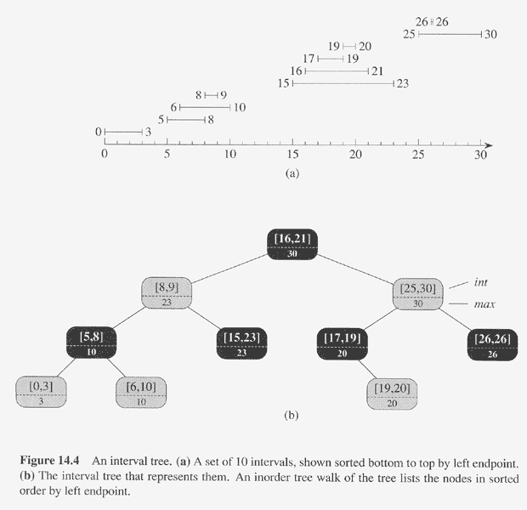
Copyright © The McGraw-Hill Companies, Inc. Permission required for reproduction or display.

Slide 14
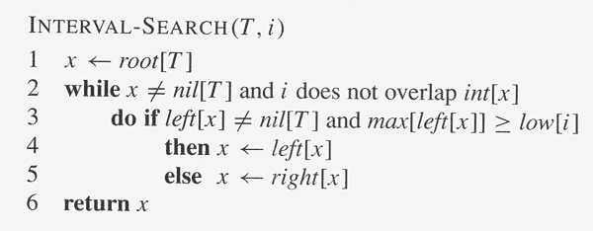
Copyright © The McGraw-Hill Companies, Inc. Permission required for reproduction or display.
If go to right, then safe since there is no interval in the left overlapping with i.
If go to left, either there is an interval in the left overlapping with I or there is
no overlaps. In the latter, we can prove that there will also be no overlaps
in the right.

Slide 15
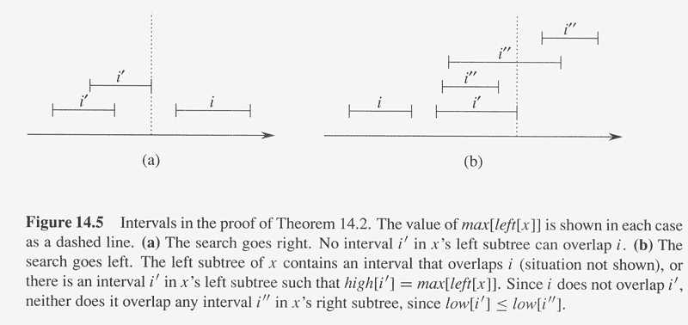
Copyright © The McGraw-Hill Companies, Inc. Permission required for reproduction or display.

Slide 16
USACO problems
USACO 2021 Open (April 2021) Golden P1: United Cows of Farmer John using ordered statistic tree

