Slide 1
Cyclistic_Report
File created on: 4/9/2022 10:53:42 PM

Slide 2
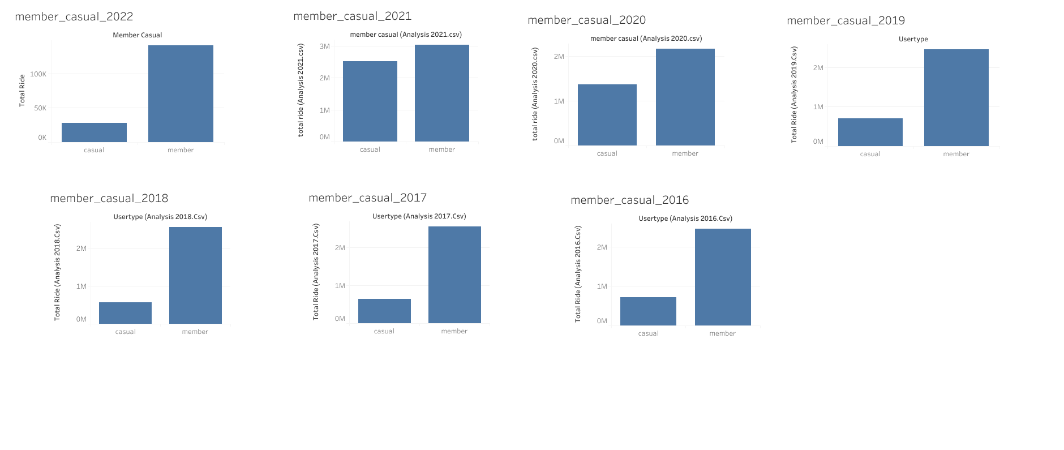

Slide 3
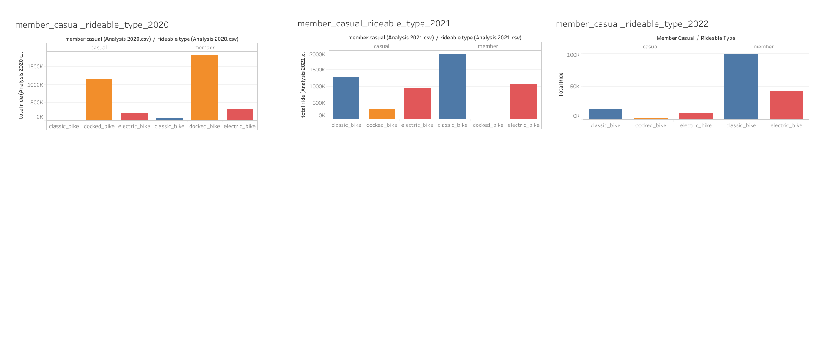

Slide 4
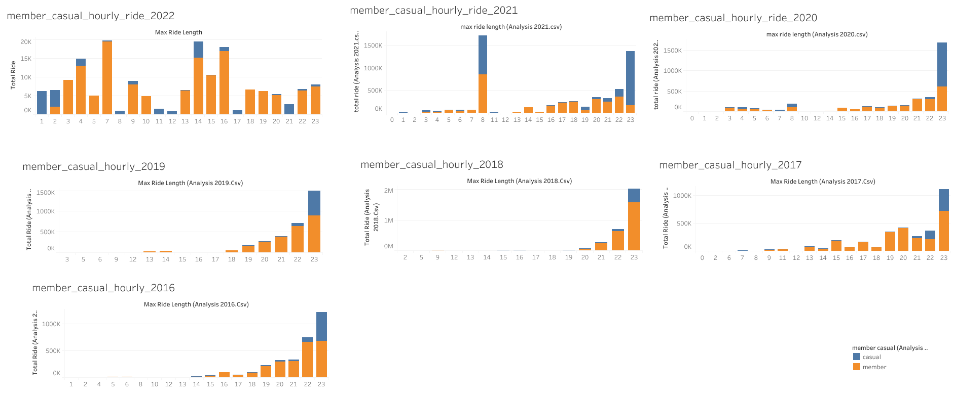

Slide 5
