Slide 1
DATA SCIENCE CAPSTONE · EDA & PREDICTIVE MODELING
YouTube Trending
Video Analytics
Uncovering what drives a video to trend — and forecasting what happens next
161,470 videos analyzed · 55,886 clean records · 3 predictive models
01 / 15

Slide 2
PROJECT OVERVIEW
Why YouTube trending data?
1
The Question
What separates a trending video from the millions that never break through — and can we predict it?
PIPELINE AT A GLANCE
1
Import & Load CSV
2
The Data
Daily Kaggle trending-video snapshots: titles, tags, timing, channel history, and engagement metrics.
2
Clean & Engineer Features
3
Exploratory Data Analysis
3
The Approach
Clean & engineer features → explore patterns visually → train regression models → forecast trending volume.
4
Model A: Predict Views
4
The Outcome
5
Model B: Forecast Volume
A view-prediction model, a ranked list of the features that matter most, and a short-term trending forecast.
02 / 15

Slide 3
THE DATASET
Dataset at a glance
161,470
19
55,886
18
Raw trending records
Original columns
Clean rows after dedup
Video categories
Median video: ~96,000 views · median 1 day to trend · 16.7 tags avg. · 60-char titles avg.
KEY RAW FIELDS
• video_id
• trending_date
• title
• channel_title
• category_id
• publish_date
• tags
• views
• likes
• dislikes
• comment_count
• comments_disabled
03 / 15

Slide 4
PREPARATION
Cleaning & feature engineering
CLEANING STEPS
Sort by trending_date, drop duplicate video_id (keep first)
DERIVED SIGNALS
log_views
Drop rows missing publish_date or trending_date
log10(views) — tames extreme skew for modeling
Keep only videos with views > 0
like_dislike_ratio
Clip likes / dislikes / comment_count to ≥ 0
likes / dislikes (0 replaced with 1)
channel_video_count
ENGINEERED FEATURES
how often a channel has trended
tags_count · title_length
channel_tier (1–5)
days_to_trend (clipped 0–60)
quintile rank of channel activity
publish_hour · publish_dow
engagement_rate = (likes+comments)/views
04 / 15

Slide 5
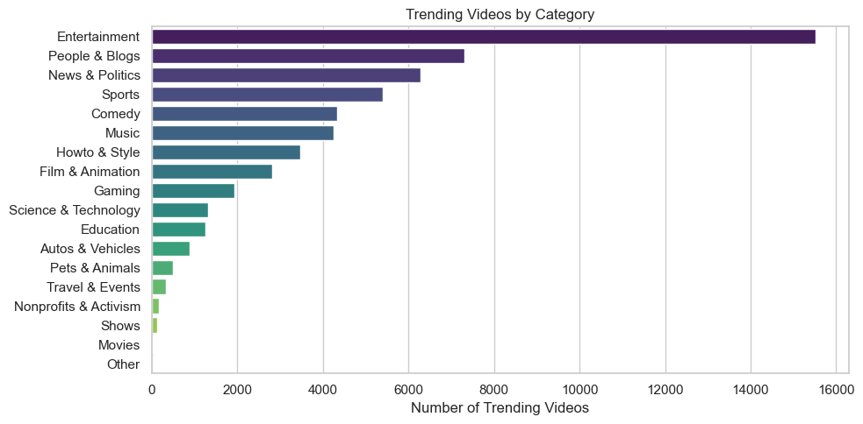
EXPLORATORY ANALYSIS
Which categories trend most often?
05 / 15
Entertainment, Music, and Howto & Style dominate trending volume across the sample.

Slide 6
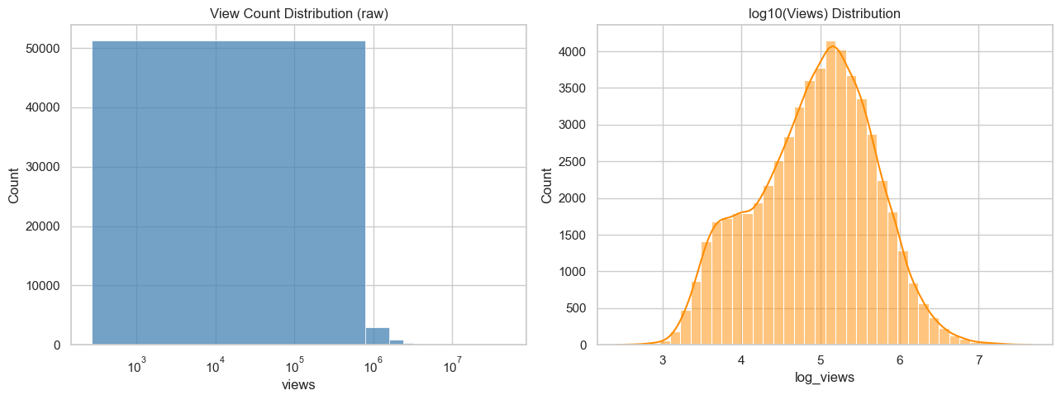
EXPLORATORY ANALYSIS
View counts are heavily right-skewed
Raw views span orders of magnitude; log10(views) is far closer to a normal distribution — the reason it's used as the model target.
06 / 15

Slide 7
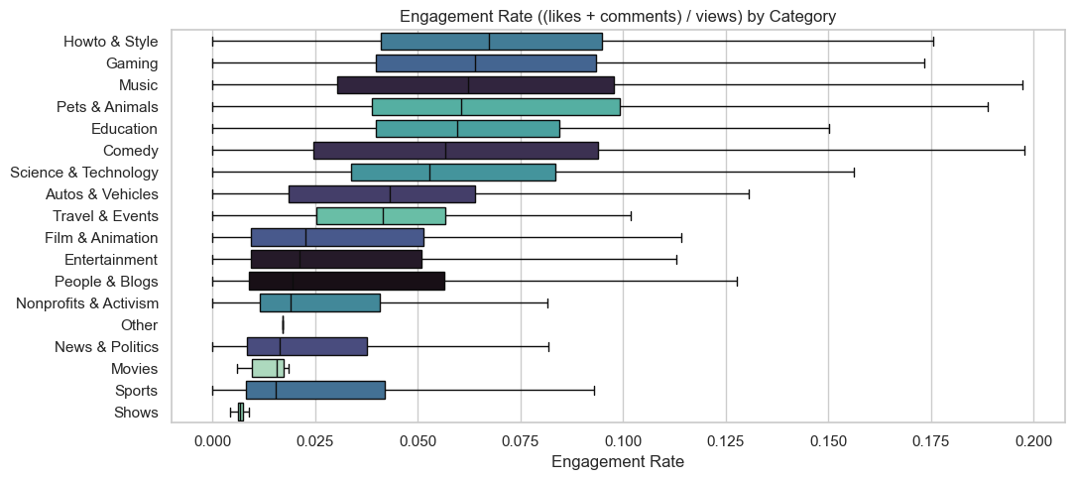
EXPLORATORY ANALYSIS
Engagement varies sharply by category
(likes + comments) / views differs widely across categories — some genres inspire far more interaction per view than others.
07 / 15

Slide 8
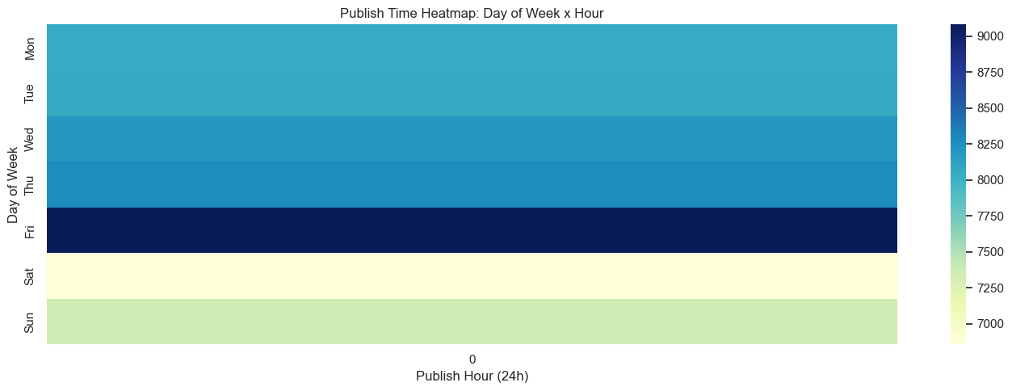
EXPLORATORY ANALYSIS
When do trending videos get published?
Clear clustering around weekday daytime and early-evening publish hours, with a lighter footprint on weekends.
08 / 15

Slide 9
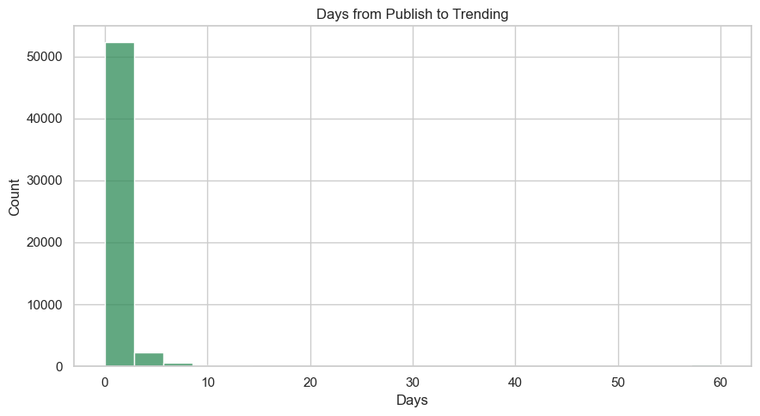
EXPLORATORY ANALYSIS
How fast does a video reach trending?
1 day
Median time to trend
1.65 days
Average time to trend
60 days
Maximum observed
Most videos trend within a day of publishing — a long tail stretches out to 60 days, the clipping ceiling applied during cleaning.
09 / 15

Slide 10
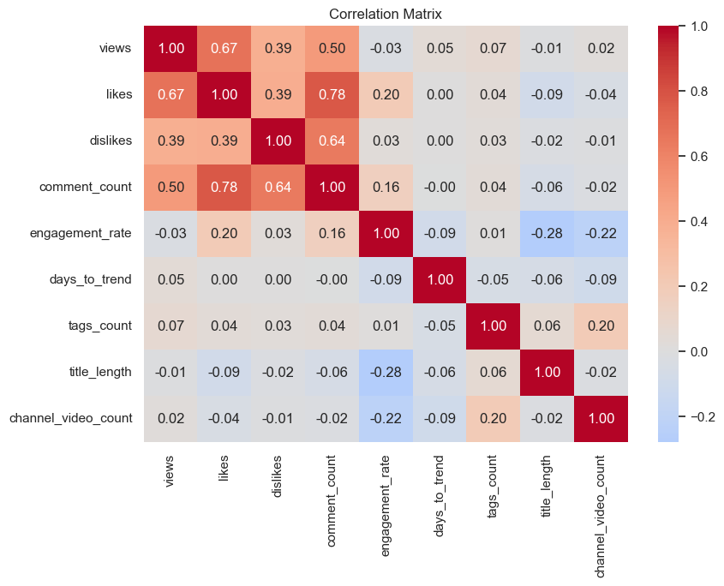
EXPLORATORY ANALYSIS
How do numeric features relate?
10 / 15
Likes, comments, and engagement rate move together; days_to_trend and title_length show only weak links to raw performance.

Slide 11
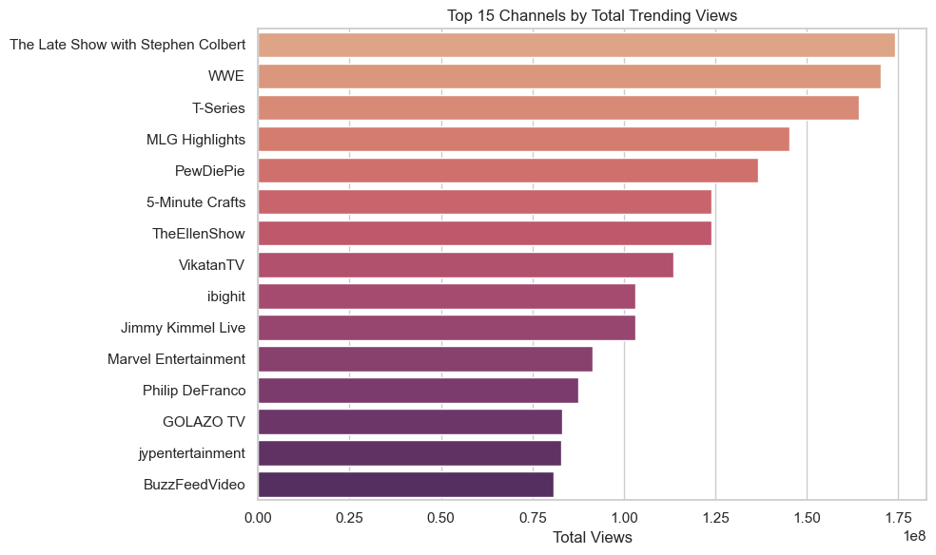
EXPLORATORY ANALYSIS
The top 15 channels by trending views
A small set of high-frequency channels account for a disproportionate share of total trending views.
11 / 15

Slide 12
PREDICTIVE MODELING · MODEL A
Predicting a video's view count
MODELS COMPARED
SETUP
M1
Linear Regression
Target
A transparent baseline for comparison
log10(views) — stabilizes the heavy right skew
Features
M2
Random Forest Regressor
title_length, tags_count, channel_tier, publish_hour, publish_dow, category, comments_disabled, ratings_disabled
300 trees, max depth 12 — captures non-linear interactions
Encoding
One-hot encoding for category via ColumnTransformer
M3
Gradient Boosting Regressor
300 stages, depth 3, learning rate 0.05
Split
80% train / 20% test, random_state = 42
12 / 15

Slide 13
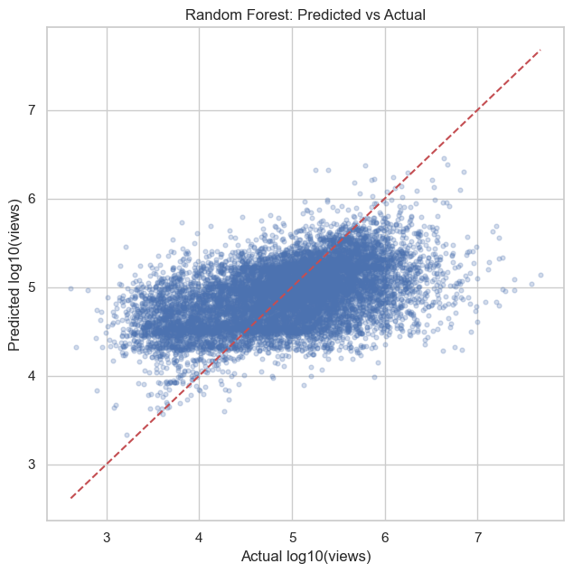
PREDICTIVE MODELING · RESULTS
Random Forest wins on test data
Model | RMSE (log10 views) | MAE | R²
Random Forest | 0.644 | 0.506 | 0.250
Gradient Boosting | 0.671 | 0.535 | 0.187
Linear Regression | 0.699 | 0.564 | 0.118
Random Forest gives the lowest error and explains the largest share of variance, though the moderate R² (0.25) shows view counts still carry a lot of unpredictable, timing-driven randomness.
Predicted vs. actual log-views on the held-out test set
13 / 15

Slide 14
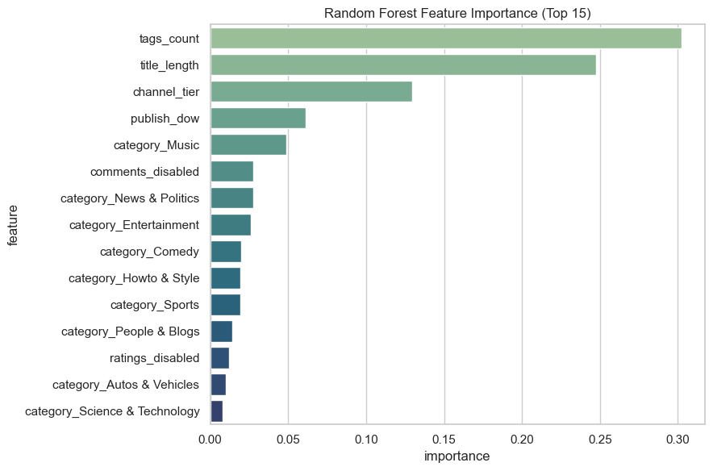
PREDICTIVE MODELING · INSIGHTS
What actually drives a video's views?
READING THE RANKING
Category (one-hot) dominates — what a video is about matters more than any single metadata field.
Channel tier and publish timing (hour, day-of-week) contribute meaningfully.
Title length and tag count add only marginal predictive lift on their own.
14 / 15

Slide 15
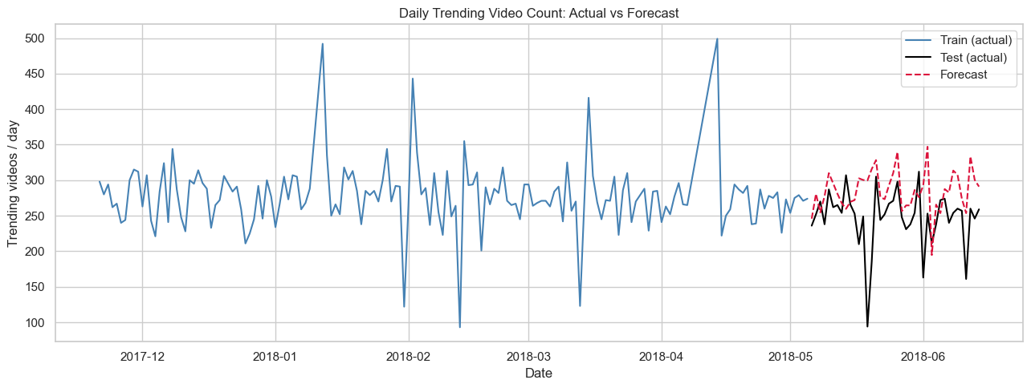
MODEL B · FORECASTING & TAKEAWAYS
Forecasting daily trending volume
KEY TAKEAWAYS
1
Category and channel history predict views far better than surface metadata like title length.
2
Random Forest is the strongest of three models tested, but moderate R² confirms virality has real randomness.
Gradient Boosting on lag features (1/2/3/7-day) + 7-day rolling mean · RMSE 59.4 · MAE 44.2 videos/day
3
Most videos trend within a single day of publishing, rewarding fast, well-timed release windows.
4
Daily trending-slot volume is forecastable from recent history — useful for content and campaign planning.
Thank you
15 / 15

