Slide 1
DATA SCIENCE • INDIVIDUAL PROJECT
Predicting Employee Attrition
A Machine Learning Approach to Understanding & Forecasting Workforce Turnover
Name : Ankul Raghav Email : ankulraghav283204@gmail.com
1,470
35
2
Employees
Original Features
ML Models Compared

Slide 2
INTRODUCTION
Project Objective & Problem Statement
Why Attrition Matters
Project Goal
Employee turnover is costly — recruitment, onboarding, and lost productivity add up fast.
Organizations need to identify at-risk employees before they resign, not after.
A predictive model turns HR data into an early-warning system for retention teams.
Build and compare classification models that predict whether an employee will leave the company (Attrition = Yes/No), using demographic, job, and satisfaction data — then interpret which factors drive the decision to leave.
1
Explore & clean the data
2
Engineer & encode features
3
Train ML models
4
Evaluate & explain results
2

Slide 3
THE DATA
Dataset Overview
1,470
35
16.1%
0
Employee Records
Original Columns
Attrition Rate
Missing Values
Source: IBM HR Analytics Employee Attrition & Performance dataset (WA_Fn-UseC_-HR-Employee-Attrition.csv)
Feature Categories
Demographics: Age, Gender, Marital Status, Distance From Home
Job Details: Department, Job Role, Job Level, Business Travel
Compensation: Monthly Income, Daily/Hourly Rate, Salary Hike %
Satisfaction: Job / Environment / Relationship Satisfaction, Work-Life Balance
Tenure: Years at Company, in Current Role, Since Last Promotion
Engagement: Job Involvement, Training Times, Stock Option Level
3

Slide 4
PREPROCESSING
Data Cleaning & Preparation
Quality Checks
Result
Missing values — None found across all 35 columns
1,470 × 31
Duplicate rows — 0 duplicates detected
rows × columns
Columns Removed (non-informative)
EmployeeCount — constant value (always 1)
A clean dataset with 4 fewer columns, ready for exploratory analysis and encoding — no imputation was needed since there were zero missing values.
Over18 — constant value (always Y)
StandardHours — constant value (always 80)
EmployeeNumber — unique ID, no predictive signal
4

Slide 5
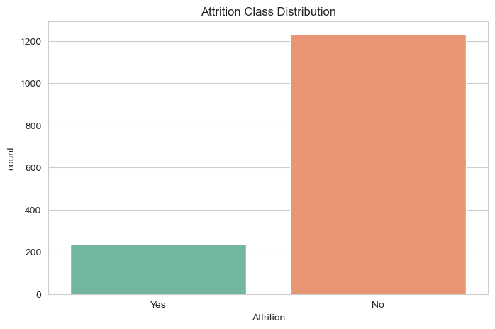
EXPLORATORY DATA ANALYSIS
Target Variable: Attrition Distribution
Class Imbalance
83.9%
16.1%
Stayed
(1,233 employees)
Left
(237 employees)
The dataset is imbalanced — only about 1 in 6 employees left. This motivates using class_weight="balanced" during training so the minority (Left) class isn't ignored by the models.
5

Slide 6
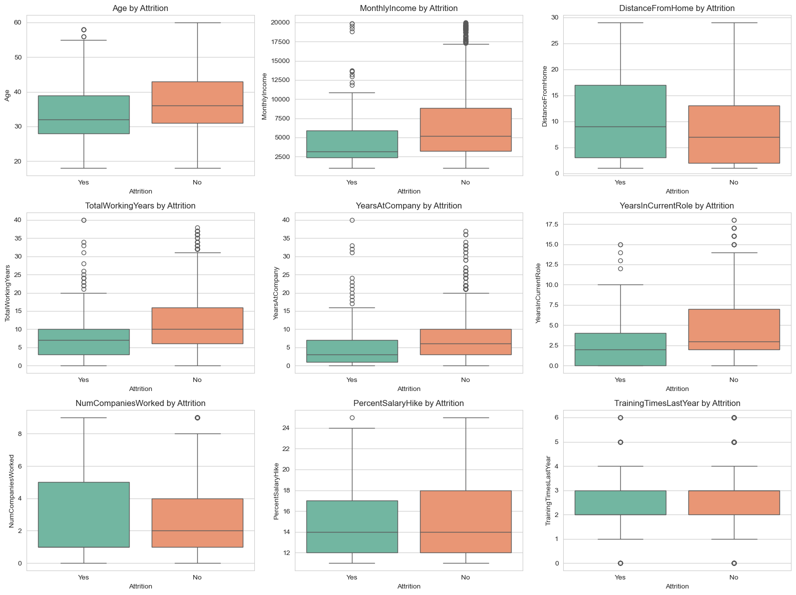
EXPLORATORY DATA ANALYSIS
Numeric Features vs. Attrition
Younger, shorter-tenured employees
show higher attrition (lower Age, YearsAtCompany, TotalWorkingYears).
Frequent job-hopping & low income
correlate with leaving — note NumCompaniesWorked and MonthlyIncome spread.
6

Slide 7
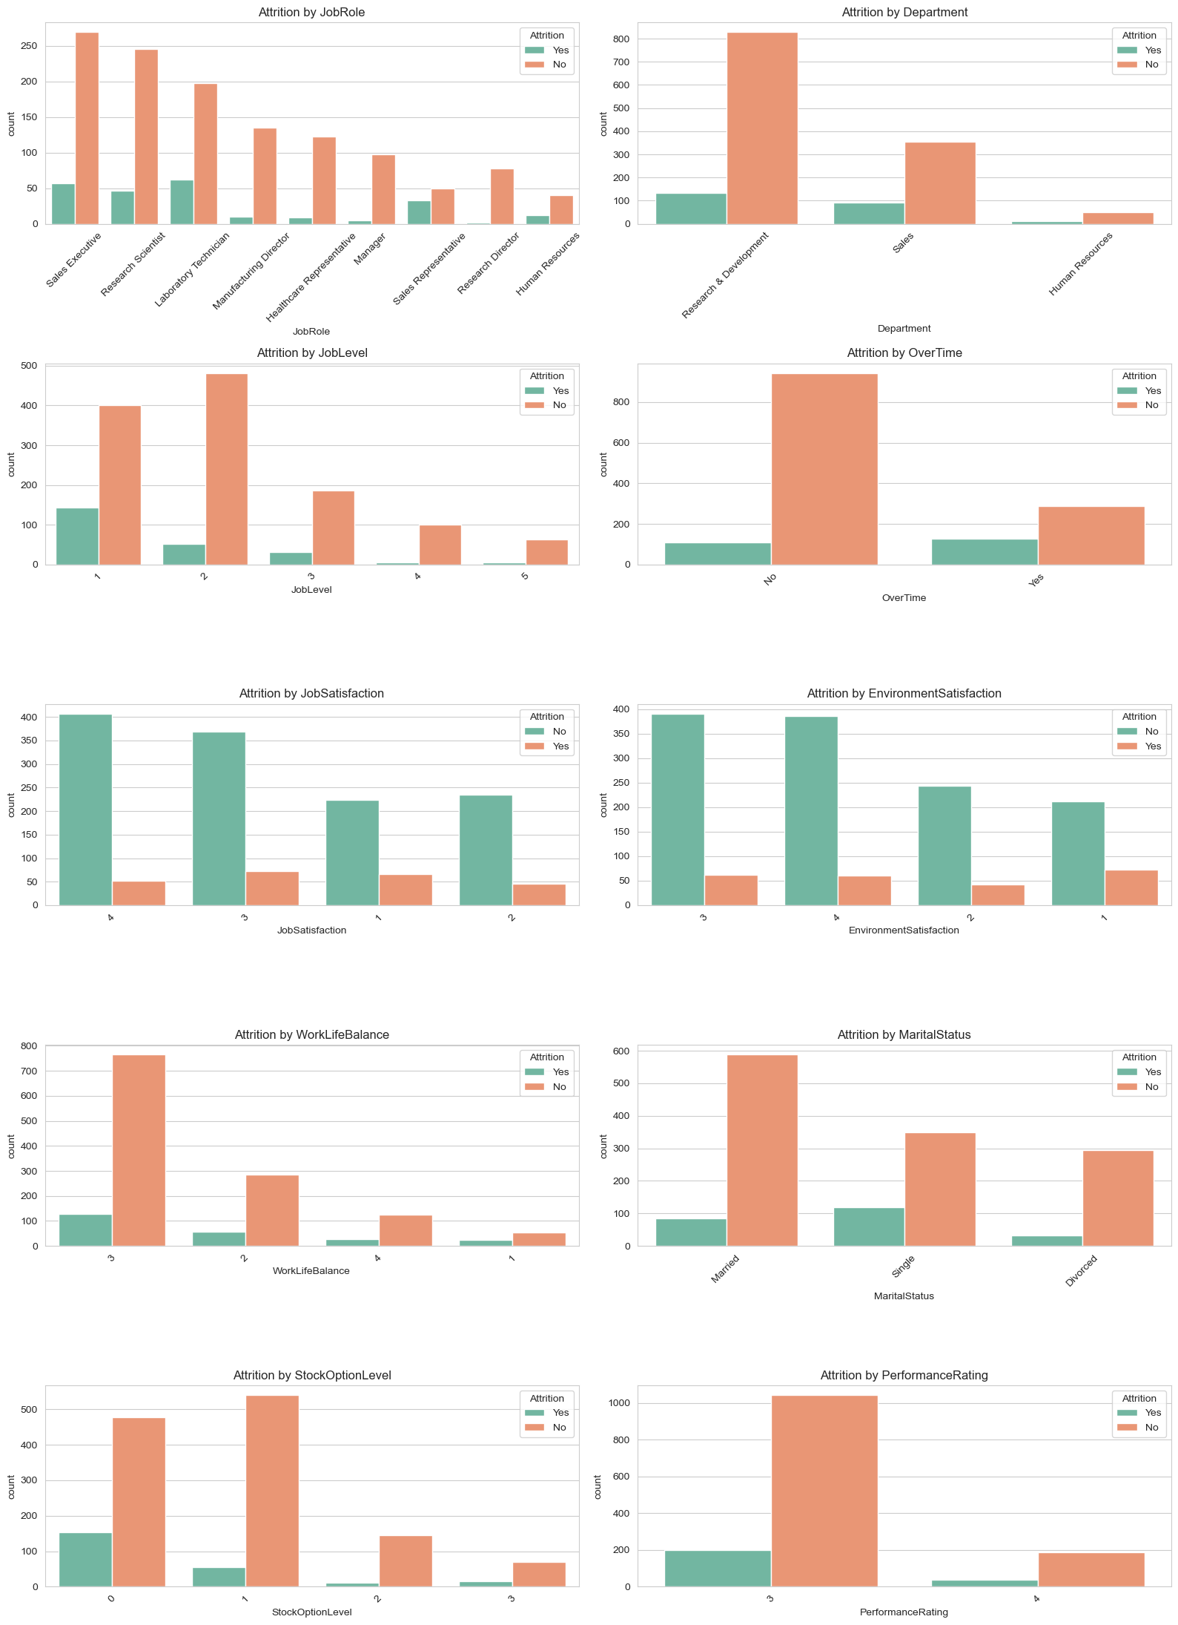
EXPLORATORY DATA ANALYSIS
Categorical Features vs. Attrition
OverTime
Job Role
Employees working overtime leave at a much higher rate.
Sales Reps & Lab Technicians show the highest attrition shares.
Marital Status
Job Satisfaction
Single employees leave more often than married/divorced.
Low satisfaction scores (1–2) skew heavily toward leaving.
Work-Life Balance
Stock Option Level
Poor balance ratings align with higher turnover.
Employees with 0 stock options leave more frequently.
7

Slide 8
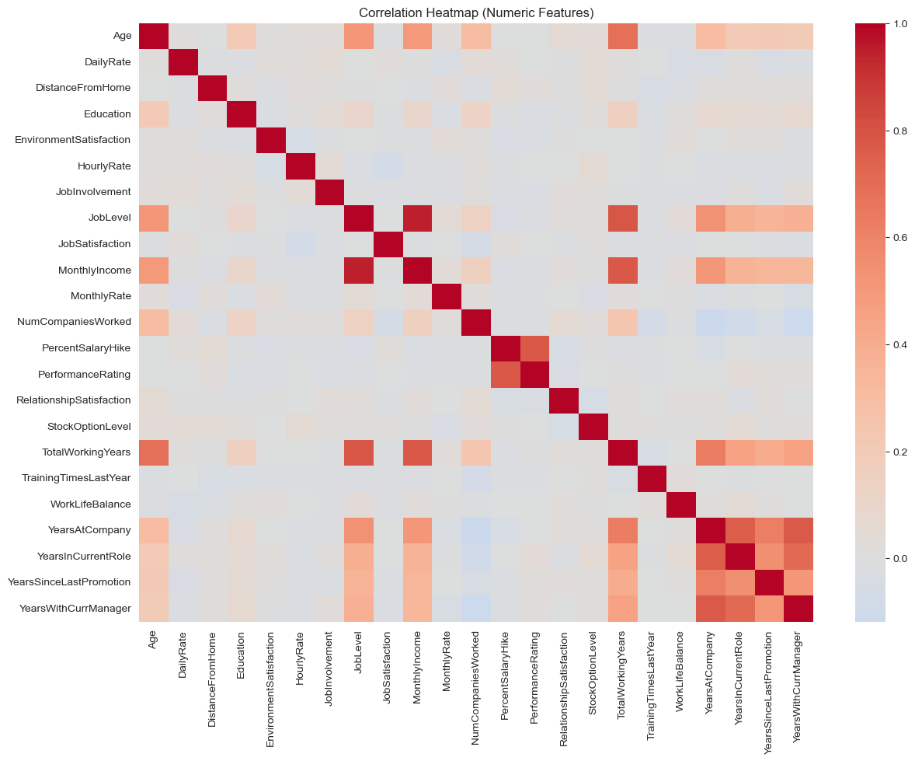
EXPLORATORY DATA ANALYSIS
Correlation Heatmap (Numeric Features)
Reading the Map
Strong positive correlations
between tenure fields: YearsAtCompany, YearsInCurrentRole, YearsWithCurrManager.
JobLevel & MonthlyIncome
are highly correlated, as expected from pay-grade structure.
Most features show low multicollinearity,
supporting their combined use in modeling.
8

Slide 9
FEATURE ENGINEERING
Encoding Categorical Features
31 Columns
Encode
45 Columns
Cleaned dataset
(numeric + categorical)
Attrition → 0/1 flag
One-hot encode categoricals
(drop_first = True)
Fully numeric,
model-ready feature set
Target definition: Attrition_Flag = 1 if the employee left ("Yes"), else 0. Encoding:
pd.get_dummies() with drop_first=True on all object-type columns (JobRole, Department, MaritalStatus, OverTime, etc.) to avoid the dummy-variable trap.
9

Slide 10
MODELING APPROACH
Train/Test Split, Scaling & Model Choice
80 / 20 Split
Feature Scaling
Class Balancing
Stratified train_test_split on Attrition_Flag preserves the 16% attrition ratio in both sets (random_state=42).
StandardScaler standardizes features for Logistic Regression; Random Forest uses unscaled data (tree-based, scale-invariant).
class_weight="balanced" applied to both models to counter the 84/16 imbalance in the target.
Models Trained
Logistic Regression — max_iter=1000 · class_weight=balanced · scaled features
Random Forest — n_estimators=300 · max_depth=8 · class_weight=balanced · unscaled features
10

Slide 11
RESULTS
Model Evaluation: Performance Metrics
Metric | Logistic Regression | Random Forest
Accuracy | 0.752 | 0.830
Precision | 0.345 | 0.421
Recall | 0.617 | 0.170
F1-score | 0.443 | 0.242
ROC-AUC | 0.798 | 0.769
How to Read This
Random Forest wins on accuracy
but misses most leavers (recall 0.17) — it's biased toward the majority class.
Logistic Regression finds more leavers
(recall 0.617, ROC-AUC 0.798) — better suited when missing a leaver is costly.
For an HR retention use case, recall on the “Left” class matters more than raw accuracy — the cost of missing a real flight-risk employee outweighs a false alarm.
11

Slide 12
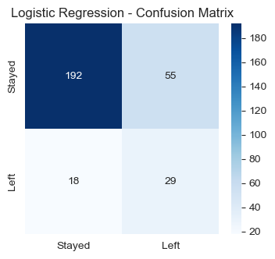
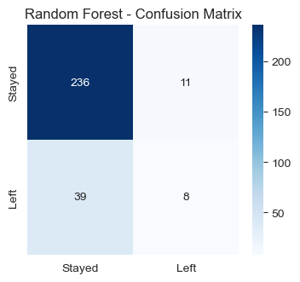
RESULTS
Confusion Matrix Comparison
Logistic Regression
Random Forest
Logistic Regression catches far more true “Left” cases, at the cost of more false alarms; Random Forest is conservative and misses most leavers.
12

Slide 13
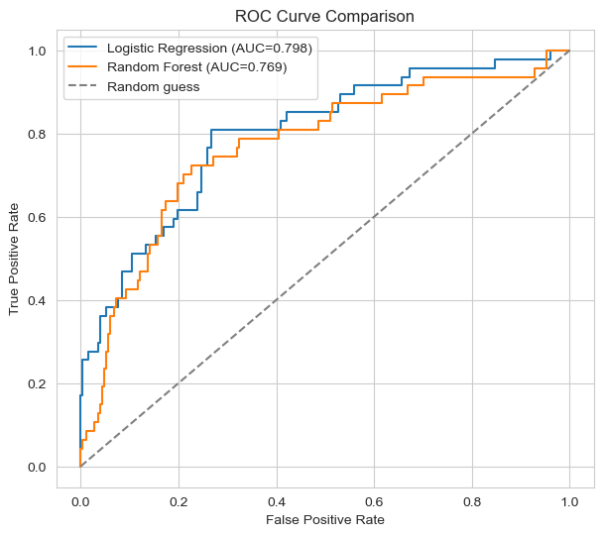
RESULTS
ROC Curve Comparison
AUC Scores
0.798
Logistic Regression
0.769
Random Forest
Both models separate the classes far better than random guessing (the dashed diagonal). Logistic Regression has the edge in overall ranking ability.
13

Slide 14
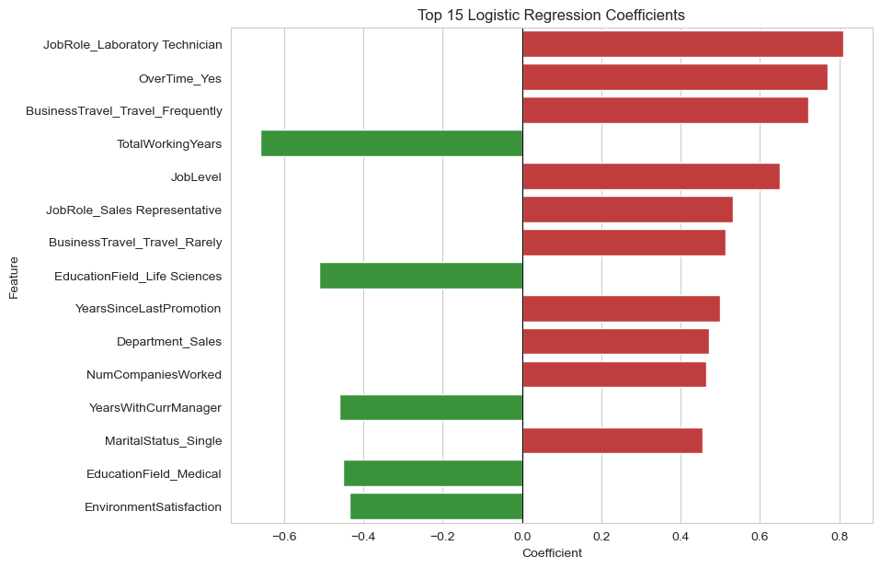
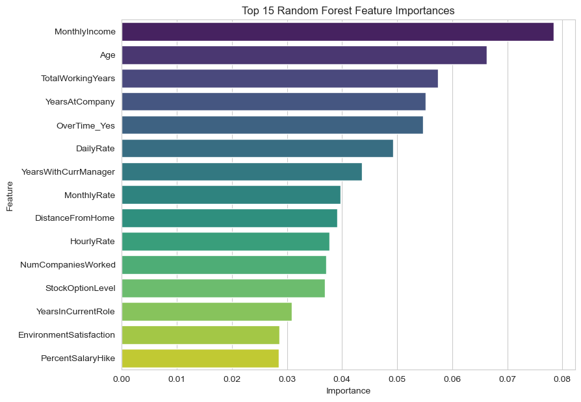
EXPLAINABILITY
What Drives Attrition? Feature Importance
Logistic Regression Coefficients
Random Forest Importance
Both models agree: OverTime, low job/environment satisfaction, and short tenure are the strongest signals of attrition risk.
14

Slide 15
CONCLUSION
Key Findings & Recommendations
Key Findings
Recommendations
Attrition is imbalanced (16%) — accuracy alone is misleading; recall and ROC-AUC matter more.
Monitor overtime load closely — it's the single strongest attrition signal.
Logistic Regression offers the best recall (0.617) and ROC-AUC (0.798) for catching at-risk employees.
Prioritize retention check-ins for employees in their first 2–3 years.
OverTime, low satisfaction, and short tenure are the top drivers of attrition in both models.
Track satisfaction & work-life balance survey scores as leading indicators.
Deploy Logistic Regression as the screening model; use it to flag employees for HR outreach, not automated decisions.
Thank you
15

