Slide 1
POKEMON DATA ANALYSIS
Submitted By: Ankur
Reg No. (11811133)

Slide 2
Introduction
This project basically deals with cleaning and optimization of data from a given rough dataset. I am having a rough dataset of “Pokemon” having various pokemon and their with their speed, attack and defence etc. I have cleaned this dataset and made it completely optimized so that each and every stuff of this dataset must be well arranged and well optimized. I have used Pivot Tables, graphs etc. to make this data well arranged. Along with that I have used Tableau Prep as well to clean the dataset.

Slide 3
Objective
Analyzing Pokemons on the basis of their speed.
Analyzing Pokemons on the basis of their Attacking Power.
Analyzing Pokemons on the basis of their generation.
Analyzing Pokemons on the basis of their Defensive Power.
Analyzing Pokemons on the basis of their Field.
Analyzing Pokemons on the basis of their Legendary.

Slide 4
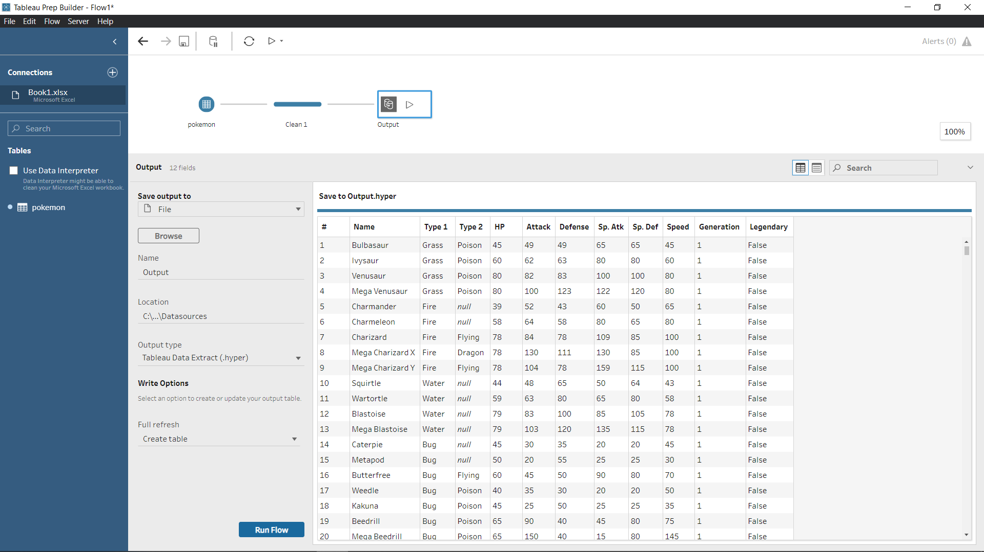
DATA CLEANING

Slide 5
Objective 1
Analyzing Pokemons on the basis of their speed.

Slide 6
Objective 2
Analyzing Pokemons on the basis of their generation.

Slide 7
Objective 3
Analyzing Pokemons on the basis of their Attacking Power.

Slide 8
Objective 4
Analyzing Pokemons on the basis of their Defensive Power.

Slide 9
Objective 5
Analyzing Pokemons on the basis of their Field.

Slide 10
Objective 6
Analyzing Pokemons on the basis of their Legendary.

Slide 11
Refrences
I did my level best to collect more and more information from various websites, YouTube. I would like to share which helped me lot in analysis of this data.
https://www.kaggle.com/zserdarb/google-playstore-data-analysis/data
https://www.youtube.com/results?search_query=dashboard+for+application+in+excel

Slide 12
Thanks

