Slide 1

WIPRO NGA Program – LSP Batch
Capstone Project Presentation – 04 June 2024
Project Title:
MULTI-THREADED SERVER-CLIENT USING SHARED MEMORY
Presented by:
Ankur Kumar Gupta
www.rpsconsulting.in

Slide 2
Agenda
Introduction
Project Overview
Code Functionality
Source Code
Application Demo
Q&A

Slide 3
Introduction
Demonstrates the effectiveness of client-server architecture, multithreading, and shared memory communication.
Implements the client-server model for seamless data exchange between multiple processes.
Utilizes multithreading to handle concurrent client requests, enhancing responsiveness and resource utilization.
Employs shared memory communication for swift data exchange between processes, simplifying communication without complex protocols.

Slide 4
Project Overview
Description of the project:
A server generates random numbers and shares them with clients using shared memory.
Clients connect to the server and read these random numbers.
Key features:
Multi-threaded server handling multiple clients.
Shared memory for efficient data sharing.
Semaphores for synchronization.

Slide 5
Code Functionality
Server:
Initializes a socket and listens for connections.
Generates random numbers and stores them in shared memory.
Handles multiple clients using threads.
Client:
Connects to the server.
Reads data from shared memory.
Displays the random numbers received.

Slide 6
Source Code
Server
Socket initialization.
Shared memory creation.
Semaphore usage.
Client handling in threads.
Client
Socket connection.
Accessing shared memory.
Semaphore synchronization.

Slide 7
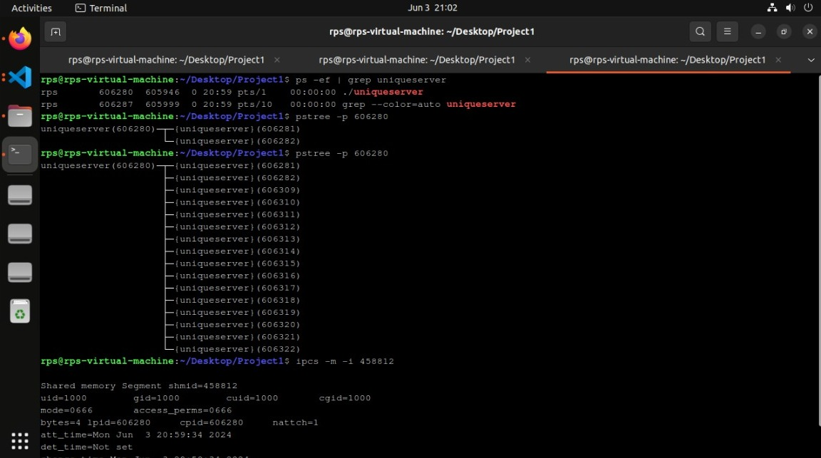
Application Demo

Slide 8


Slide 9


