Slide 1
UNIT 1- introduction

Slide 2
What is Software?
Software is: (1) instructions (computer programs) that when executed provide desired features, function, and performance;
(2)enable the programs to adequately manipulate information and (3) documentation that describes the operation and use of the programs.
Software is developed or engineered, it is not manufactured in the classical sense.
Software doesn't "wear out."
Although the industry is moving toward component-based construction, most
software continues to be custom-built.

Slide 4
Software Applications
system software
application software
engineering/scientific software
embedded software
WebApps (Web applications)
AI software

Slide 5
Legacy Software
Why must it change?
software must be adapted to meet the needs of new computing environments or technology.
software must be enhanced to implement new business requirements.
software must be extended to make it interoperable with other more modern systems or databases.
software must be re-architected to make it viable within a network environment

Slide 6
Software Engineering
Some realities:
a concerted effort should be made to understand the problem before a software solution is developed
design becomes a prime activity
software should exhibit high quality
software should be maintainable
The definition:
[Software engineering is] the establishment and use of sound engineering principles in order to obtain economically software that is reliable and works efficiently on real machines.
The IEEE definition:
Software Engineering: (1) The application of a systematic, disciplined, quantifiable approach to the development, operation, and maintenance of software; that is, the application of engineering to software. (2) The study of approaches as in (1).

Slide 7
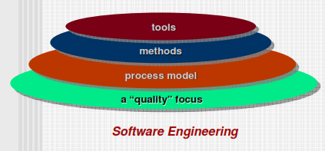
S/W Engg is A Layered Technology

Slide 8
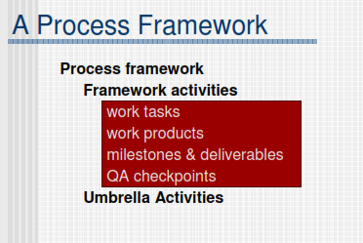

Slide 9
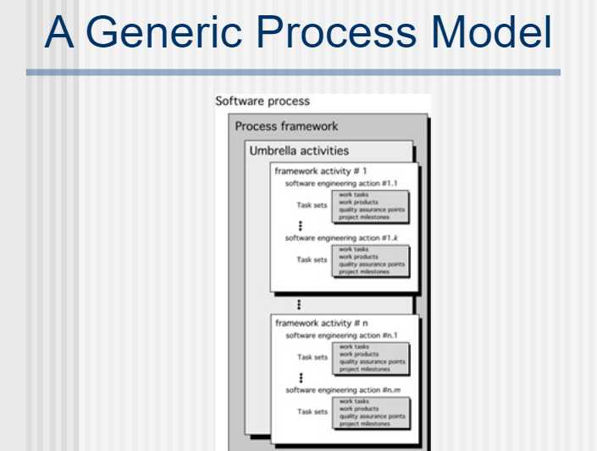

Slide 10
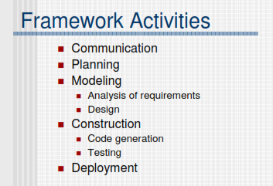
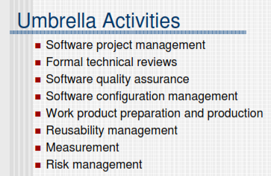

Slide 11
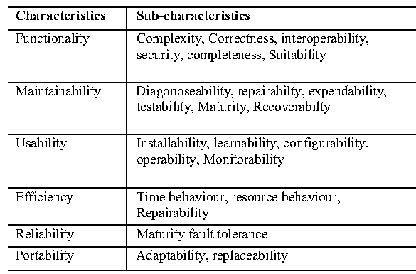
Software characteristics

Slide 12
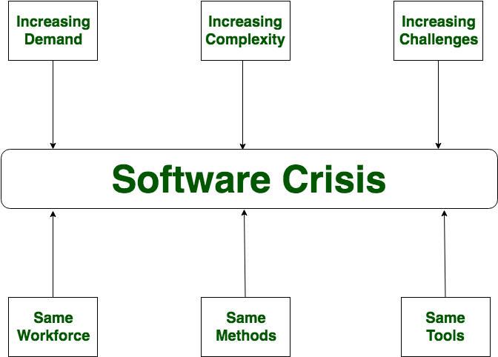
Software Crisis
Software Crisis is a term used in computer science for the difficulty of writing useful and efficient computer programs in the required time
Reasons can be:
Solution: SOFTWARE ENGINEERING

Slide 13
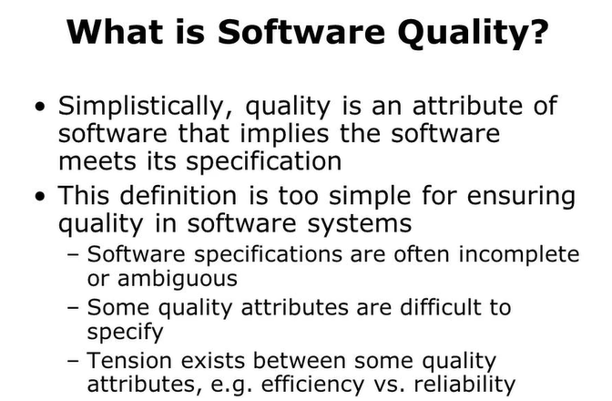

Slide 14
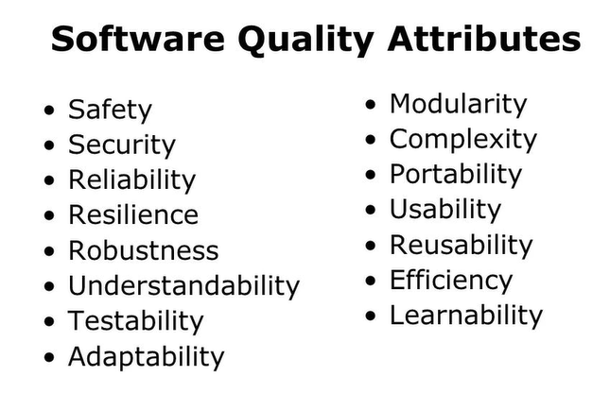

Slide 15
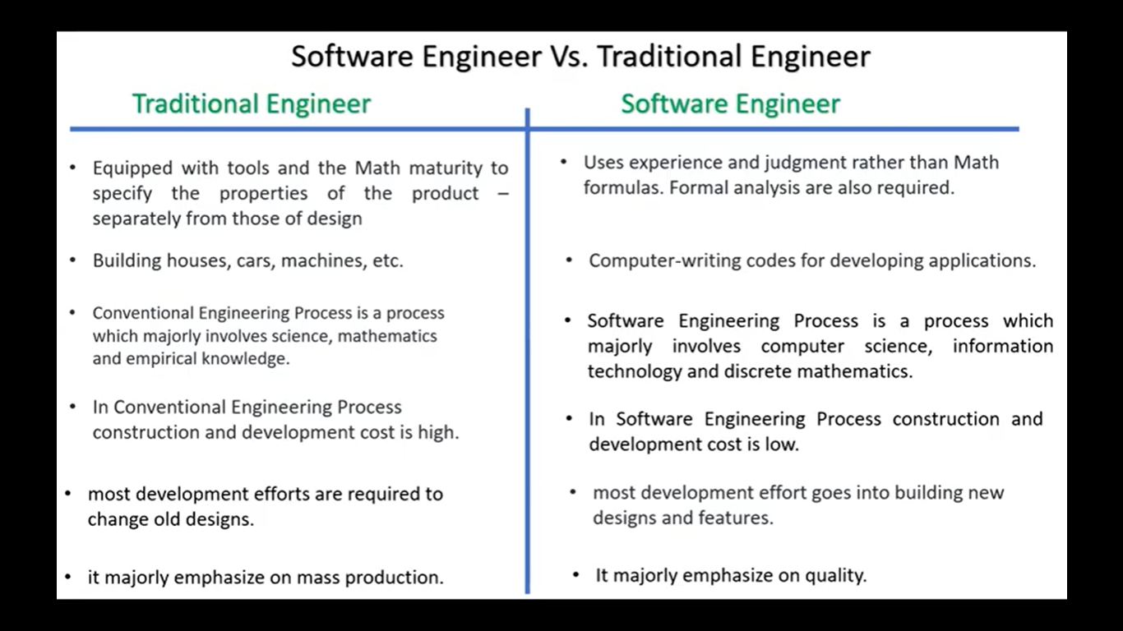

Slide 16
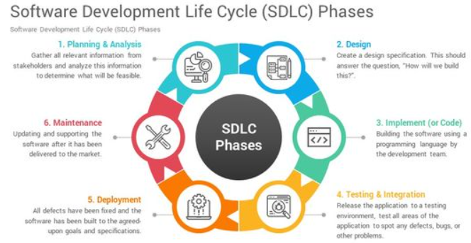

Slide 17
Various sdlc models
WATERFALL MODEL
PROTOTYPE MODEL
SPIRAL MODEL
EVOLUTIONARY DEVELOPMENT MODELS
ITERATIVE ENHANCEMENT MODELS

Slide 18
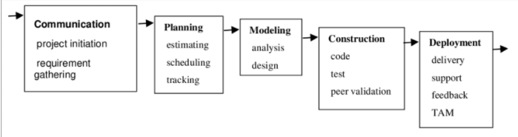
WATERFALL MODEL (classic life cycle model)

Slide 19
Points to ponder(Waterfall model)
Systematic, sequential approach for software development
Oldest paradigm for software engineering
Also sometimes called linear model
Real projects rarely follow it. Why?
Linear nature. Customer need a lot of patience to see the end product. Blocking states occurs where some team members of later phases wait until earlier phases complete their work.
For completing all phases in a concrete fashion huge and highly skilled workmen are necessary.
Useful at places where requirements are fixed and work need to be completed in a linear manner.

Slide 20
The incremental MODEL
It delivers a series of releases, called increments, that provide progressively more functionality for the customers as each increment is delivered.
Thus combines waterfall model elements , applied in incremental fashion.
Each linear sequence produces deliverables “increments” of the software
Useful when staffing is less. Early increments can be implemented with fewer people and later more staff can be hired.

Slide 21
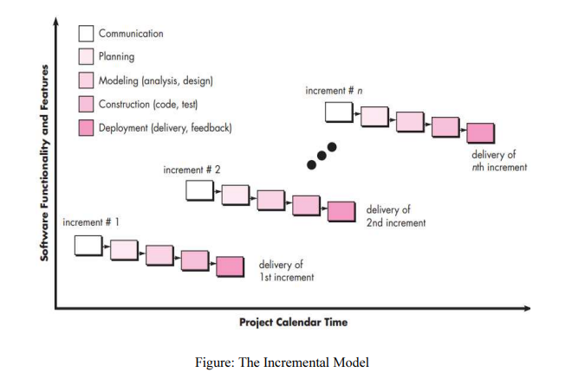

Slide 22
Advantages and Disadvantages
Advantages –
• Error Reduction (core modules are used by the customer from the beginning of the phase and then these are tested thoroughly)
• Uses divide and conquer for breakdown of tasks.
• Lowers initial delivery cost.
• Incremental Resource Deployment.
Disadvantages –
• Requires good planning and design.
• Total cost is not lower.
• Well defined module interfaces are required

Slide 23
THE RAD (RAPID APPLICATION DEVELOPMENT) MODEL:
Rapid Application Development (RAD) is an incremental software development process model which is a “high-speed” adaptation of the linear sequential model in which rapid development is achieved by using component-based construction. If requirements are well understood and project scope is constrained, the RAD process enables a development team to create a “fully functional system” within very short time periods, such as in 60 to 90 days.

Slide 24
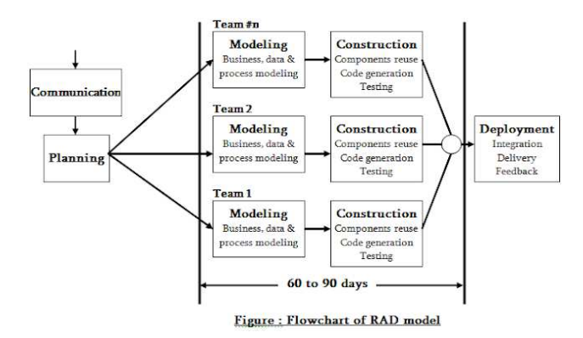

Slide 25
Advantages –
• Use of reusable components helps to reduce the cycle time of the project.
• Feedback from the customer is available at initial stages.
• Reduced costs as fewer developers are required.
• Use of powerful development tools results in better quality products in comparatively shorter time spans.
• The progress and development of the project can be measured through the various stages.
• It is easier to accommodate changing requirements due to the short iteration time spans.

Slide 26
disadvantages
The use of powerful and efficient tools requires highly skilled professionals.
The absence of reusable components can lead to failure of the project.
The team leader must work closely with the developers and customers to close the project in time.
The systems which cannot be modularized suitably cannot use this model.
Customer involvement is required throughout the life cycle.
It is not meant for small scale projects as for such cases, the cost of using automated tools and techniques may exceed the entire budget of the project.

Slide 27
Activity time
SCENARIO:
ABC - Honda 2- wheeler spare parts manufacturer industry - is searching for some s/w developer who can create their website.
Client Profile: ABC is a well renowned name in Delhi NCR region for manufacturing and wholesale selling of spare parts of two-wheeler of Honda company. It is one among the leading company in this business. Yearly turnover is around 80 crores. It is clean and highly reputed industry.
Case 1: Reputation is most and most important thing for ABC. They are ready to pay but they want best results. Ready to invest more time even. So, they have invested a lot of time and money to come up with very clear requirements.
Case 2: Due to some top management and developer conflicts, company now started doubting the work and want to see some output . It cannot wait anymore
Case 3 : Developer has crossed the timeline …company want the deliverables in next 90 days.

Slide 28
EVOLUTIONALRY PROCESS MODELS
Process model which evolves more in each iteration.
Thus evolutionary process models are iterative
They are characterized in a manner that enables software engineers to develop increasingly more complete versions of the software.
Some if them are:
Prototyping
Spiral Model
Concurrent Development Model

Slide 29
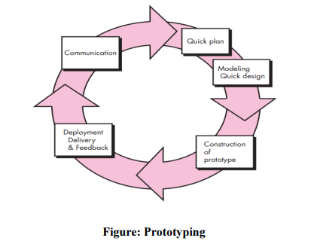
Prototyping
Prototyping: Often, a customer defines a set of general objectives for software but does not identify detailed requirements for functions and features.
In other cases, the developer may be unsure of the efficiency of an algorithm, the adaptability of an operating system, or the form that human-machine interaction should take.
In these, and many other situations, a prototyping paradigm may offer the best approach.
Although prototyping can be used as a stand-alone process model, it is more commonly used as a technique that can be implemented within the context of any one of the process models.

Slide 30
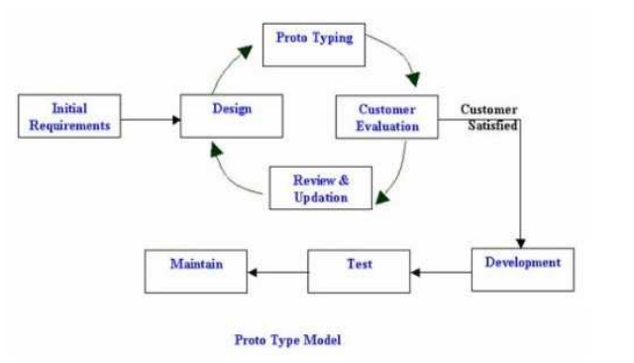
The prototype model

Slide 31
Advantages –
• The customers get to see the partial product early in the life cycle. This ensures a greater level of customer satisfaction and comfort.
• New requirements can be easily accommodated as there is scope for refinement.
• Missing functionalities can be easily figured out.
• Errors can be detected much earlier thereby saving a lot of effort and cost, besides enhancing the quality of the software.
• The developed prototype can be reused by the developer for more complicated projects in the future.
• Flexibility in design.

Slide 32
Disadvantages –
• Costly w.r.t time as well as money.
• There may be too much variation in requirements each time the prototype is evaluated by the customer.
• Poor Documentation due to continuously changing customer requirements.
• It is very difficult for the developers to accommodate all the changes demanded by the customer.
• There is uncertainty in determining the number of iterations that would be required before the prototype is finally accepted by the customer.
• After seeing an early prototype, the customers sometimes demand the actual product to be delivered soon.
• Developers in a hurry to build prototypes may end up with sub-optimal solutions.
• The customer might lose interest in the product if he/she is not satisfied with the initial prototype.

Slide 33
THE SPIRAL MODEL
Originally proposed by Barry Boehm, the spiral model is an evolutionary software process model that couples the iterative nature of prototyping with the controlled and systematic aspects of the waterfall model.
It provides the potential for rapid development of increasingly more complete versions of the software.
Boehm describes the model in the following manner:
"The spiral development model is a risk-driven process model generator that is used to guide multi-stakeholder concurrent engineering of software intensive systems.
It has two main distinguishing features. One is a cyclic approach for incrementally growing a system’s degree of definition and implementation while decreasing its degree of risk. The other is a set of anchor point milestones for ensuring stakeholder commitment to feasible and mutually satisfactory system solutions."

Slide 34
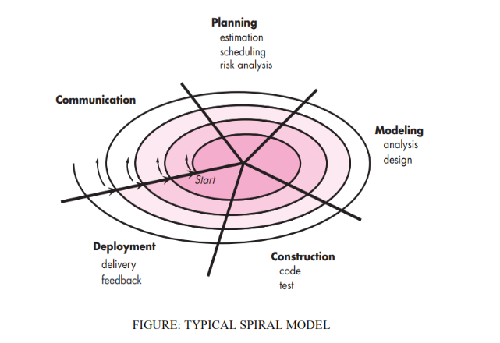

Slide 35
Key points : spiral model
Using the spiral model, software is developed in a series of evolutionary releases.
During early iterations, the release might be a model or prototype.
During later iterations, increasingly more complete versions of the engineered system are produced.
A spiral model is divided into a set of framework activities defined by the software engineering team.
Each of the framework activities represent one segment of the spiral path illustrated in Figure.
The spiral model can be adapted to apply throughout the life of the computer software.

Slide 36
SEGMENTS:
SEGMENT 1 includes following activities: Communication (requirement gathering,
customer evaluation and understanding)
SEGMENT 2 includes following activities: Planning (estimation, scheduling and risk analysis)
SEGMENT 3 includes following activities: Modeling (analysis and design)
SEGMENT 4 includes following activities: Construction (coding and testing)
SEGMENT 5 includes following activities: Deployment (delivery and feedback)

Slide 37
CIRCUITS AROUND THE SPIRAL:
As this evolutionary process begins, the software team performs activities that are implied by a circuit around the spiral in a clockwise direction, beginning at the center.
Risk is considered as each revolution is made.
Anchor point milestones - a combination of work products and conditions that are attained along the path of the spiral - are noted for each evolutionary pass.
The first circuit around the spiral might result in the development of a product specification and concept development of project, that starts at the core of the spiral and continues for multiple iterations until concept development is complete.
Each pass through the planning region results in adjustments to the project plan.
Cost and schedule are adjusted based on feedback derived from the customer after delivery.
In addition, the project manager adjusts the planned number of iterations required to complete the software.
The version or build or deliverable produced at the end of Deployment phase of the last circuit, is the final software product.

Slide 38
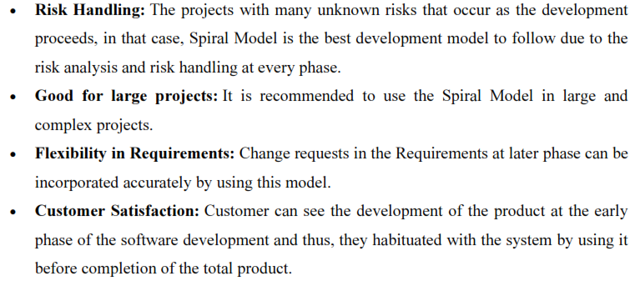
Advantages of Spiral Model:

Slide 39
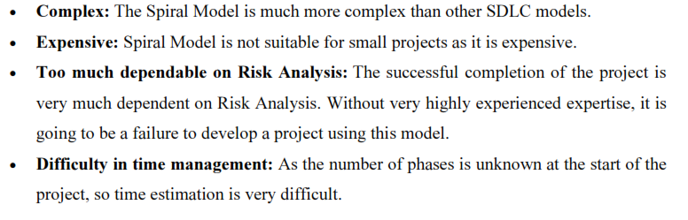
Disadvantages of Spiral Model:

Slide 40
Iterative enhancement model
In this Model, you can start with some of the software specifications and develop the first version of the software. After the first version if there is a need to change the software, then a new version of the software is created with a new iteration. Every release of the Iterative Model finishes in an exact and fixed period that is called iteration.
The Iterative Model allows the accessing earlier phases, in which the variations made respectively. The final output of the project renewed at the end of the Software Development Life Cycle (SDLC) process.

Slide 41
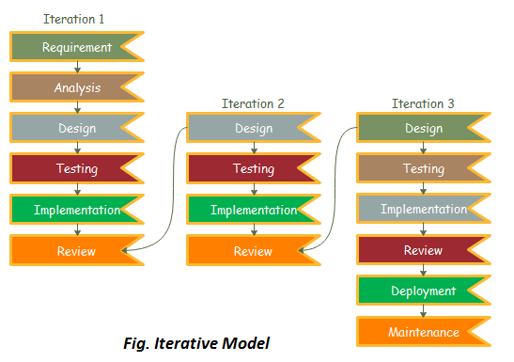

Slide 42
When to use the Iterative Model?
When requirements are defined clearly and easy to understand.
When the software application is large.
When there is a requirement of changes in future.

Slide 43
Advantage
Testing and debugging during smaller iteration is easy.
A Parallel development can plan.
It is easily acceptable to ever-changing needs of the project.
Risks are identified and resolved during iteration.
Limited time spent on documentation and extra time on designing.

Slide 44
Disadvantage
It is not suitable for smaller projects.
More Resources may be required.
Design can be changed again and again because of imperfect requirements.
Requirement changes can cause over budget.
Project completion date not confirmed because of changing requirements.

