Slide 1


SMART INDIA HACKATHON 2025
TITLE PAGE
Problem Statement ID – SIH25101
Problem Statement Title - Remote classroom for rural colleges
Theme- Smart Education
PS Category - Software
Team ID -
Team Name - Tinkerers

Slide 2





IDEA TITLE
Virtual Classroom (Software)
• Lightweight, audio-first solution optimized for 2G/3G networks.
• Supports auto-reconnect & offline downloads (≤15 MB/hr).
• Mobile-first design for entry-level Android devices.
• Prototype website Link
OCD (Hardware)
• Low-cost plug-and-play device enabling online classes on any TV.
• One-time cost, compatible with standard TVs.
Integration
• Hardware ensures device access.
• Software ensures usability in weak networks.
• Together, they create an inclusive hybrid ecosystem.
Innovation
• Unique hybrid model blending device + app.
• Goes beyond conventional online learning platforms.

Slide 3
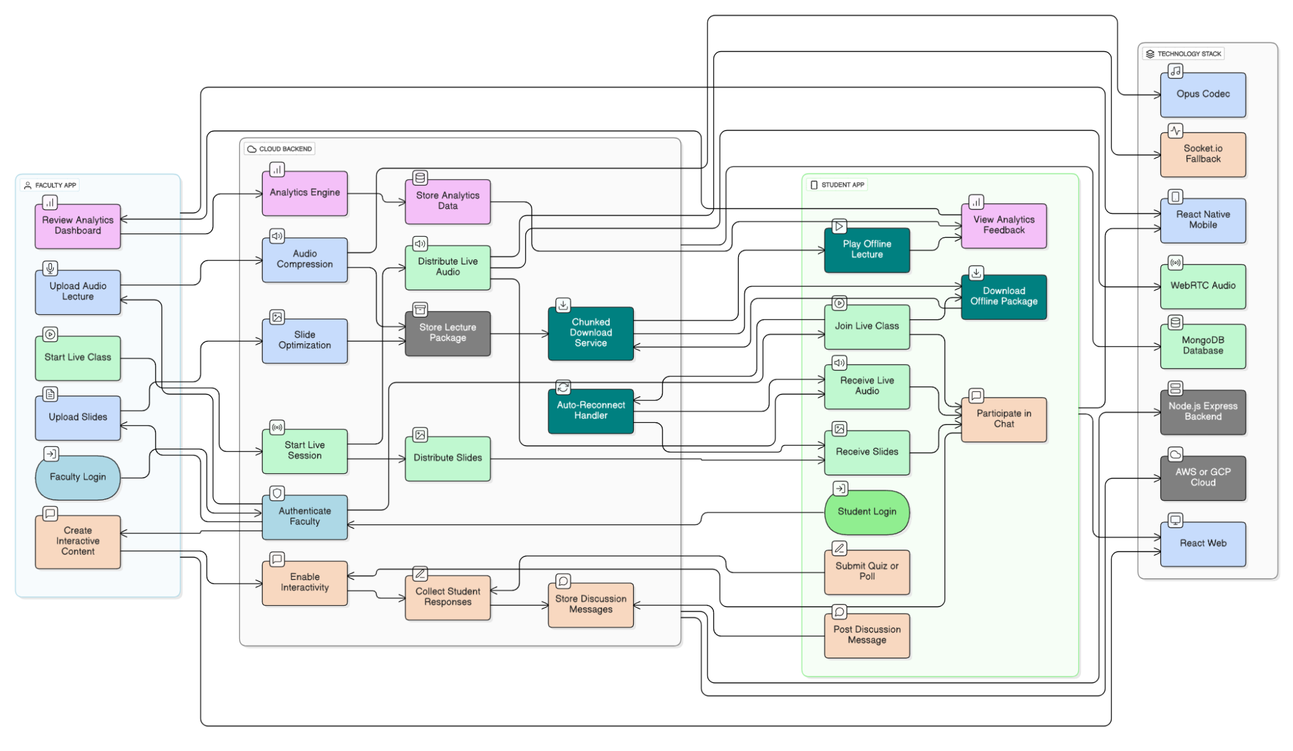


TECHNICAL APPROACH
Software (Virtual Classroom):
Audio compression
(Opus codec 20–30 kbps).
Slides → compressed
images synced with audio.
Auto-reconnect + offline
downloads (≤15 MB/hr).
Mobile-first (entry-level Android).
Hardware (OCD):
Streaming-based device, TV-compatible, one-time cost.

Slide 4




FEASIBILITY AND VIABILITY
Feasibility
OCD module costs only ₹500–700 (affordable for rural institutes).
Software is open-source with cloud freemium model, keeping costs low.
Scalability
Works seamlessly at institute, district, and state levels.
Can expand without major infrastructure upgrades.
Challenges
Internet instability in rural areas.
Adoption by faculty may take time due to limited digital familiarity.
Mitigation
Provide offline packages for low-connectivity areas..
Conduct faculty onboarding & training sessions for smooth adoption.

Slide 5




IMPACT AND BENEFITS
Social
Equal access for rural & underprivileged students.
Bridges the gap in digital learning opportunities.
Long-term
Reduces rural–urban learning divide.
Improves employability and skill development in rural youth.
Economic
Affordable: low-cost hardware .
Free & open-source software reduces recurring expenses.
Educational
Introduces AI, VLSI, and renewable energy expertise to rural diploma colleges.
Enhances quality of technical education in underserved areas.

Slide 6


RESEARCH AND REFERENCES
RESEARCH:
Only ~54% of schools have internet access, ~57% have functional computers (UDISE+ 2023-24)
SIH Problem Statement insights (low-bandwidth classroom)
Our prior work: OCD (Online Classroom Device) – cost-efficient plug-and-play hardware enabling access without smartphones/PCs.
BharatNet is the world’s largest rural broadband project aimed at providing affordable digital connectivity to every village in India.
This SIH solution complements OCD with a software-only ecosystem designed for rural diploma colleges.
REFERENCES:
Hindustan Times, IndiaTV, Times of India.
OCD Report (2021–22).
BharatNet

