Slide 1
MINOR PROJECT-1
NAME = ANKUR KUMAR
COLLEGE ROLL = 20222763
UNIVERSITY ROLL = 22020107052
COURSE = B.VOC (Software Development)
PROJECT = SPOTIFY CLONE
GIT HUB LINK = https://github.com/Ankur-creator/spotify-clone.git
SUBMITTED TO = VIPIN RATHI SIR

Slide 2
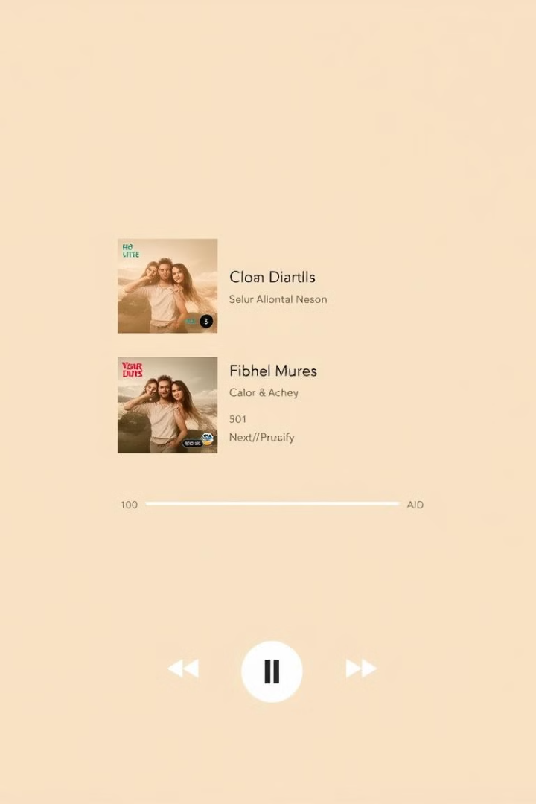
Spotify Clone: A Simple Music Player
This project is a functional clone of Spotify's basic features built using HTML, CSS, and JavaScript. It allows users to browse a playlist of songs, control playback (play, pause, skip), and view the song progress. The application is designed with a focus on simplicity and ease of use.

Slide 3
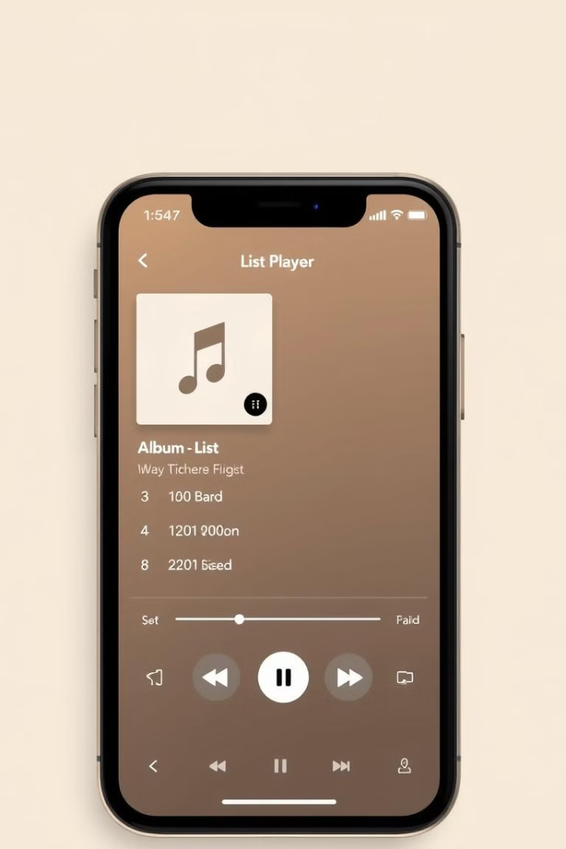
Key Features
1
Song List
2
Playback Controls
Displays a list of songs with titles and play buttons.
Play, pause, skip, and previous buttons to control the music.
3
Progress Bar
4
Responsive Design
Tracks the progress of the current song.
Adapts to different screen sizes for optimal viewing.

Slide 4
Technologies Used
HTML
CSS
JavaScript
FontAwesome
Page structure.
Styling and layout.
Dynamic features.
Icons for controls.

Slide 5


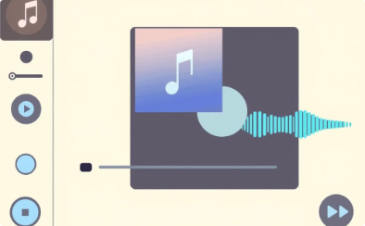

How to Use
Play
Pause
Next
Previous
Click on a song title to start playback.
Pause the current song.
Skip to the next song in the playlist.
Go back to the previous song.

Slide 6
Installation
Clone the Repository
Open index.html
Use Git to clone the project from GitHub.
Load the main HTML file in your web browser.

Slide 7
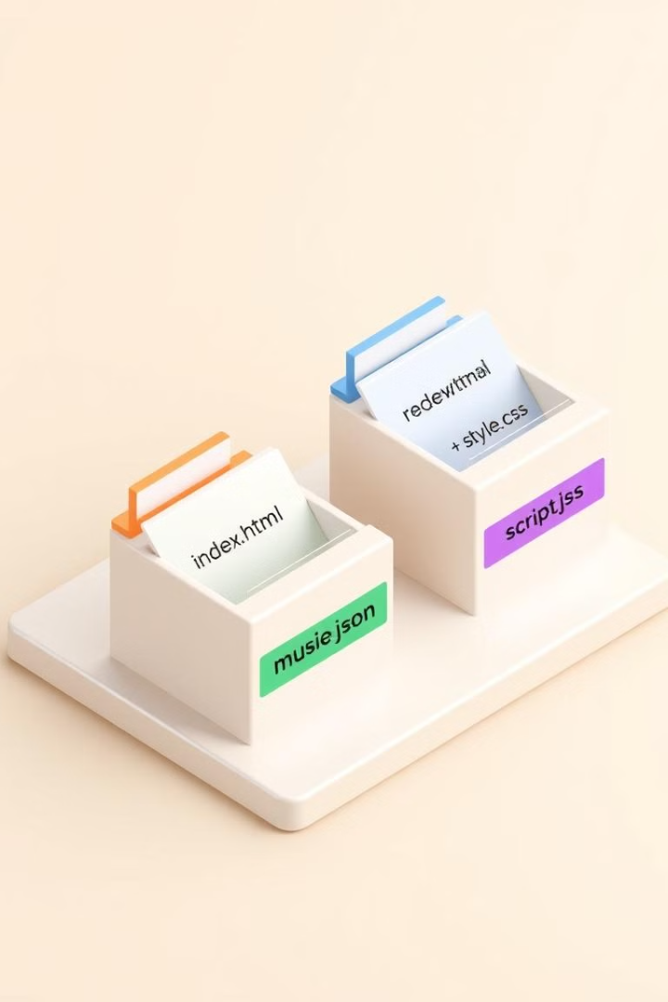
Project Structure
index.html
Main HTML structure.
style.css
CSS styling and layout.
script.js
JavaScript code for dynamic features.
music.json
Song list for the music player.

Slide 8



Open Source & License
Open Source
1
The code is freely available.
MIT License
2
Allows for modification and redistribution.
Contribute
3
Fork the repository and submit changes.

Slide 9
Next Steps
Explore
Customize
Expand
Dive into the code and understand its functionality.
Adjust the design and features to your preferences.
Add new features to enhance the music player.

Slide 10
Thank You!

