Slide 1
Welcome to My Mini-Project
Philia – A Chat Application

Slide 2
Content
Objective
Introduction
Technologies Used
Features
Interface
References

Slide 3
Objective
To create a chat application which enables users to chat with each other
To develop an instant messaging solution to enables user to communicate
With each other
This project is very easy to use enabling even a novice person to use it.
The Main purpose of this project is to provide multi-chatting functionality.

Slide 4
Introduction
It is an real-time chat application through which users will be able to
communicate with each other in real-time.
Users will able to send files like photos, videos, documents, etc
It has a very simple and clean interface.

Slide 5
Technologies Used
Html
CSS
JavaScript
ReactJS
Stream API

Slide 6
Features
Sign Up/Sign In
Direct Messaging
Group Messaging
Send photos, videos, documents, etc
React to messages
And many more

Slide 7
Interface

Slide 8
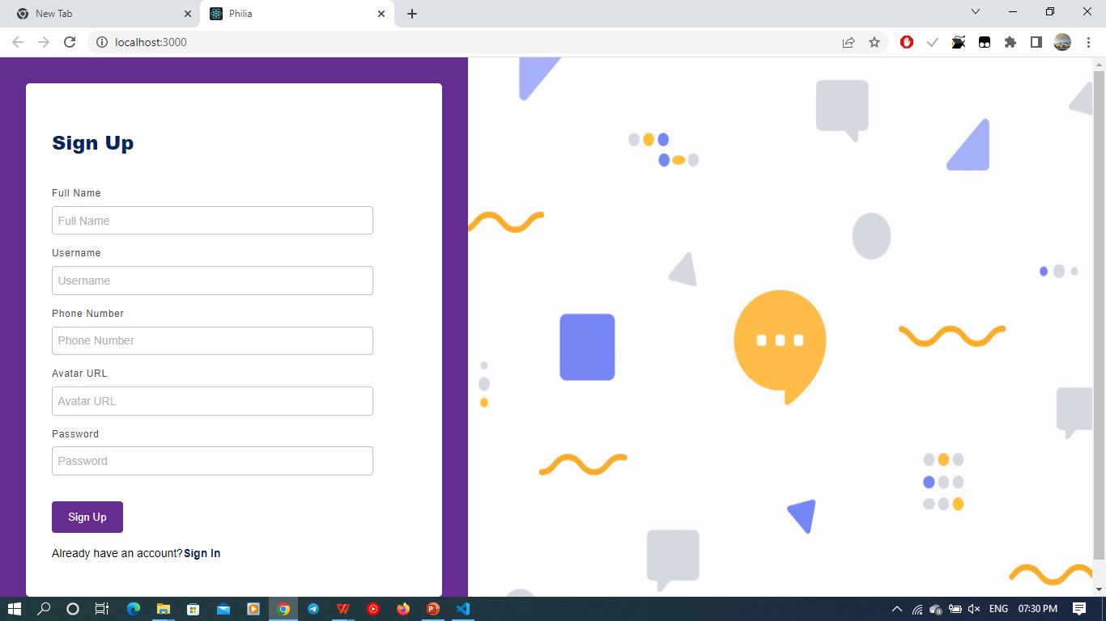
Sign Up

Slide 9
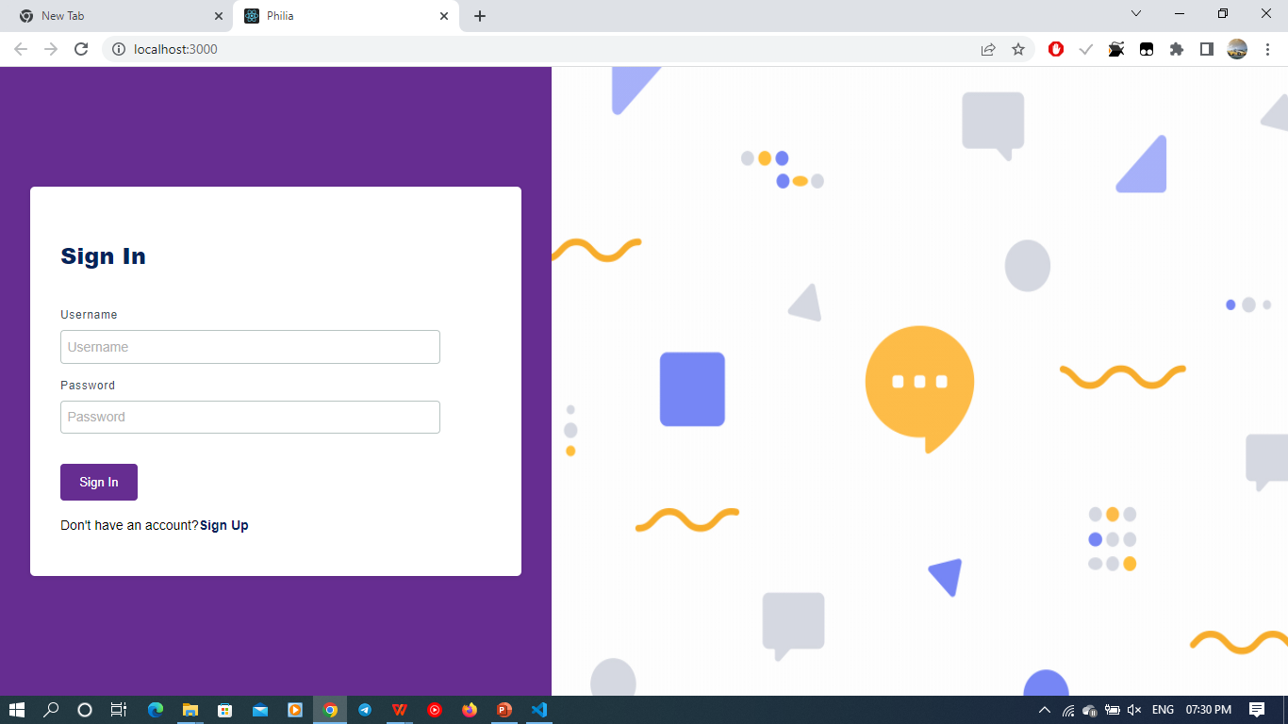
Sign In

Slide 10
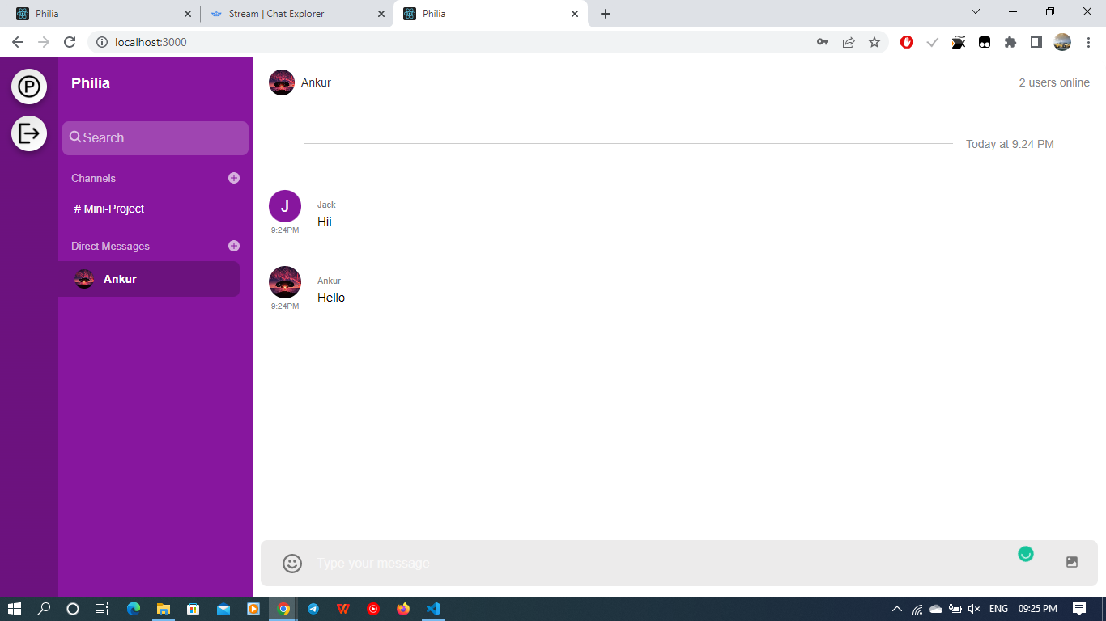
Direct Chatting

Slide 11
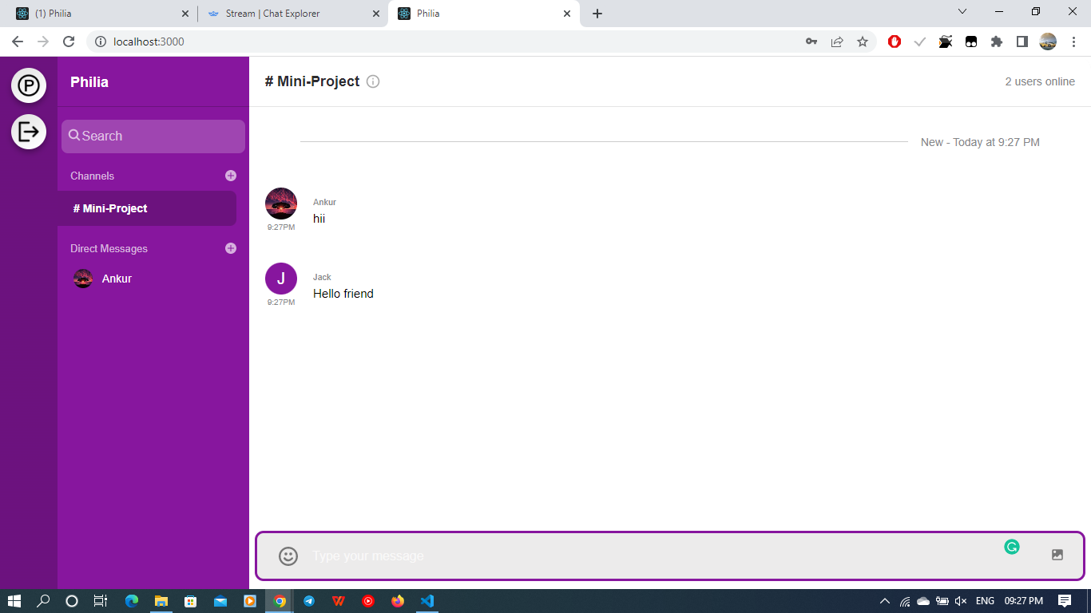
Group Chatting

Slide 12
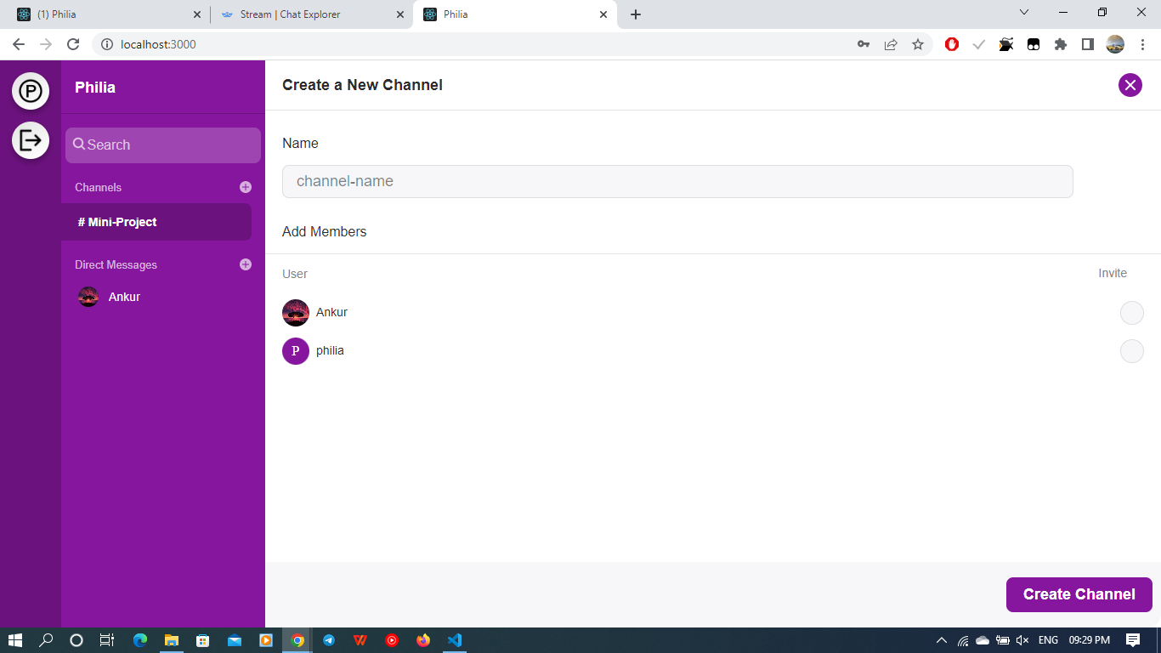
Create Groups

Slide 13
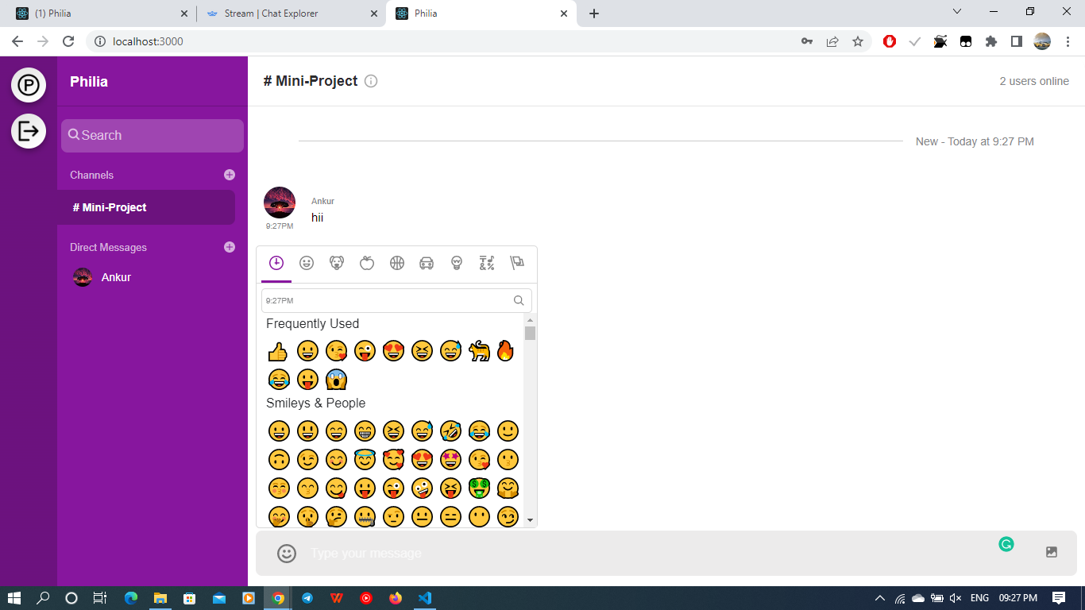
Emojis

Slide 14
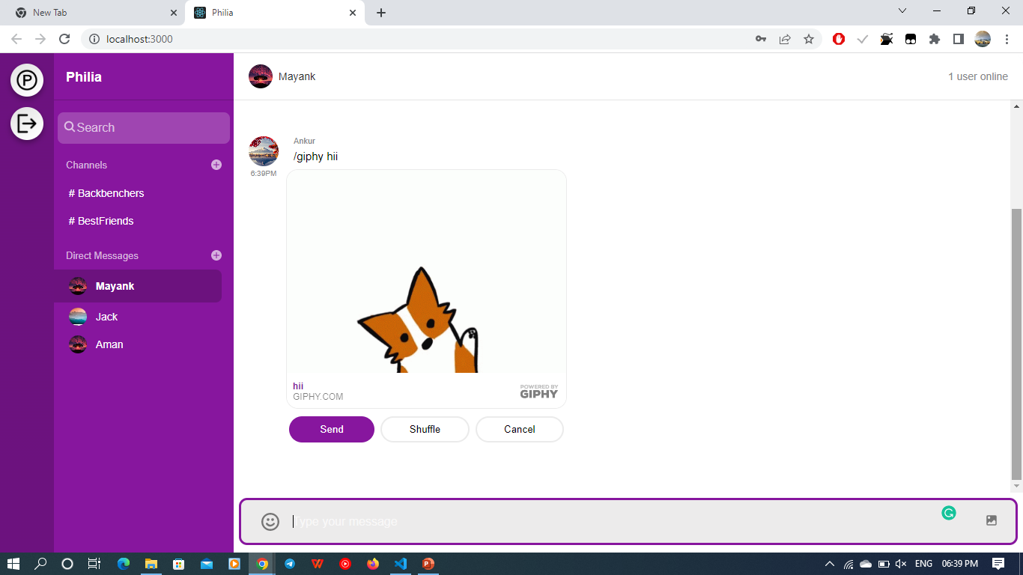
Use Giphy Command to send
gifs and stickers

Slide 15
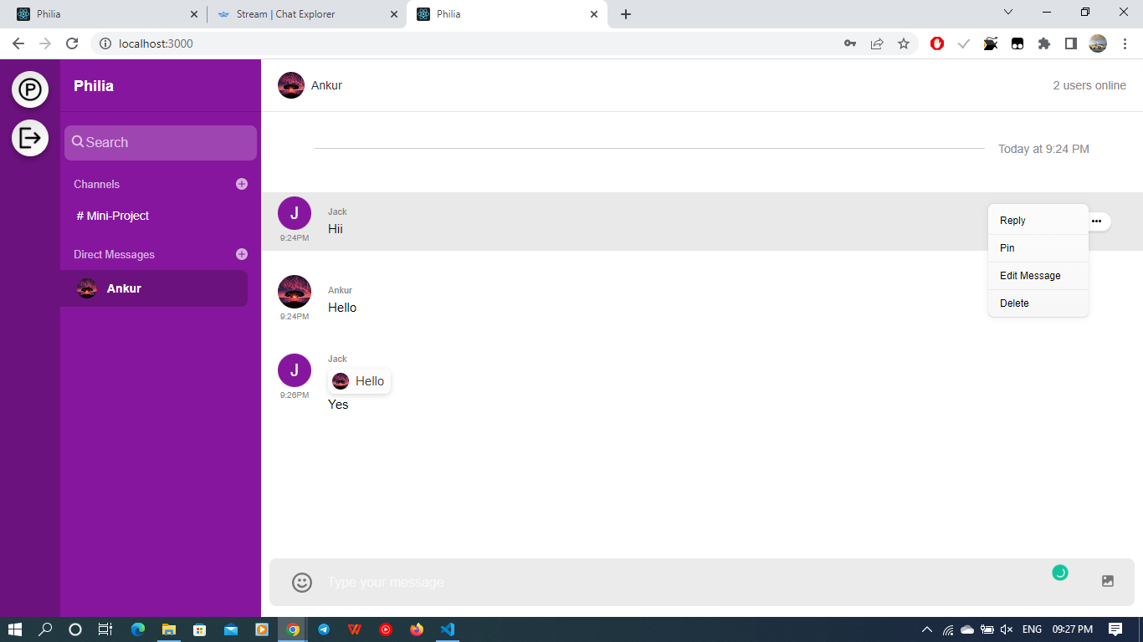
Some Other Features

Slide 16
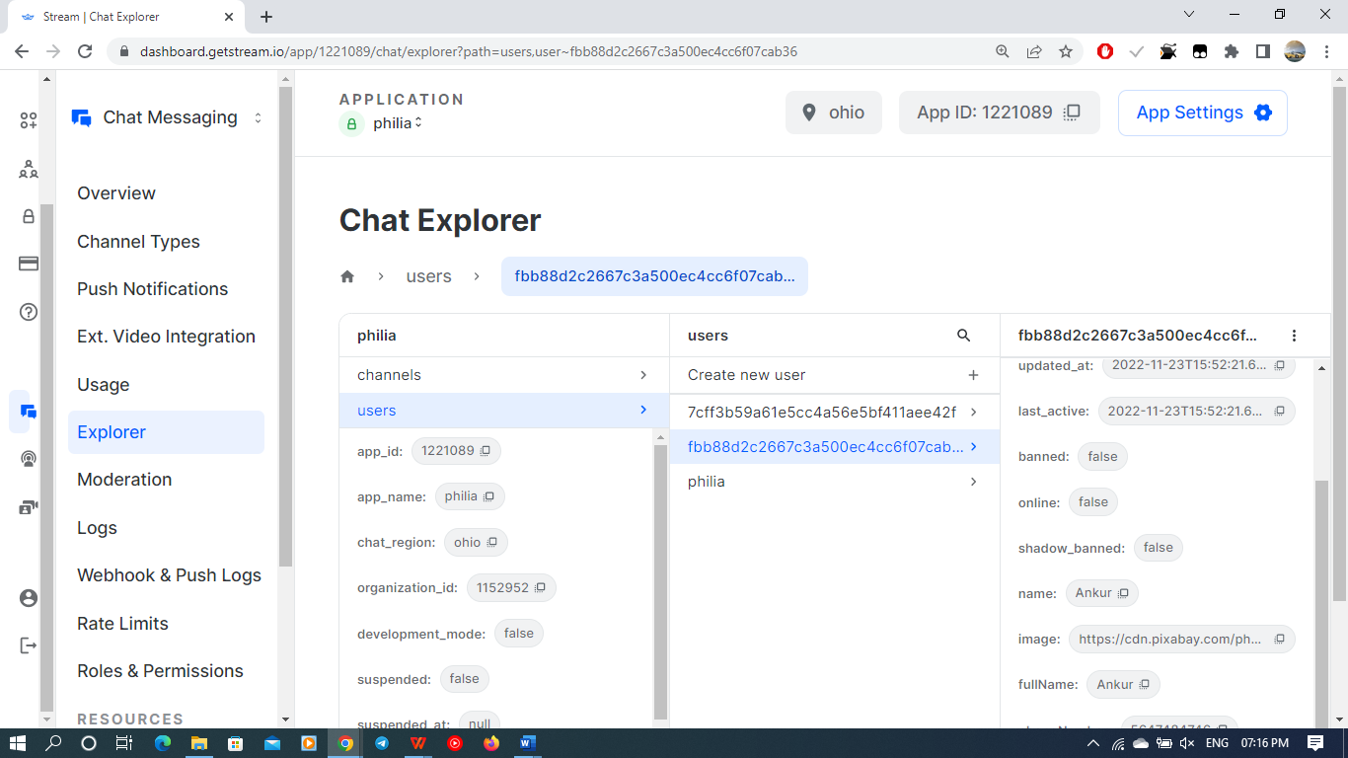
Remove user

Slide 17
REFERENCES
https://tutorialspoint.com/
http://javatpoint.com/
http://code.visualstudio/
https://getstream.io/
http://youtube.com/

Slide 18
Thank You

