Slide 1

Database Management Systems
Atal Bihari Vajpayee Indian
Institute of Information Technology
And Management
Payment Mechanism Database
In the supervision of:- Dr Debanjan Sadhya

Slide 2
Meet our team:-
Ankur Agnihotri(2021IMG-008)
Harikishan Yadav(2021IMG-025)
Prateek Goyal(2021IMG-041)
Priyanshu Katiyar(2021IMG-042)
Amgoth Saiteja(2021IMG-007)
Rachit Mourya(2021IMG-044)

Slide 3
Contents
INTRODUCTION
ASSUMPTIONS
E.R DIAGRAM
ENTITY SETS
RELATIONSHIP SETS AND CARDINALITY

Slide 4
Contents
CONVERTING ER DIAGRAM INTO SCHEMAS
FUNCTIONAL DEPENDENCIES
DECOMPOSITION USING NORMALIZATION AND FINAL SCHEMAS
SQL QUERIES
RELATIONAL ALGEBRA QUERIES

Slide 5

Introduction
Our project is an example of how various payment mechanisms’ data interact with each other in a payment mechanism.
Note:- this isn’t a real payment mechanism it is actually our own take on how various payment system works in INDIA, like the UPI ecosystem and NEFT payment mechanism.

Slide 6
Assumptions
1)We are assuming that email can not be unique because it may be possible that one user has not its own email but using other user’s email
2) There are varius type of services which user can get but We are taking only insurance as a service.

Slide 7
E R Diagram

Slide 8
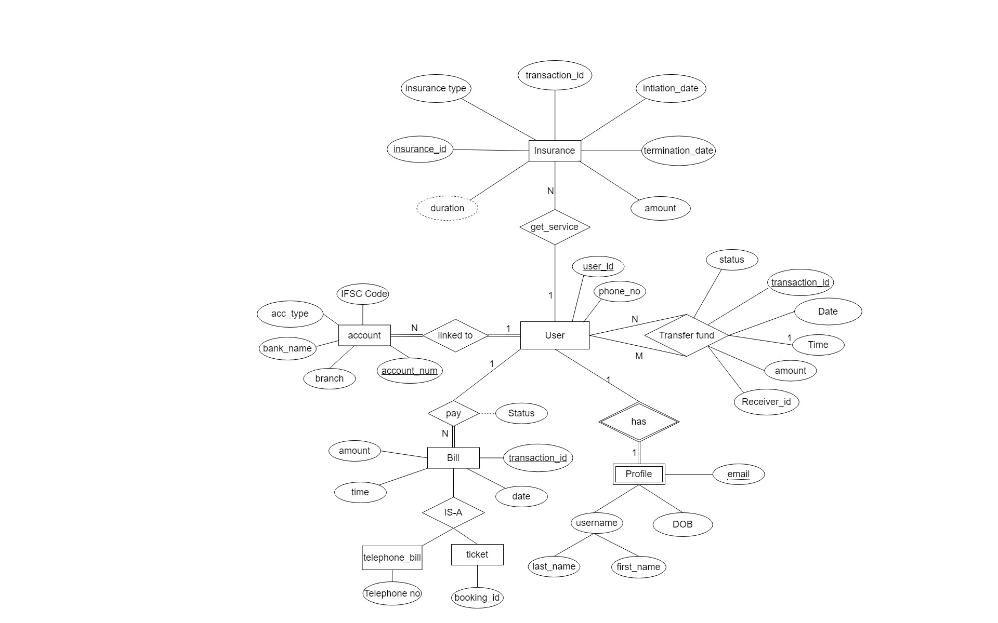

Slide 9
Entity sets

Slide 10
Entity set:-
Account:-
account(account-num,IFSC code,bank_name,branch Name ,Acc-type )
In the account entity set account_num is the primary key, and other attributes are giving detailed information about the user’s account.
Bill:-
bill(transaction-id,date,time,amount,status)
In the bill entity set transection_id is the primary key and other attributes contain other details of the bill. Since bills can be of different types we have used the concept of an extended ER model i.e. specialization (top to bottom approach).
Here the bill can be:-
telephone bill(Telephone-no)
tickets (Booking-id)

Slide 11
Entity set:-
profile:-
profile(Name(first name,last name),dob,email,address)
In profile entity set, since it's a weak entity set it is dependent on a strong entity i.e. the user entity set.
user:-
user (user-id,phone_no.)
In the user entity set user_id is the primary key.
Insurance:-
insurance(insurance-id,transaction-id,Insurance type, ini_date, ter_date,amount,duration)
As we know every insurance has a unique id therefore an insurance entity set will have the primary key as insurance_id and other attributes are to provide details about insurance.

Slide 12
Relationship and cardinality

Slide 13
Relationship and cardinality:-
Transfer fund:-
transfer fund(transaction-id, receiver-id, user-id, date, time, amount, status)
There is a unary relation with the user entity set. Transfer fund is a many to many relationships because one user can transfer to many other users and other users can transfer to a single user. partial participation from both sides because it is possible that one uses does or doesn’t do a fund transfer.
Linked to:-
linked to(account-num , user-id)
There is a many-to-one relation between the account entity set and the user entity set. There is total participation from both ends.
pay:-
pay(User-id, Trasaction-id)
There is a many-to-one relation because many bills could be paid by a single user. There is total participation from the bill side.

Slide 14
Relationship and cardinality:-
Get_service:-
get_service(insurence_id, user_id)
There is a one-to-many relation because one user can have a lot of insurance. There is a total participation from the insurance side.
has:-
has(User id)
It’s a weak relationship and there is a total participation from the profile side. There is a one-to-one relationship.

Slide 15
Converting ER diagram into schema

Slide 16
Converting ER diagram into schema:-
Account and user:-
It is many to one relation from account to user and it is total on many side so we can add primary key of user entity to the account entity and remove the schema for relationship “linked-to”.Thus we will obtain two tables:-
account (account_num, user_id,IFSC code , bank name , branch)
User (User_id, phone_no)
Bill and user:-
It is many to one relation from bill to user and it is total on many sides so we can add the primary key of the user entity to the bill entity and remove the schema for relationship “pay”,Thuss we will obtain two tables.
bill(transaction-id , user_id,date,time,amount,status)
user (user_id, phone_no)

Slide 17
Converting ER diagram into schema:-
Profile and user:-
It is a one to one relation of a user entity with a weak entity set profile.so we have to add primary key of user to profile entity and remove the schema for relationship ”Has” , thus we will obtain two tables.
Profile(user_id, name(first_name, last_name) ,dob ,email)
User (user_id,phone_no)
Bill, telephone_bill and ticket:-
Telephone and ticket entities are examples of specialisation.
Thus the table of telephone bill will be
telephone_bill (Trasaction_id, telephone_num )
Similarly the table of ticket will be
Ticket (trasaction_id, booking_id)
And for bill table will be
Bill(Transaction-id, user_id,date ,time,status)

Slide 18
Converting ER diagram into schema:-
Transfer fund:-
Since it is many to many unary relationship for user entity set ,so we have to make a separate table for transfer fund
transfer fund(transaction-id, Receiver-id, user-id,date,time,amount,status)
Insurance and user:-
since it is many to one relation from insurance to user and total on many sides so we can add the primary key of user to the insurance entity and remove the schema for the relationship “get_service”
insurance(insurance-id, transaction-id, user-id,Insurance type,ini_date, ter_date,amount,duration)
user (user_id, phone_no)

Slide 19
Functional dependencies

Slide 20
Functional Dependencies:-
account:-
account (account_num, user_id, IFSC code, bank name, branch)
account_num.-->Ifsc code, acc_type,bank name ,branch
Ifsc code->bank name, branch
insurence:-
Insurance(insurance_id, transaction_id, user_id, ini_date, ter_date, amount, duration)
insurance_id, transaction_id→ ini_data, ter_date, amount, duration
Transaction_id → amount
user:-
user (User_id, phone_num)
user_id → user_id, phone_num

Slide 21
Functional Dependencies:-
Transfer fund:-
transfer fund(transaction-id, Receiver-id, user-id,date, time, amount, status )
Transaction-id→ transaction-id,user_id, date, time,amount, status
profile:-
Profile(user_id,name(first name,last name) ,dob ,email)
User-id→ user-id, name, dob, email

Slide 22
Functional dependencies:-
bill:-
bill(transaction_id, user_id,date ,time,status)
transaction_id-> transaction_id, date, time, status, amount
Telephone bill:-
telephone_bill (trasaction_id, telephone number )
trasaction_id → Telephone-no, trasaction_id
ticket:-
ticket (trasaction_id, booking_id)
trasaction_id → Booking _id, trasaction_id

Slide 23
Normalization and final Schema

Slide 24
Normalization and final schema:-
account:-
account (account_num, user_id, IFSC code, bank name, branch)
1NF: since all attributes are atomic, hence it’s in 1NF.
2NF: since there is only one primary key, hence it’s in 2NF.
3NF: since non prime attribute IFSC_code can define branch_name, and bank_name. We have to decompose the account schema into:-
account(acc_no., acc_type, IFSC_code, user_id)
bank( IFSC_code, branch_name, bank_name)
BCNF: since there is no non-prime attribute defining prime attribute, hence it’s already in BCNF.

Slide 25
Normalization and final schema:-
user:-
user (User_id, phone_num)
1NF: since each attribute involved in this schema is atomic, hence the given schema is in 1NF.
2NF: since there is only one primary key, there is no partial dependency. Hence the user entity is in 2NF.
3NF: since there is no transitive dependency, hence it's in 3NF.
BCNF: since there is no non-prime attribute defining prime attribute, hence it's already in BCNF.

Slide 26
Normalization and final schema:-
bill:-
bill(transaction_id, user_id,date ,time,status)
1NF: since every attribute is atomic, hence the given schema is in 1NF.
2NF: since there is only one primary key, thus we can say that there is no partial dependency, Hence the schema is in 2NF
3NF:since there is no other functional dependency of the forms a→b and b→c, thus the given schema is in 3NF,
BCNF: since there is no non-prime attribute defining a prime attribute, thus the given schema is in BCNF

Slide 27
Normalization and final schema:-
Insurance:-
Insurance(insurance_id, transaction_id, user_id, ini_date, ter_date, amount, duration)
1NF: since all attributes are atomic, hence it’s in 1NF.
2NF: since by using transaction_id we can determine amount and insurance_id can determine termination_date, initiation_date and duration. We will have to decompose there schema into:-
insurance(insurence_id, transaction_id, user_id, ini_date, ter_date, duration)
insur_amt(transaction_id, amount)
3NF: since there is no transitive dependency, hence it’s already in 3NF.
BCNF: since we can not define prime attributes using non-prime attributes. Hence it's already in BCNF.

Slide 28
Normalization and final schema:-
Transfer fund:-
transfer fund(trasaction_id, Receiver-id, user-id,date, time, amount ,status )
1NF: since every attribute is atomic, hence the given schema is in 1NF.
2NF: since there is only one primary key , thus we can say that there is no partial dependency, Hence the schema is in 2NF
3NF: since there is no other functional dependency of the forms a→b and b→c, thus the given schema is in 3NF,
BCNF: since there is no non-prime attribute defining a prime attribute, thus the given schema is in BCNF

Slide 29
Normalization and final schema:-
profile:-
profile(user_id,name(first name,last name) ,dob, email)
1NF: since the name is a composite attribute composed of the first name and last name two attributes, thus the above schema is not in 1NF. We will redefine the above schema as
Profile(user_id,first name,last name,dob, email)
2NF: since there is only one primary key, thus we can say that there is no partial dependency, Hence the given schema is in 2NF
3NF: since there is no other functional dependency of the forms a→b and b→c, thus the schema is in 3NF,
BCNF: since there is no non-prime attribute defining a prime attribute, thus the above schema is in BCNF

Slide 30
Normalization and final schema:-
Telephone bill:-
telephone_bill (trasaction_id, telephone number )
1NF: since every attribute is atomic, hence the given schema is in 1NF.
2NF: since there is only one primary key, thus we can say that there is no partial dependency, Hence the schema is in 2NF
3NF:since there is no other functional dependency of the forms a→b and b→c, thus the given schema is in 3NF,
BCNF: since there is no non-prime attribute defining a prime attribute, thus the given schema is in BCNF

Slide 31
Normalization and final schema:-
ticket:-
ticket (trasaction_id, booking_id)
1NF: since every attribute is atomic, hence the given schema is in 1NF.
2NF: since there is only one primary key, thus we can say that there is no partial dependency, Hence the schema is in 2NF
3NF:since there is no other functional dependency of the forms a→b and b→c, thus the given schema is in 3NF,
BCNF: since there is no non-prime attribute defining a prime attribute, thus the given schema is in BCNF

Slide 32
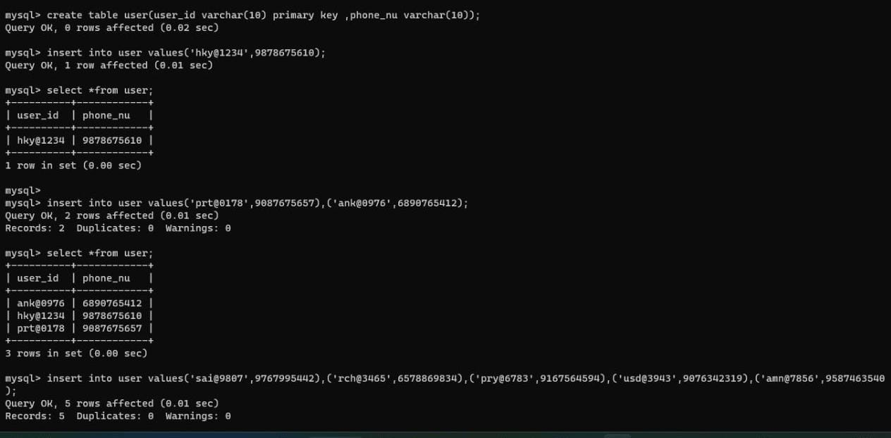
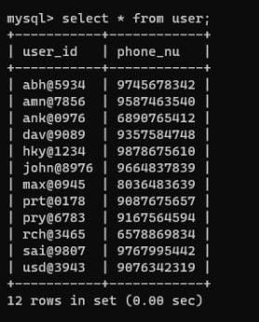
creating tables and inserting data into tables

Slide 33
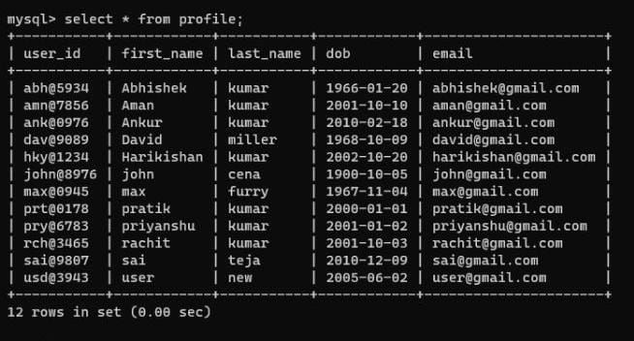
profile

Slide 34
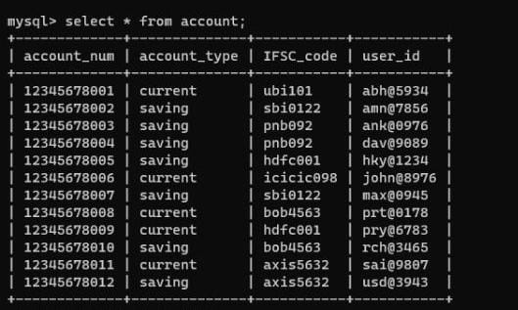
Account

Slide 35
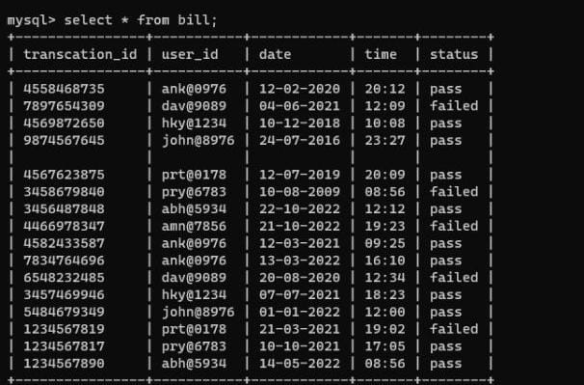
Bill

Slide 36
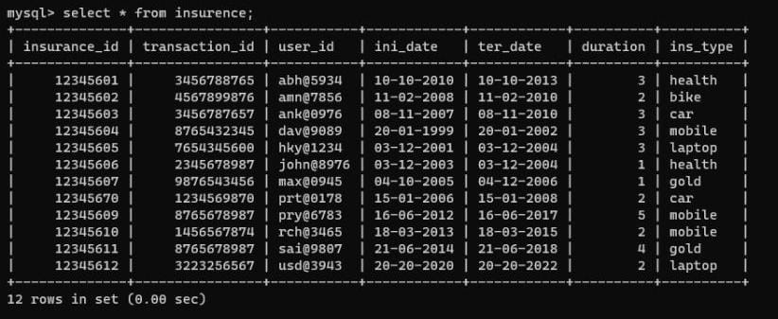
Insurance

Slide 37
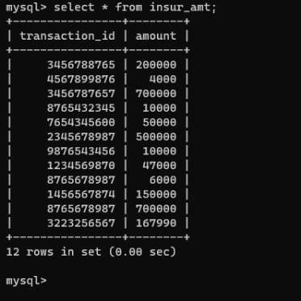
insur_amt

Slide 38
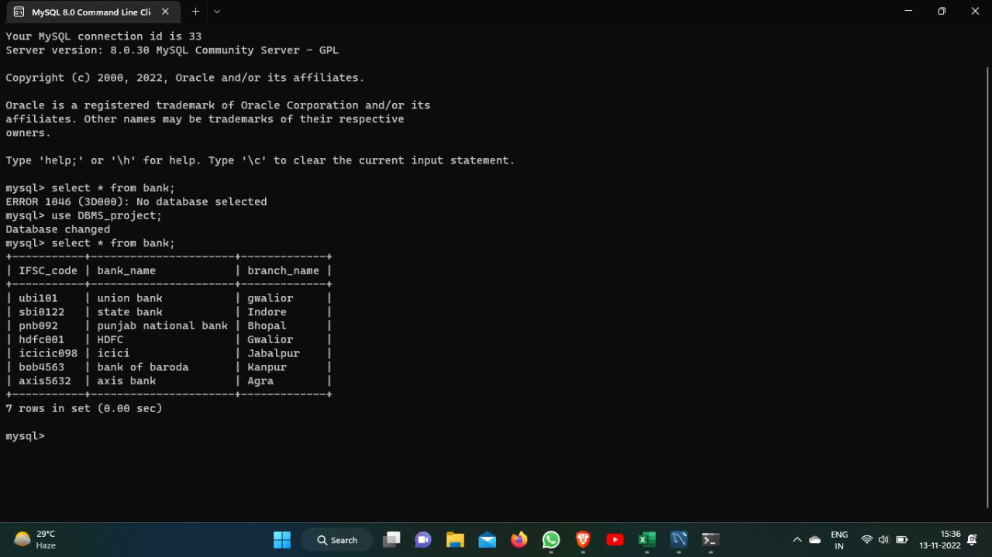
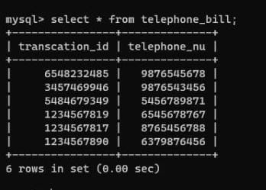
bank telephone_bill

Slide 39
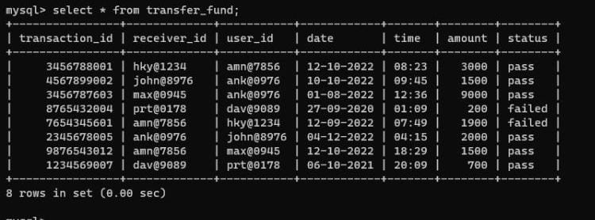
transfer_fund

Slide 40
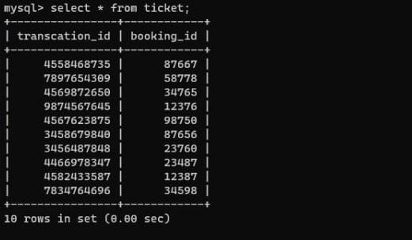
ticket

Slide 41
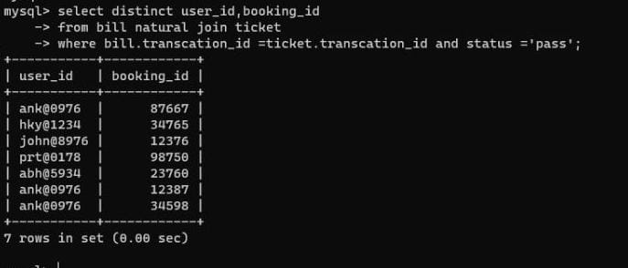
SQL Queries
1) Find user id and booking id of those users who have booked tickets successfully.

Slide 42
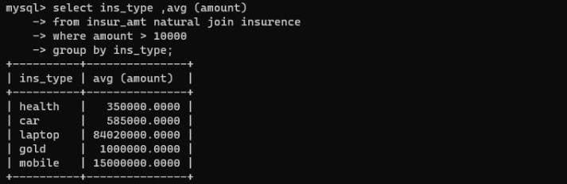
SQL Queries
2)Find the average insurance amount of all types of insurance and their insurance amount must be greater than 10000 rs.

Slide 43
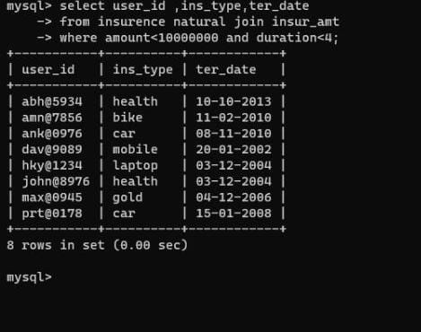
SQL Queries
3) Find the user id ,type of insurance and termination date of the insurance ,whose insurance amount is less than one cr. and time duration is less than 4 years

Slide 44
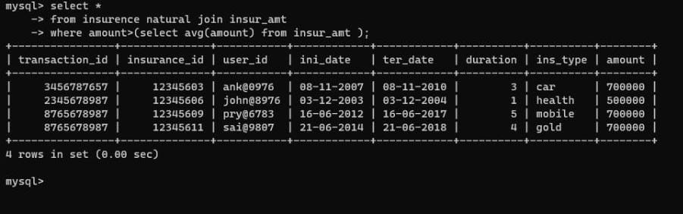
SQL Queries
4)Find the details of those insurances who have insurance amounts greater than the average insurance amount.

Slide 45
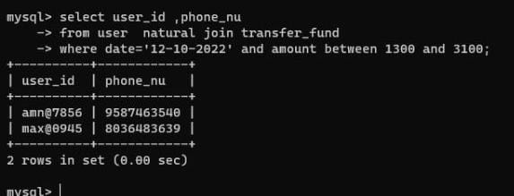
SQL Queries
5) Find those users who have paid money to any user on date 12-10-2022 and their transaction amount is greater than 1300 rs and less than 3100 rs.

Slide 46
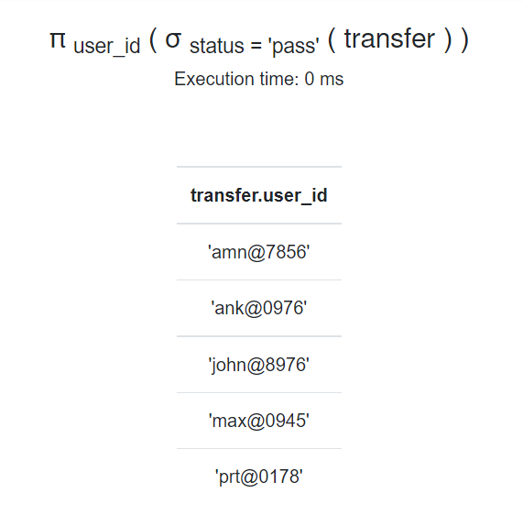
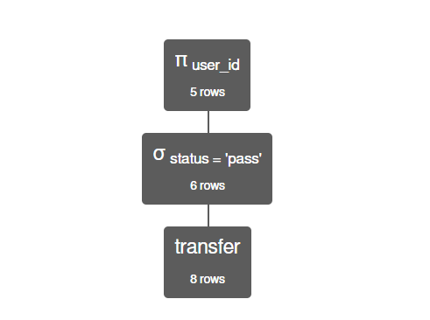
Relational Algebra Queries
1)Find the user-id of the people who have done successful transactions.

Slide 47
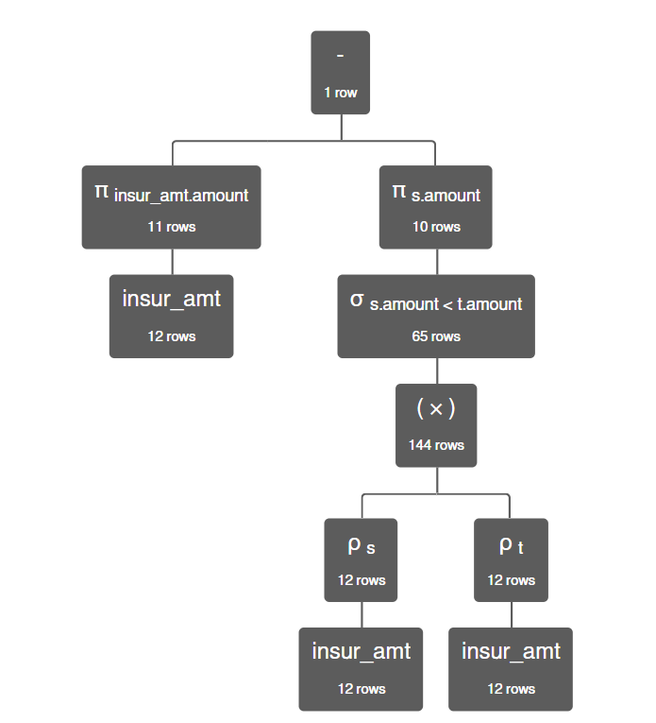
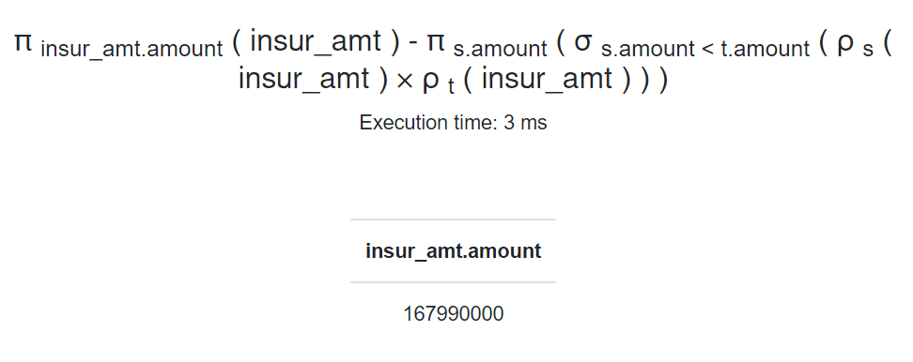
Relational Algebra Queries
2)Find the MAX amount spent by the user on insurance.

Slide 48
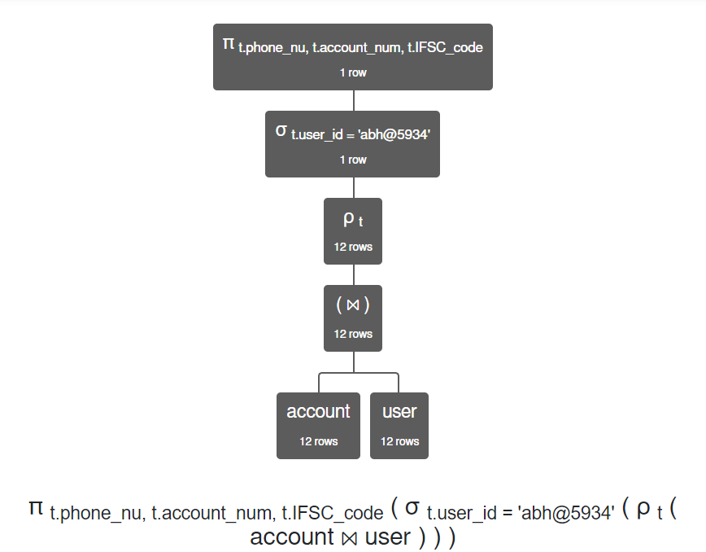
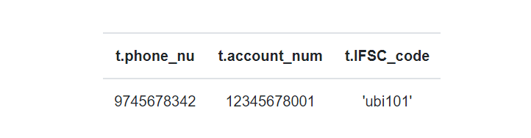
3) Find the mobile number, account number and IFSC code of the user having user_id =’abh@5934’
Relational Algebra Queries

Slide 49
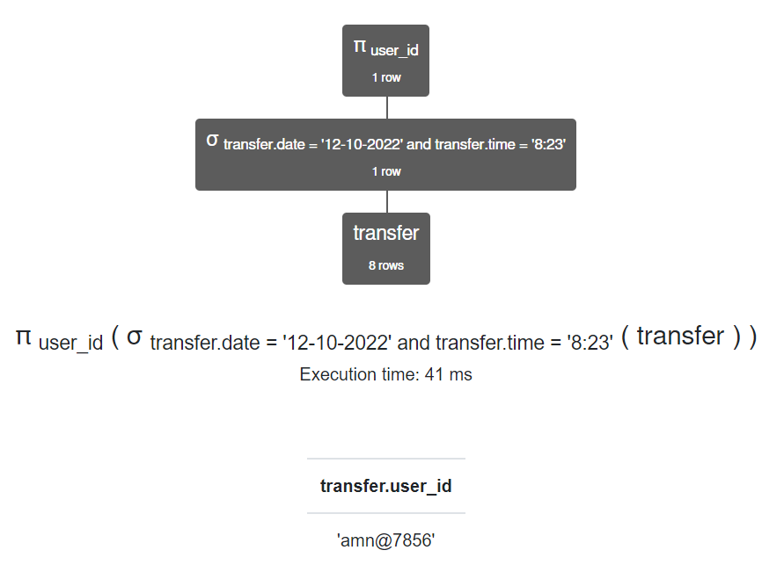
Relational Algebra Queries
4)Find the user-id who has done the transaction on “___8:23__” and “__12-10-2022___” date.

Slide 50
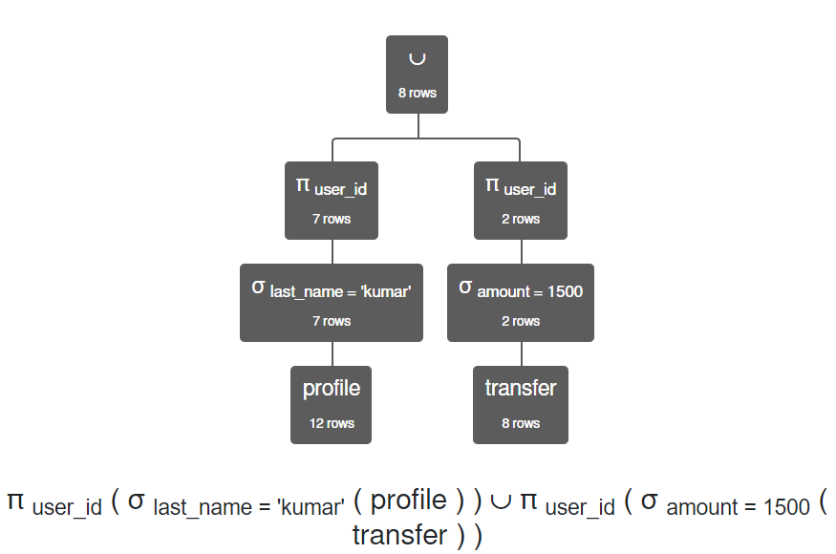
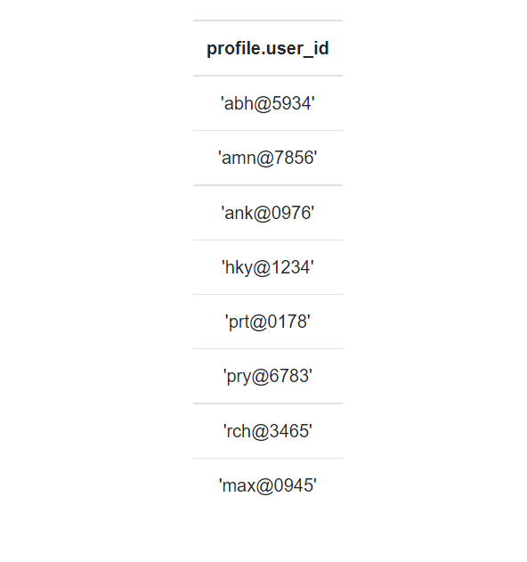
Relational Algebra Queries
5)Find user_id of the user who has made a transfer of 1500 OR who’s last name ends with ‘kumar’.

Slide 51
thank you

