Slide 1
Sweet Treat
Designed by the Puzzling Candies

Slide 2
Table of Contents

Slide 3
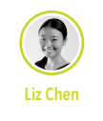
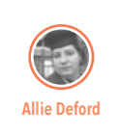
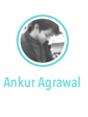
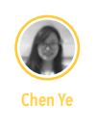
Meet the Team
I'm a designer who like to wear multiple hats at a time: from researcher, designer to prototyper. I hold a B.E. in industrial design, which means I can contribute my 3D modeling and physical product design skills to the capstone project. I also have professional experience at design agencies doing packaging, retail display, consumer electronic, and digital product design. Many of my design proposals had been implemented by clients and launched to the market.
Over the last year and a half, I've been transitioning from a software developer to a user researcher. In my time developing software, I found the developers often failed to consider their users’ needs over technical considerations, and that user experience was often tacked onto the end of projects. I thought this seemed backwards, so I began learning about user research so that I could prove there was a better way. More specifically, I'm interested in doing user research for civic technology projects and developer tools; these are both areas that I feel have been neglected.
I’m a Computer Scientist transitioning into Design Technologist. I like to invent technology and design interfaces for it. I mostly focus on designing tangible interfaces to interact with technology digital or otherwise. I feel that most of the people working in UX are biased towards designing screen based solutions (web/mobile), so I try to remain neutral during brainstorming and let the methods guide me to a solution be it non-technology based. Before joining the program I was an entrepreneur in India and also have worked as a software engineer for a startup company. I left all that because it became mundane and less interesting. Now with knowledge of design I am able to do a lot more interesting things with technology.
With a solid background in Electrical Engineering, I've gained rich experience in physical computing and electronic design. I've been enjoyed building things all the time and now I am actively improving my design skills and gaining experience, which I believe would help me build things in a better way.

Slide 4
Executive Summary

Slide 5
The Problem
The current problem stated by the HCDE office staff is that, even though a wide variety of candy is available, visitors to the candy bowl tend to select only specific types of candy, causing it to run out more quickly and leaving less variety for later visitors. This happens because the candy taker's behavior is only motivated by sensation, which is the best-tasting candies.
To solve this problem, we are aiming to design and implement a system that change people's current behavior of getting candy, with carefully designed motivations throughout each stage of user/player journey, and provide a fun and collaborative atmosphere for people working and visiting the office. Furthermore, through this project, we hope to not only design an engaging experience to solve the initial behavioral problem, but to promote a spirit of creativity, fun and collaboration in the HCDE department.

Slide 6
Design Question
“How do we motivate staff, faculty, and students to change their current behavior of taking candy from the HCDE main office and create a fun and collaborative atmosphere in the office?”

Slide 7
RESEARCH
In order to better understand the problem space and to uncover design opportunities, we performed user research. We started with a literature review to gain an understanding of the psychology around changing people’s behavior and to learn about gamification. We interviewed candy bowl managers to gain an understanding of common problems that surround the candy bowl.

Slide 8
Literature Review
We interviewed 3 candy bowl managers about their experience maintaining the candy bowl as well as to get a better understanding of the culture and common problems surrounding candy bowls.

Slide 9
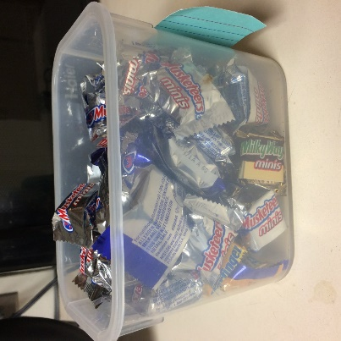
Interviews
We interviewed 3 candy bowl managers about their experience maintaining the candy bowl as well as to get a better understanding of the culture and common problems surrounding candy bowls. This allowed us to quickly understand the culture around the candy bowl without having to perform hours of observation.
Alex 7 months as a Candy Bowl Manager | Madeleine 18 months as a Candy Bowl Manager | Robin 2.5 years as a Candy Bowl Manager
From this interview, we learned that candy takers behavior is different when they have to give something, in this case a quarter, in order to obtain candy. We also learned that the candy bowl can serve as a sort of meeting place for a group of people, especially if those people have similar schedules. | From this interview, we learned a lot about how people interact with the candy bowl while someone in nearby. A key takeaway from this was that people who are frequent visitors to the candy bowl feel the need to justify their actions; in this instance, she said they often felt the need to justify the exact reason they were taking a piece of candy. She speculates this is because she sits near the bowl, and people might think she is judging the amount of candy they take. Interestingly, infrequent visitors to the bowl do not seem to suffer from this phenomenon and do not justify their actions, unless they are grabbing a large amount of candy at once. | From this interview, we learned that people have two different objectives when they

Slide 10
INSIGHTS

Slide 11
INSIGHT 1
Free candy in the office provide a place for people to interact with others. However, some less positive social interactions happens when people sitting near the bowl being frequently interrupted by candy takers.
“I sit next to the candy bowl, so people talk to me when they‘re taking candy. They comment on how many they’re taking, especially if they’re taking more than one” - p1
"people don't comment about guilt, but they have to pay for the candy, which makes a difference. They don't feel like they're getting it for free." -p2
Design Opportunity:
Enrich positive social interactions among HCDE staff, faculty and students.

Slide 12
INSIGHT 2
The department thinks the bowl belongs to everyone in the office, with shared burden of buying and refilling candy. But people only take candy from it, and complain to the office manager when the bowl is empty.
If it runs out then people starts complaining to me. Now the new administrator will go out and buy candy to bring in as well. So, the task is no longer all mine, I don’t own it anymore. It’s kind of like whoever wants to bring in candy, can.
The responsibility, I have decided, I am disowning that responsibility. Now it’s like whoever decides or remembers to pick up some candy, they can do it. I will go get some, I just don’t do it all the time, I am trying to empower other people to bring in the candy –p3
Design Opportunity
Encourage all staff in the office to refill the candy bowl, and foster the collective sense of responsibility.

Slide 13
INSIGHT 3
The bowl is usually filled with a variety of candy at first. But some type of candy always runs out quickly because of people tend to pick the same, and the least desirable ones stay there for a long time before it is finally selected.
“Red and pink go fast, and everyone leaves the orange and yellow without fail. People search through to get to the ones they want.” -p1
"It’s all babe ruth and 3 musketeers [left in the bowl], which happen to have the same color packaging." -p2
"They pick something that they can see, but something they like" -p2
Design Opportunity:
Enrich positive social interactions among HCDE staff, faculty and students.

Slide 14
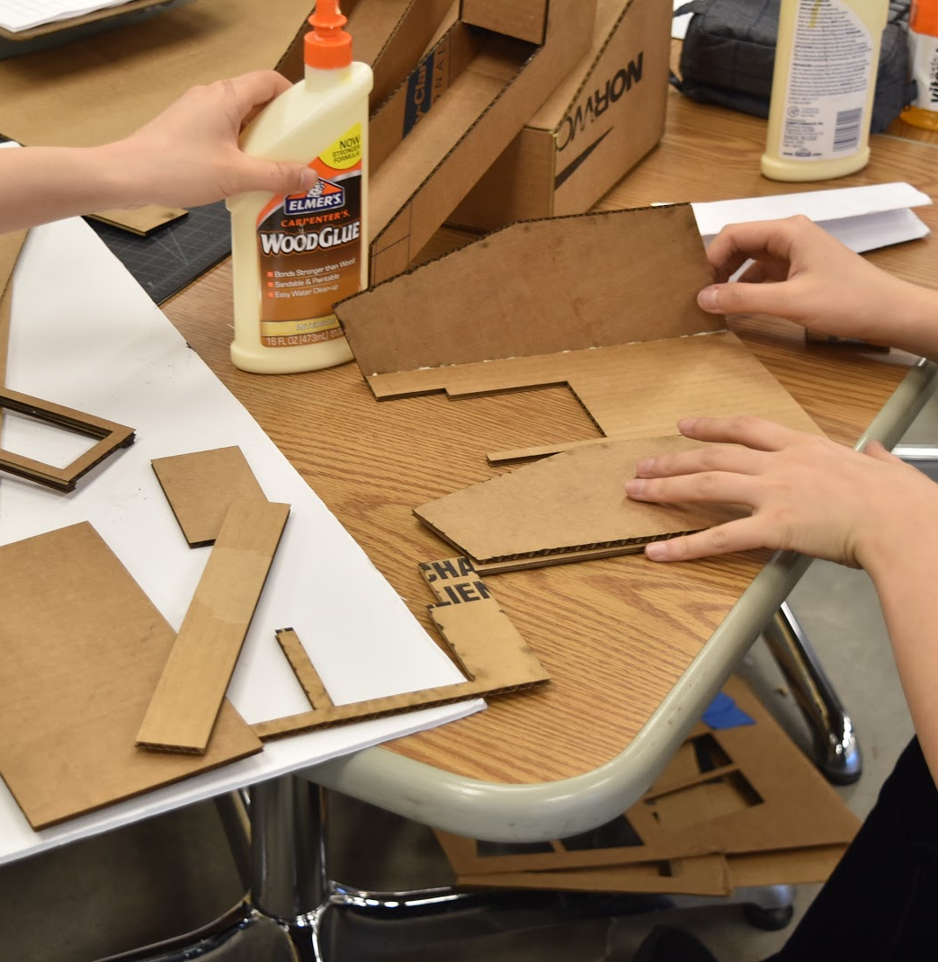
FIRST PROTOTYPE
Out of the 3 key insights and design opportunities, we brainstormed a wide variety of systems that cold meet the needs we uncovered. Finally, the ideas were narrowed down to a single physical form, with 3 possible digital interactions. We then created a mockup of the physical form using cardboard and created a simple website to host our 3 digital interactions.

Slide 15
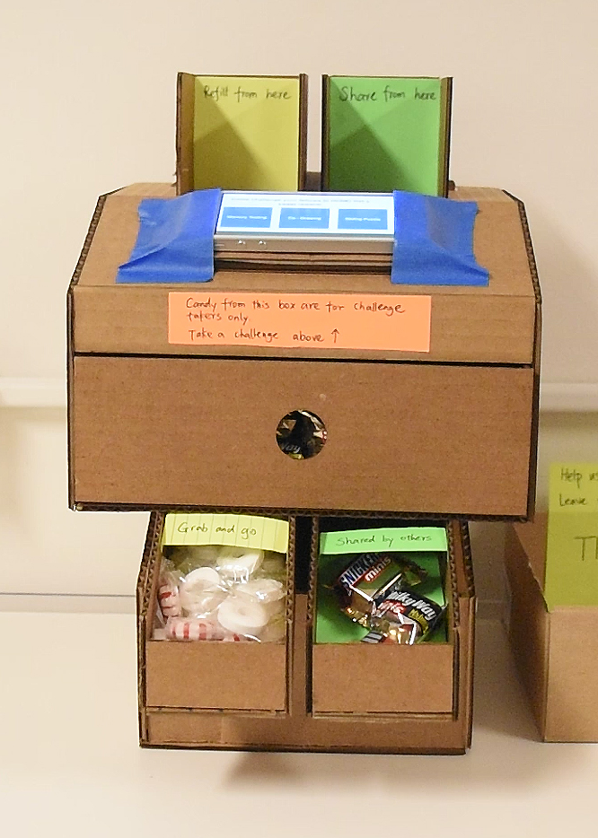
First Prototype: Physical
While designing, we kept the following things in mind:
Catering to The Needs Of Two Different User Groups: According to our research, there are two different reasons users take candy: getting a quick sugar rush by quickly grabbing a candy and going, versus using it as a way to take time to have fun, relax, and social with others. This difference is the reason behind dividing candy into different boxes and trays. For the later instance, the candy machine provides higher quality candy, and requires users to take part in certain challenge or collaborative activity in order to get the candy. For the former, the candy machine provides ordinary candy or candy donated from other users in the trays at the bottom.
Social Gifting: In order to make the quick grabbing experience more engaging, we utilize the gamification concept of Social Gifting, which refers to the benefit or reward that can only be obtained from social relationships. This is utilized in the ‘Shared by Others’ tray, which is designed to be the place where people have the chance to grab higher quality candy shared by previous users who were able to complete the challenges without any extra effort. This social gift is designed to encourage the sharing and collaboration spirit among the target users.
Utilizing Form to Control Picking: By shrinking the size of the two trays at the bottom, the design reduces the chance that a user will pick only their favorite candies from the available candy, since they are able to see fewer options. This leaves a wider variety of candy for late-comers. The design typically allows users to pick from less than seven candies, which they can see from the tray openings.
Emphasis on Refilling Form Factors: The two tubs at the top are designed for refilling the two trays at the bottom. By emphasizing the two tubs with color, textual hints, and eye-catching form, the design aims to encourage users to refill and share candy.

Slide 16
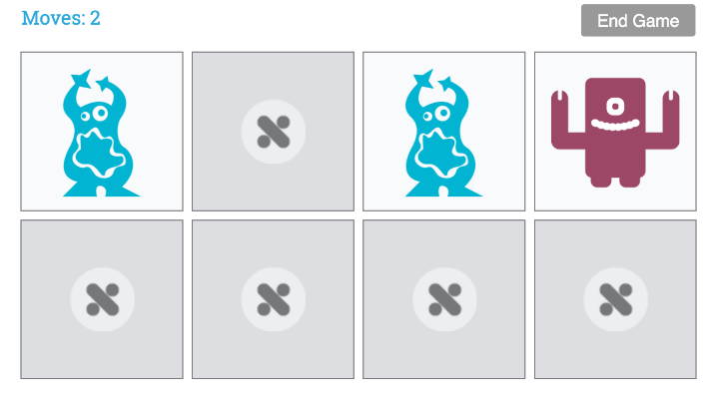
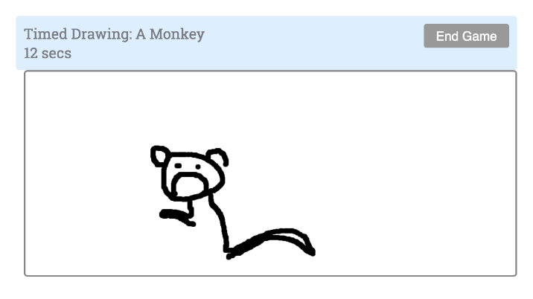
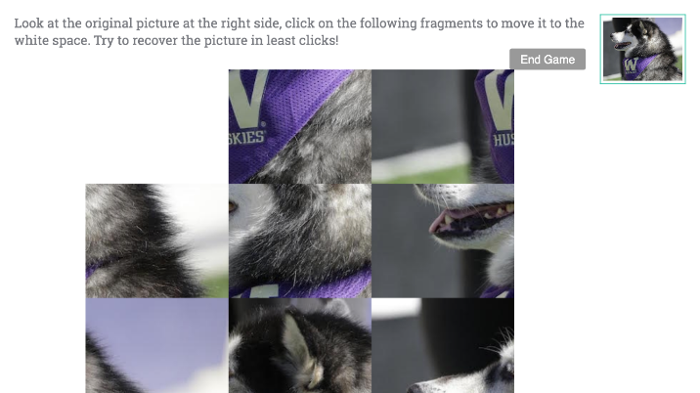
First Prototype: Digital
We created 3 possible digital interactions for the final system, which we called Challenges.
1: Memory Testing
2: Co-Drawing
3: Sliding Puzzle
The objective of this Memory Testing game is to flip over pairs of cards and match all the turned-down cards in as few moves as possible. We choose this game for its simplicity, fun, and good fit for screens with small size.
The idea behind Co-drawing is to encourage social interaction inside the department, by providing this platform for people to have fun drawing together. The system will rotate the topic of drawing periodically. The users will be provided with incomplete drawings started by previous users, and continue drawing for 30 seconds based upon the partially finished drawing. After a specified number of sessions (3 or 4), the picture is considered complete and added to the gallery. A new image is then started. This challenge was chosen for it’s attention to collaboration and group interaction.
Sliding puzzle is a game that challenges the players to move pieces which are stuck in a fixed frame around in the right sequence to recreate the original picture. The user can only move one piece at one time to the blank space until they get the whole picture, and only adjacent tiles may be moved into the blank space.
The choices of the pictures can add another layer of fun, as we can use pictures of the provided by members of the department or university specific images. Additionally, this challenge is more complex than the previous ones, which helped us determine how much effort users will willing to put forth to earn candy.

Slide 17
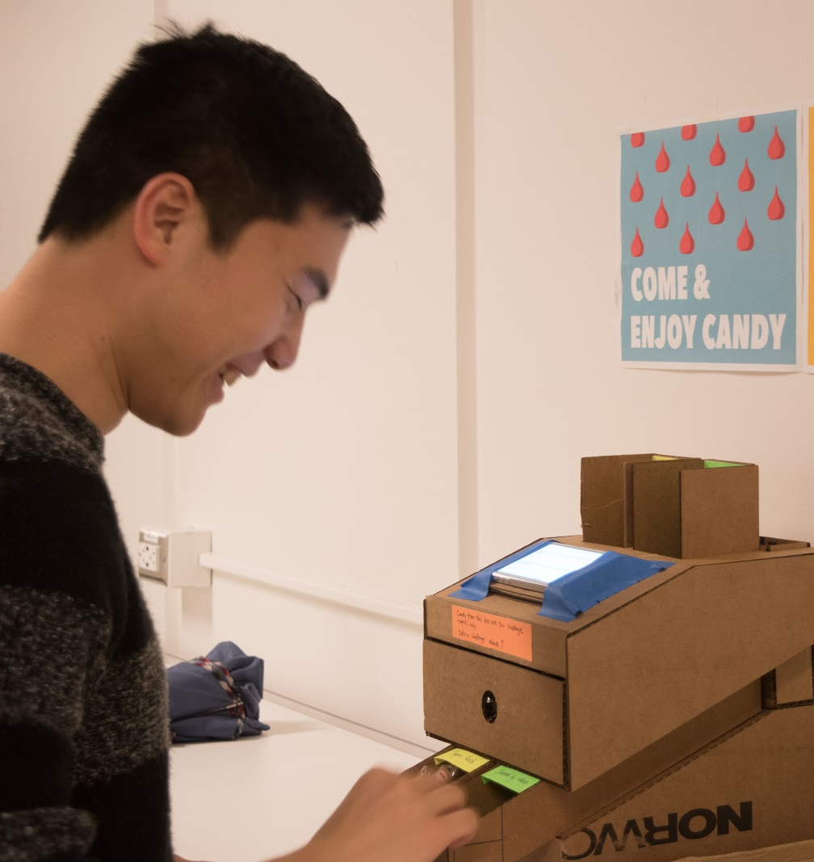
Evaluation
In order to evaluate our initial prototype, we conducted a round of usability testing to gather user feedback. Our main goal was to gather feedback on the 3 potential digital challenges and the overall physical design.
Our testing was completed one afternoon in Sieg Hall. The prototype was placed in a public place where students, staff, and faculty would pass by. A researcher stood with the prototype. Participants were those who walked and took a few minutes to explore the prototype. They were directed to explore the prototype, and after they were done, the researcher asked them about their experience using the prototype and for any feedback they might have.
Ultimately, we had 7 participants complete our study, and we uncovered a variety of information. Their feedback uncovered several key usability issues.

Slide 18
Key Findings
Key findings from the usability study include:
The sliding game is too time consuming. When completing games, users want to be able to quickly complete the challenge in order to earn candy. However, a participant who played the sliding game thought it was too complicated to achieve that goal.
The buttons are hard to select due to their size. Participants commented that the buttons, which are required to advance through the system, were hard to select using their finger due to their small size.
The purpose of the charity box and the sugar rush box is unclear. Until participants played the game that instructed them to open the drawer to get a higher quality candy, they were unsure how the candy would be different from the candy in the two boxes.

Slide 19
Final Prototype
As a result of the findings from our testing, we made modifications to the design of both the physical and digital parts of the prototype.

Slide 20
Electronics Diagram

Slide 21
Digital Interaction

Slide 22
Key Feature 1

Slide 23
Key Feature 2

Slide 24
Key Feature 3

Slide 25
Future Work

Slide 26
Thank You

