Slide 1
Nearest Neighbor of Different Image Representation
Presented by
Sajid Wasif (1912313642)
&
Ankur Chowdhury (1911844042)

Slide 2
The Project
This project presents a system that utilizes pretrained models and feature extraction techniques to identify similarities between images from different nature. Collecting a diverse dataset and computing feature vectors, the system measures distances using both Euclidean distance and cosine similarity. The retrieval system returns the top 10 images with the highest similarity scores, revealing hidden connections and showcasing the potential for image similarity. This work has applications in content-based image retrieval, cross-domain analysis, and creative exploration.

Slide 3
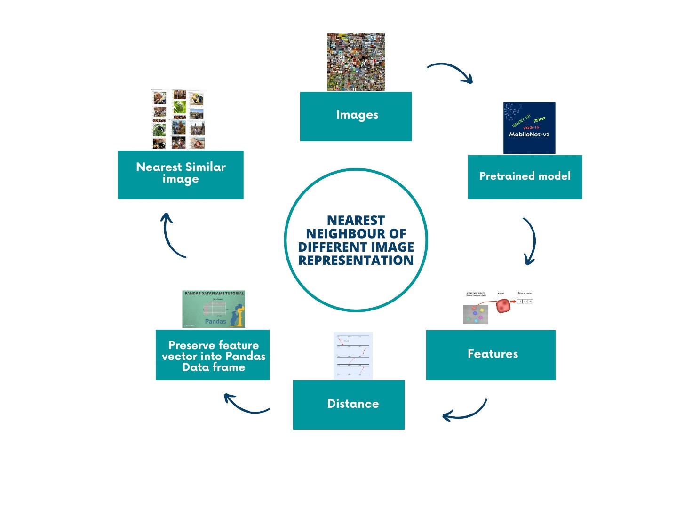
Analysis of the design

Slide 4
Usability, Manufacturability, Sustainability
Usability:
The system developed in this project demonstrates good usability by providing a user-friendly interface for inputting images and retrieving similar images. The retrieval process is straightforward and intuitive, allowing users to quickly obtain results
Manufacturability:
The project focuses primarily on software development rather than physical manufacturing. As such, the manufacturability aspect may not directly apply in this context. However, the software implementation can be easily deployed on various platforms and integrated into existing systems, ensuring scalability and adaptability.
Sustainability:
The project contributes to the sustainable use of computational resources. By utilizing pretrained models and feature extraction techniques, the system optimizes computational efficiency, reducing the need for extensive training on large datasets. Additionally, the project promotes reuse and repurposing of existing models, which aligns with the principles of sustainability in the field of artificial intelligence.

Slide 5
Implementation
Approach: Initially we chose three pretrained models (Vgg16, Resnet101, Zfnet) in order to extract features from every picture of our dataset and then convert every picture feature into a single feature vector and then calculate the distance between these vectors. Finally, we built an input system where user can input a random picture and then using cosine similarity and Euclidian distance our system would give 10 nearest neighbors of that picture so that we can observe what they represent.
Challenges: Increasing the amount of features extracted by each model and Ensuring compatibility between the models and the metrics so that they can give pictures that represent similar feature from different nature.
Limitation: only able to process dataset consisting of only 4 thousand images max . As a result similarity in features of the result was sometimes difficult to relate and observe

Slide 6
Development Process
•Initially, only VGG16 model was used for feature extraction, but the number of features obtained was insufficient for generating similar images.
•The dataset used in the initial stages was limited to only 200 images, which limited the diversity and coverage of the dataset.
• Cosine similarity was the first metric employed to identify the 10 nearest neighbors, but the initial similarity scores were low.
• To improve the similarity scores, additional models, namely ResNet101 and ZFNet, were incorporated into the feature extraction process.
•Euclidean distance was introduced as another similarity metric, alongside cosine similarity, to find the nearest neighbors.
• A new dataset, the ImageNet dataset, was used to provide a larger and more diverse set of images for retrieval.
• Lastly, MobileNetV2 was added to the set of pre-trained models used in the image retrieval process, expanding the range of feature extraction capabilities.

Slide 7
Environment Considerations & Sustainability
Nearest neighbor algorithms are used in various image representation techniques, but their environmental impact is minimal. It is important to optimize the algorithm and utilize energy-efficient hardware to minimize the environmental impact. Data storage and data collection should also be considered to reduce the environmental footprint. Algorithmic efficiency, hardware lifecycle, and ethical considerations should be taken into account when applying nearest neighbor algorithms to image representation. Optimizing computational resources, data storage, algorithmic efficiency, and ethical considerations can lead to more sustainable image representation techniques.

Slide 8
Tools & Technologies used
google colab
Visual Studio Code (vs code)
ImageNet dataset(partial)

Slide 9
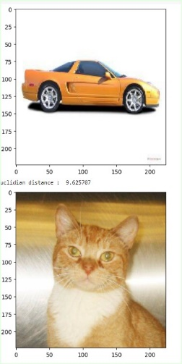
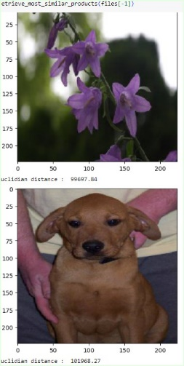
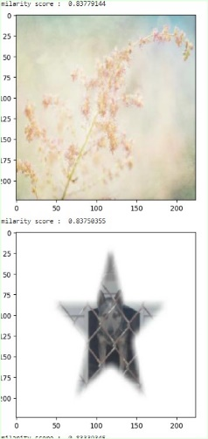
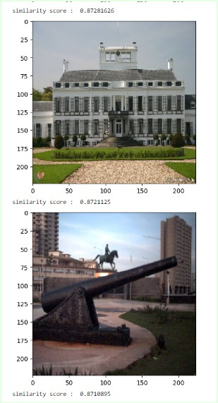
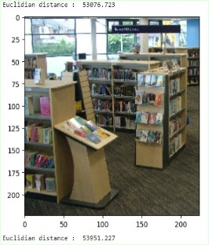
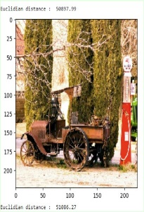
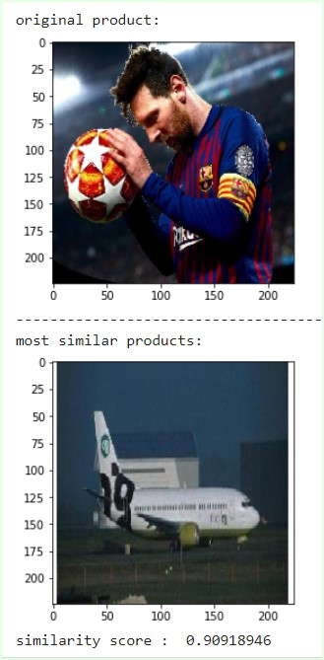
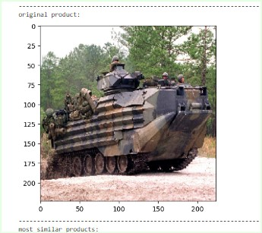

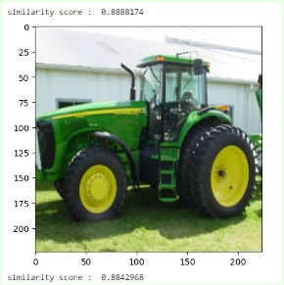
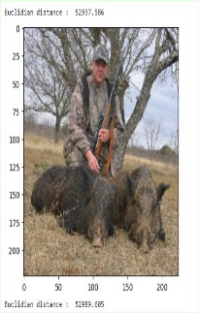
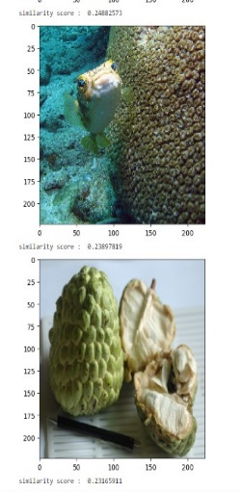
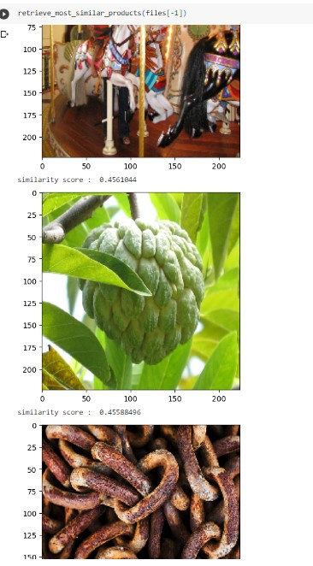
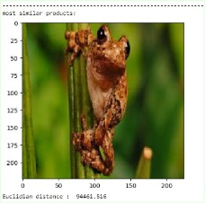
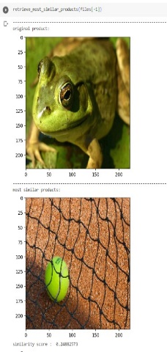
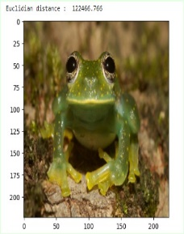
Results
output
output
input
input
output
input

