Slide 1
Battle of the Neighborhoods
-
Rental housing properties

Slide 2
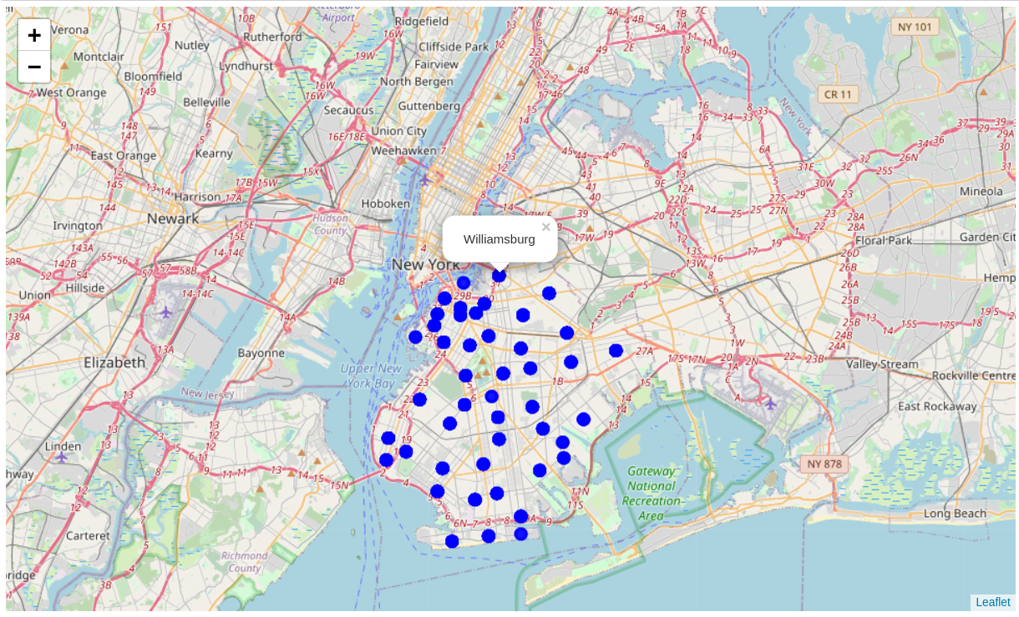
Unique Neighborhoods on New York City
We have 47 unique Neighborhoods in our dataset. Using the folium library, all the contentration of neighborhoods are plotted on the New York City map.

Slide 3
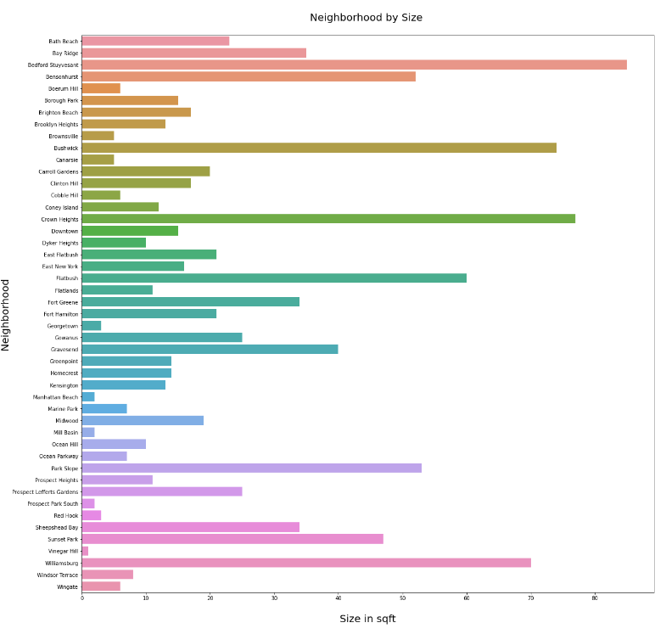
Graphical Representation of Dataset
Size of Properties Per Neighborhood

Slide 4
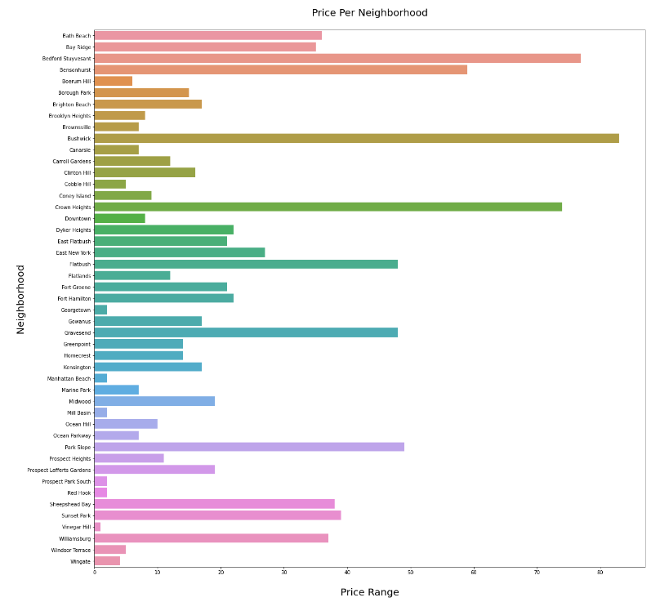
Graphical Representation of Dataset
Price of Properties Per Neighborhood

Slide 5
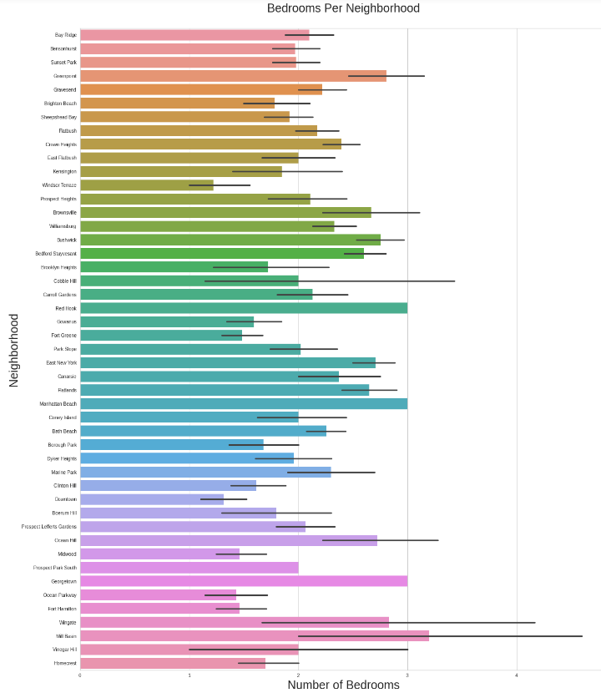
Graphical Representation of Dataset
Bedrooms of Properties Per Neighborhood

Slide 6
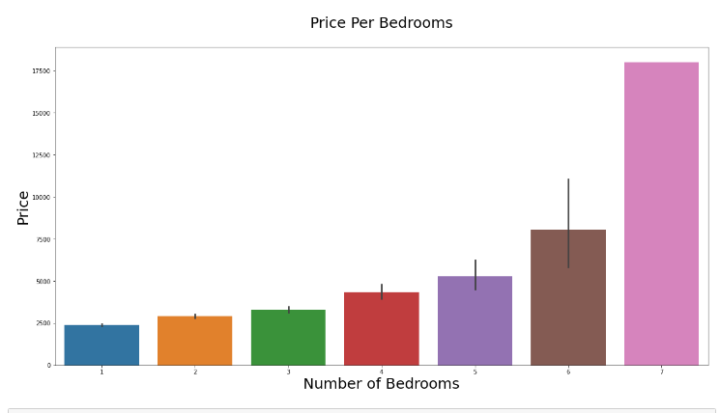
Graphical Representation of Dataset
Price of Properties Per Bedrooms

Slide 7
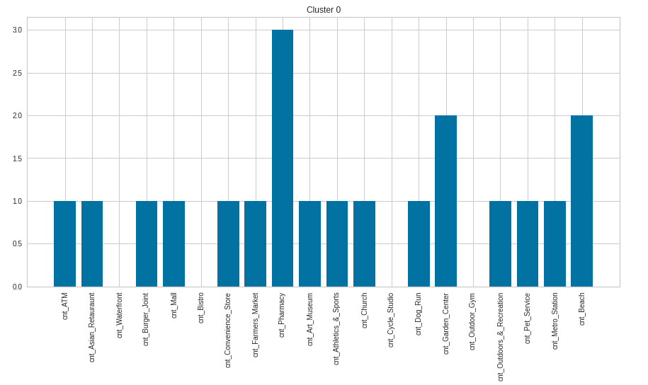
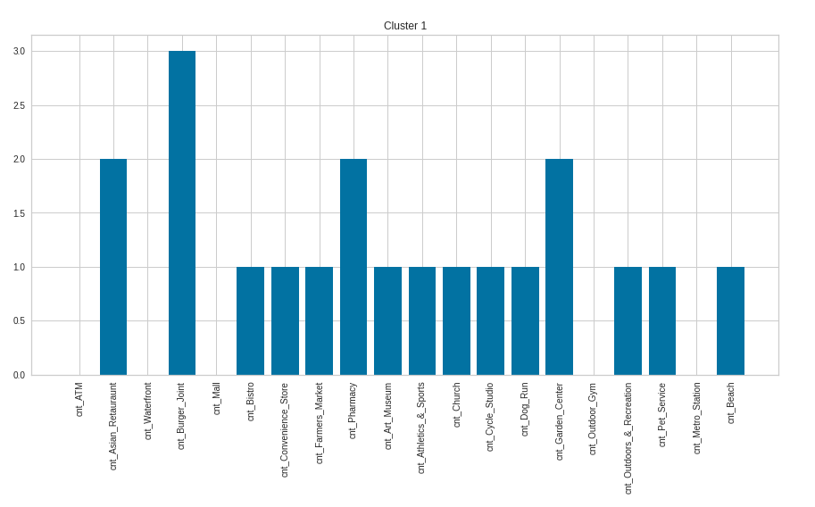
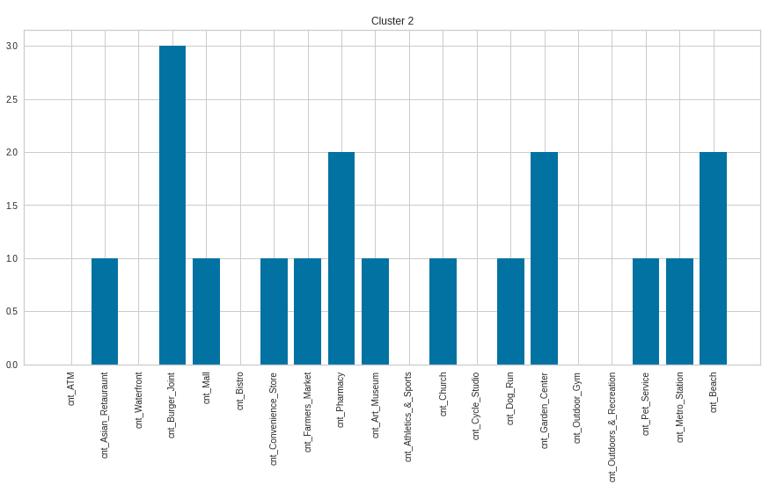
Clustering and Segmentation Using KMeans
Cluster 1
Cluster 0
Cluster 2

Slide 8
Conclusion Clustering and Segmentation
(1 of 4)
Based on the clustering exercise, we are able to narrow down to the properties in Cluster 0 because of the following reasons:
1. Close proximity to finacial services – ATMs
2. Quick access to daily need stores - Convenience stores and Malls
3. Good transporation connectivity - Metro Station
4. Fitness and Relaxation - Oudoor and Recreational places
Cluster 0

Slide 9
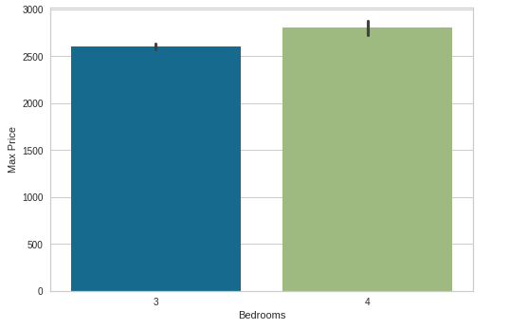
Conclusion Clustering and Segmentation
(2 of 4)
This graph shows that there are:
1. 3 bedroom set properties within a range of $2,600
2. 4 Bedrooms set properties within a range of $2,800

Slide 10
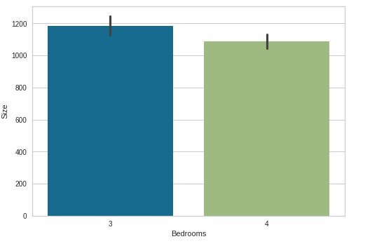
Conclusion Clustering and Segmentation
(3 of 4)
This graph shows that there are:
1. 3 bedroom set properties within a range of 1,800 sqft
2. 4 Bedrooms set properties within a range of 1,100 sqft

Slide 11
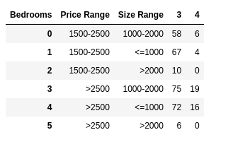
Conclusion Clustering and Segmentation
(4 of 4)
1. Based on the properties in Cluster 0, we get properties in specific price and size range with 3 to 4 bedrooms
2. These properties are in the price range of: USD 1500-2000 and USD 2500-3500
3. In these price ranges, we have options for both both 3 and 4 bedroom properties
4. Though the number of bedrooms differ in properties, but there are options within same price range with different number of bedrooms
5. These options can help the individual to easily narrow down few proeperties as per their preferences/ constraints and prioritize visits to these properties

Slide 12
Final Conclusion
Best Cluster out of 3
Based on the clustering exercise, we are able to narrow down to the properties in Cluster 0 because o Bedrooms within the range of size 200 sqft – 1800 sqftf the following reasons:
1. Close proximity to finacial services - ATMs
2. Quick access to daily need stores - Convenience stores and Malls
3. Good transporation connectivity - Metro Station
4. Fitness and Relaxation - Oudoor and Recreational places
This cluster provides us with affordable properties having 3 and 4 bedrooms in a price limit of $2,800 and with a size range upto 1,800 sqft

