Slide 1
CLASSIFICATION AND DETECTION OF MELANOMA SKIN CANCER USING NEURAL NETWORKS
Ankur Napa

Slide 2

Outline
01 | Problem Statement
02 | Significance of the study
03 | Data Gathering
04 | Literature review
05 | Research methodology
06 | Exploring the data
07 | Results & Evaluation
08 | Conclusion
09 | Future Scope
10 | References

Slide 3
PROBLEM STATEMENT
PROBLEM
Melanoma, a deadly skin cancer form originating from melanocytes, poses significant health and economic challenges globally. Despite being a minority among skin cancer types, its high metastasis rate leads to most skin cancer-related deaths. Traditional detection methods, involving clinical examinations, patient histories, and biopsies, are essential yet prone to human error. Tools like the ABCDE criteria, used by dermatologists to evaluate skin lesions, can sometimes result in unwarranted invasive procedures. Thus, there's an urgent need for more accurate, cost-effective, and less invasive melanoma detection techniques.
SOLUTION
In this thesis, we present a novel approach to melanoma detection using Deep Convolutional Neural Networks (DCNNs). Harnessing the power of machine learning, our method offers a more accurate, efficient, and non-invasive alternative to traditional techniques. The DCNN model, termed LCNet, is meticulously designed to classify skin lesions, improving early detection rates. This innovative approach not only enhances patient outcomes but also minimizes unnecessary invasive procedures, revolutionizing the way melanoma is diagnosed.

Slide 4
SIGNIFICANCE OF THE STUDY
BOOSTING DIAGNOSTIC PRECISION
ADVANCING CAD SYSTEMS
Employing state-of-the-art Convolutional Neural Networks, the study significantly contributes to the evolving field of Computer-Aided Diagnosis. It sets the stage for advancements in image-based diagnostic systems.
The study aims to enhance melanoma detection accuracy through Deep Convolutional Neural Networks. This technology offers a non-invasive, cost-effective screening, especially beneficial in resource-limited areas.
ENSURING SCALABILITY
AIDING HEALTHCARE PROFESSIONALS
The research holds the potential for broad adoption due to its focus on automation and machine learning. This scalability can further enable early detection and prevention of melanoma on a larger scale.
The research can assist dermatologists in early-stage screening, serving as a decision-making tool. This helps facilitate timely treatment, improving patient outcomes and potentially saving lives.

Slide 5
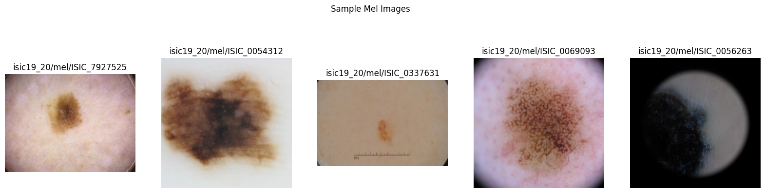

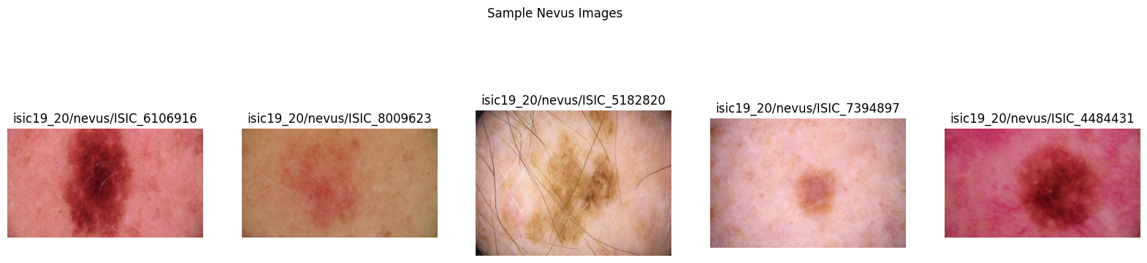
DATA GATHERING
ISIC Melanoma Dataset

Slide 6
LITERATURE REVIEW
CNN
(Hasan et al., 2021) developed "DermoExpert," a high-precision hybrid CNN framework, setting new benchmarks in AUC metrics. Meanwhile, (Zhou et al., 2020) leveraged spike-timing-dependent plasticity in spiking neural networks, achieving notable accuracy and runtime efficiency, Both studies highlight the evolving landscape of neural networks in skin lesion classification,
XCEPTION-NET
(Jain et al., 2021) highlighted the effectiveness of transfer learning nets in skin cancer classification, with Xception Net leading at a 90.48% accuracy rate, yet noted the need for broader datasets. (Lu and Zadeh, 2022) improved XceptionNet for skin cancer diagnosis, achieving superior accuracy but suggested further research on data pre-processing and methodology optimization.
VGG16
(Majtner et al., 2018) utilized VGG16 and GoogLeNet for melanoma prediction, achieving 0.815 accuracy with detailed preprocessing. (Bechelli and Delhommelle, 2022) highlighted VGG16's excellence in skin tumor classification, lacking preprocessing details.

Slide 7
OTHER DL APPROACHES
(Li et al., 2020) reviewed 45 studies since 2016, underscoring deep learning's superiority in skin disease detection. (Naeem et al., 2022) introduced SCDNet, combining Vgg16 with CNNs, achieving 96.91% accuracy. Both studies hint at further research potential.
HYBRID APPROACH
(Brindha et al., n.d.) utilized CNN and SVM algorithms with data augmentation and Gabor filter for early skin cancer prediction, indicating room for further exploration whereas (Gong and Xiao, 2021) introduced a CNN and NLP chatbot integration for skin cancer detection.
ADVANCED APPROACHES
(Höhn et al., 2021) utilized CNNs, specifically ResNeXt50, for melanoma/nevus classification in histologic WSIs, emphasizing gaps in patient data integration. Meanwhile, (Ali et al., 2021) demonstrated the superiority of their DCNN model over transfer learning models in skin lesion classification, without pinpointing specific literature gaps.

Slide 8
RESEARCH METHODOLOGY
DataSet Selection
The study uses Kaggle's UCF-Crime dataset, featuring 1900 surveillance videos of 13 public safety-impacting anomalies, suitable for general anomaly detection and specific activity recognition.
Exploratory Data Analysis
Exploratory Data Analysis (EDA) serves as a pivotal stage in our research process. In this investigation, we meticulously scrutinize the dataset to identify meaningful patterns and trends that are instrumental for the study's objectives.

Slide 9
Data Pre-preprocessing
In this thesis, data pre-processing is crucial for enhancing model performance. It involves image cropping, resizing, and augmentation to create a robust dataset, ultimately improving melanoma classification accuracy.
Image Cropping
In the study, dynamic image cropping is applied to isolate lesion areas, removing extraneous image details. This targeted approach aids the model in making more accurate melanoma classifications.
Resizing
In the thesis, image resizing to uniform dimensions is vital for efficient model training. Bilinear interpolation is employed during this step to preserve image quality.
Augmentation
In this thesis, data augmentation is applied solely to the training set, introducing random rotations, scalings, and translations. This enhances model robustness and mitigates overfitting.

Slide 10
LCNet
The thesis details the creation of LCNet, a specialized CNN for lesion classification. The architecture, dataset handling, training, and evaluation metrics are comprehensively covered, demonstrating robust performance.
Results
The Results section showcases LCNet's strong performance in melanoma detection, validated by key metrics like F1 Score, Precision, and Recall, confirming its clinical applicability.

Slide 11
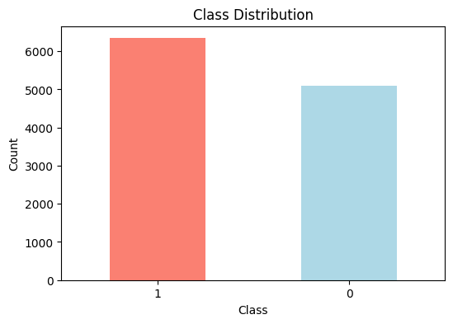
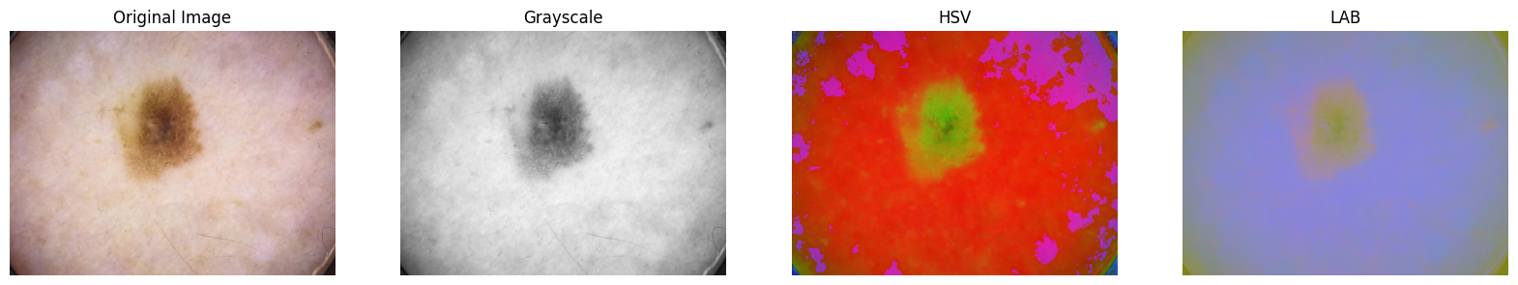
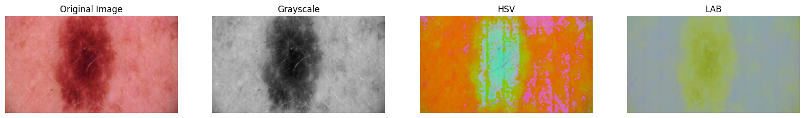
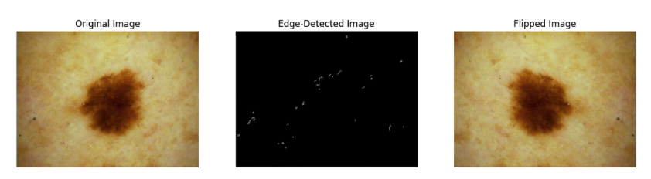
EXPLORING THE DATA
Figure 1 shows the dataset's class distribution: 6,343 Nevus ('1') and 5,106 Melanoma ('0') images.
Figure 2: Color Space Transition for Mel Image
Figure 1: Class Distribution
Figure 3: Color Space Transition for Nevus Image
Figure 2 and 3 showcases various color spaces: Grayscale, HSV, and LAB, highlighting their unique image data perspectives and applications for Mel and Nevus Images Respectively
Figure 4 showcases edge-detected images using Canny algorithm, statistical color metrics, and horizontally flipped images, aiding dataset understanding and model generalization.
Figure 4:Statistical Analysis

Slide 12
RESULTS & EVALUATIONS
SUMMARY
Balanced Performance: The model's F1 Score of 0.8707 suggests a balanced trade-off between precision and recall, making it a reliable tool for both identifying and ruling out melanoma cases.
Minimized False Positives: A Precision score of 0.87 indicates that the model accurately identifies melanoma most of the time, reducing the likelihood of false positives, which is crucial in medical diagnostics.
Comprehensive Detection: The model's Recall score of 0.8717 highlights its capability to detect a large proportion of actual melanoma cases, reducing the chances of missing true positive cases in a clinical setting.
Clinical Reliability: The aligned scores of F1, Precision, and Recall around 0.87 signify the model's suitability for real-world medical applications, reinforcing its overall reliability in melanoma detection.

Slide 13
CONCLUSION
Comprehensive Research Approach
This thesis undertook a multifaceted research journey, focusing on the creation and evaluation of a neural network model to identify melanoma skin cancer. It wasn't just a machine learning exercise but a comprehensive endeavor, blending data science and medical research.
Structured Model Development
The research followed a structured approach that began with Exploratory Data Analysis (EDA) and continued through data pre-processing, model architecture design, and rigorous training. A dual-axis graph proved vital for monitoring the model's performance and its generalizability to new data.
Promising Evaluation Metrics
In the final phase, the model underwent evaluation using robust metrics like F1 Score, Precision, and Recall, signalling its readiness for clinical applications. These metrics not only confirmed the model's capabilities but also its reliability for medical settings.
Future Contributions
This thesis is not just a culmination of a research endeavour; it serves as a roadmap for future work in the field of medical image analysis. It highlights the importance of integrated approaches and sets the stage for integrating the model into existing healthcare systems for broader medical applications.

Slide 14
FUTURE SCOPE
User Experience and Accessibility
Building an intuitive user interface for the model could significantly improve its accessibility. Such an interface would not only benefit healthcare professionals but could also be adapted for public use, facilitating more frequent skin checks.
04
Real-world Validation
The natural progression from this thesis would be to conduct clinical trials in partnership with dermatology clinics. These trials would assess the model's real-world efficacy and its utility in medical settings.
03
Enhancing Model Performance
Exploring different machine learning techniques, such as ensemble methods or transfer learning, could potentially improve the model's performance. Further algorithmic enhancements could lead to more accurate melanoma detection.
02
Expanding Data Diversity
Future research should consider enriching the dataset to include a variety of skin types, lighting conditions, and melanoma stages. A more comprehensive dataset would make the model universally applicable and robust.
01

Slide 15

THANK YOU

