Slide 1
Xxxxxxxxxxxxxxxxxxxxx ssssssssssssss ssssssssssssssss
Xxxxxxxx sssss

Slide 2

Outline
01 | Problem Statement
02 | Significance of the study
03 | Data Gathering
04 | Literature review
05 | Research methodology
06 | Exploring the data
07 | Results & Evaluation
08 | Conclusion
09 | Future Scope
10 | References
Notes:
As we move forward, I'd like to give you a roadmap of what we'll be covering today. The presentation is structured to provide you with a comprehensive understanding of our approach to detecting brain tumors using neural networks and MRIs. We'll begin by defining the problem statement, outlining why this research is crucial. Following that, we'll delve into the methodology, discussing the neural network models we employed and the MRI data we analyzed. We'll also explore the results and their implications, ending with conclusions and next steps for this research. So, buckle up as we navigate through this fascinating intersection of healthcare and technology

Slide 3
PROBLEM STATEMENT
PROBLEM
Brain tumors are among the most lethal medical conditions, and their accurate and timely detection is crucial for effective treatment. Traditional methods of identifying tumor spots in Magnetic Resonance Imaging (MRI) can be time-consuming and prone to human error. With the advancements in Neural Network technology, there is potential for more precise and efficient detection methods. However, there exists a gap in harnessing these advanced techniques to improve the accuracy and speed of brain tumor detection in MRI scans.
SOLUTION
This thesis leverages neural networks, specifically U-Net and DeepLabV3+, to enhance the accuracy of brain tumor detection in MRI scans. Through meticulous MRI data pre-processing and continuous model refinement, the solution ensures standardized input and optimal performance. By testing on a diverse MRI dataset from various institutions, the models' robustness and adaptability are ascertained. In summary, the proposed approach combines advanced neural network models and optimized techniques to offer an innovative method for MRI-based brain tumor detection.

Slide 4
SIGNIFICANCE OF THE STUDY
EARLY DETECTION AND DIAGNOSIS
COST AND TIME EFFICIENCY
Automated detection methods can reduce the time radiologists spend on analyzing each image manually, leading to faster results and decreased healthcare costs in the long run.
Utilizing neural networks for detecting brain tumors in magnetic resonance images can facilitate early diagnosis, drastically improving the chances of successful treatment and patient recovery.
ADVANCEMENT IN NEURAL NETWORK
PRECISION IN MEDICAL IMAGING
By focusing on brain tumor detection, this study contributes to the growing body of knowledge surrounding the practical applications of neural networks in diverse medical fields, setting a precedent for future research endeavors.
The study pushes the boundaries of accuracy in medical imaging, potentially minimizing false positives and negatives, which are critical in neuro-oncology decisions.

Slide 5
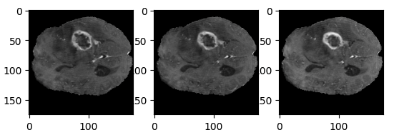

DATA GATHERING
BraTS2020 Dataset (Training + Validation)
In this research, we utilized:
BraTS Scans: Accessed in NIfTI format, these scans cover native (T1), post-contrast T1-weighted (T1Gd), T2-weighted (T2), and T2 FLAIR volumes, collected using various protocols from 19 institutions.
Segmentation Process: Datasets were segmented by multiple raters and validated by neuro-radiologists, focusing on GD-enhancing tumor, peritumoral edema, and non-enhancing tumor core.
Annotations: As per BraTS standards, segments included the GD-enhancing tumor, peritumoral edema, and the necrotic tumor core.
Data Pre-processing: Datasets were co-registered, interpolated to a 1 mm^3 resolution, and skull-stripped before distribution.
Diverse Data Origins: Data was sourced from 19 distinct institutions for a comprehensive analysis.

Slide 6
LITERATURE REVIEW
CNN
(Abd El Kader et al., 2021) introduced a differential deep-CNN model for MRI-based brain tumor detection, achieving a 99.25% accuracy through data augmentation. Conversely, (Zhao et al., 2018) combined three 2D FCNNs with 3D CRFs, emphasizing the value of integrating multiple models for improved segmentation accuracy.
CNN
(Islam and Ren, 2018) showcased robust tumor segmentation in BraTS 2017, underlining CNN's strength. Meanwhile, (Shoukat et al., 2021) highlighted CNN's efficiency with the EfficientNet for tumor detection. (LillyMaheepa and Nath, 2020) thoroughly analyzed various CNNs for brain tumor segmentation, while (Khan et al., 2022) use of VGG19 and MobileNetV2 with transfer learning achieved notable accuracy in predicting tumors.
ADVANCE APPROACH
(Zhou et al., 2019) achieved commendable Dice scores using deep architectures for brain tumor segmentation. In contrast, (Nema et al., 2020) introduced RescueNet, which demonstrated superior performance on the BraTS datasets by utilizing adversarial training.

Slide 7
ADVANCED APPROACH
(Rezaei et al., 2021) demonstrated a 42% mIoU for hand segmentation using weak labels. (Giacomello et al., 2020) highlighted transfer learning's potential in brain cancer segmentation using Adversarial Networks. (Yang et al., 2020) introduced BiHand for 3D hand estimation, suggesting CNN's capabilities in medical imaging. (Sharifi et al., 2021) accentuated CNN's effectiveness in diagnosing foot fatigue.
OTHER DL MODELS
(Ahmadi et al., 2019) showcased hybrid algorithms, notably MLP, for economic forecasting with KBE indicators. Conversely, (Afshar et al., 2018) emphasized CapsNet's superiority over conventional CNNs in brain tumor detection by incorporating tumor boundaries. Both studies highlight the versatility and efficacy of deep learning models in diverse realms.
OTHER DL MODELS
(Khan et al., 2020-2022) emphasized CNNs, especially VGG16, VGG19, and YOLOv7, for advanced brain tumor classification. (Hsu et al., 2022) introduced a hybrid method, combining WSI with mpMRI for glioma subtyping. Both showcase deep learning's transformative potential in brain imaging analysis.

Slide 8
RESEARCH METHODOLOGY
DataSet Selection
For our research, we utilized the comprehensive BraTS2020 Dataset from Kaggle, which provides diverse MRI scans from 19 institutions. Expert annotations highlight tumor classifications, and standardized preprocessing ensures data consistency, forming the core of our study.
Exploratory Data Analysis
Exploratory Data Analysis (EDA) serves as a pivotal stage in our research process. In this investigation, we meticulously scrutinize the dataset to identify meaningful patterns and trends that are instrumental for the study's objectives.

Slide 9
Data Pre-preprocessing
In this research, meticulous pre-processing readied the diverse BraTS2020 dataset for modeling. Data modalities were systematically organized, efficiently extracted using nib.load, and then standardized to consistent dimensions, ensuring optimal neural network performance.
U-Net
In this research, we have utilized U-Net, a deep learning model renowned for its proficiency in biomedical image segmentation. Its design efficiently segments features in images even with minimal training data, proving optimal for brain tumor identification.
DeepLabV3+
In this research, we have also utilized DeepLabV3+, a sophisticated convolutional neural network, for semantic segmentation. This tool effectively discerns fine details and broader contexts, pivotal for detecting tumor boundaries in medical images.
Evaluation
In the evaluation section, we critically assess the performance of our proposed model, considering accuracy, efficiency, and reliability. The results are benchmarked against existing methodologies to determine its superiority.

Slide 10
Results
In our results, we compared the U-Net and DeepLabV3+ models for image segmentation. DeepLabV3+ significantly outperformed U-Net, highlighting its enhanced capabilities in delineating intricate tumor boundaries.
Notes:
Let's now shift our focus to one of the most crucial aspects of our research—the results. We conducted a comparative analysis between the U-Net and DeepLabV3+ models, specifically focusing on their capabilities in image segmentation. What we found was quite revealing. DeepLabV3+ significantly outperformed U-Net, especially when it came to delineating intricate tumor boundaries. This underscores the enhanced capabilities of DeepLabV3+ in complex medical imaging tasks. The superiority of this model in our tests provides valuable insights into which tools might be most effective in advancing the state-of-the-art in brain tumor identification.

Slide 11
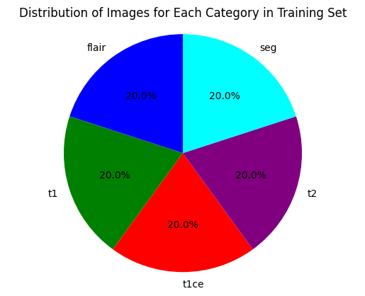
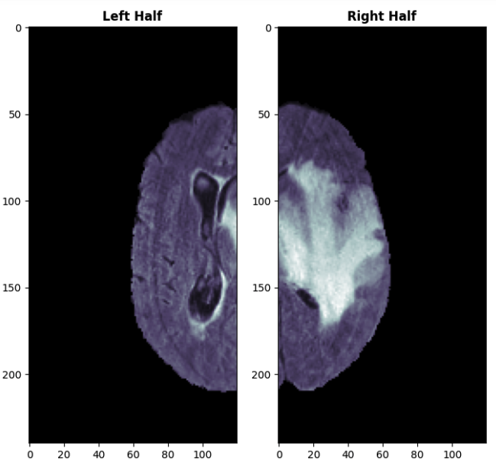
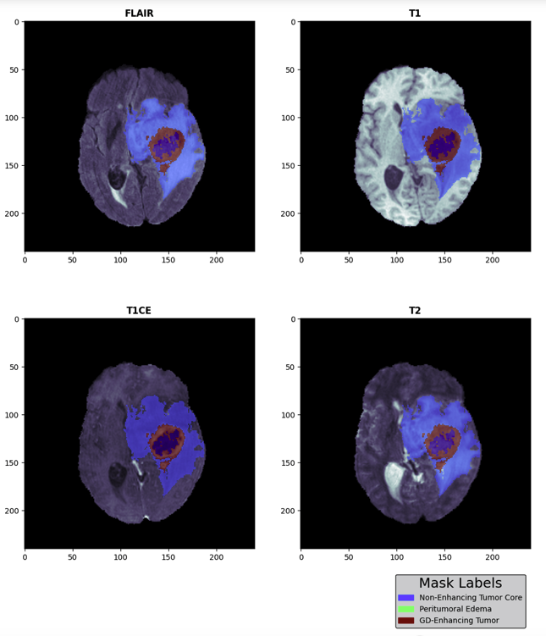
EXPLORING THE DATA
Figure 1: Dataset Distribution
Figure 2: Half Volume Visualization
Figure 1 describes the dataset components: 369 Flair images vital for lesion detection, 369 T1-weighted images highlighting fatty structures, 369 enhanced T1ce images post contrast injection, 369 T2-weighted images crucial for tumor identification, and 369 segmentation images demarcating tumor boundaries.
Figure 2 describes the non-enhancing tumor core, distinguishable from adjacent tissue. Adjacently, peritumoral edema indicates fluid accumulation. Prominently, the gadolinium-enhancing tumor highlights aggressive, invasive tumor sections.
Figure 3 presents a visualization that showcases half of the total volume. This method of representation allows for a deeper understanding by providing a clear view of the internal structures and intricate details that might otherwise be obscured in a full-volume display.
Figure 3: Mask Visualization
Notes:
Having discussed the methodology and initial results, let's now dive into some visual explorations of our dataset. This Slide features three critical figures that provide a multi-faceted understanding of the data we're working with. Figure 1 breaks down the dataset components, showcasing a variety of image types, each serving a specific purpose. We have 369 Flair images vital for lesion detection, an equal number of T1-weighted images that highlight fatty structures, 369 enhanced T1ce images post-contrast injection, and 369 T2-weighted images crucial for tumor identification. Additionally, we have segmentation images that clearly demarcate tumor boundaries.
Moving on to Figure 2, it offers insights into the non-enhancing tumor core, which is distinguishable from adjacent tissues. We can also see peritumoral edema, indicating fluid accumulation, and gadolinium-enhancing tumor areas that signify aggressive, invasive sections of the tumor.
Lastly, Figure 3 takes a unique approach by showcasing half of the total volume of a sample scan. This method of representation allows for a deeper understanding of the internal structures and intricate details that might be obscured in a full-volume display. The figures collectively serve to enrich our understanding and validate the methodologies we have employed.

Slide 12
RESULTS & EVALUATIONS
SUMMARY
DeepLabV3+ Efficacy: The DeepLabV3+ model achieved a remarkably high Dice Coefficient of 0.9766, indicating excellent segmentation accuracy.
U-Net Performance: The U-Net model registered a Dice Coefficient of 0.6256, reflecting moderate segmentation effectiveness.
Comparative Superiority: DeepLabV3+ outperforms U-Net in the context of the provided data, showing its superiority in segmenting images accurately.
Scope for Improvement: While DeepLabV3+ demonstrates high efficacy, there might still be room for refining and enhancing the U-Net model to achieve better results.

Slide 13
CONCLUSION
Evolution of Biomedical Imaging
Biomedical image segmentation has witnessed significant advancements with the adoption of neural architectures like U-NET and DeepLabV3+. The research aimed to evaluate their capabilities and relevance in addressing real-world imaging challenges.
Performance Analysis
DeepLabV3+ exhibited a superior segmentation capability with a Dice coefficient of 0.9766, demonstrating its precision in capturing complex details. In contrast, U-NET, designed specifically for biomedical image segmentation, achieved a coefficient of 0.6256, emphasizing its focus on rapid convergence and computational efficiency.
Model Suitability
The selection between U-NET and DeepLabV3+ should be guided by the specific requirements of the task, computational constraints, and the desired results. While DeepLabV3+ stands out in accuracy, the benefits of U-NET's efficiency and simplicity are equally vital in certain scenarios.
Future Implications
Beyond the statistical analysis, the study emphasizes the broader perspective in choosing appropriate models. The insights gained not only enrich the academic narrative but also set the stage for further exploration and potential advancements in the field of biomedical image segmentation

Slide 14
FUTURE SCOPE
Embracing Continual Learning
Medical science is an ever-evolving field. Therefore, models must be tailored to learn and adapt to new data over time, embracing strategies that allow for continuous learning without forgetting past insights.
04
Balancing Accuracy with Efficiency
Beyond precision, models' speed is paramount, especially for real-time scenarios. Prioritizing model optimization to achieve swift predictions without significant accuracy losses is crucial.
03
Expanding Dataset Spectrum
For a comprehensive evaluation, it's advisable to subject the models to diverse biomedical datasets. Such exposure can unearth any latent strengths or potential challenges not evident in the existing data.
02
Optimizing Model Structures
Both DeepLabV3+ and U-NET have showcased their potential in image segmentation. However, integrating recent deep learning innovations like attention mechanisms could further boost their performance.
01

Slide 15
REFERENCES
Rezaei, M., Farahanipad, F., Dillhoff, A., Elmasri, R. and Athitsos, V., (2021) Weakly-supervised hand part segmentation from depth images. In: Proceedings of the 14th PErvasive Technologies Related to Assistive Environments Conference. [online] PETRA ’21: The 14th PErvasive Technologies Related to Assistive Environments Conference. Corfu Greece: ACM, pp.218–225. Available at: https://dl.acm.org/doi/10.1145/3453892.3453902 [Accessed 8 Sep. 2023].
Giacomello, E., Loiacono, D. and Mainardi, L., (2020) Brain MRI Tumor Segmentation with Adversarial Networks. In: 2020 International Joint Conference on Neural Networks (IJCNN). [online] pp.1–8. Available at: http://arxiv.org/abs/1910.02717 [Accessed 8 Sep. 2023].
Yang, L., Li, J., Xu, W., Diao, Y. and Lu, C., (2020) BiHand: Recovering Hand Mesh with Multi-stage Bisected Hourglass Networks. Available at: http://arxiv.org/abs/2008.05079 [Accessed 8 Sep. 2023].
Sharifi, A., Ahmadi, M., Mehni, M.A., Jafarzadeh Ghoushchi, S. and Pourasad, Y., (2021) Experimental and numerical diagnosis of fatigue foot using convolutional neural network. Computer Methods in Biomechanics and Biomedical Engineering, 2416, pp.1828–1840.
Ahmadi, M., Jafarzadeh-Ghoushchi, S., Taghizadeh, R. and Sharifi, A., (2019) Presentation of a new hybrid approach for forecasting economic growth using artificial intelligence approaches. Neural Computing and Applications, 3112, pp.8661–8680.
Afshar, P., Plataniotis, K.N. and Mohammadi, A., (2018) Capsule Networks for Brain Tumor Classification based on MRI Images and Course Tumor Boundaries. Available at: http://arxiv.org/abs/1811.00597 [Accessed 8 Sep. 2023].
Khan, J.Y., Khondaker, M.T.I., Afroz, S., Uddin, G. and Iqbal, A., (2021) A benchmark study of machine learning models for online fake news detection. [online] Available at: https://www.semanticscholar.org/paper/3a0f0dae6e69b5a0508da05c344e9ca8a3d1f562.
Khan, M.A., Ashraf, I., Alhaisoni, M., Damaševičius, R., Scherer, R., Rehman, A. and Bukhari, S.A.C., (2020) Multimodal Brain Tumor Classification Using Deep Learning and Robust Feature Selection: A Machine Learning Application for Radiologists. Diagnostics, 108, p.565.
Khan, M.M., Omee, A.S., Tazin, T., Almalki, F.A., Aljohani, M. and Algethami, H., (2022) A Novel Approach to Predict Brain Cancerous Tumor Using Transfer Learning. Computational and Mathematical Methods in Medicine, 2022, pp.1–9.

Slide 16

THANK YOU

