Slide 1


E-CHALLAN PORTAL
Ankur Kumar Rai
Divyansh Puri
Sidharth Koli
Ashok Kumar

Slide 2
INTRODUCTION
01
APPROACH
02
TABLE OF CONTENTS
05
DESIGN FLOW
LEARNINGS
03
06
STATISTICS
07
MOCKUPS
04
CHALLENGES

Slide 3
01
INTRODUCTION

Slide 4
INTRODUCTION
E-Challan is an electronic format of challan. We have established a website where one can check if their vehicle has any offenses registered against it. This process is initiated to make the traffic services convenient, easy as well as transparent to general public.
With E-Challan system, effective and strong monitoring of traffic violators becomes easy for the traffic police, in the age of digitalization , traffic defaulters will now be able to pay e-challan at the ease of their hands.
Website can be accessed on any mobile/tablet/computer .
Traffic inspector can check the details/history of challan generated by him.

Slide 5
02
APPROACH

Slide 6
APPROACH
Explored different e-challan sites and came up with our own idea .
Came up with database design to store traffic officer, vehicle owner and challans data .
Came up with api designs.
Implemented the repos with api calls.
Designed the Mock UI.
Implemented the UI in angular.
Connected backend and database with angular.

Slide 7
03
LEARNINGS

Slide 8
LEARNINGS
Break complex tasks into parts and steps.
Plan and manage time.
Refine understanding through discussion and explanation.
Challenge assumptions.
Develop stronger communications skills.
Delegate roles and responsibilities.

Slide 9
04
CHALLENGES

Slide 10
CHALLENGES
Designing the database as per our need.
Creating custom methods as per our backend repository.
Making the website secure so that no one can login into an account without proper authorization.
Generating number of challans issued per pincode.
Designing the website.

Slide 11
05
DESIGN FLOW

Slide 12
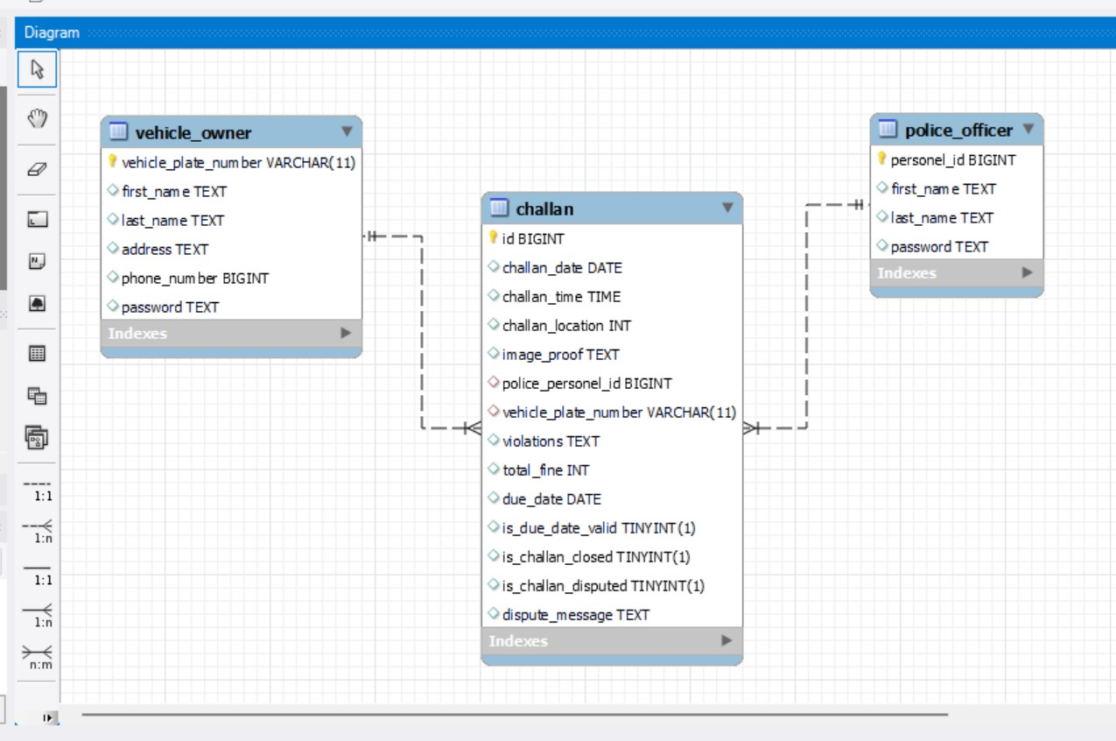
DESIGN FLOW

Slide 13
06
STATISTICS

Slide 14
STATISTICS

Slide 15
07
MOCKUPS

Slide 16
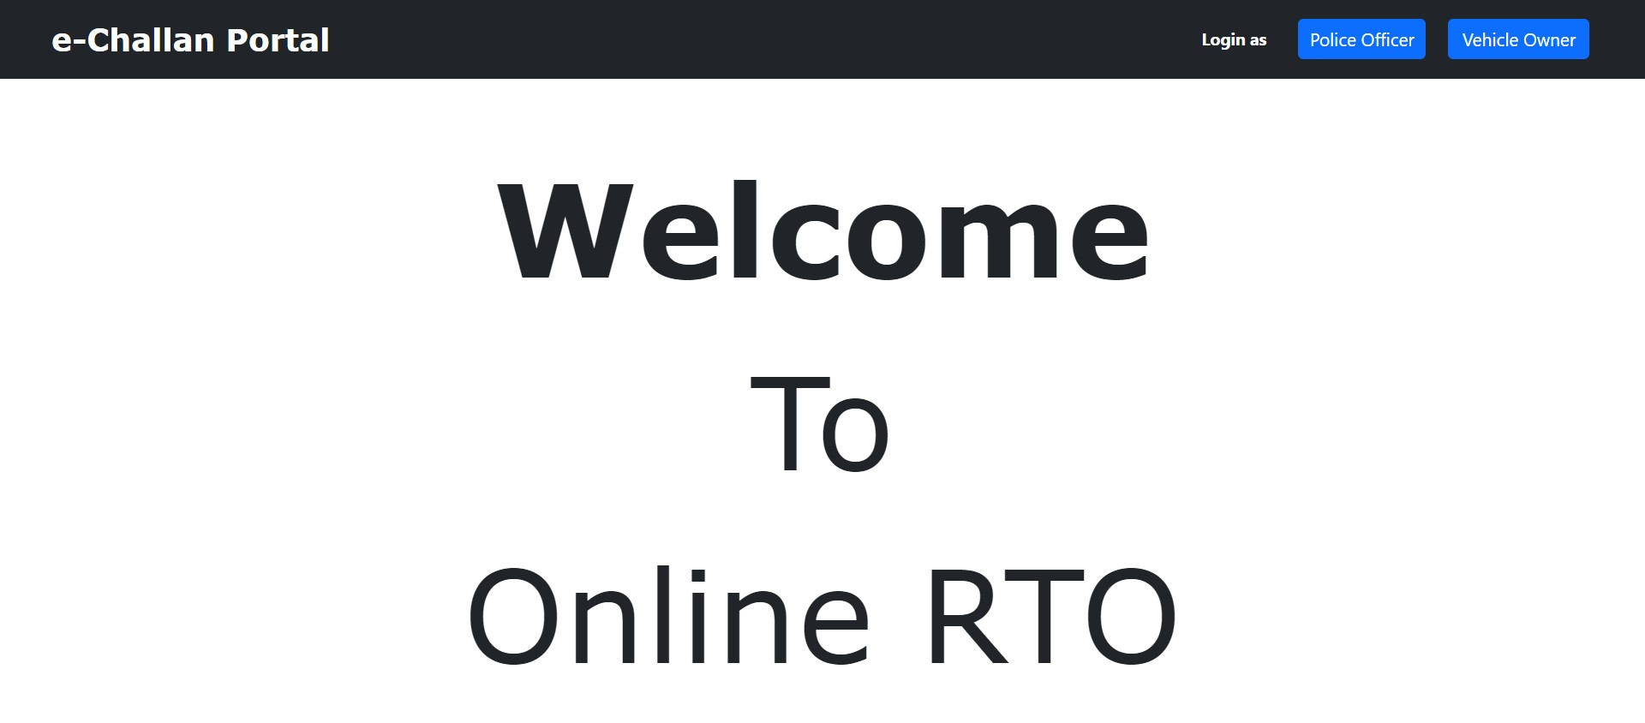

Slide 17
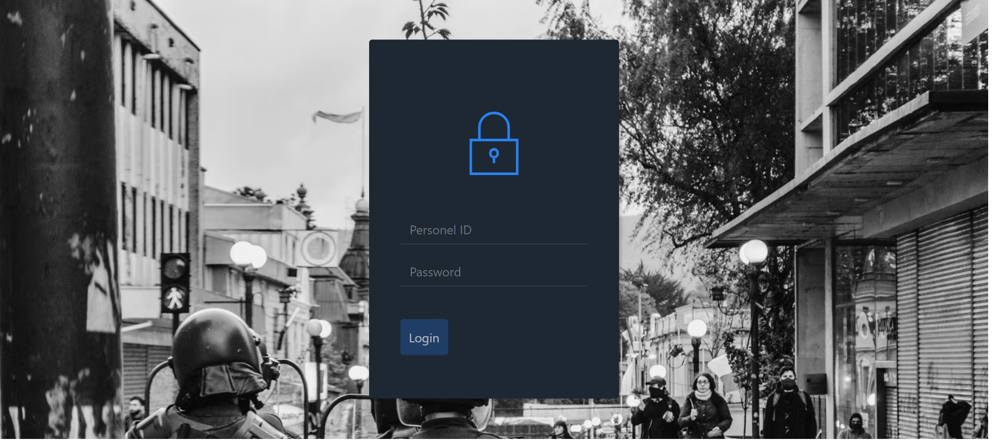
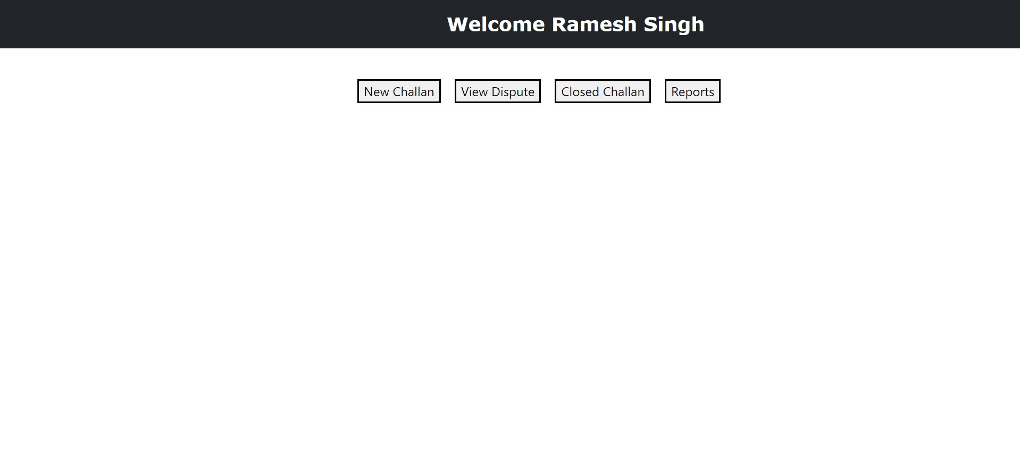

Slide 18
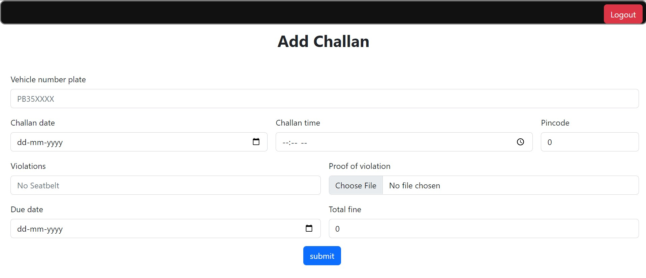
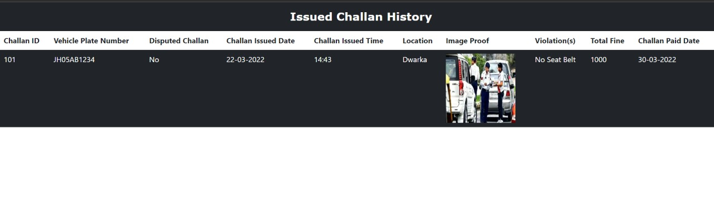

Slide 19
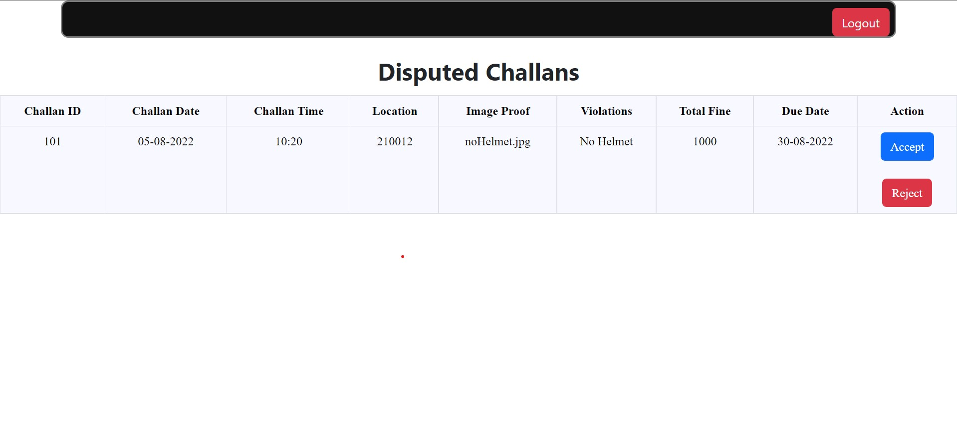
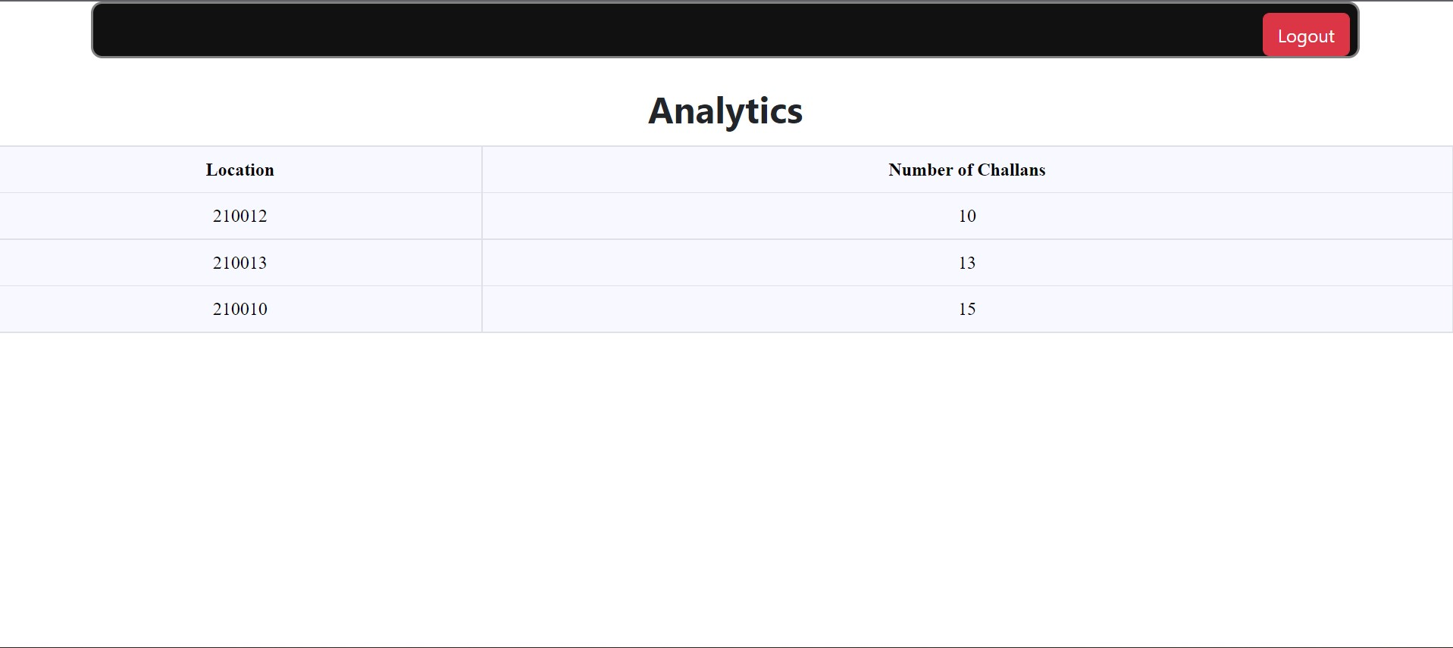

Slide 20
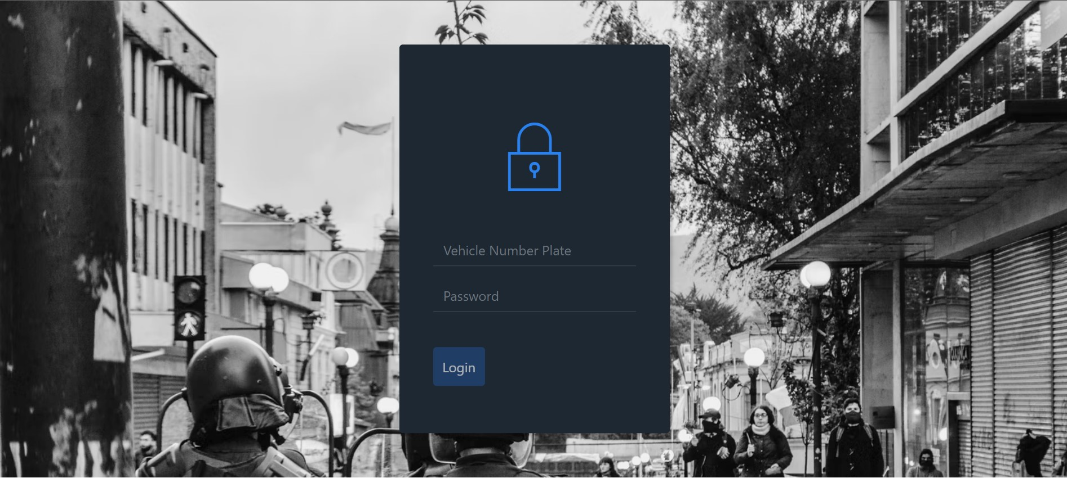
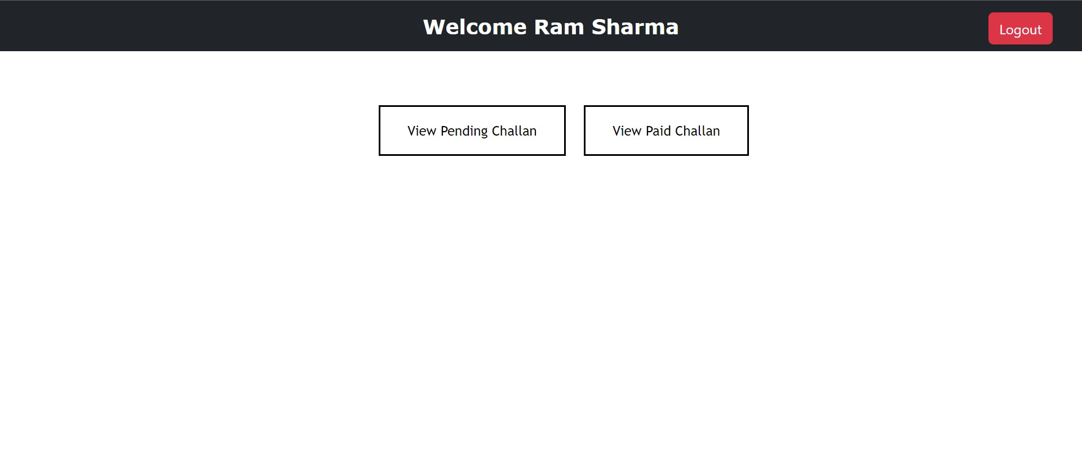

Slide 21
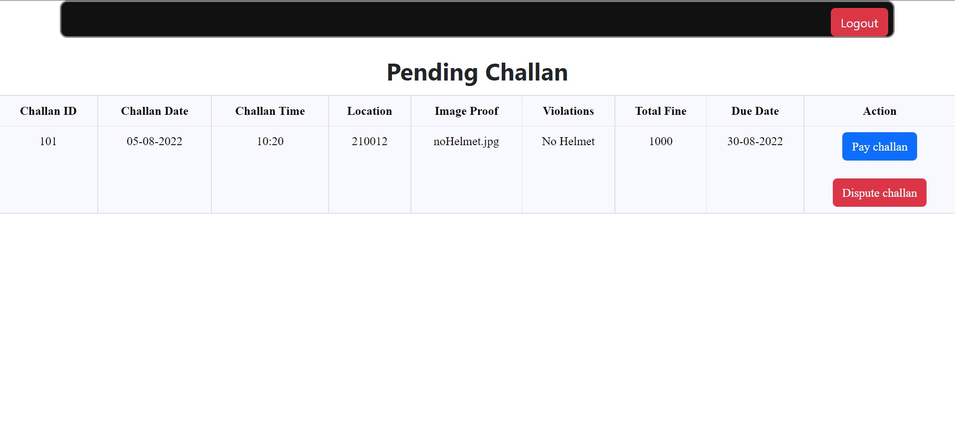
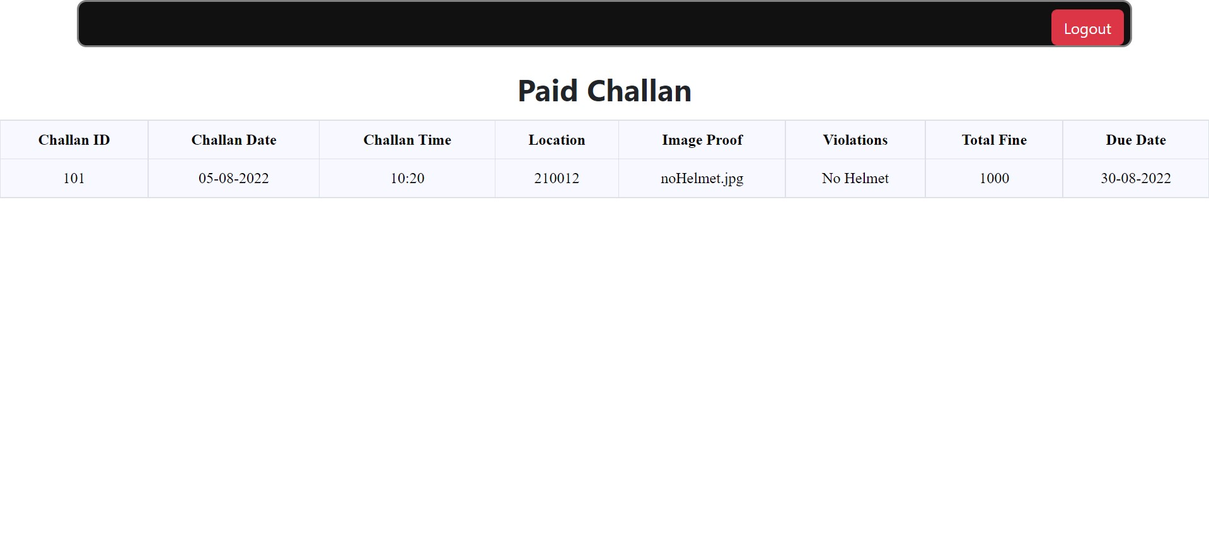

Slide 22

THANKS ☺
Does anyone have any questions?

