Slide 1


Slide 2
Agenda
Project Team
Project Details
Executive Summary
High Level Approach
Project Scope
Project Output
Conclusion

Slide 3




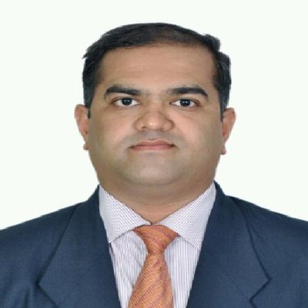
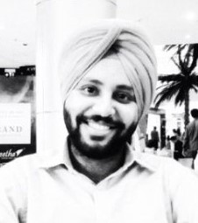
Our Team
Ankur Mehta
Shwetank Nagar
Management Consultant
Management Consultant
Jairaj Shetty
Vikas Phatak
Oil & Gas Professional
Competency: Intermediate – Python, R, SQL, Hadoop, Tableau
Management Consultant
Niranjanprasad Bhagwat
Gunnvant Singh
Management Consultant
Project SPOC

Slide 4
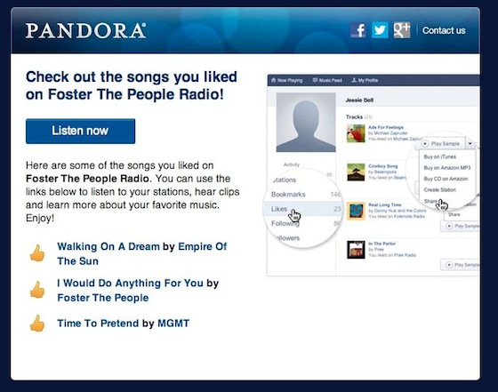
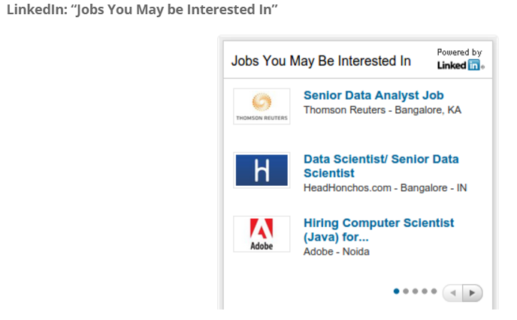
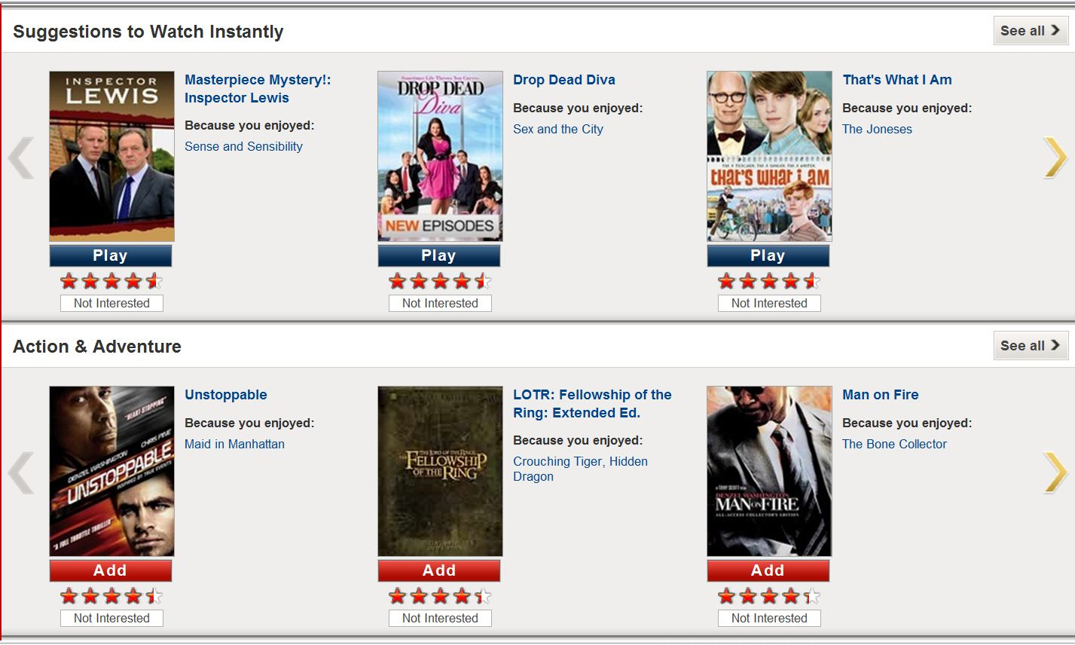
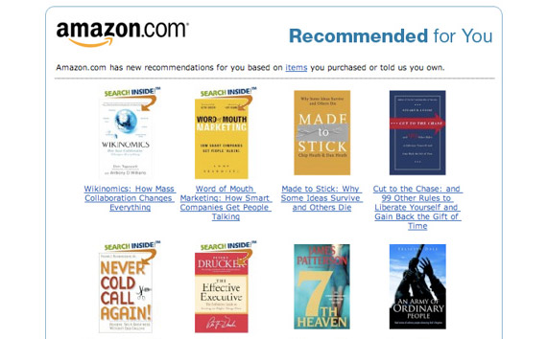
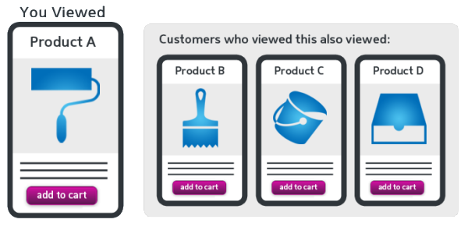
Recommendation Engine!
Powerful Marketing Tool - “Every marketer dreams to become the next Pandora, Amazon or Netflix”

Slide 5

Project Details
Summary:
Improve readership for news website, by recommending news articles specific to user’s tastes or preferences
Data Source:
2.5 lacs news article collected from 20-25 news sites
Client Details: Sidharth Shah, CEO
www.fafadiatech.com

Slide 6
Executive Summary
Evaluate different techniques – content based and collaborative filtering
For collaborative approach, challenge to receive quality data (ratings) from subscribers
In reality, following alternatives:
Frequency of visits to web pages
Pages visited/ clicked
Duration & time spent visiting specific pages
High level view of the solution
Enhance subscriber’s profile
Ad Targeting
Event triggers

Slide 7
Use Case & Stakeholders
Customer: Start-Up
E-commerce start-up offers service to curate articles per user preferences
Analytics Service Provider
Offers service to build a news recommendation engine
Uses data science to improve selection of relevant news articles, e.g. with different models
Generates revenue through advertisements
Beats the competition by increased readership
Helps improve readership with more relevant selections
Notes:
Narrative – how the ecosystem works – interdependence – how the analytics provider helps the customer

Slide 8
High Level Approach: SIPOC
Sources
News websites
Input
User profile
User ratings (explicit)
Process
See below
Output
Reco. engine
Top match articles
Customer
New Users
Nearest users (close to similar profile)
User web clicks (implicit)
News articles
Users/ subscribers
Front End Capture: User creation, User profile, Ratings, Click stream
Back End Capture: Web crawling, Data clean-up
Algorithm Development: Content & Collaborative
Performance evaluation & Iterative Model improvement

Slide 9
Project Scope
Current Scope
Web crawling
Data cleaning
Content based & collaborative filtering
Model performance evaluation & iteration
Output top match articles & nearest user
Future Scope
Ratings based on frequency of visits to web pages, pages visited/ clicked and duration/ time spent visiting specific pages
Collect more user data base and fine tune the recommendation engine

Slide 10
Data Exploration
Sources
News article time interval : Jul’16 –Aug’16
Highly right skewed with most articles from technology, finance & business domain

Slide 11
Data Exploration
Sources
From the standard news article categories, 14% articles are sub-categorized giving deeper insights in a particular domain
Out of 15K authors, top authors wrote 2.7K articles with top 10 authors wrote 1.8K average articles

Slide 12
User Profile
Input
New User - Registration
Demographic data capture
User creation
Display sub-categories to User
User selection of 3-5 preferred sub-categories
Save user preferences
Typical user profile, taking into account demographics, user preferences
Key input for collaborative filtering algorithm
Also, a con for collaborative filtering if user database is very small

Slide 13
User Rating
Input
Provide Initial articles, using demographic and sub-category preferences
User rates articles on 1-5 scale (5=best)
Capture User Rating
Explicit Rating
User is expected to ideally rate all articles he/ she reads – Explicit Rating
In real world, it’s a challenge which can be dealt with using Implicit Ratings
With increase in data, recommendations result improves
Implicit Rating
Define criteria for clickstream data
Capture user browsing pattern
Define implicit user-article rating

Slide 14
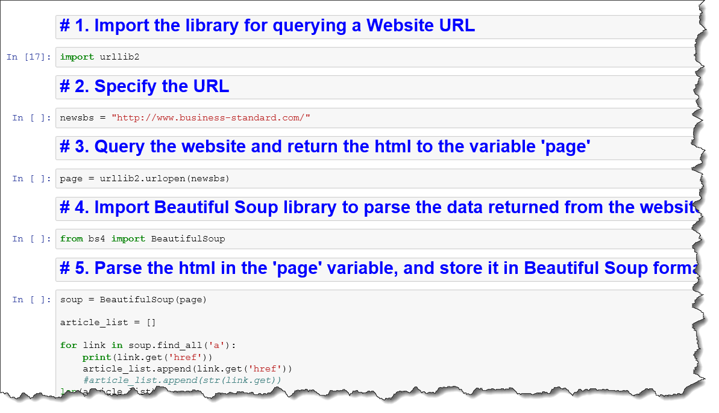
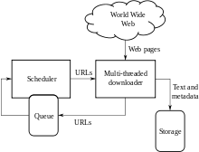
Web Crawling
Process
Web crawler automatically fetches contents of a web page, by indexing to certain search items
40 websites were crawled for this database
For regular update of the database, a scheduler using Apache Solr has been setup
Beautiful Soup/ Scrapy libraries were used
Save article text
Save source URL, time stamp, sub-categories, keywords, etc.
For each URL, get relevant HTML tags
Prepare a list of news site URL’s
Capture article using tag (Beautiful Soup)

Slide 15
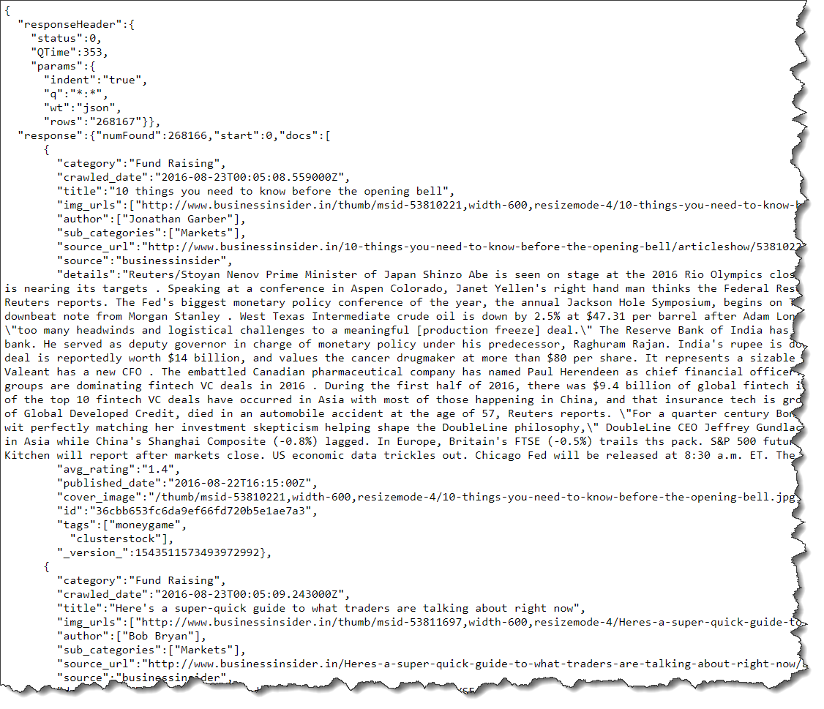
Data Cleaning
Process
Removal of expressions
Split attached words
Add cleaned text data to dictionary
Store dictionary
Import data
Escaping html characters
Decoding data
Apostrophe lookup
Approach followed to clean the database

Slide 16
Algorithm: Content Based
Process
Snapshot

Slide 17
Algorithm: Collaborative Filtering
Process
Snapshot

Slide 18
Algorithm: Hybrid
Process
Snapshot

Slide 19
Model Evaluation: Approach
Process
Ensemble Approach
Apply all 3 algorithms on entire dataset
Chaining & Combination Approach
Feed entire dataset to the 1st algorithm; then feed output of 1 to 2nd algorithm, and output of 2 to 3
Take the intersection of all 3 algorithm outputs – URL’s and opening lines
Evaluate accuracy of output - precision
Repeat above approach across all model combinations
Evaluate accuracy of all combinations - precision

Slide 20
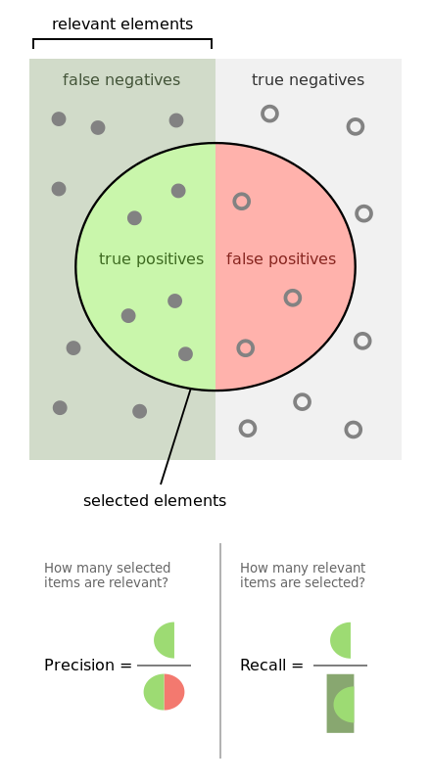


Model Evaluation: Methodology
Process
Theoretically confusion matrix is used to evaluate model performance
Precision: how precise is our recommendation
Recall: how well have we covered the universe of good articles
Trade-off: Reducing False Positives, results in an increase in False Negatives
Cut-off decision: If user prefers fewer articles, algorithm with better precision should be selected
If user prefers capturing all articles, algorithm with better recall to be picked
Ideally the engine should be tailored to user preferences

Slide 21
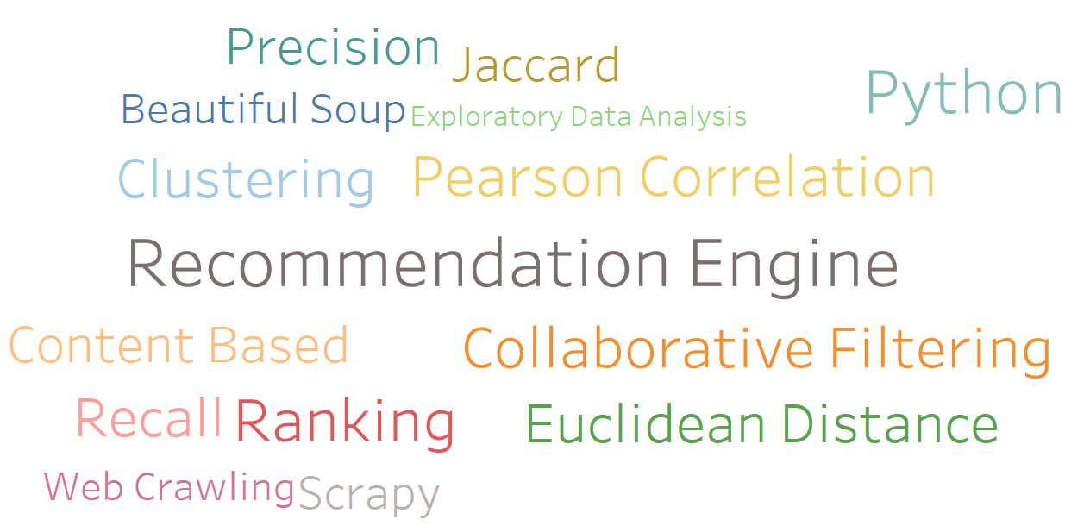
Project Output
Output
ss

Slide 22
Conclusion

Slide 23
Appendix

Slide 24
References

Slide 25
Questions?

