Slide 1
Credit Card Fraud Detection
Credit Card Fraud Detection using Machine Learning
Ankur Singh
12324852
Kaggle – ULB Credit Card Fraud Dataset

Slide 2
Problem Statement
Credit card fraud leads to significant financial losses.
Fraud transactions are rare and difficult to identify.
Objective: Classify transactions as Fraud or Legitimate.
This is a highly imbalanced binary classification problem.

Slide 3
Dataset Overview
• Total transactions: 284,807
• Fraud cases: 492 (0.17%)
• Features:
V1–V28: PCA-transformed (anonymized)
Time, Amount
Target variable: Class (0 = Legit, 1 = Fraud)

Slide 4
Key Challenges
Extreme class imbalance
Accuracy is misleading
False negatives (missed fraud) are costly
Recall is more important than accuracy

Slide 5
Exploratory Data Analysis (EDA)
The dataset is extremely imbalanced, with fraud transactions forming only 0.17% of the total data.
Fraud transactions generally involve smaller amounts, while legitimate transactions show a wide and skewed distribution.
PCA-transformed features (V1–V28) show partial class separability, indicating learnable patterns.
Time and Amount alone are weak predictors but become useful when combined with PCA features.

Slide 6
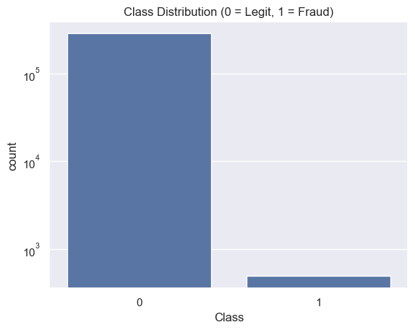
Class Distribution(Log Scale)

Slide 7
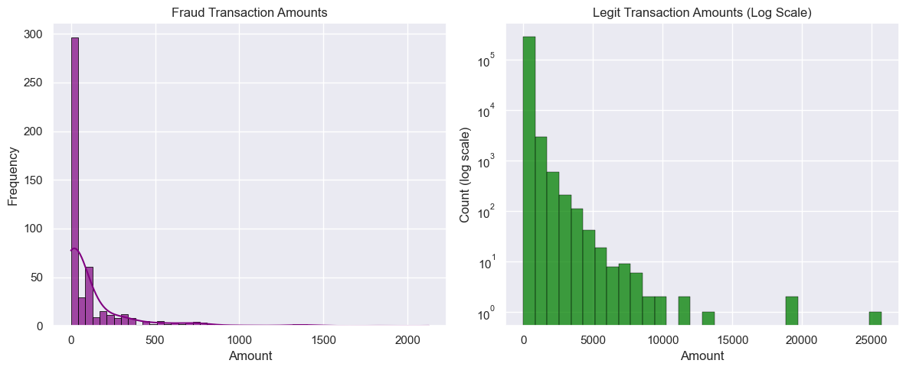
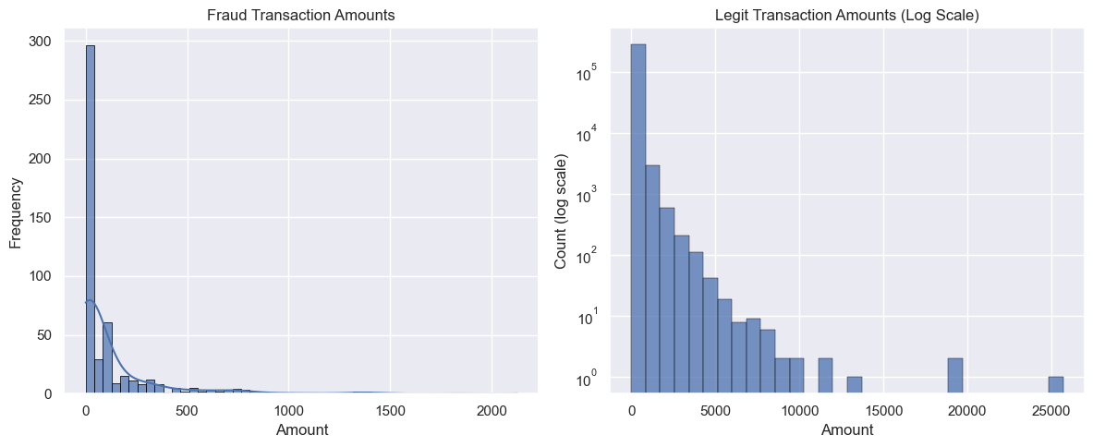
Transaction Amount Distribution (Fraud vs Legit)

Slide 8
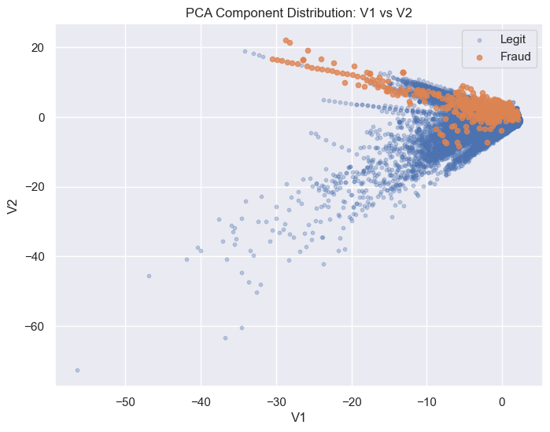
PCA Feature Space Visualization (V1 vs V2)

Slide 9
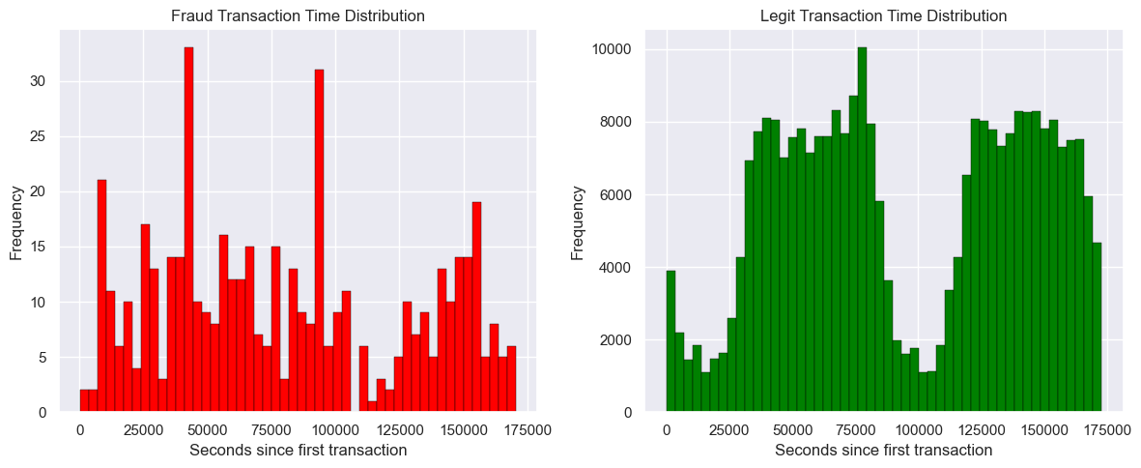
Transaction Time Distribution (Fraud vs Legit)

Slide 10
Data Preprocessing
Stratified train-test split (80% train, 20% test).
Scaled only Time and Amount features.
PCA features already standardized.
Scaling applied after split to avoid data leakage.

Slide 11
Models Used
Logistic Regression – baseline linear model.
Random Forest – non-linear comparison model.
Models evaluated using recall and ROC-AUC.

Slide 12
Evaluation Metrics
Precision: Correctness of fraud predictions.
Recall: Ability to detect fraud (most important).
F1-score: Balance between precision and recall.
ROC-AUC: Overall class separability.

Slide 13
Results Comparison
Logistic Regression:
High Recall (~0.92)
ROC-AUC ~0.97
Random Forest:
High Precision
Recall ~0.74
ROC-AUC ~0.95

Slide 14
ROC Curve Analysis
ROC curve shows trade-off between recall and false positives.
Logistic Regression shows better overall separability.
Threshold tuning allows control over precision-recall trade-off.

Slide 15
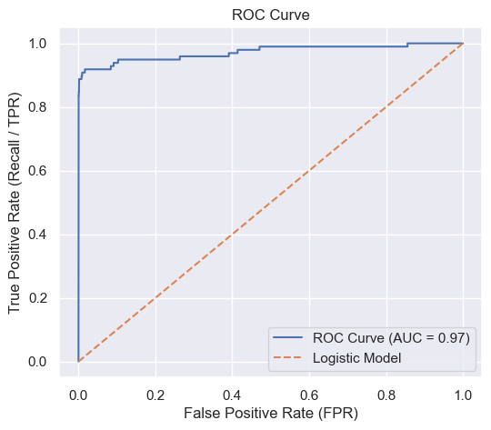

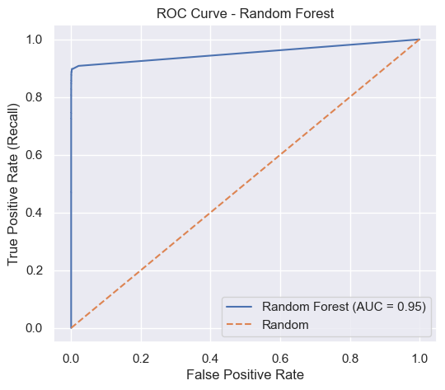
ROC-Curve(Logistic v/s RF)

Slide 16
Conclusion
Logistic Regression outperformed Random Forest for this dataset.
PCA-transformed features favor linear models.
Model selection driven by data and business objective.
Simpler models can outperform complex ones.

Slide 17
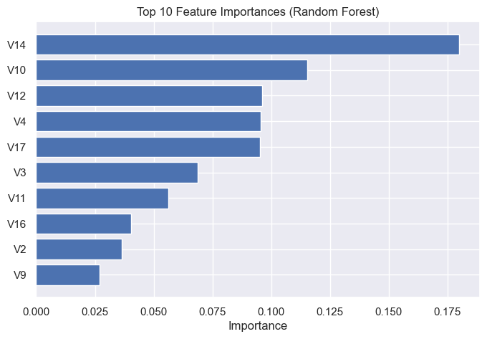
Top Feature Importances (Random Forest)

Slide 18
Future Scope
Threshold tuning for better balance.
SMOTE-based resampling.
Gradient Boosting / XGBoost.
Cost-sensitive learning.

