Slide 1
GNR 602
Programming Assignment
Harris Corner Detector
Team Members: Ankur Verma, Bhavya Kohli, Hemant Hajare

Slide 2
Harris Corner Detector
Move a small window over the image and note the changes in the intensity values
At a corner there will be a large change in intensity value
This feature can be exploited to extract the corners in the image

Slide 3
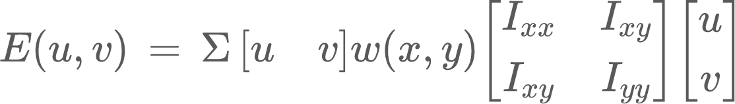
Mathematical Formulation
The change in the intensity for a change of (u, v) using the Taylor series approximation can be given by

Slide 4
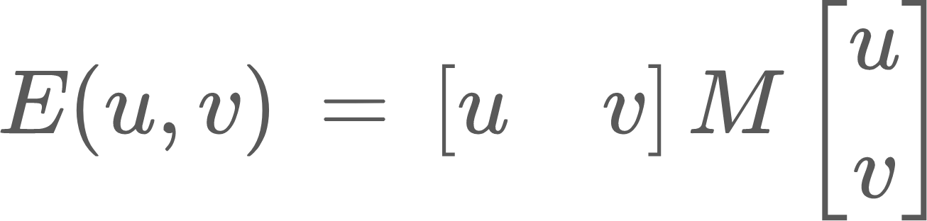
Further if the shifts are small then the above formula can be written as
This is the bilinear approximation

Slide 5
Analysis of Corners
The algorithm can extract corners based on the eigenvalues of the matrix M
A corner is said to be detected when both the eigenvalues of the matrix M are large
The measure of corner response in terms of the eigenvalues is given by
R = det[M] - s*(trace[M])²
where det[M] = λ₁λ₂, trace[M] = λ₁ + λ₂
and s is the sensitivity, which is kept close to zero (default set to 0.06)

Slide 6
Implementation and Results
Upon running the python script:
All the images in the “images” directory are listed and any one can be chosen for running the corner detection algorithm
The image is converted into a single channel grayscale image using the rgb to grayscale conversion formula : 0.299 ∙ R + 0.587 ∙ G + 0.114 ∙ B, where R, G and B are the red, green and blue channels of the original image
The corner detection algorithm is run using sensitivity and threshold parameters supplied by the user
The original image is displayed along with the detected corners marked in red
A few sample outputs on a test image using different values of sensitivity and thresholds are shows in the following slides

Slide 7
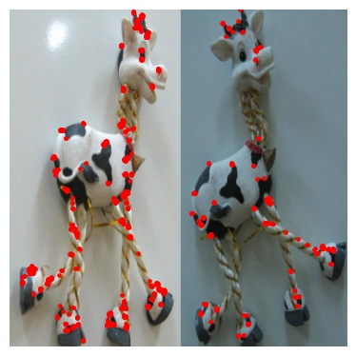
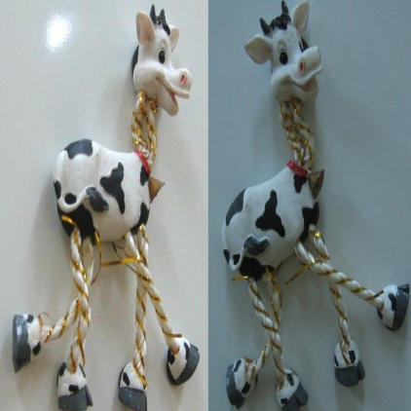
Outputs of image taken from slides
Sensitivity - 0.06, Threshold - 0.4

Slide 8
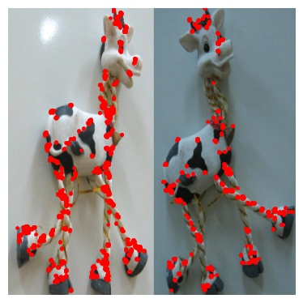
Sensitivity - 0.06 , threshold - 0.39

Slide 9
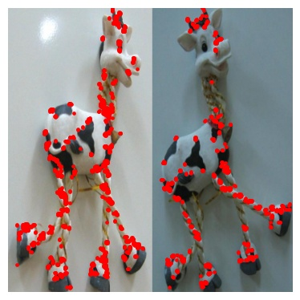
Sensitivity - 0.062 Threshold - 0.04

Slide 10
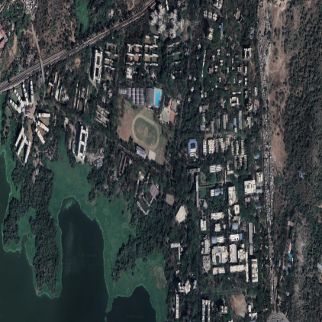
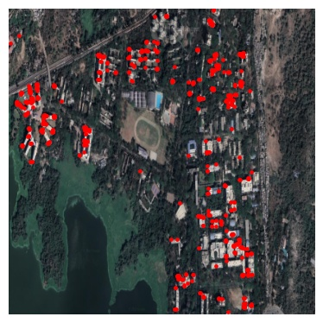
Outputs for a satellite image of IITB
Sensitivity - 0.06 Threshold - 0.4

Slide 11
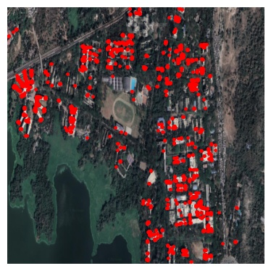
Sensitivity - 0.06 Threshold - 0.35

Slide 12
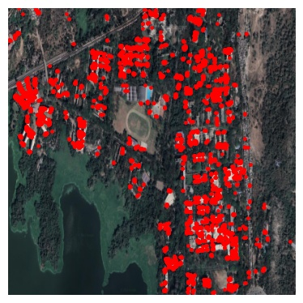
Sensitivity - 0.06 Threshold - 0.32

Slide 13
Thank you

Slide 14
Implementation and Results
We have implemented the Harris Corner Detection algorithm in Python
We ran the algorithm for different values of threshold and sensitivity
The corner points detected and extracted are shown in red

