Slide 1
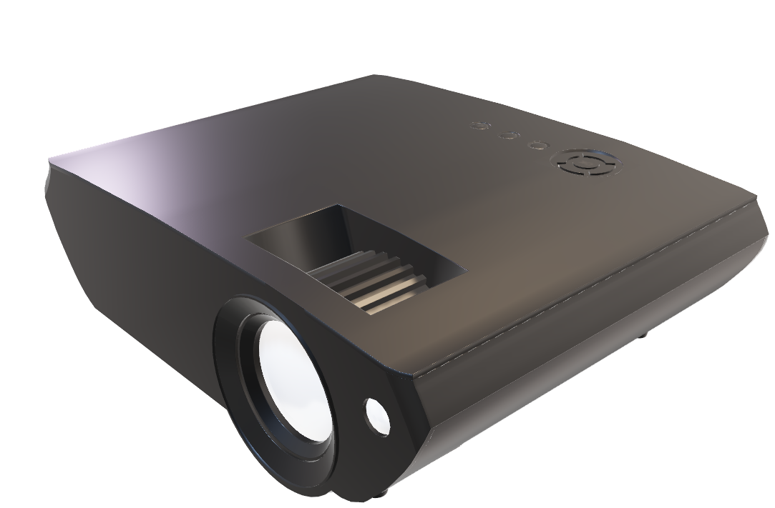
ER DIAGRAMS

Slide 2
THE COMPLAIN ENGINE
Student
Ongoing
Works
Student Profile
Filed
Complaints
Worker
Worker Profile
Thread
Admin
Faculty Profile
Staff/
Faculty

Slide 3
WORKERS
WorkDepartment
Worker
OngoingWorks
dId
dName
dLocation
dEmail
dHead
workerId
workerName
dId
{workerMoblieNo}
workerDesig
workerPass
cId
{workerId}
{stuId}
{facId}
iniDate
expCompDate

Slide 4
PATIENT
Patient
pId
pName
emailId
image
pAdd?
{pMoblieNo}
pEmgCont
pGender

Slide 5
DRIVER
Driver
dId
dName
emailId
image
dLicence
dVehicleNo
dRC
{dMoblieNo}
dEmgCont
dGender

Slide 6
HOSPITAL
Hospital
hId
H
Name
emailId
image
dLicence
dVehicleNo
dRC
{dMoblieNo}
dEmgCont
dGender

Slide 7
ADMIN
SuperAdmin
adUserName
adPass
adName
{adMobileNo}
adEmail
adLocation

Slide 8
Complaints
Filed Complaint
tempCompId
stuId
cDesc
cDept

Slide 9
THREAD
Thread
threadId
cId
reply

