Slide 1
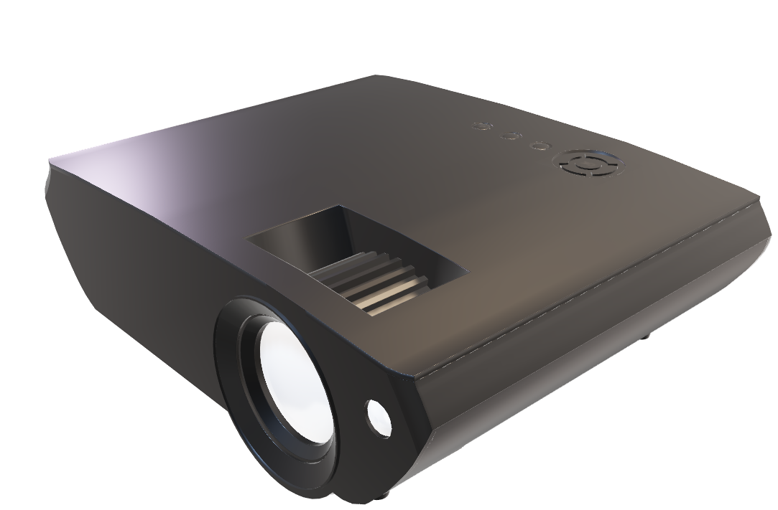
ER DIAGRAMS

Slide 2
THE COMPLAIN ENGINE
Student
Ongoing
Works
Student Profile
Filed
Complaints
Worker
Worker Profile
Thread
Admin
Faculty Profile
Staff/
Faculty

Slide 3
WORKERS
WorkDepartment
Worker
OngoingWorks
dId
dName
dLocation
dEmail
dHead
workerId
workerName
dId
{workerMoblieNo}
workerDesig
workerPass
cId
{workerId}
{stuId}
{facId}
iniDate
expCompDate

Slide 4
STUDENT
Student
stuId
stuName
emailId
stuDepartment
roomNo
{stuMoblieNo}
stuPass
stuGender
stuBatch

Slide 5
FACULTY
Faculty
facId
facName
{facMobileNo}
facEmail
facDesig
facPass

Slide 6
ADMIN
SuperAdmin
adUserName
adPass
adName
{adMobileNo}
adEmail
adLocation

Slide 7
Complaints
Filed Complaint
tempCompId
stuId
cDesc
cDept

Slide 8
THREAD
Thread
threadId
cId
reply

