Slide 1
Secure Data Hiding in Images Using Steganography
CAPSTONE PROJECT
Presented By:
Student Name : Ankush Rambabu Singh
College Name & Department : Thakur Institute of Management Studies Carrier & Development (TIMSCDR)

Slide 2
OUTLINE
Problem Statement
Technology used
Wow factor
End users
Result
Conclusion
Git-hub Link
Future scope

Slide 3
Problem Statement
Traditional data encryption methods can raise suspicion during transmission. This project integrates steganography with XOR encryption to securely hide messages within images while preserving image quality.

Slide 4
Technology used
Programming Language: Python
Libraries:
OpenCV (cv2) – for image processing
OS – for file handling
String – for encoding characters
Concepts:
XOR-based encryption for message security
Pixel manipulation for hiding data

Slide 5
Wow factors
🚀 Double Security: Uses both steganography and XOR encryption.
🎭 Invisible Communication: No noticeable image distortion.
💡 Lightweight & Efficient: Minimal impact on image size and quality.
🔑 Passcode Protection: Only authorized users can decrypt the message.

Slide 6
End users
Cybersecurity Professionals: For secure data transmission.
Journalists & Whistleblowers: To protect confidential information.
Individuals & Businesses: For secure communication without detection.

Slide 7
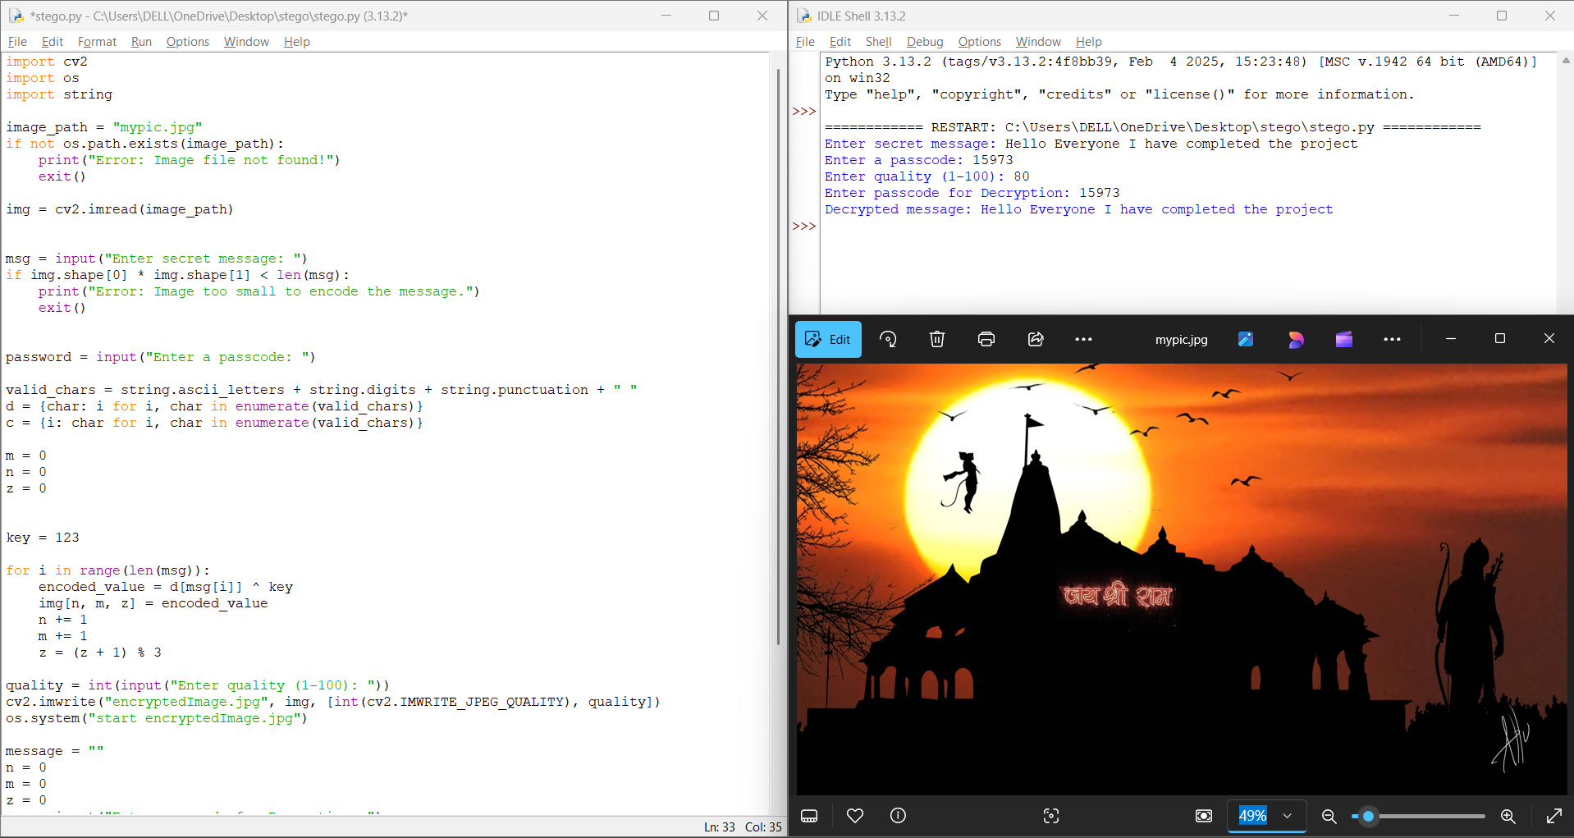
Results

Slide 8
Conclusion
This project demonstrates a secure way to hide messages inside images using steganography and XOR encryption. It ensures confidentiality while keeping the image visually unchanged.

Slide 9
GitHub Link
https://github.com/Ankush-1109/Edunet-Project

Slide 10
Future scope(optional)
🔹 Implement stronger encryption methods (AES, RSA). 🔹 Support for multiple image formats (PNG, BMP). 🔹 Develop a GUI for non-technical users. 🔹 Enhance data capacity for larger messages.

Slide 11
THANK YOU

