Slide 1
DOCKER BASIC

Slide 2

Docker Flow
Image
Run
Container
Operating System
Software
Application Code

Slide 3
Docker Flow
DockerFile / Docker Commit
Image
Run
Container

Slide 4
Docker Container Lifecycle
Conception
BUILD an Image from a Dockerfile
Birth
RUN (create+start) a container
Reproduction
COMMIT (persist) a container to a new image
RUN a new container from an image
Sleep
KILL a running container
Wake
START a stopped container
Death
RM (delete) a stopped container
Extinction
RMI a container image (delete image)

Slide 5
Docker Features….
Light-Weight
Minimal overhead (cpu/io/network)
Based on Linux containers
Decrease storage consumption
Uses layered filesystem to save space (AUFS/LVM)
Portable
Run it Everywhere! - Linux, Mac OS or Windows operating system that has Docker installed.
Raspberry pi support.
Move from one environment to another by using the same Docker technology.
Self-sufficient
A Docker container contains everything it needs to run
Minimal Base OS
Libraries and frameworks
Application code
A Docker container should be able to run anywhere that Docker can run.

Slide 6
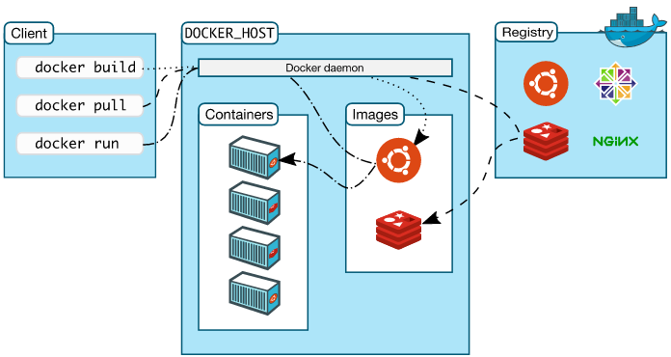
Docker Architecture
Docker client – Command Line Interface (CLI) for interfacing with the Docker
Dockerfile – Text file of Docker instructions used to assemble a Docker Image
Image – Hierarchies of files built from a Dockerfile, the file used as input to the docker build command
Container – Running instance of an Image using the docker run command
Registry – Image repository

Slide 7
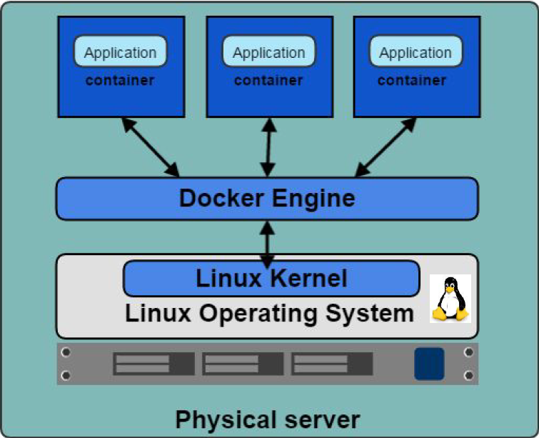
Docker Engine
The Docker Engine is THE core piece of technology that allows you to run containers.
In order for a container to run on any Linux host, at a minimum, the Docker Engine needs to be installed.
Then the container can run on any Linux host where Docker Engine is installed, providing the benefit of portability, without doing any application specific configuration changes on each host.

Slide 8
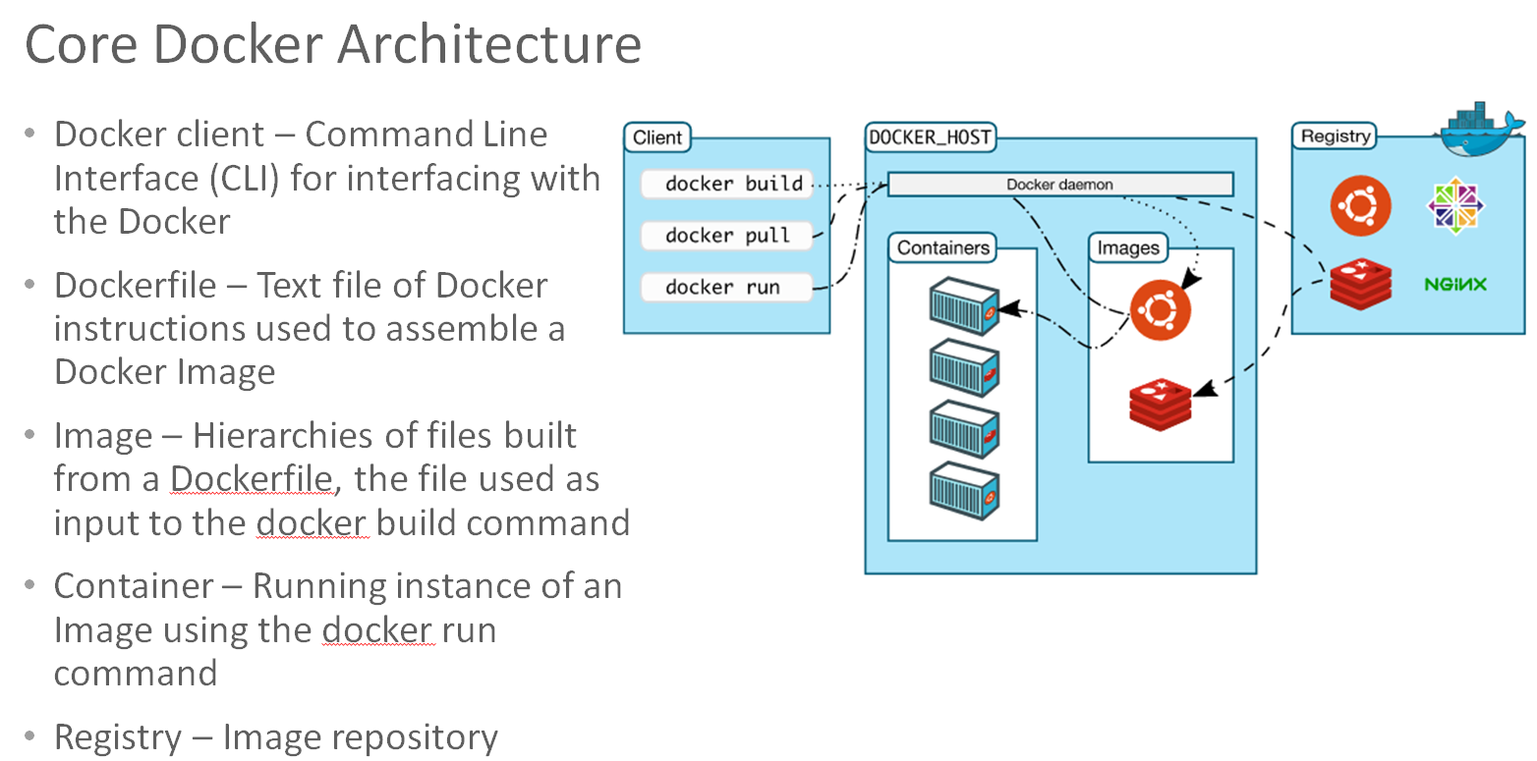
Containers are Portable, but How about Advanced Functions
Advanced Functions
Orchestration, Monitoring, Operations, Service Discovery
Docker Environment Provisioning
Fragmented Market Solutions
Kubernetes
Swarm, Docker Data Center, Docker Cloud
Consul, ETCD, Docker Networking
etc
+

