Slide 1
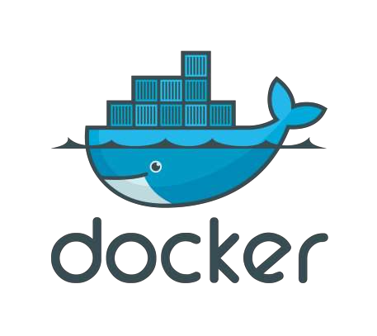
DevOps 2019

Slide 2
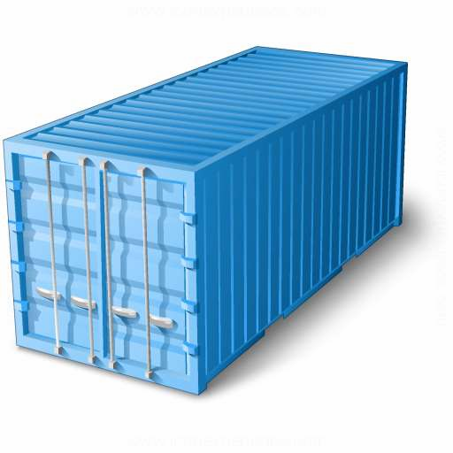
CONTAINERS ?

Slide 3
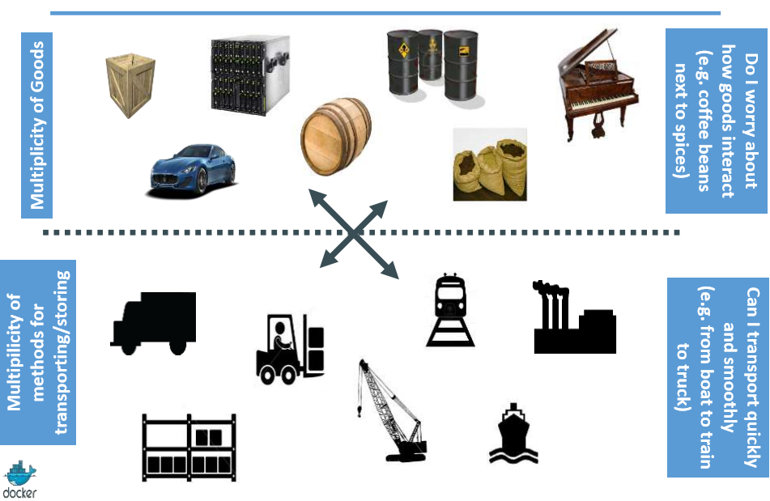
Cargo Transport Pre-1960

Slide 4
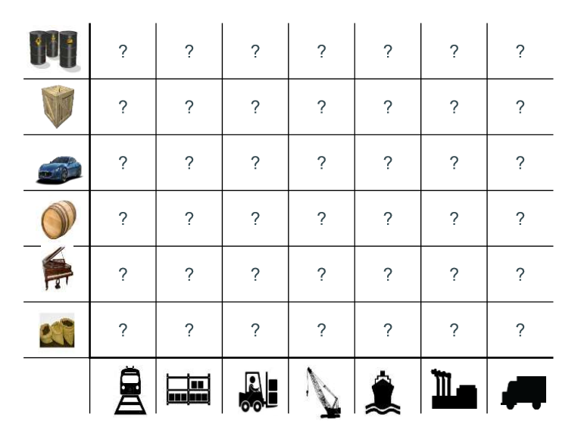
Then we have NxN Matrix

Slide 5
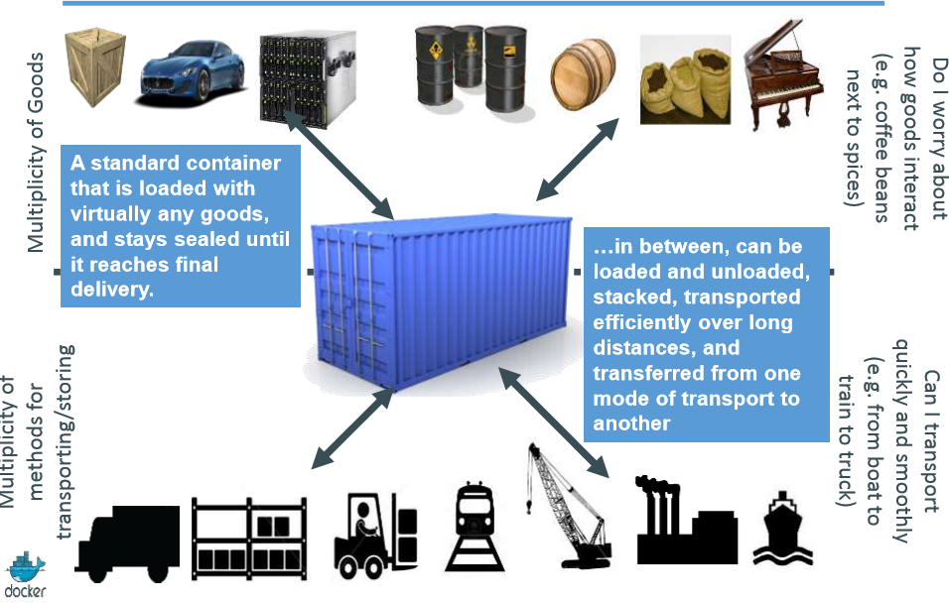
Solution: Intermodal Shipping Container

Slide 6
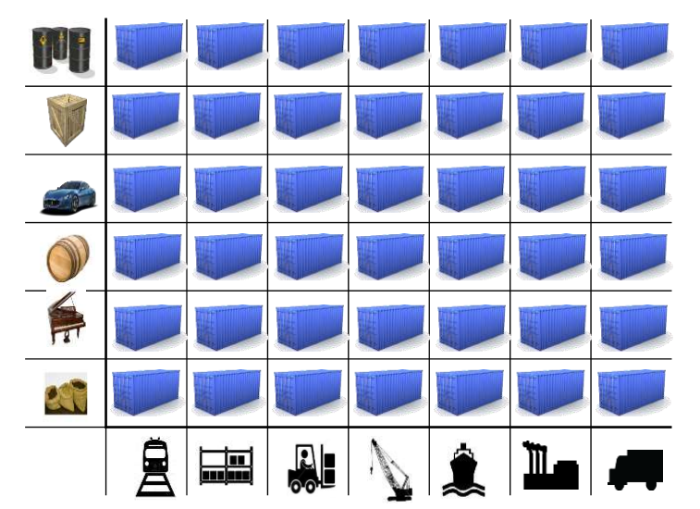
This eliminated the NXN Problem….

Slide 7
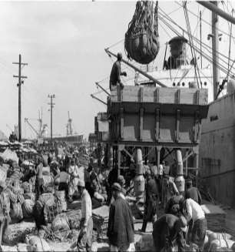
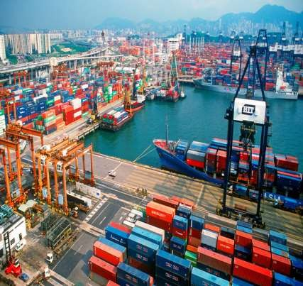
and spawned an Intermodal Shipping Container Ecosystem
90% of all cargo now shipped in a standard container
Order of magnitude reduction in cost and time to load and unload ships
Massive reduction in losses due to theft or damage
Huge reduction in freight cost as percent of final goods (from >25% to<3%)
massive globalizations
5000 ships deliver 200M containers per year

Slide 8
Why We Need Software CONTAINERS ?

Slide 9
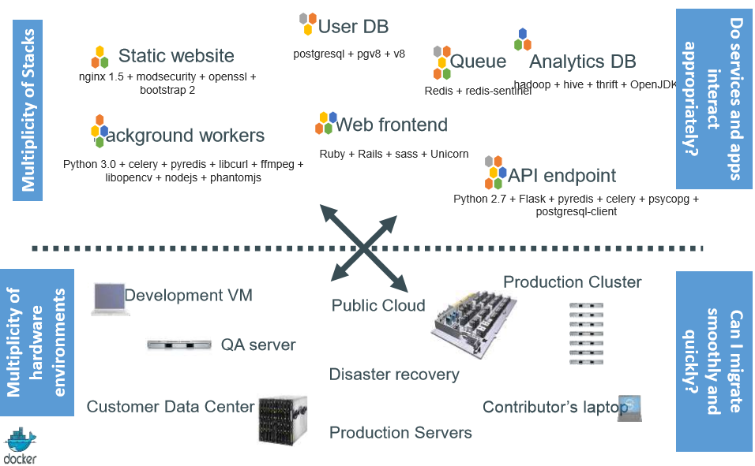
Present Software delivery mechanism

Slide 10
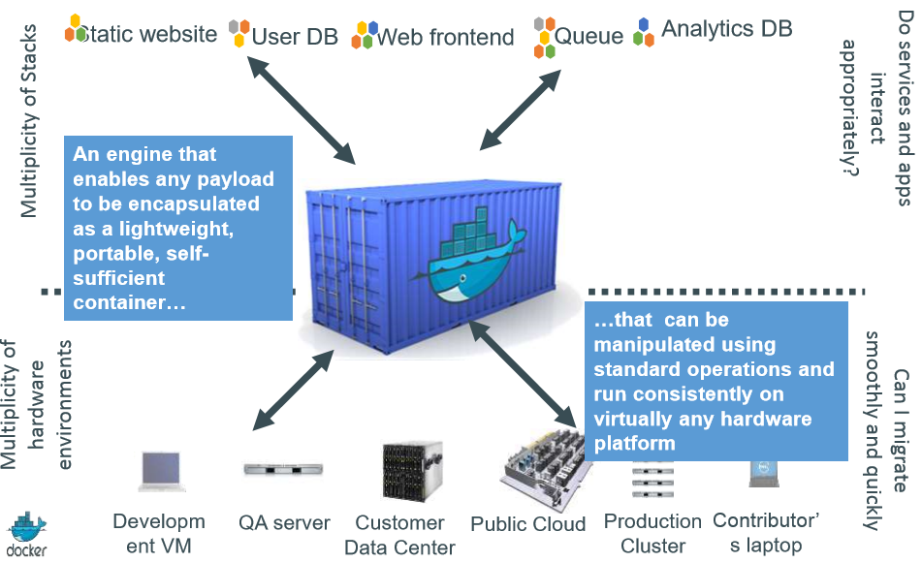
We need a shipping container system

Slide 11

Brings the power of creating a for code & all of its dependencies together, which can be shipped across the environments.
So Docker CONTAINER
Is an Isolated run time environment of a service/code with all dependencies, but shares OS and appropriate bins / libraries

Slide 12
How DOCKER Works ?
Docker uses the Linux Kernel features like namespaces and control groups to create containers on top of an operating system.
Docker has a client-server architecture. Docker Daemon or server is responsible for all the actions that are related to containers. The daemon receives the commands from the Docker client through CLI or REST API’s.
Docker client can be on the same host as a daemon or it can be present on any other host
Docker uses Copy-on-write union file system for its backend storage. Whenever changes are made to a container, only the changes will be written to disk using copy on write model

Slide 13
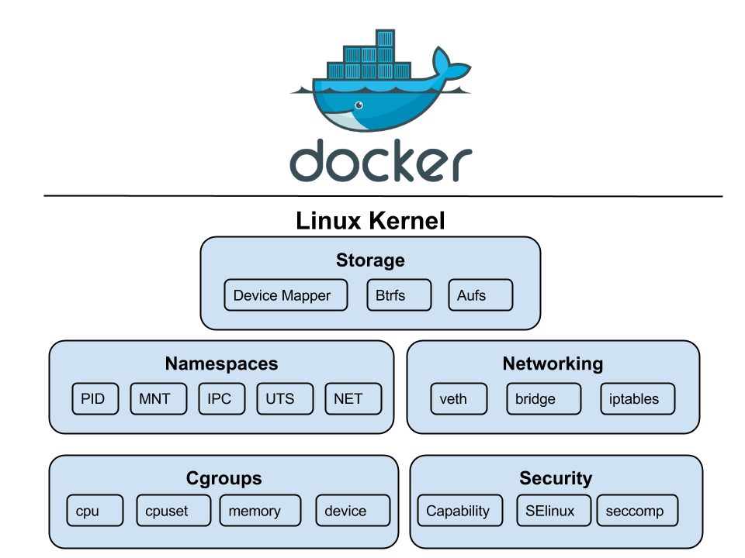

Slide 14

Docker became Amazing
Docker Containers are lightweight.
Can up and run in few seconds.
Easy to deploy & remove.
Clear separation of concerns.
Scale up/down more easily
Get higher density and run more workloads

Slide 15
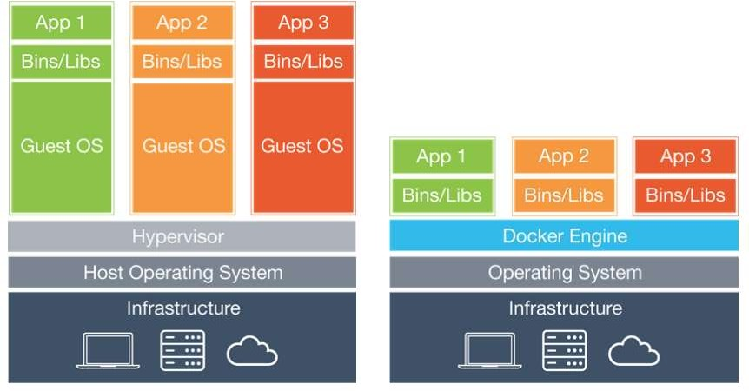
How Container differ from a VM
Virtual Machine
Container

Slide 16
Key Differences
Virtual Machine
Container
VMs are very large, which makes
Impractical to store and transfer.
If you want to replicate a VM which used as a service, you need full VM for each of instance.
1 GB space for 1 instance =
1 TB for 1000 instance.
Resource utilization
Full virtualized system means allocate resource to specific VM.
Heavier!
Performance
Takes minutes to start.
Share a bulk of space to hundred or thousands of containers, thanks to union file system.
Resource utilization
No need to create virtual device. All container share host, running on top op same kernel but isolated
Performance
Take a few seconds, mostly.

Slide 17
Why containers matter?
 | Physical Containers | Docker
Content Agnostic | The same container can hold almost any type of cargo | Can encapsulate any payload and its dependencies
Hardware Agnostic | Standard shape and interface allow same container to move from ship to train to semi-truck to warehouse to crane without being modified or opened | Using operating system primitives (e.g. LXC) can run consistently on virtually any hardware—VMs, bare metal, openstack, public IAAS, etc.— without modification
Content Isolation and Interaction | No worry about anvils crushing bananas. Containers can be stacked and shipped together | Resource, network, and content isolation. Avoids dependency hell
Automation | Standard interfaces make it easy to automate loading, unloading, moving, etc. | Standard operations to run, start, stop, commit, search, etc. Perfect for devops: CI, CD, autoscaling, hybrid clouds
Highly efficient | No opening or modification, quick to move between waypoints | Lightweight, virtually no perf or start-up penalty, quick to move and manipulate
Separation of duties | Shipper worries about inside of box, carrier worries about outside of box | Developer worries about code. Ops worries about infrastructure.

Slide 18

Now everyone happy!
Build once, run
anywhere
Ops
Devs
Configure once, run anything

Slide 19
For Developers
Build once…run anywhere
A clean, safe, hygienic and portable runtime environment for your app.
No worries about missing dependencies, packages and other pain points during subsequent deployments.
Run each app in its own isolated container, so you can run various versions of libraries and other dependencies for each app without worrying
Automate testing, integration, packaging…anything you can script
Reduce/eliminate concerns about compatibility on different platforms, either your own or your customers.
Cheap, zero-penalty containers to deploy services? A VM without the overhead of a VM? Instant replay and reset of image snapshots? That’s the power of Docker

Slide 20
For Ops / Devops
Configure once…run anything
Make the entire lifecycle more efficient, consistent, and repeatable Increase the quality of code produced by developers.
Eliminate inconsistencies between development, test, production, and customer environments
Support segregation of duties
Significantly improves the speed and reliability of continuous deployment and continuous integration systems
Because the containers are so lightweight, address significant performance, costs, deployment, and portability issues normally associated with VMs

Slide 21
Docker Terminology
Docker Engine
Docker Container
Docker Image
Docker Hub ( public repo )
Docker Trusted Registry ( Private repo )
Docker Compose
Docker Swarm
Docker Networking

Slide 22
Lets Try Docker
Start Experimenting

Slide 23
Installing on Linux
https://docs.docker.com/engine/installation/linux/docker-ce/ubuntu/
Remove any pre installed docker packages :
sudo apt-get remove docker docker-engine docker.io
Install using the repository:
Setup the Repository:
Step1: Update the apt package index
Run → sudo apt-get update
Step2: Install packages to allow apt to use a repository over HTTPS
Run → sudo apt-get install apt-transport-https ca-certificates curl software-properties-common
Step3: Add Docker’s official GPG key
Run → curl –fsSL https://download.docker.com/linux/ubuntu/gpg | sudo apt-key add -
Step4: Use the following command to set up the stable repository
Run → sudo add-apt-repository "deb [arch=amd64] https://download.docker.com/linux/ubuntu $(lsb_release -cs) stable"

Slide 24
Install docker-ce:
Step1: Update the package
Run → sudo apt-get update
Step2: Install the latest version of Docker CE
Run → sudo apt-get install docker-ce
Install a Specific Version
Run → sudo apt-get install docker-ce=<VERSION>
Step3: Start the Docker Service
Run → sudo service docker start

Slide 25
Install Docker On Windows or Mac
Install Docker on Windows.
https://docs.docker.com/docker-for-windows/install/
Install Docker on Mac
https://docs.docker.com/docker-for-mac/install/
Image
Read only layer used to build a container. They do not change.
Container
Self contained runtime environment using one or more images. You can commit your changes to a container and create an image.
Hub / Registry
Public or private servers which act as repository where pople can upload images and share what they made.

Slide 26


