Slide 1
DOCKER NETWORKING- BASICS

Slide 2
Contents
Basic Network understanding
Why we need Docker Networking
Docker Native Network Drivers
How we can create our own network & assign them to set of containers

Slide 3
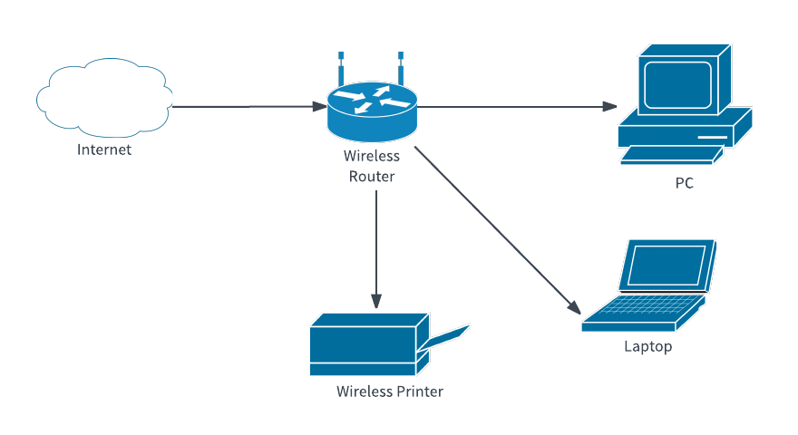
Basic Network Understanding
A network can be defined as a group of computers and other devices connected in some ways so as to be able to exchange data.
Each of the devices on the network can be thought of as a node; each node has a unique address

Slide 4
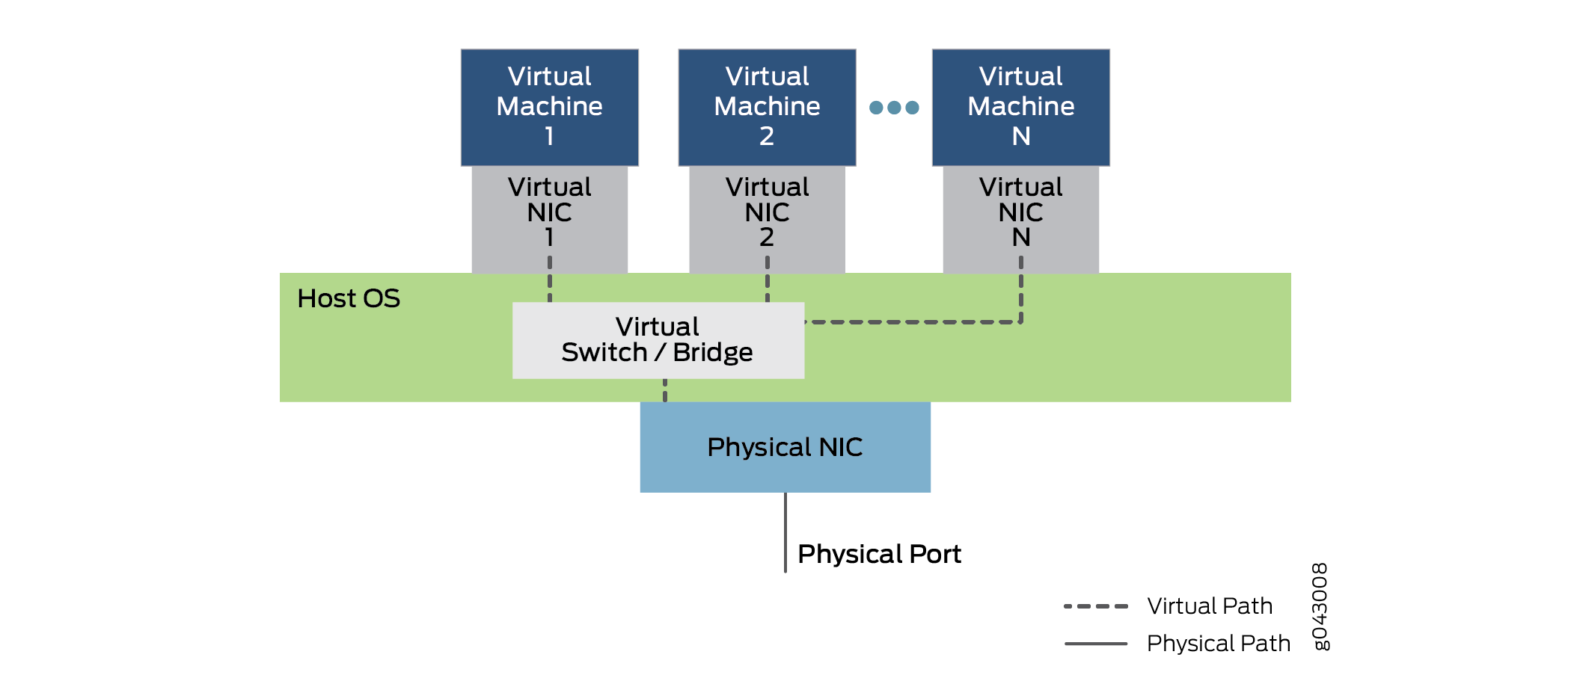
Basic Virtual Networking
Virtual networking is a technology that facilitates data communication between two or more virtual machines (VM). It is similar to traditional computer networking but provides interconnection between VMs, virtual servers and other related components in a virtualized computing environment
Virtual networking is based on physical computer networking principles, but its functions are mostly software-driven

Slide 5
Why We Need Docker/Container Networking ?
Containers need to talk to external world.
Reach Containers from external world to use the service that Containers provides.
Allows Containers to talk to host machine.
Inter-container connectivity in same host and across hosts.
Discover services provided by containers automatically.
Load balance traffic between different containers in a service
Provide secure multi-tenant services

Slide 6
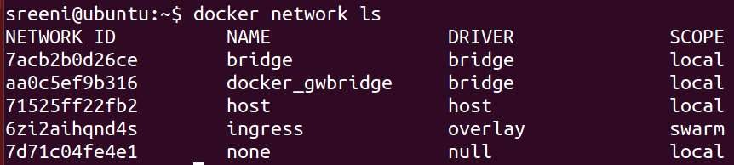
Default Networks created by Docker
“bridge” is the default Bridge network
“docker_gwbridge” is used by multi-host networks to connect to outside world
“host” network is used for having containers in host namespace
“ingress” network is used for routing mesh
“none” network is used when Containers don’t need any networking
“Scope” signifies if the network is local to host or across the Swarm cluster

Slide 7
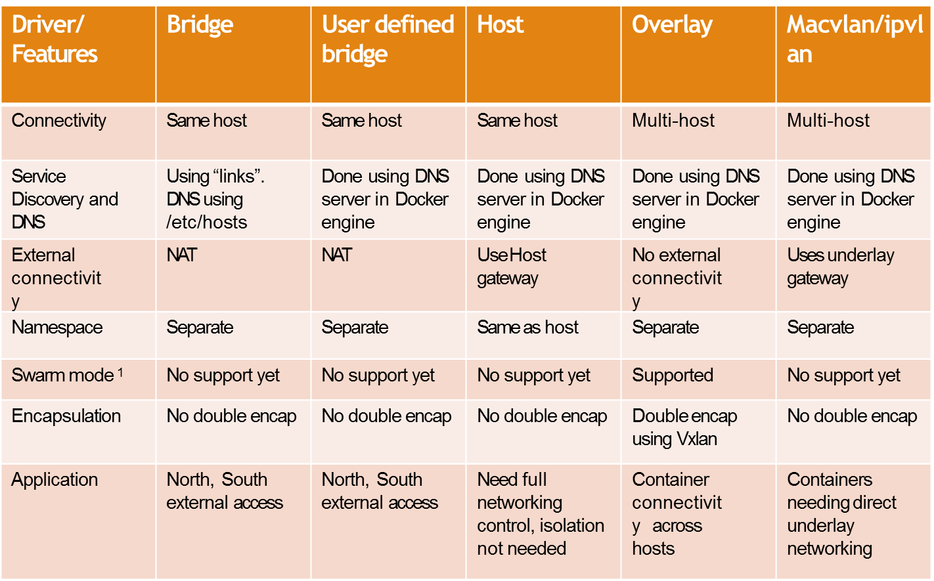
Compare Docker Network Driver Types

Slide 8
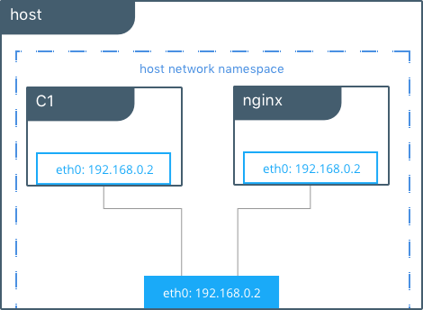
Docker Host Network Driver

Slide 9
The host network driver is similar to networking configuration that Linux uses without Docker.
the host network driver containers are all in the same host network namespace and use the network interfaces and IP stack of the host.
All containers in the host network are able to communicate with each other on the host interfaces.
From a networking standpoint this is equivalent to multiple processes running on a host without containers
Lets spin two containers, one with –net option antoher without –net option
docker run -itd --net host --name Cont1 alpine ping google.com
docker run -itd --name Cont2 alpine ping google.com
Lets check our host IP Address with hostname –I → 192.168.220.130
Lets check our first cont IP → docker exec fb6aef88cd74 hostname –i -- this would show you the same IP as your host IP
Lets check our second cont IP → docker exec 83f819161dbf hostname –i -- this would show you different IP as compared to host IP

Slide 10
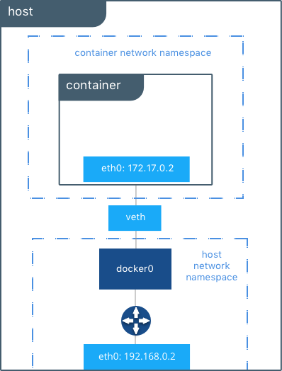
Docker Bridge Network Driver
Default Docker Bridge Network

Slide 11
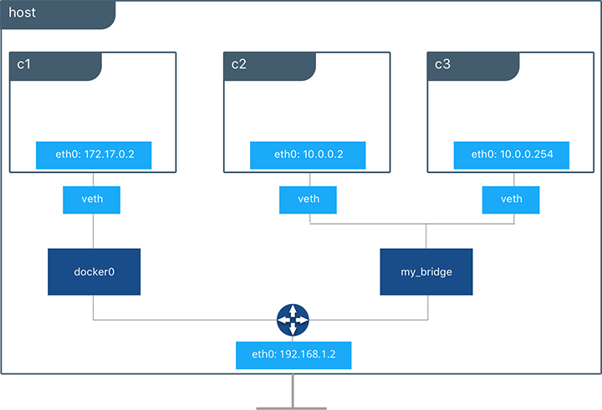
User Defined Docker Bridge Network

Slide 12
On any host running Docker Engine, there is, by default, a local Docker network named bridge, this network is created using a bridge network driver which instantiates a Linux bridge called docker0.
In addition to the default networks, users can create their own networks called user-defined networks of any network driver type.
In the case of user-defined bridge networks, a new Linux bridge is setup on the host.
Unlike the default bridge network, user-defined networks supports manual IP address and subnet assignment. If an assignment isn't given, then Docker's default IPAM driver assigns the next subnet available in the private IP space
root@ubuntu:~ # docker network create -d bridge mybridge
b782721e57d715c69b533f2cfa952ca29cb677e38f1dd6961819188a5723192b
root@ubuntu:~ # docker network ls |grep mybridge
b782721e57d7 mybridge bridge local

Slide 13
Create a container with name cont1 by adding to this network
root@ubuntu:~ # docker run -d --net mybridge --name cont1 alpine ping google.com
0cc3e0a14995202d7561e269b691f9601168c1a6c5f9147c2ff5de2492152308
Create a container with name cont2 by adding to this network
root@ubuntu:~ # docker run -d --net mybridge --name cont2 nginx
0cc3e0a14995202d7561e269b691f9601168c1a6c5f9147c2ff5de2492152308
Create another container with name cont3 without network option
root@ubuntu:~ # docker run -d --name cont3 alpine ping google.com
5d2117052b9e6633759b11b81cc719455f79620d7d14b271f2193b7b8ff59208
Lets get into cont1 & try to ping cont2 & 3
root@ubuntu:~ # docker exec -it cont1 sh
/ # ping cont2
PING cont2 (172.19.0.3): 56 data bytes
64 bytes from 172.19.0.3: seq=0 ttl=64 time=0.214 ms
64 bytes from 172.19.0.3: seq=1 ttl=64 time=0.267 ms
^C
--- cont2 ping statistics ---
2 packets transmitted, 2 packets received, 0% packet loss
round-trip min/avg/max = 0.214/0.240/0.267 ms
/ # ping cont3
ping: bad address 'cont3'
/ #

Slide 14
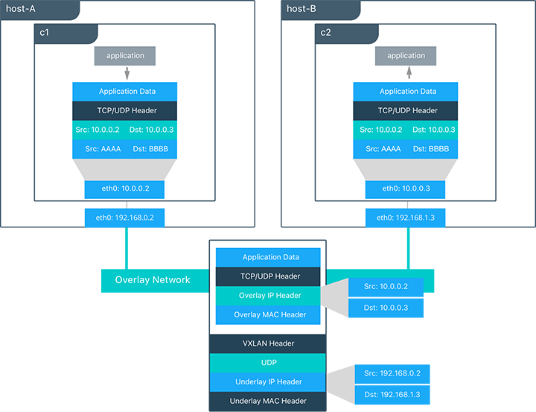
Docker overlay Network Driver

Slide 15
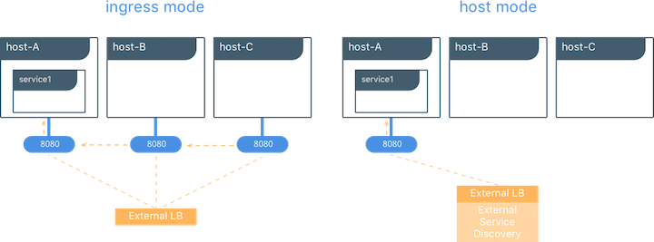
Docker overlay network required swarm mode enabled
During overlay network creation, Docker Engine creates the network infrastructure required for overlays on each host. A Linux bridge is created per overlay along with its associated VXLAN interfaces.
The Docker Engine intelligently instantiates overlay networks on hosts only when a container attached to that network is scheduled on the host.
It extends the overlay across all hosts participating in this particular overlay.

Slide 16


