Slide 1
DOCKER SWARM - BASICS

Slide 2
Contents
What is Docker Swarm
Initializing a cluster of Docker Engines in swarm mode
Adding nodes to the swarm
Deploying services to the swarm

Slide 3
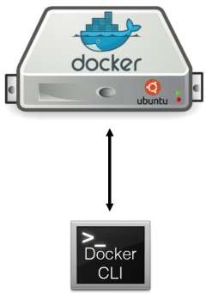
What we did till now

Slide 4
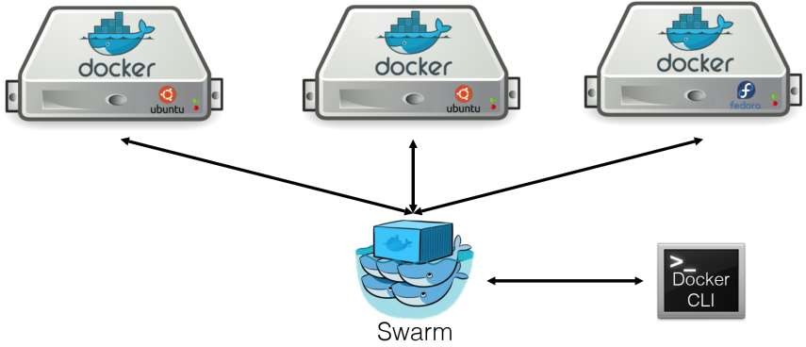
What we Need

Slide 5
Docker Swarm
Docker Swarm is a clustering and scheduling tool for Docker containers. With Swarm, IT administrators and developers can establish and manage a cluster of Docker nodes as a single virtual system
Docker Swarm Mode enables
  To have multiple Docker Engines / Nodes as a single cluster
  Also Provides orchestration features
One manager, and rest workers
Docker Swarm features are integrated with Docker Engine – we do not need to install it separately. We can just turn our Docker Engine into a Swarm mode
How ? Lets check it out.

Slide 6
How to initialize the swarm for a Docker Engine
root@Ubuntu:# docker info | grep -i swarm
Swarm: inactive
root@ubuntu:# docker swarm init
Swarm initialized: current node (lkp0ak3ro0lx2pa0xtjepz5s4) is now a manager.
To add a worker to this swarm, run the following command:
docker swarm join --token SWMTKN-1-3os00ywctmqupkq525o6dgol277ocoshsgchizwl7podp6j310-34q3ulhh9pg4qxjoakyodz079 192.168.220.130:2377
To add a manager to this swarm, run 'docker swarm join-token manager' and follow the instructions.
root@ubuntu:~# docker info |grep -i swarm
Swarm: active

Slide 7
Let’s Add Nodes to manager
root@worker1:~# docker swarm join --token SWMTKN-1-3os00ywctmqupkq525o6dgol277ocoshsgchizwl7podp6j310-34q3ulhh9pg4qxjoakyodz079 192.168.220.130:2377
This node joined a swarm as a worker.
root@worker2:~# docker swarm join --token SWMTKN-1-3os00ywctmqupkq525o6dgol277ocoshsgchizwl7podp6j310-34q3ulhh9pg4qxjoakyodz079 192.168.220.130:2377
This node joined a swarm as a worker.

Slide 8

On manager node run the docker node ls command to see the worker nodes:
The MANAGER column identifies the manager nodes in the swarm. The empty status in this column for worker1 and worker2 identifies them as worker nodes.
Swarm management commands like Docker node ls only works on manager nodes.

Slide 9
Lets start deploying our containers in the manager node – which by default will be able to deploy your containers to all worker nodes
We going to do little different way than we did till now

Slide 10


