Slide 1

INFRASTRUCTURE
Virtual Machines

Slide 2
HOST OPERATING SYSTEM
INFRASTRUCTURE
Virtual Machines

Slide 3
HYPERVISOR
HOST OPERATING SYSTEM
INFRASTRUCTURE
Virtual Machines

Slide 4
HYPERVISOR
2 Types of Hypervisors
Type 1: Direct link to Infrastructure
Type 2: Runs as an app on the Host OS
HOST OPERATING SYSTEM
INFRASTRUCTURE
Virtual Machines

Slide 5
HYPERVISOR
2 Types of Hypervisors examples
Type 1: VMware ESXi, Microsoft Hyper-V server and open source KVM.
Type 2: Oracle VM VirtualBox, VMWare Workstation
HOST OPERATING SYSTEM
INFRASTRUCTURE
Virtual Machines

Slide 6

HYPERVISOR
HOST OPERATING SYSTEM
INFRASTRUCTURE
Virtual Machines

Slide 7

HYPERVISOR
HOST OPERATING SYSTEM
INFRASTRUCTURE
Virtual Machines

Slide 8
HYPERVISOR
HOST OPERATING SYSTEM
INFRASTRUCTURE
Virtual Machines

Slide 9
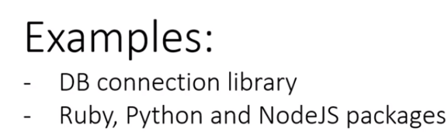
HYPERVISOR
HOST OPERATING SYSTEM
INFRASTRUCTURE
Virtual Machines

Slide 10
HYPERVISOR
HOST OPERATING SYSTEM
INFRASTRUCTURE
Virtual Machines

Slide 11
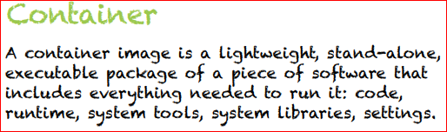

Slide 12
HYPERVISOR
HOST OPERATING SYSTEM
INFRASTRUCTURE
INFRASTRUCTURE
Virtual Machines
Docker Containers

Slide 13
HYPERVISOR
HOST OPERATING SYSTEM
HOST OPERATING SYSTEM
INFRASTRUCTURE
INFRASTRUCTURE
Virtual Machines
Docker Containers

Slide 14
HYPERVISOR
DOCKER CONTAINER ENGINE
HOST OPERATING SYSTEM
HOST OPERATING SYSTEM
INFRASTRUCTURE
INFRASTRUCTURE
Virtual Machines
Docker Containers

Slide 15
HYPERVISOR
DOCKER CONTAINER ENGINE
HOST OPERATING SYSTEM
HOST OPERATING SYSTEM
INFRASTRUCTURE
INFRASTRUCTURE
Virtual Machines
Docker Containers

Slide 16
HYPERVISOR
DOCKER CONTAINER ENGINE
HOST OPERATING SYSTEM
HOST OPERATING SYSTEM
INFRASTRUCTURE
INFRASTRUCTURE
Virtual Machines
Docker Containers

Slide 17

HYPERVISOR
DOCKER CONTAINER ENGINE
HOST OPERATING SYSTEM
HOST OPERATING SYSTEM
INFRASTRUCTURE
INFRASTRUCTURE
Virtual Machines
Docker Containers

Slide 18
HYPERVISOR
DOCKER CONTAINER ENGINE
HOST OPERATING SYSTEM
HOST OPERATING SYSTEM
INFRASTRUCTURE
INFRASTRUCTURE
Virtual Machines
Docker Containers

Slide 19
HYPERVISOR
DOCKER CONTAINER ENGINE
HOST OPERATING SYSTEM
HOST OPERATING SYSTEM
INFRASTRUCTURE
INFRASTRUCTURE
Virtual Machines
Docker Containers

Slide 20
Containers Are ‘Like’ Jars
Java Jar 1
Java Jar 2
Docker Container 1
Docker Container 2
JAVA RUNTIME
DOCKER CONTAINER ENGINE
HOST OPERATING SYSTEMS
HOST OPERATING SYSTEMS
INFRASTRUCTURE
INFRASTRUCTURE
Java Jars
Docker Containers

Slide 21
Containers Are ‘Like’ Jars
Java Jar 1
Java Jar 2
Docker Container 1
Docker Container 2
Compile Code into Jars
Layer of abstraction – Java Runtime
JAVA RUNTIME
DOCKER CONTAINER ENGINE
HOST OPERATING SYSTEMS
HOST OPERATING SYSTEMS
Platform Independent
INFRASTRUCTURE
INFRASTRUCTURE
Java Jars
Docker Containers

Slide 22
Containers Are ‘Like’ Jars
Java Jar 1
Java Jar 2
Docker Container 1
Docker Container 2
Compile Code into Jars
Containerise apps into Docker containers
Layer of abstraction – Java Runtime
Layer of abstraction – Docker Runtime
JAVA RUNTIME
DOCKER CONTAINER ENGINE
HOST OPERATING SYSTEMS
HOST OPERATING SYSTEMS
Platform Independent
Platform Independent
INFRASTRUCTURE
INFRASTRUCTURE
Java Jars
Docker Containers

Slide 23
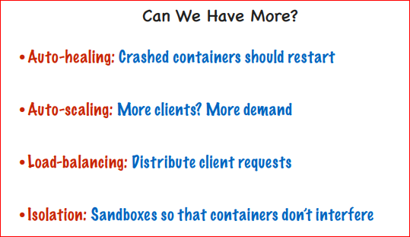
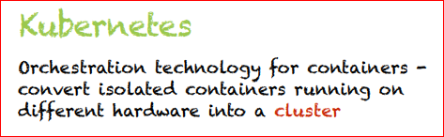

Slide 24
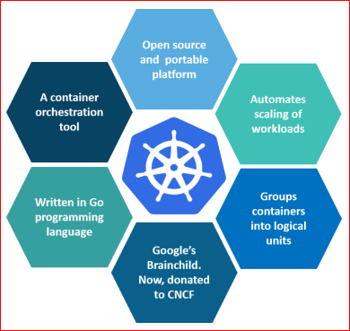
What is Kubernetes
Kubernetes is a platform for hosting Docker containers in a clustered environment with multiple Docker hosts.
Provides Container grouping, load balancing, auto-healing and scaling features.
Project started by Google.
Contributors ➔ Google, CoreOS, Redhat, Mesosphere, Microsoft, HP, IBM, VMWare, Pivotal, SaltStack, etc.

Slide 25
Kubernetes Architecture
Isolated Infra – Potentially thousands of containers on hundreds of VMs
Docker Container 1
Docker Container 2
Docker Container 1
Docker Container 2
Docker Container 1
Docker Container 2
Docker Container 1
Docker Container 2
DOCKER CONTAINER ENGINE
DOCKER CONTAINER ENGINE
DOCKER CONTAINER ENGINE
DOCKER CONTAINER ENGINE
HOST OPERATING SYSTEMS
HOST OPERATING SYSTEMS
HOST OPERATING SYSTEMS
HOST OPERATING SYSTEMS

Slide 26
Kubernetes Cluster Orchestration
Isolated Infra – Potentially thousands of containers on hundreds of VMs
Docker Container 1
Docker Container 2
Docker Container 1
Docker Container 2
Docker Container 1
Docker Container 2
Docker Container 1
Docker Container 2
DOCKER CONTAINER ENGINE
DOCKER CONTAINER ENGINE
DOCKER CONTAINER ENGINE
DOCKER CONTAINER ENGINE
HOST OPERATING SYSTEMS
HOST OPERATING SYSTEMS
HOST OPERATING SYSTEMS
HOST OPERATING SYSTEMS
KUBERNETES MASTER (Control Plane)

Slide 27
Kubernetes Cluster Orchestration
Isolated Infra – Potentially thousands of containers on hundreds of VMs
Docker Container 1
Docker Container 2
Docker Container 1
Docker Container 2
Docker Container 1
Docker Container 2
Docker Container 1
Docker Container 2
DOCKER CONTAINER ENGINE
DOCKER CONTAINER ENGINE
DOCKER CONTAINER ENGINE
DOCKER CONTAINER ENGINE
HOST OPERATING SYSTEMS
HOST OPERATING SYSTEMS
HOST OPERATING SYSTEMS
HOST OPERATING SYSTEMS
NODE 1
NODE 2
NODE 3
NODE N
KUBERNETES MASTER (Control Plane)

Slide 28
Kubernetes Cluster Orchestration
Isolated Infra – Potentially thousands of containers on hundreds of VMs
PODS
PODS
PODS
PODS
Docker Container 1
Docker Container 2
Docker Container 1
Docker Container 2
Docker Container 1
Docker Container 2
Docker Container 1
Docker Container 2
DOCKER CONTAINER ENGINE
DOCKER CONTAINER ENGINE
DOCKER CONTAINER ENGINE
DOCKER CONTAINER ENGINE
HOST OPERATING SYSTEMS
HOST OPERATING SYSTEMS
HOST OPERATING SYSTEMS
HOST OPERATING SYSTEMS
NODE 1
NODE 2
NODE 3
NODE N
KUBERNETES MASTER (Control Plane)

Slide 29
KUBERNETES DEMO

Slide 30
