Slide 1
AZURE FUNDAMENTALS
- AnkusH AGRAWAL

Slide 2
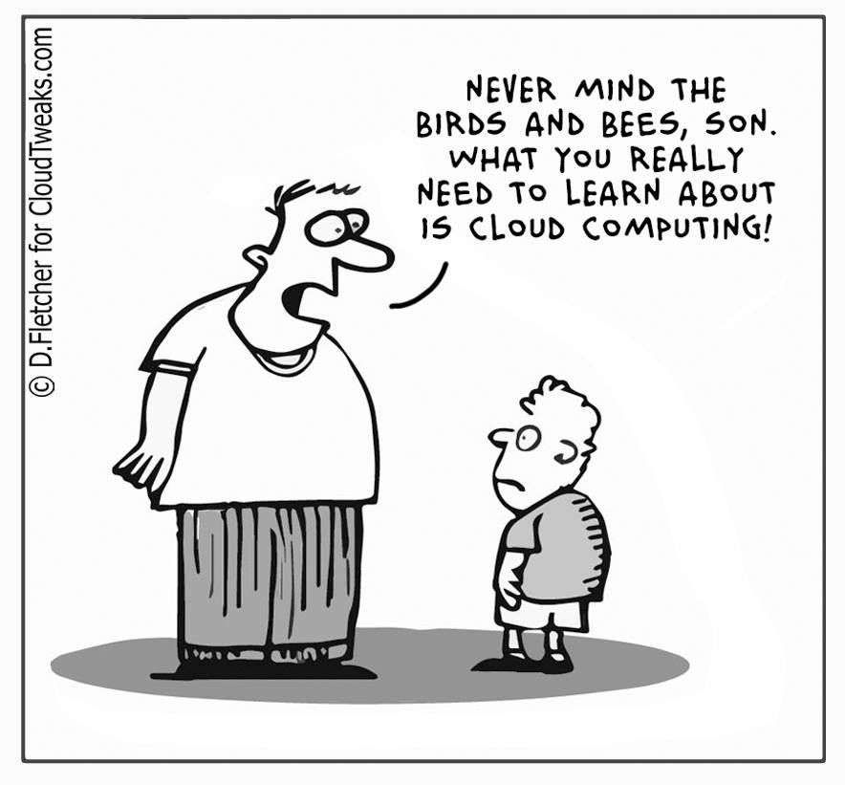
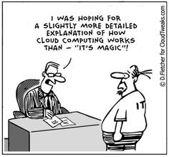

Slide 3
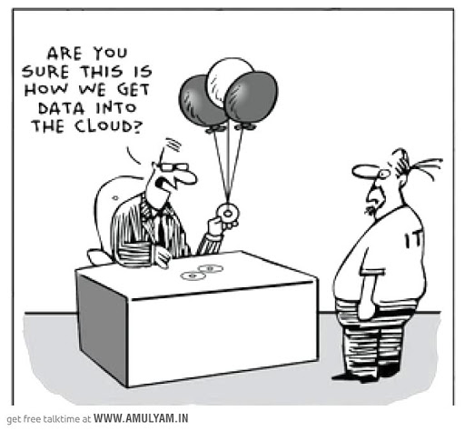
CLOUD COMPUTING
Delivery of computing services over the Internet using a pay-as-you-go pricing model.
It enables you to quickly solve your toughest business challenges and bring cutting edge solutions to your users.

Slide 4
PROBLEM :
In our ever-changing digital world, two trends emerge:
Teams are delivering new features to their users at record speeds.
End users expect an increasingly rich and immersive experience with their devices and with software.

Slide 5
SOLUTION :ClOUD COMPUTING
To power services and deliver innovative and novel user experiences more quickly, the cloud provides on-demand access to:
A nearly limitless pool of raw compute, storage, and networking components.
Speech recognition and other cognitive services that help make your application stand out from the crowd.
Analytics services that enable you to make sense of telemetry data coming back from your software and devices.

Slide 6
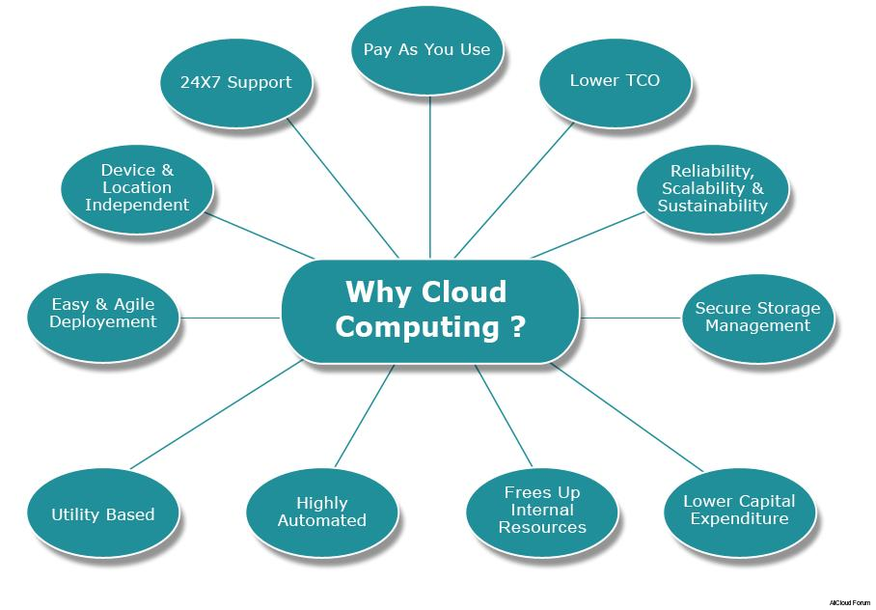

Slide 7
SERVICES OFFERed
Compute power - such as Linux servers or web applications.
Storage - such as files and databases
Networking - such as secure connections between the cloud provider and your company
Analytics - such as visualizing telemetry and performance data

Slide 8
CompUTING SERVICES
Virtual machines : includes an operating system and hardware that appears to the user like a physical computer running Windows or Linux.
Containers : similar to VMs except they don't require a guest operating system. Instead, the application and all its dependencies is packaged into a "container" and then a standard runtime environment is used to execute the app.
Serverless Computing : run application code without creating, configuring, or maintaining a server. Pay for the processing time used by each function as it executes.

Slide 9
Benefits
Cost-effective : pay-as-you-go or consumption-based pricing model.
Scalable : Vertical/Horizontal Scaling
Elastic : compensate by automatically adding or removing resources.
Current : focus on what matters: building and deploying applications.
Reliable : offer data backup, disaster recovery, and data replication services.
Global : datacenters located in various regions all over the globe.
Secure : Physical security and Digital Security.

Slide 10
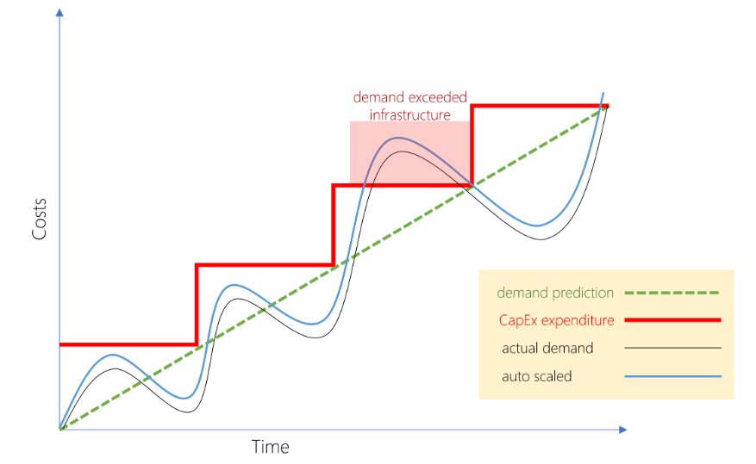
(CapEx) versus (OpEx)
CapEx - With capital expenditures, you plan your expenses at the start of a project or budget period. Your costs are fixed, meaning you know exactly how much is being spent. This is appealing when you need to predict the expenses before a project starts due to a limited budget.
OpEx - Demand and growth can be unpredictable and can outpace expectation, which is a challenge for the CapEx model as shown in the following graph.

Slide 11
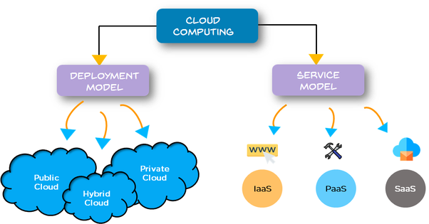
CLOUD MODELS

Slide 12
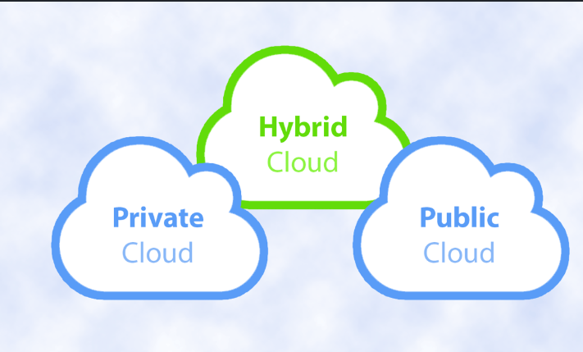
dEPLOYMENT MODeLS

Slide 13
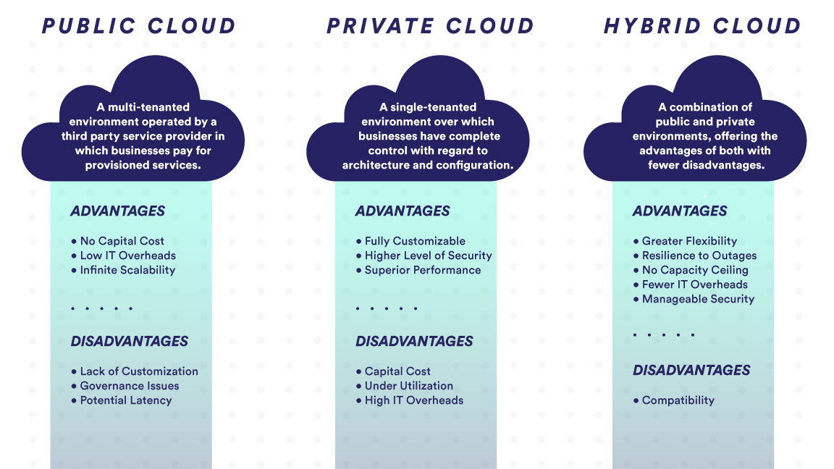

Slide 14
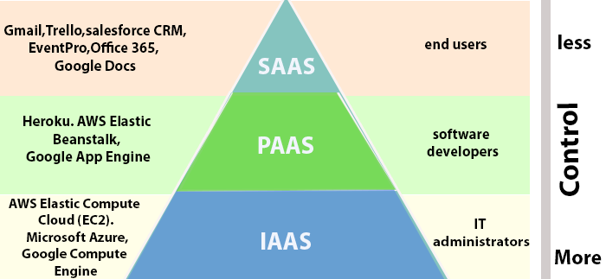
Service models

Slide 15
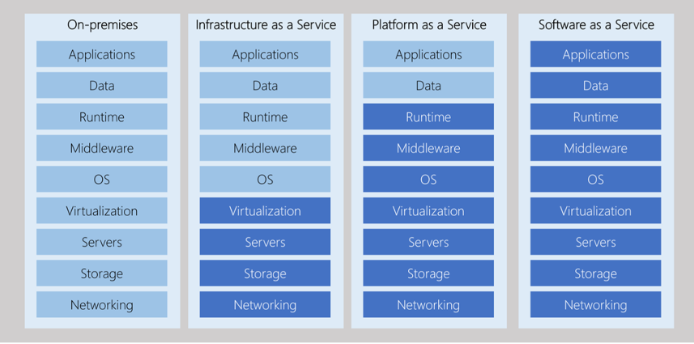
MANAGEMENT

Slide 16


Slide 17
WHAT IS AZURE ?
Microsoft's cloud computing platform.
Continually expanding set of cloud services that help your organization meet your current and future business challenges.
Gives the freedom to build, manage, and deploy applications on a massive global network using tools and frameworks.

Slide 18
AZURE SERVICES
Compute
Networking
Storage
Mobile
Databases
Web
Internet of Things
Big Data
Artificial Intelligence
DevOps

Slide 19
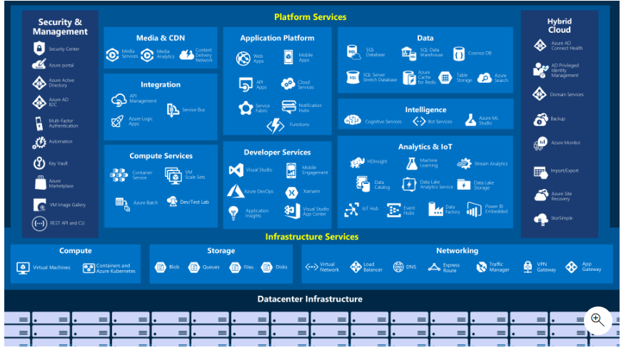

Slide 20
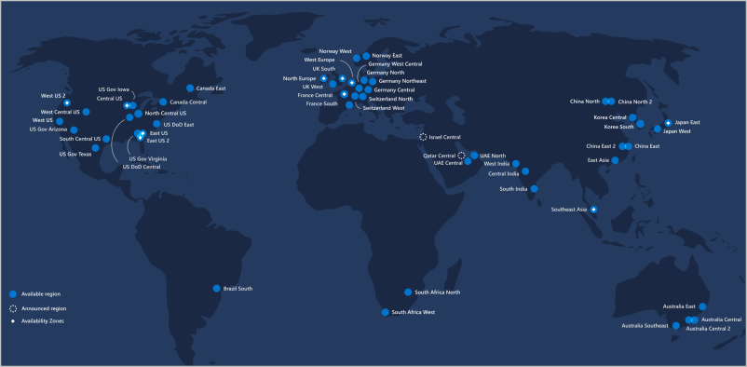
DATACENTERS AND REGIONS
Microsoft Azure is made up of datacenters located around the globe.
When we create a resource we are using physical equipment in one or more of these locations.
A region is a geographical area on the planet containing at least one, but potentially multiple datacenters that are nearby and networked together with a low-latency network.

Slide 21
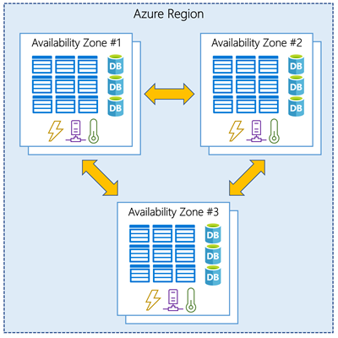
AVAILABILITY ZONES
Availability Zones are physically separate datacenters within an Azure region.
Availability Zones are connected through high-speed, private fiber-optic networks.

Slide 22
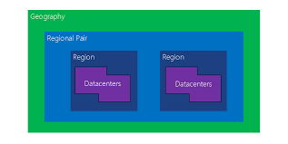
REGION PAIRS
There is a minimum of three zones within a single region.
Each Azure region is always paired with another region within the same geography (such as US, Europe, or Asia) at least 300 miles away.

Slide 23
Azure tools
Tools that are commonly used for day-to-day management and interaction include :-
> Azure Portal : public website that you can access with any web browser.
>Azure Powershell/Azure Command Line interface : a cross-platform version of PowerShell that runs on Windows, Linux, or macOS.
>Azure Cloud Shell : an interactive, authenticated, browser-accessible shell for managing Azure resources.
>Azure Mobile App

Slide 24
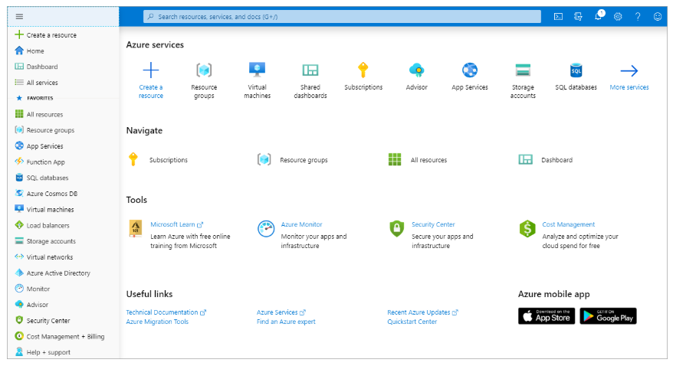
Navigate the portal

Slide 25
Azure marketPlacE
The Azure Marketplace is often where you start when creating new resources in Azure.
The Marketplace allows customers to find, try, purchase, and provision applications and services from hundreds of leading service providers, all certified to run on Azure.

Slide 26
AZURE ADVISOR
Get proactive, actionable, and personalized best practices recommendations.
Improve the performance, security, and high availability of your resources as you identify opportunities to reduce your overall Azure costs.
Get recommendations with proposed actions inline.

Slide 27
Azure dashboard
A dashboard is a customizable collection of UI tiles displayed in the Azure portal.
Add, remove, and position tiles to create the exact view you want.
Multiple dashboards are supported, and you can switch between them as needed. You can even share your dashboards with other team members. For e.g RBAC
Dashboards are stored as JavaScript Object Notation (JSON) files.

Slide 28
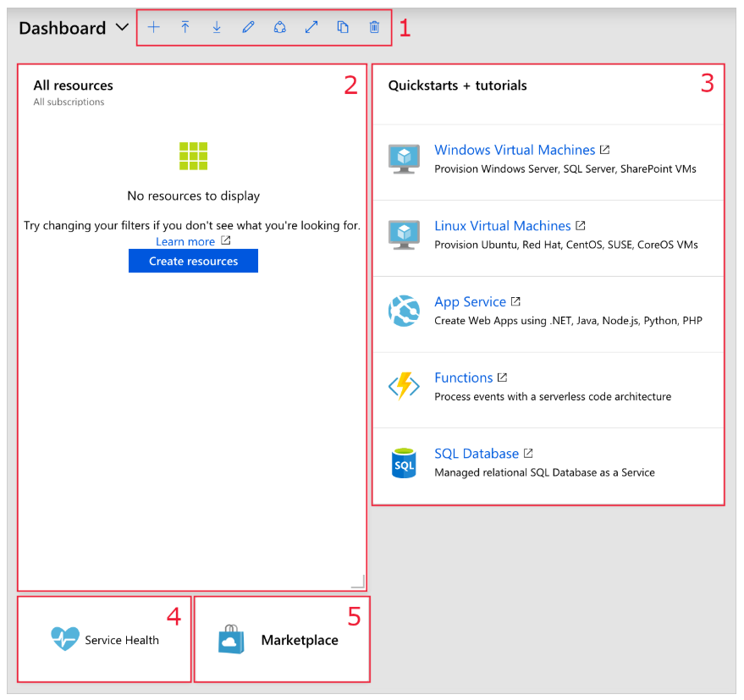
Default dashboard
Features
New Dashboard
Upload
Download
Edit using Portal
Edit using JSON file
Reset
Share or Unshare

Slide 29
PREVIEW FEATURE
With Azure Preview Features, you can test beta and other pre-release features, products, services, software, and regions.
Private Preview. An Azure feature marked "private preview" is available to specific Azure customers for evaluation purposes.
Public Preview. An Azure feature marked "public preview" is available to all Azure customers for evaluation purposes.

Slide 30
AZURE CompuTE CONCEpTS
On-demand computing service for running cloud-based applications.
There are four common techniques for performing compute in Azure:
Virtual machines
Containers
Azure App Service
Serverless computing

Slide 31
VIRTUAL MACHINES (IAAS)
Create and use virtual machines in the cloud.
Selecting an image is one of the most important decisions you'll make when creating a VM. An image is a template used to create a VM.
These templates already include an OS and often other software.
VMs are also an excellent choice when moving from a physical server to the cloud ("lift and shift").

Slide 32
ContAInERS (PAAS)
Azure supports Docker containers .
There are several ways to manage containers in Azure.
Azure Container Instances (ACI)
Azure Kubernetes Service (AKS)
Using Containers : This architecture is where you break solutions into smaller, independent pieces.

Slide 33
Azure app Service (PAAS)
Enables you to build and host web apps, background jobs, mobile backends, and RESTful APIs in the programming language of your choice without managing infrastructure.

Slide 34
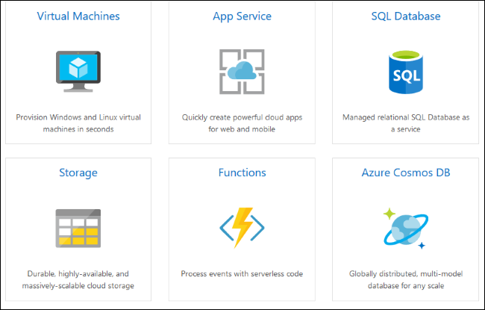

Slide 35
serverleSs computing
Abstraction of servers: abstracts the servers you run on. You never explicitly reserve server instances; the platform manages that for you.
Event-driven scale: an excellent fit for workloads that respond to incoming events. For e.g. HTTP, Webhooks, Queues
Micro-billing: pay only for the time their code runs.

Slide 36
Azure has two implementations of serverless compute:
Azure Functions, which can execute code in almost any modern language.
Azure Logic Apps, which are designed in a web-based designer and can execute logic triggered by Azure services without writing any code.
Azure Functions : concerned only about the code running your service, and not the underlying platform or infrastructure, Azure Functions are ideal.
Logic Apps : execute workflows designed to automate business scenarios and built from predefined logic blocks.

