Slide 1
Product Management System And Billing System
Presented by :-
1. Ankush Rajendra Bhalage Roll No:- 219028
2. Sarthak Sanjay Joshi Roll No:- 219167

Slide 2
Introduction
Nowadays ,Product Management and Billing System has become important factor in modern business field. This system will help the businessmen to maintain record of products delivery and purchased items.
In this system, User can see the available items and which items are sold to which customer.
With the help of this system, User will see which products they have purchased from which vendor.
According to available products, user can order other products as per their need.

Slide 3
Scope
This system will be mainly designed for small shops for their business.
The System will keep record of available products and sold products.
This system will provide better services to businessman.

Slide 4
Technology
We used Spring-Boot as backend , React JS as Frontend in our Project and MySQL Database for maintaining records of data.
Spring Boot: Spring Boot is framework which makes developing spring application and micro-services faster.
React JS: React allows developers to create large web applications that can change data, without reloading the page. The main purpose of React is to be fast, scalable, and simple. It works only on user interfaces in the application. This corresponds to the view in the MVC template.
MySQL: MySQL is a popular, time-tested, but also modern and fully relational database management software. Businesses everywhere use it for mission-critical enterprise data storage, processing, as a backend to major customer-facing applications, and as part of powerful, established web software stacks.

Slide 5
Features:- 1) Admin: -Manage the Registration of users. -Can perform All Operations of User. 2) Employee: -Check the product availability. -Register New Vendor . - Add new Product. -Register new Customer. - Make invoice of products purchased by customer. -See how much money made according to date. -Can update or delete customer and vendor details.

Slide 6
1) Availability- -Users can access this management system from anywhere as this is a web application. 2) Security: -As it is necessary to authenticate before using this system so data present in the system is accessible to only authorized persons. 3) Reliability: -System will be reliable enough to provide information about the available products. -Once the product get sold, the available product list will be updated automatically. 4) Performance: -Basic system configuration is enough to access the web application. -Users can access the web application from mobile phones with minimal performance of the same. -Performance of the system remains same regardless of platform either it is laptop or mobile phone.

Slide 7
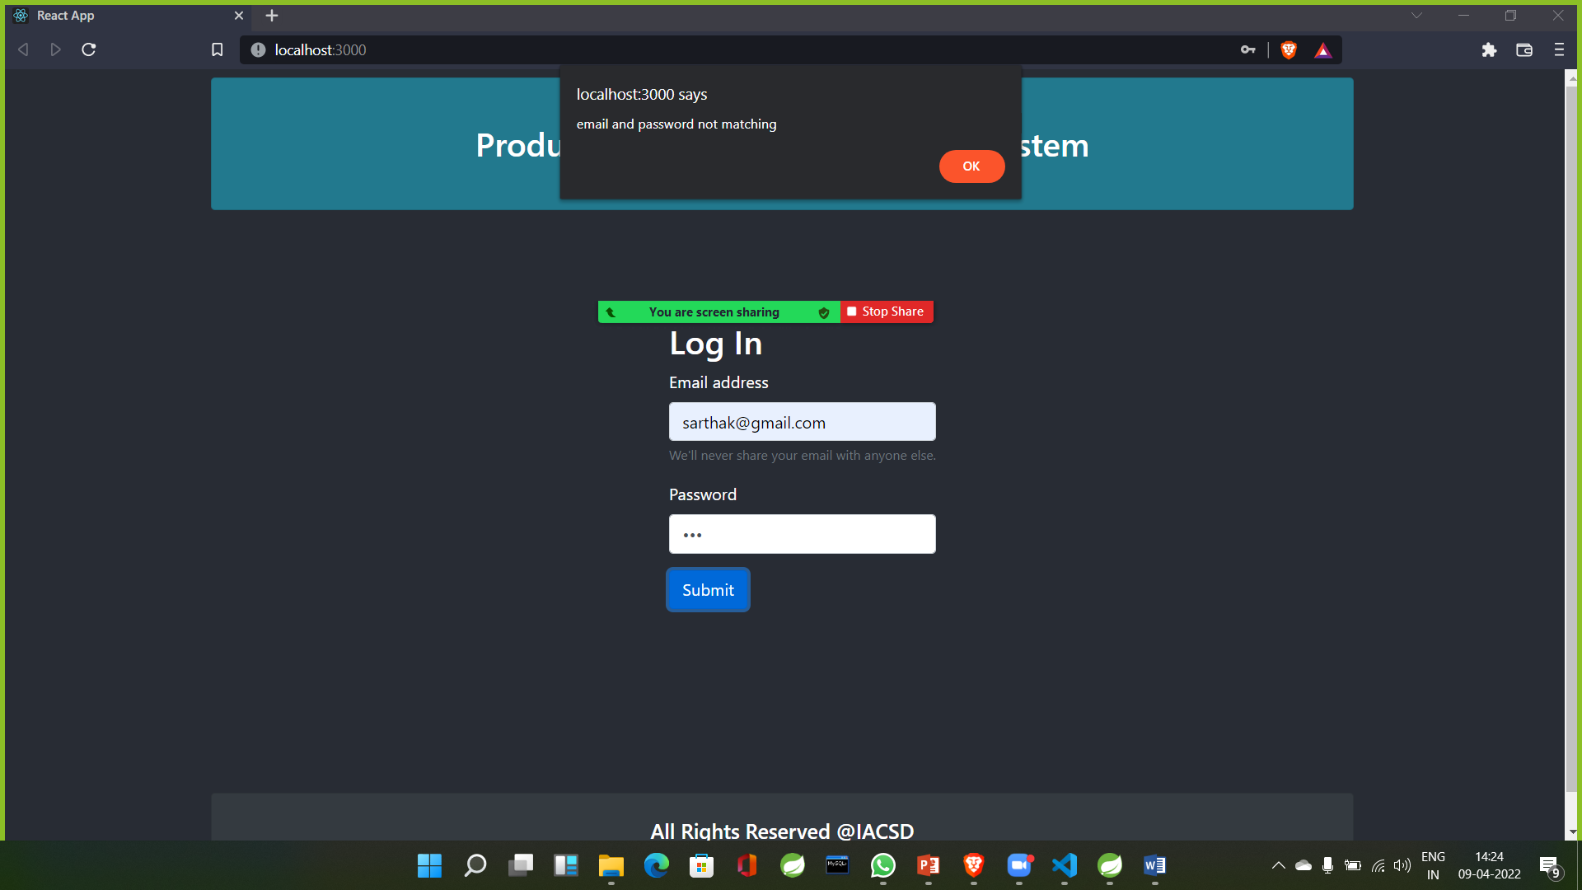
Screenshots of Project:- In case of: wrong username and password.

Slide 8
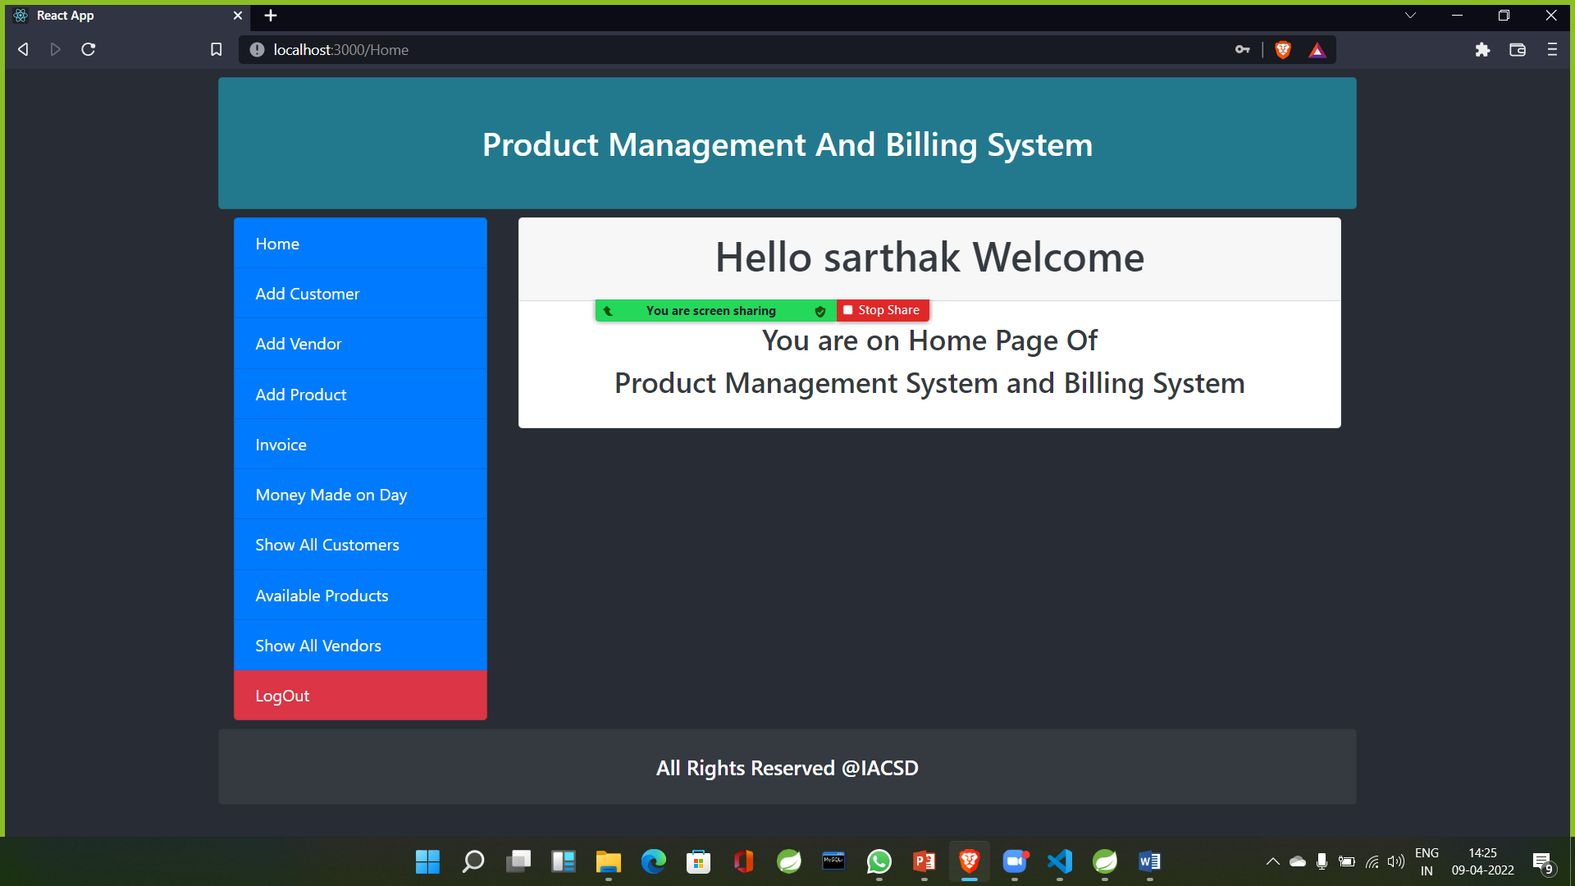
Screenshots of Project:- In case of: right username and password.

Slide 9
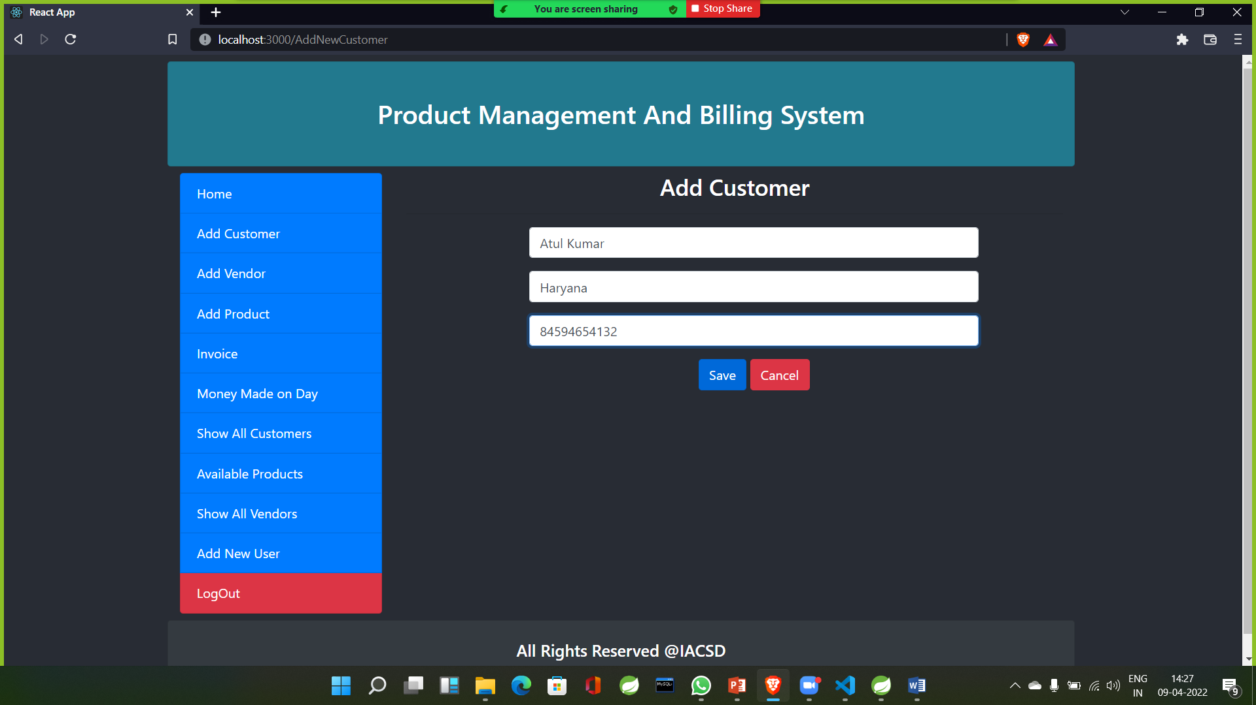
Screenshots of Project:- In case of: Adding new Customer.

Slide 10
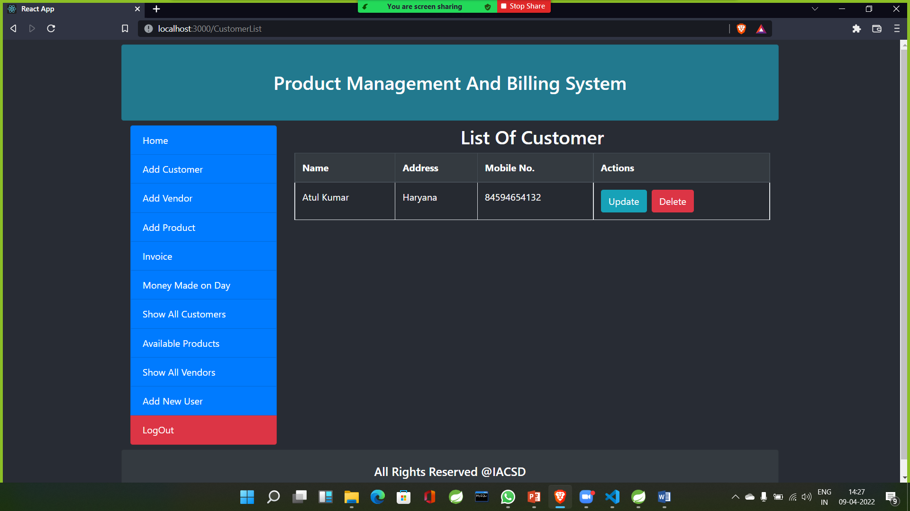
Screenshots of Project:- The newly added Customer can be seen in the Customer list.

Slide 11
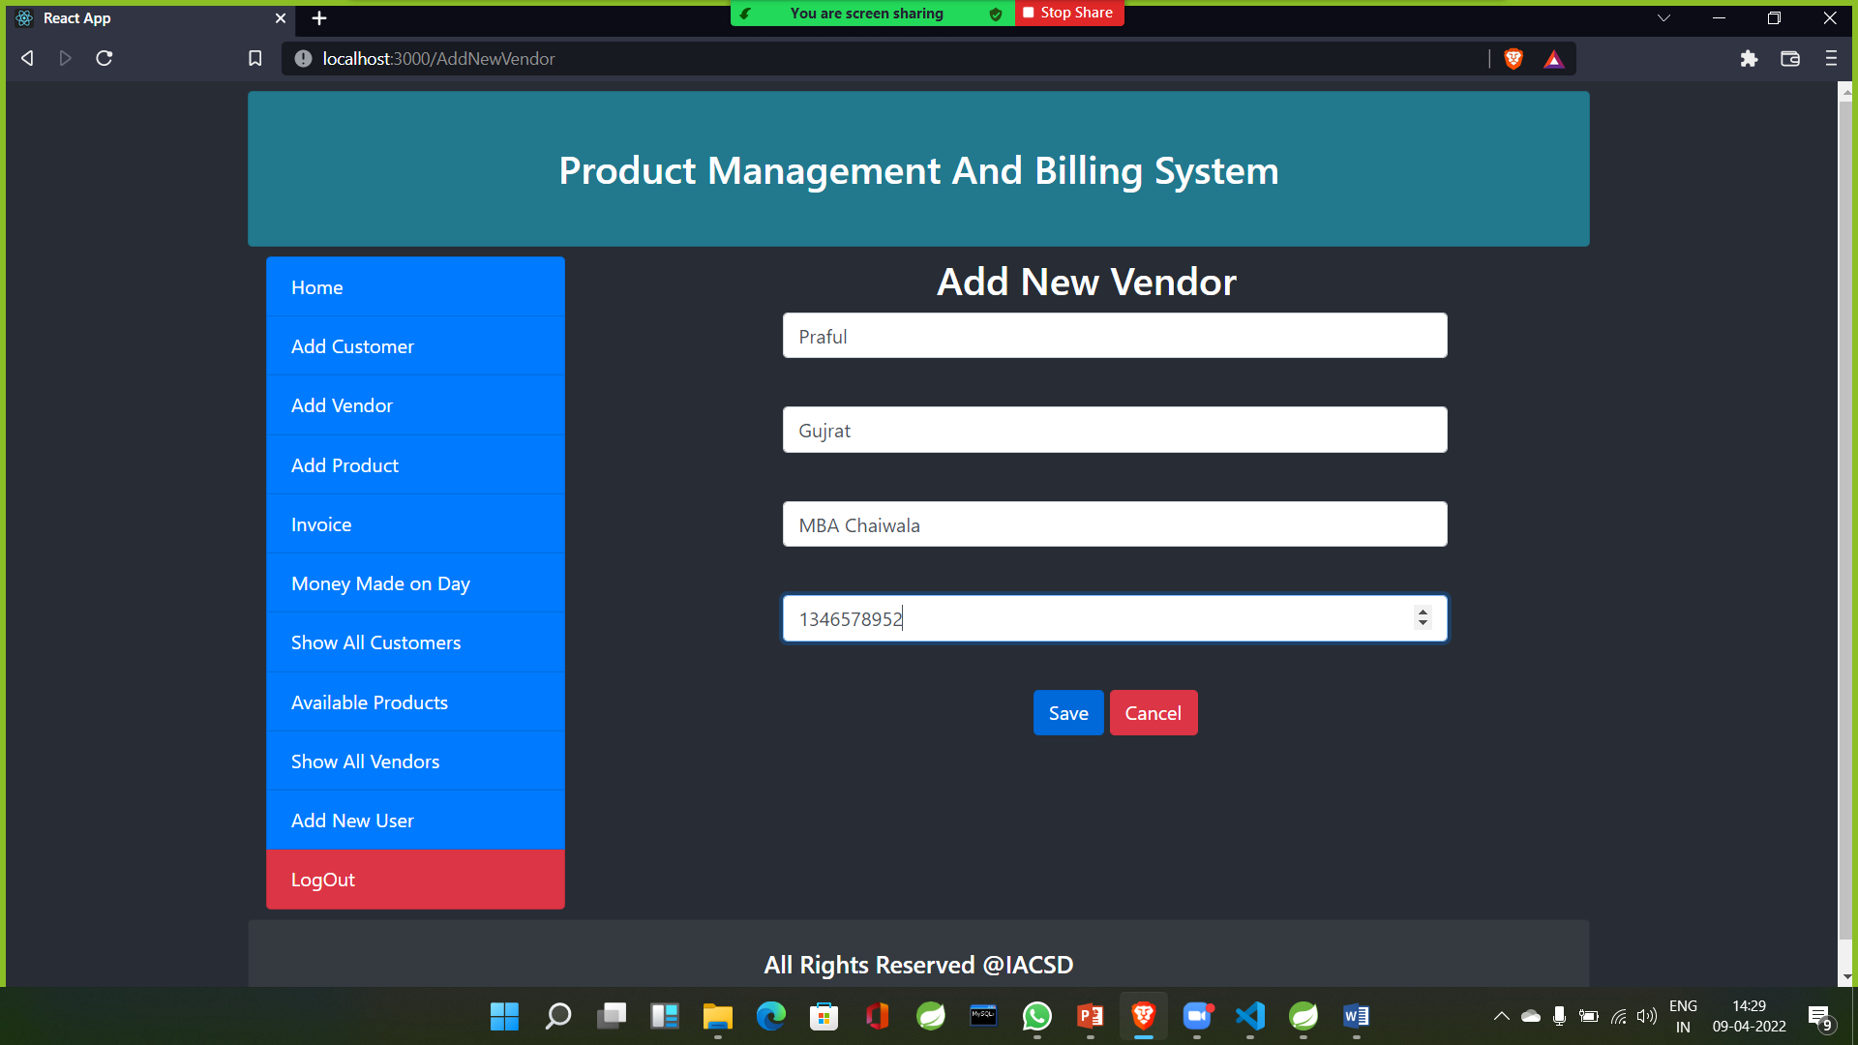
Screenshots of Project:- In case of: Adding new Vendor.

Slide 12
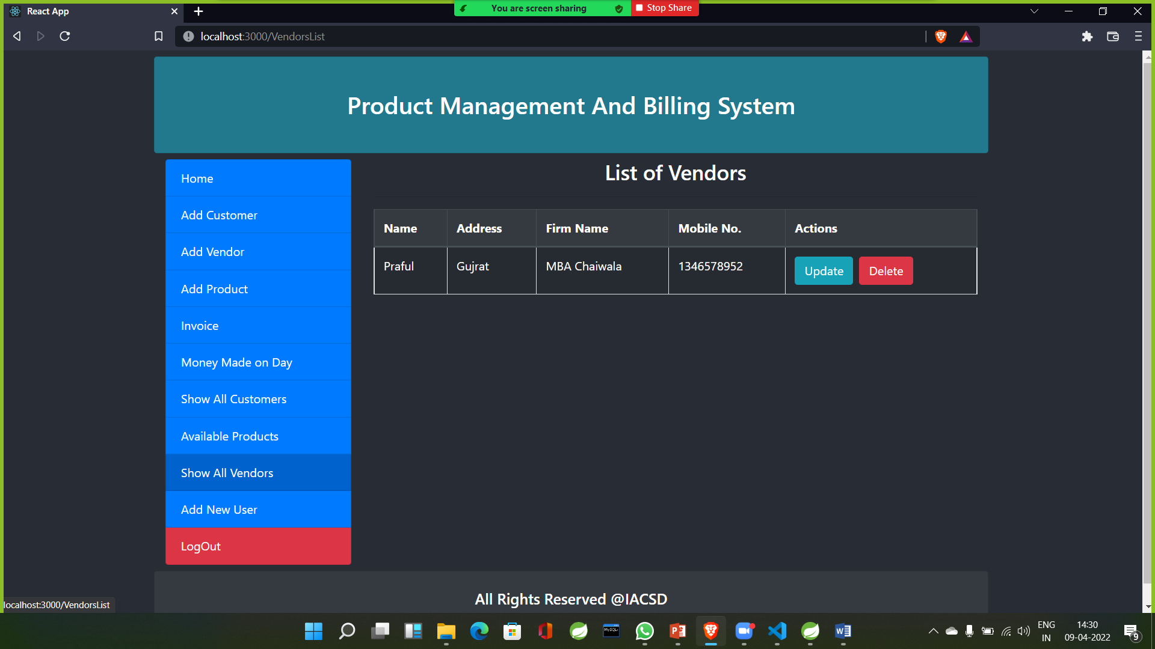
Screenshots of Project:- The newly added Vendor can be seen in the Vendors list.

Slide 13
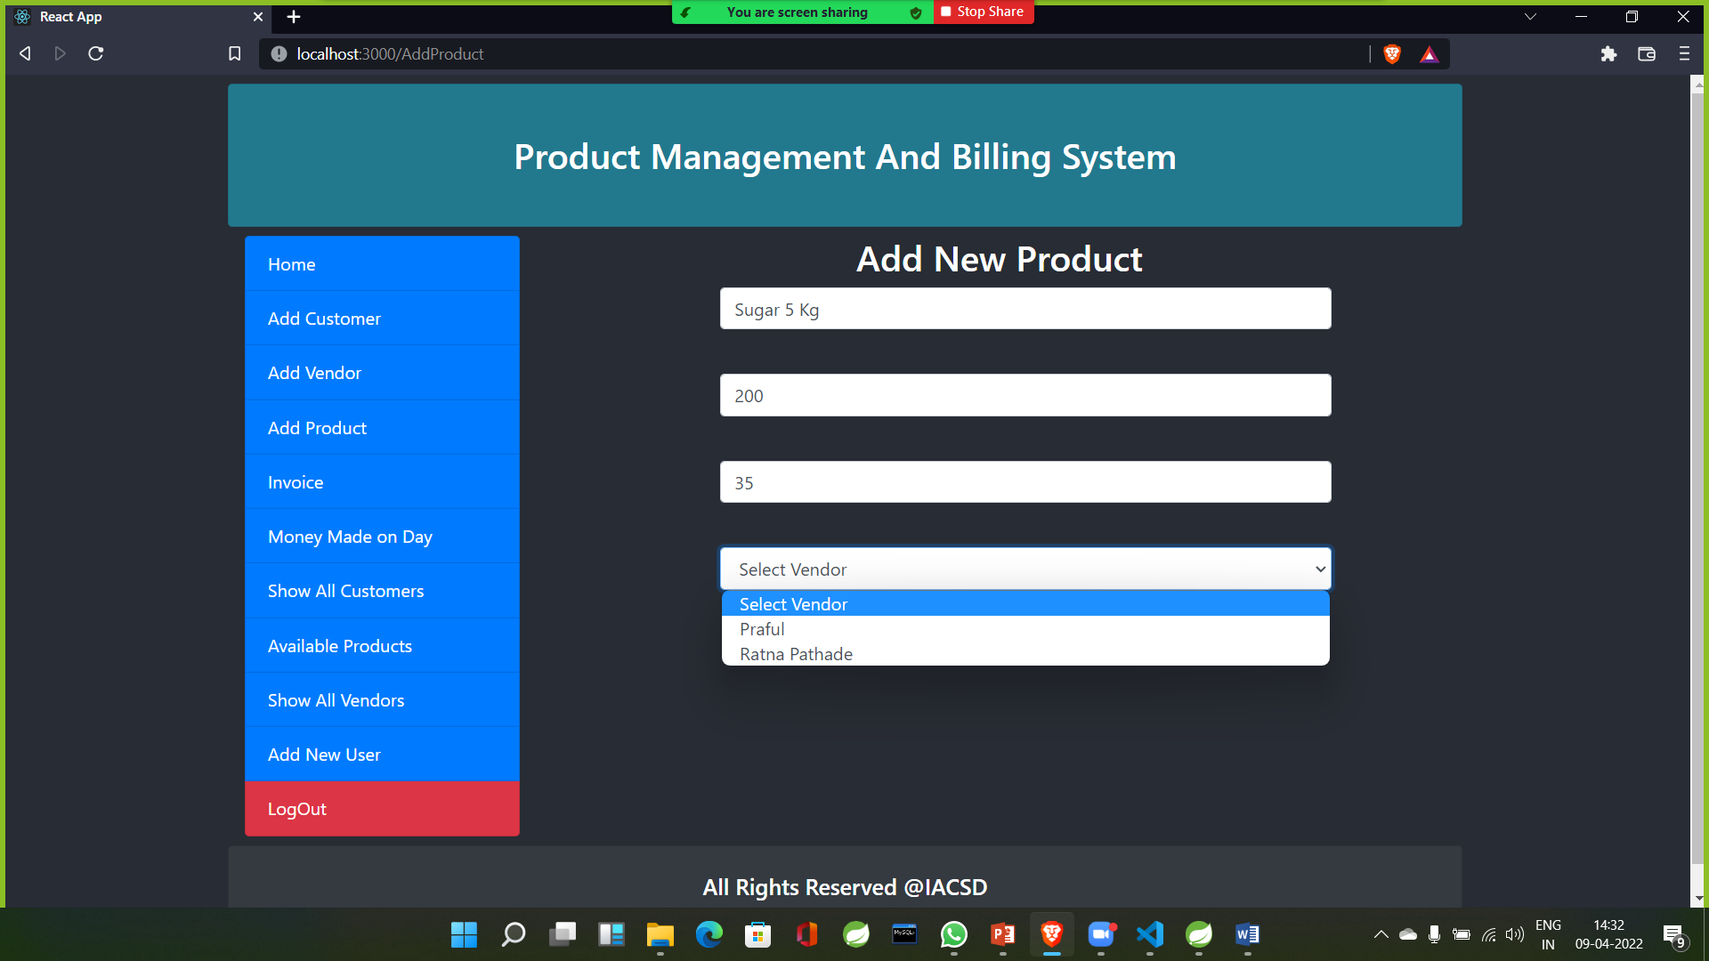
Screenshots of Project:- In case of: Adding New Product.

Slide 14
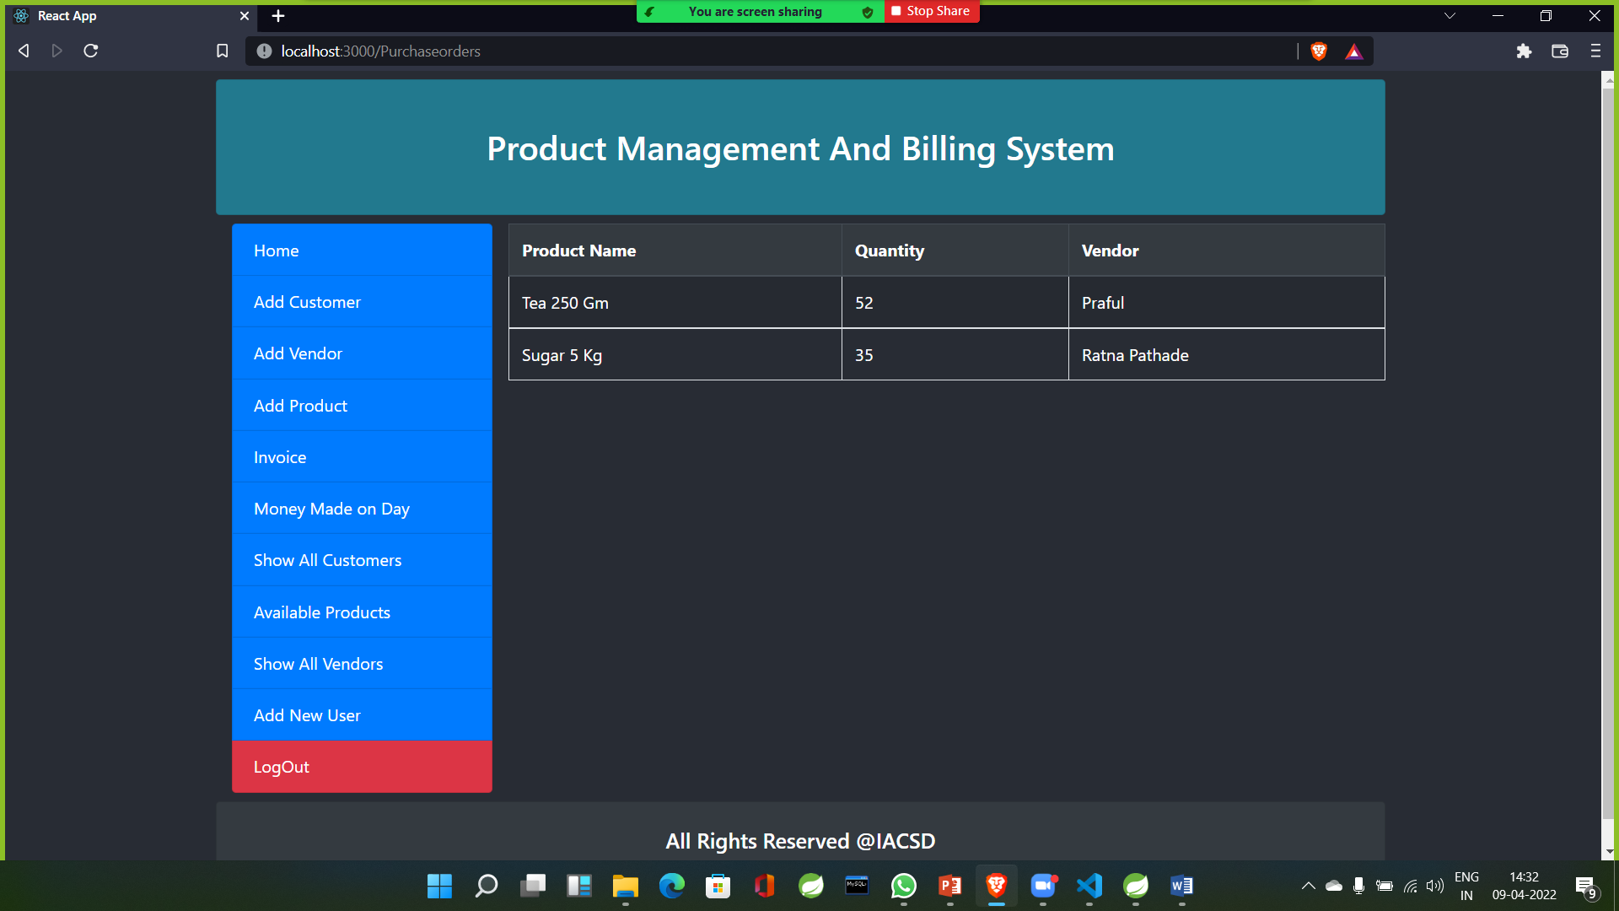
Screenshots of Project:- Available Product.

Slide 15
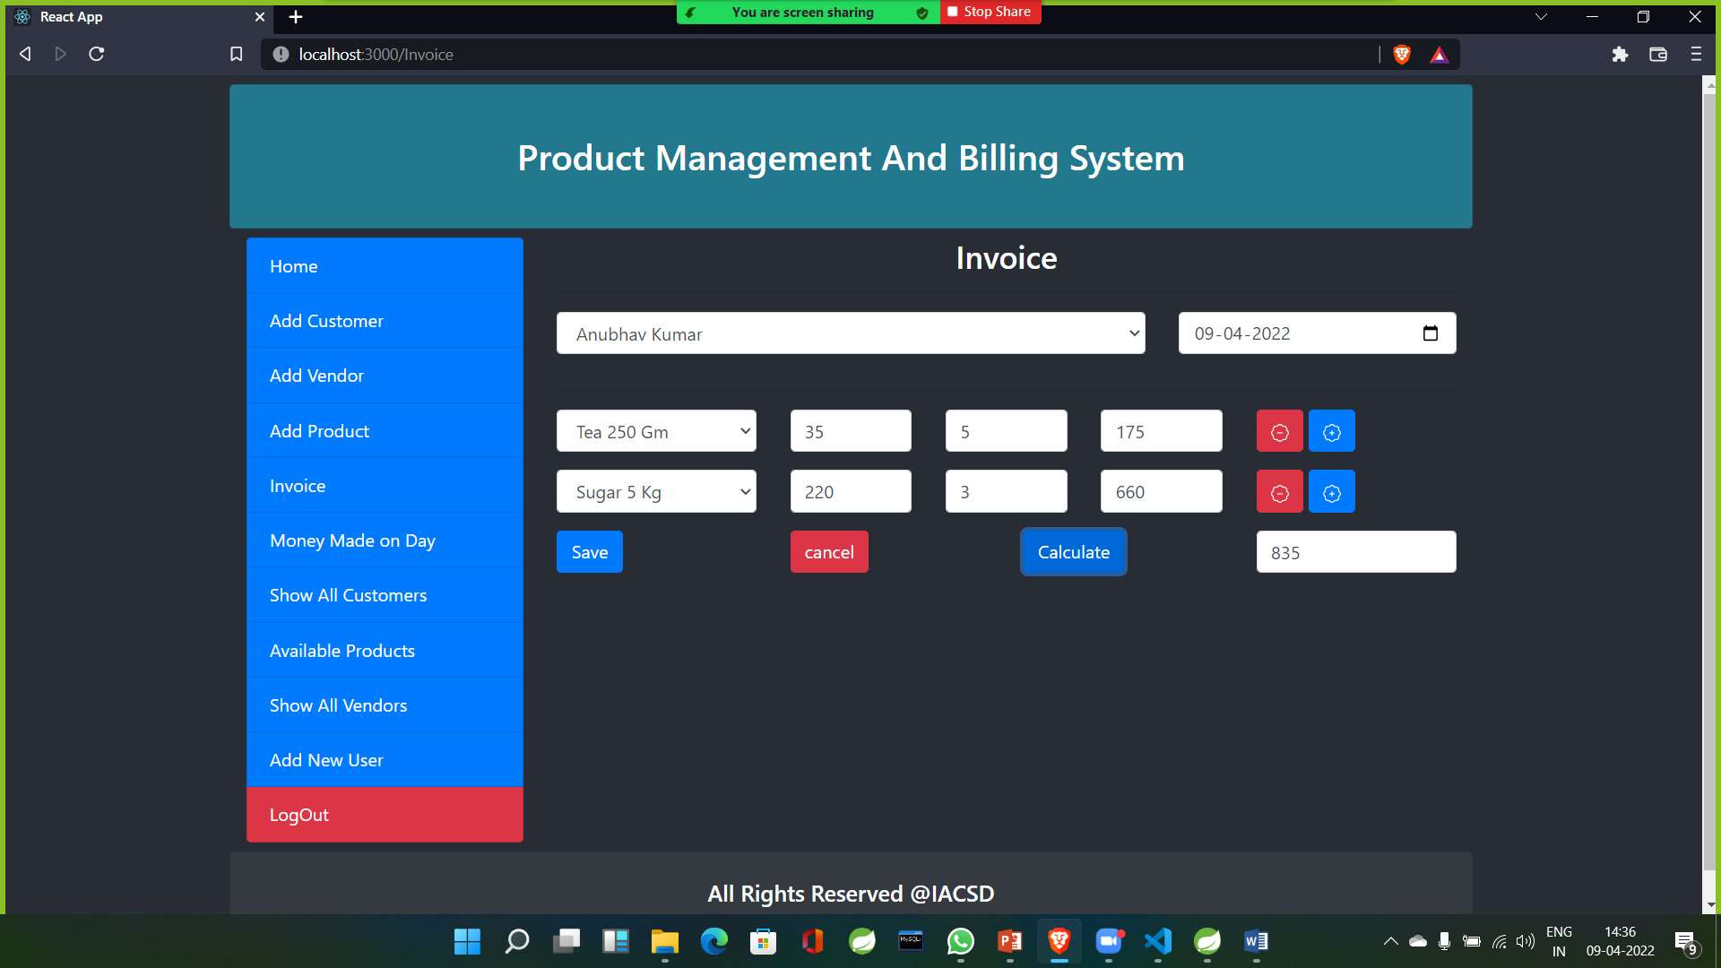
Screenshots of Project:- Making Invoice

Slide 16
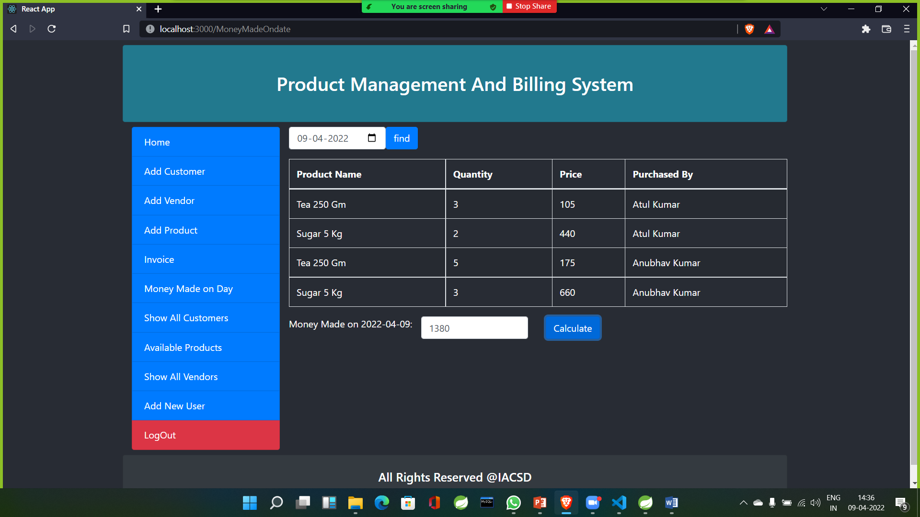
Screenshots of Project:- Money made according to Date.

Slide 17
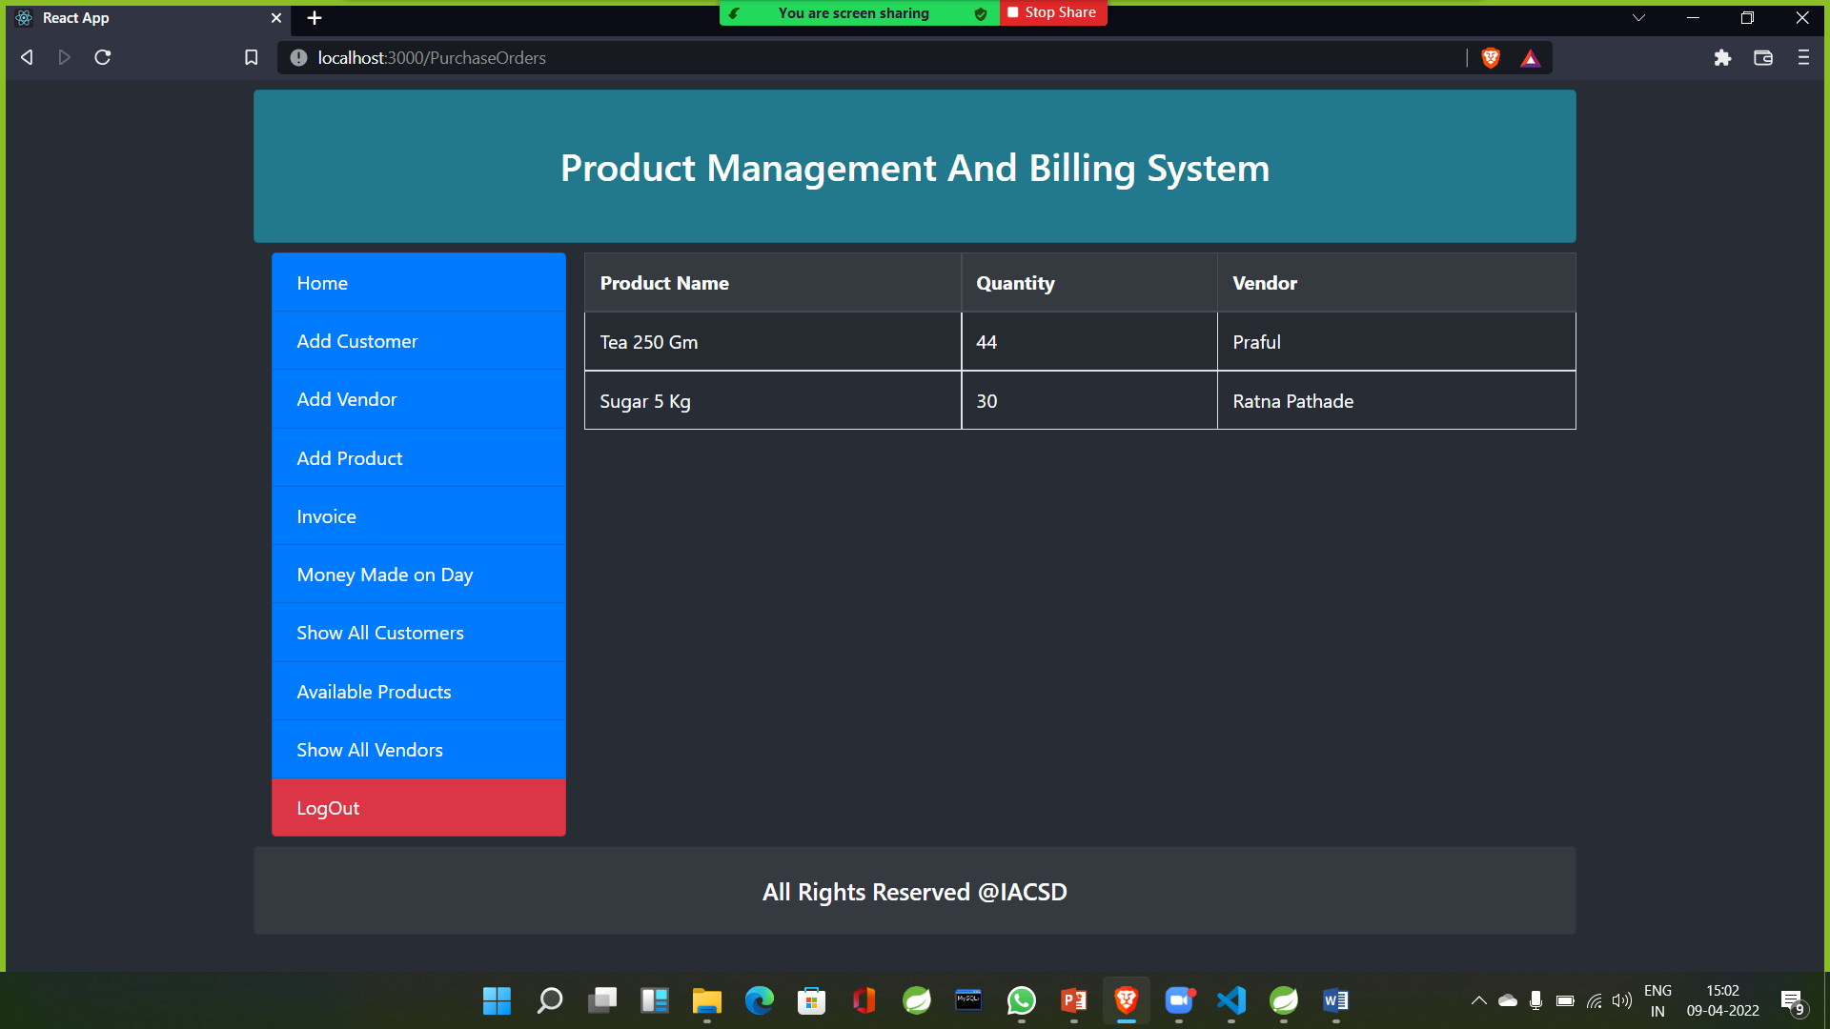
Screenshots of Project:- Updated Product List.

Slide 18
Conclusion:- Using this project “Product Management System and Billing System” user can manage products and see how much revenue they are generating on daily basis. The main benefit of this system is the information of available products and keeping data of sold products . This will save the time and eventually help to organize their shop and will make the transaction paper free. This website works 24*7 so user can use it any time.

Slide 19


