Slide 1

Airbnb Listing And Review Analysis
By- Ankush Brella

Slide 2
Index
Goals
Assessing City Location Scores
Host Metrics
Analysing Listing Prices
Analysing Composite Scores
Property Type Price Analysis
Comprehensive City Insights
Findings

Slide 3
Goals
The primary objective is to analyze Airbnb data to reveal insights into user experiences and satisfaction levels with the numerous listed stays, all accomplished using Power BI.
By:
Assessing City Location Scores
Examining Host Response Time Impact
Visualizing Airbnb Listing Prices
Analysing Composite Scores
Calculating Listing Age and Host Tenure
Property Type Price Analysis
Crafting a Comprehensive City Insights Report

Slide 4
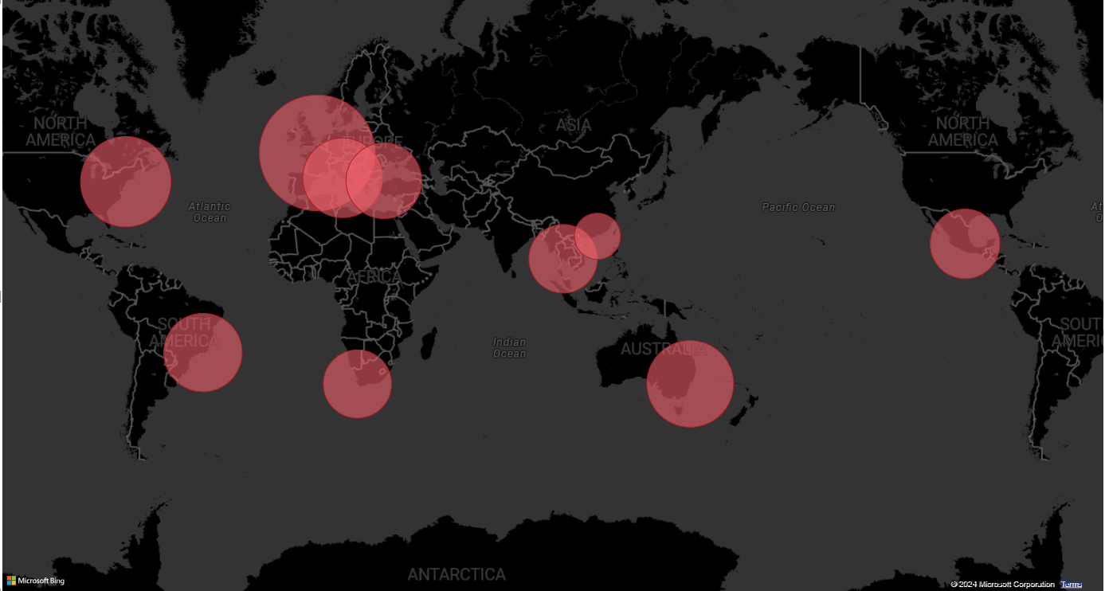
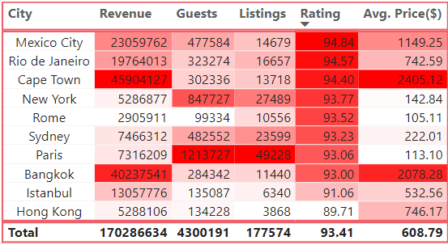
Assessing City Location Scores
Mexico City here is the most-rated location by Airbnb users with a rating of 94.84. It has over 14k listings and generates 23M revenues.
Paris
Rating: 93.06
Istanbul
Rating: 91.06
New York
Rating: 93.77
Rome
Rating: 93.52
Hong Kong
Rating: 89.71
Mexico City
Rating: 93.77
Bangkok
Rating: 93.00
Rio de Janeiro
Rating: 94.57
Cape Town
Rating: 94.40
Sydney
Rating: 93.23

Slide 5
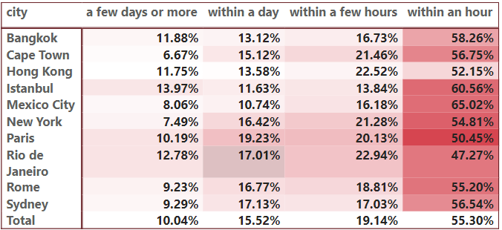
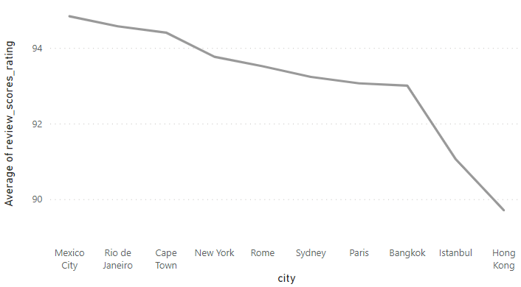
Examining Host Response Time Impact
Mexico City offers the quickest host response time.
This also shows one of the reasons for Mexico City’s high rating.

Slide 6
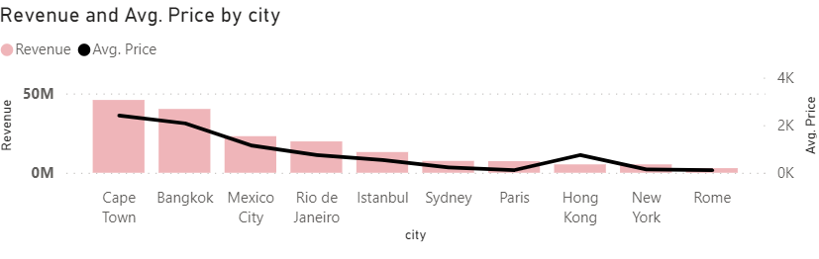
Visualizing Airbnb Listing Prices
Cape Town generated the most revenue of $46M and has the highest average listing price of $2405.12
Hong Kong has a high average listing price of $746.17 but has only generated a revenue of $53M

Slide 7
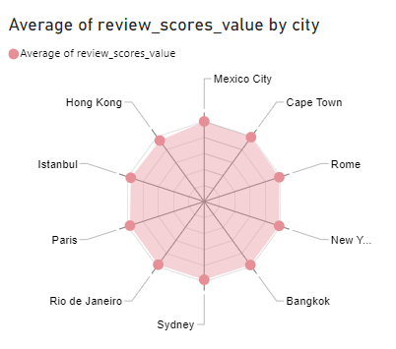
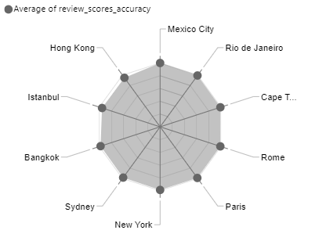
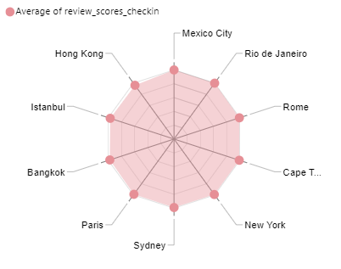
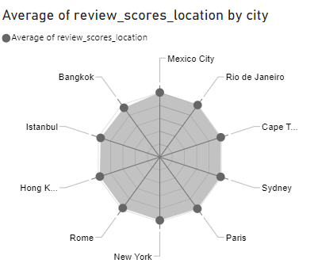
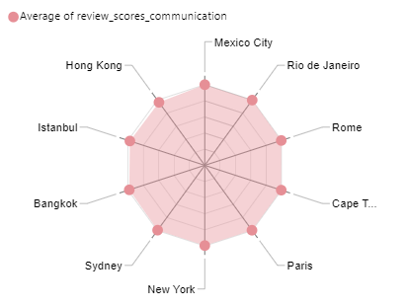
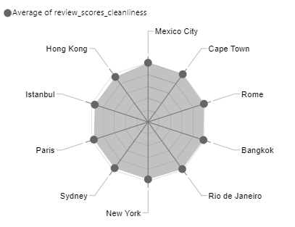
Analysing Composite Scores
Mexico City has the highest ratings and Bangkok has the lowest ratings for location
Mexico City and Rio De Janeiro have the joint highest ratings for communication.
Whereas Hong Kong has the lowest rating.
Mexico City has the highest rating and Hong Kong has the lowest rating for cleanliness.
Mexico City has the highest rating and Hong Kong has the lowest rating for value.
Mexico City has the highest rating and Hong Kong has the lowest rating for accuracy.
Mexico City and Rio De Janeiro have the joint highest ratings for check-in.
Whereas Hong Kong has the lowest rating.

Slide 8
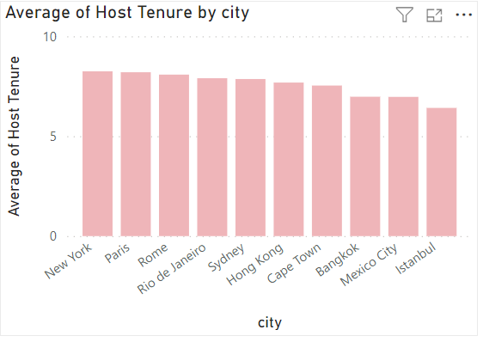
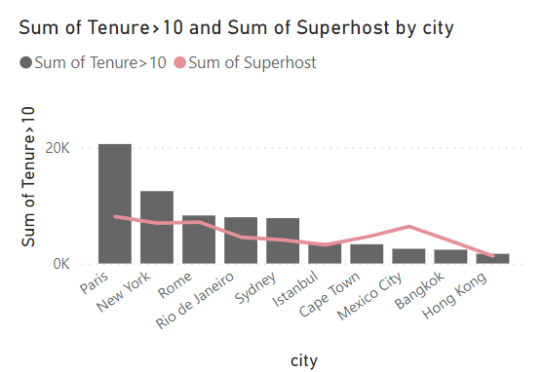
Calculating Listing Age and Host Tenure
New York has the highest average of the tenured hosts and Istanbul has the lowest average of tenured hosts.
However, Paris has the most number of hosts with more than 10 years of tenure. Whereas, the Hong Kong has the lowest.

Slide 9
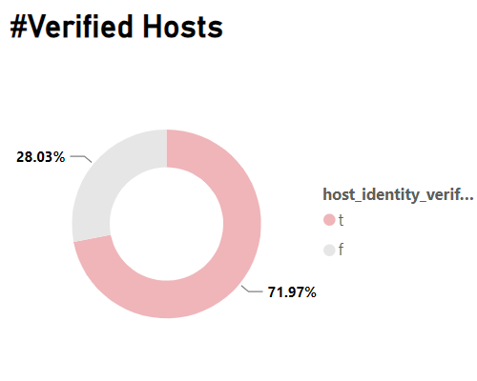
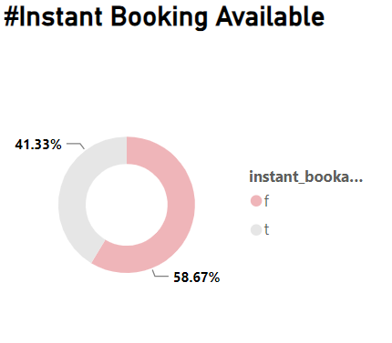
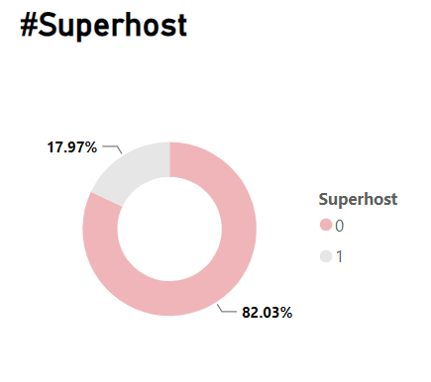

Airbnb users can earn a "Verified ID" badge on their profile by providing their online identity (Via existing Airbnb reviews, Linkedin, or Facebook) and matching it to offline ID documentation, such as confirming personal information or scanning a photo ID. 72% of total host has their identity verified
Instant Book listings allow you to book immediately without needing to send a reservation request to a host for approval. 41% of listings are instant bookable.
A Superhost is a Host who goes above and beyond to provide excellent hospitality. Guests can easily identify a Superhost from the badge that appears on their Airbnb listing and profile. Around 18% of the total hosts are superhosts.

Slide 10
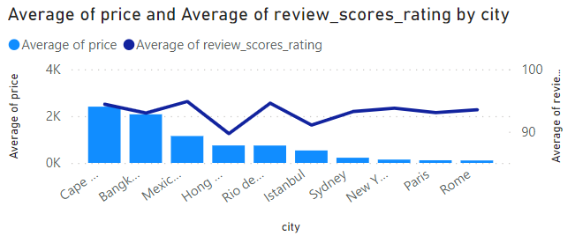
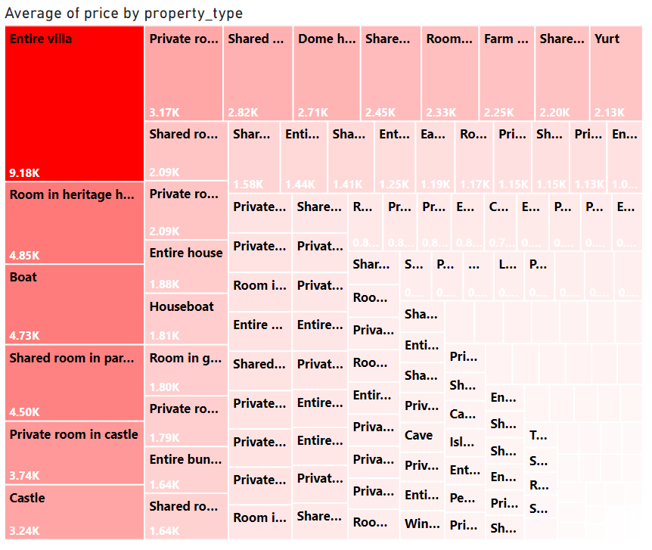
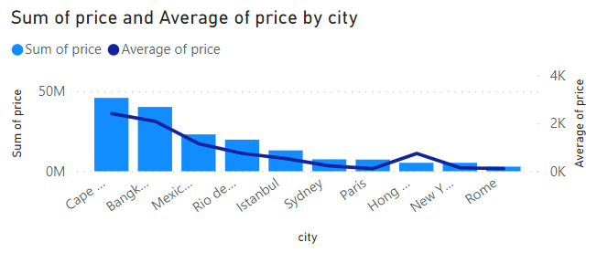
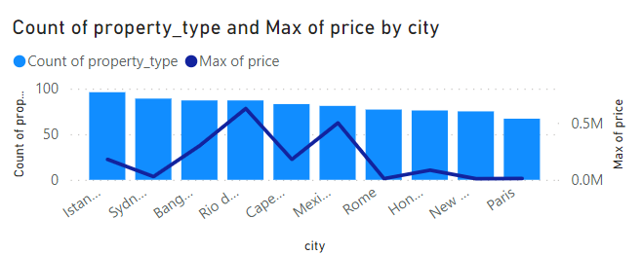
Property Type Price Analysis

Slide 11
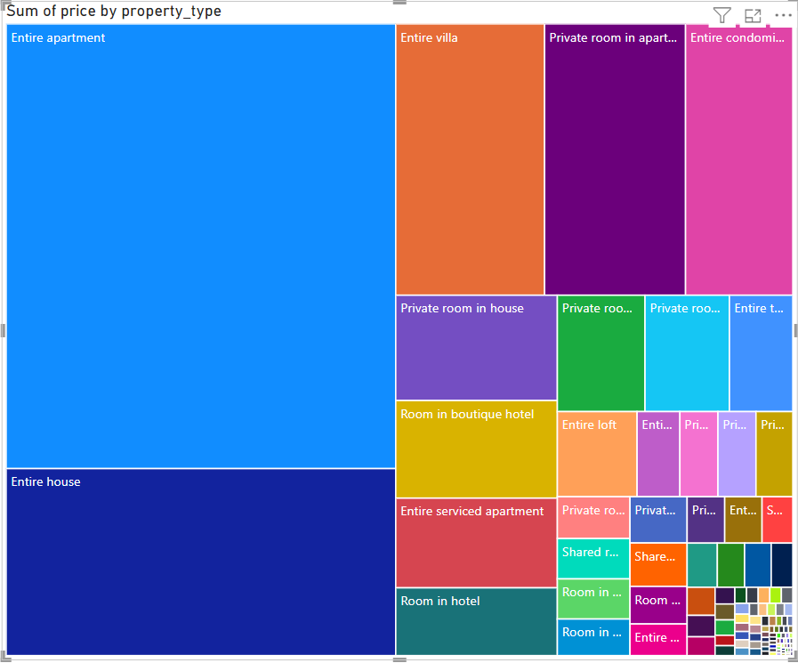
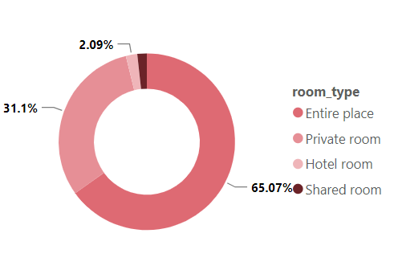
65% of the listings pertain to the Entire Place room type, which offers guests exclusive access to the entire accommodation, including private entrances and no shared spaces. Entire Place emerges as the most favored option among Airbnb guests, with Private Room ranking second in popularity.
Entire Apartment has generated the most revenue and the Entire Villa has the highest average price listing.

Slide 12
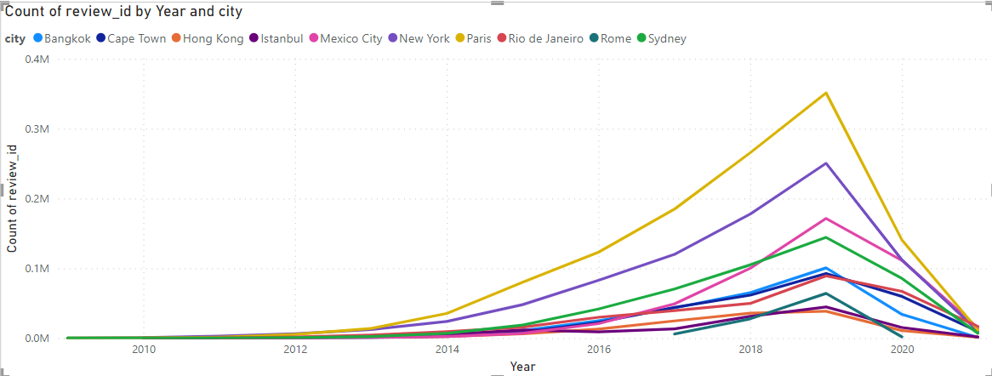
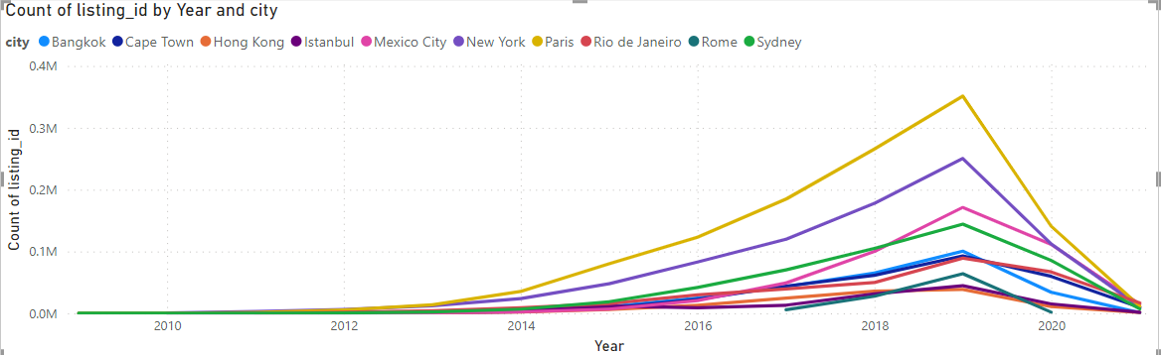
Crafting a Comprehensive City Insights Report
We can see an increase in number of listings and visitors till 2019, and then a sudden drop because of COVID-19.
Also, Paris has outperformed other cities in terms of listings and visitors.

Slide 13
Findings:
Most loved destination by Airbnb Users: Mexico City
Best response time provided by: Mexico City
Most revenue generated by: Cape Town
Most visited destination by Airbnb Users: Paris
Most numbers of listings are in Paris
Most preferred property type: Entire place
Around 18% of the hosts are Super-hosts
Around 41% of hosts provide instant booking
Around 72% of hosts are verified
Entire Villa is the costliest property type.
Entire apartments have generated the most revenue.
Total revenue generated: 170M
Total listings on Airbnb: 278K
Total hosts on Airbnb: 182K

