Slide 1

Attendance System
By: -
Abinash Chhetri (11900220026)
Rahul Gorai (11900220028)
Ankush Dhar (11900220031)
Piyush Ranjan (11900220027)
Rupantar Chakraborty (11900220015)

Slide 2
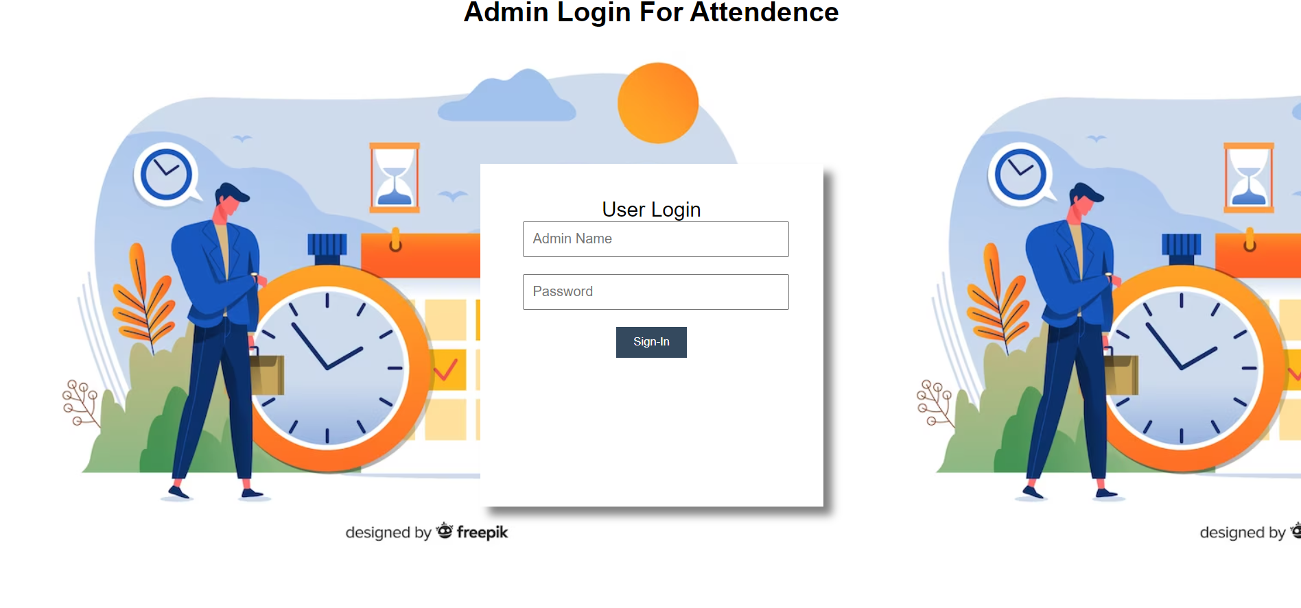
This is our landing page which is hosted in localhost. Here we provide the admin credentials to login or get access into the attendance system
Landing Page

Slide 3

Attendance Form Page
After putting the correct credentials, we get the access of the attendance system.
Here we have created an attendance system where we provide input in the system and the same is replicated in the database we created.

Slide 4
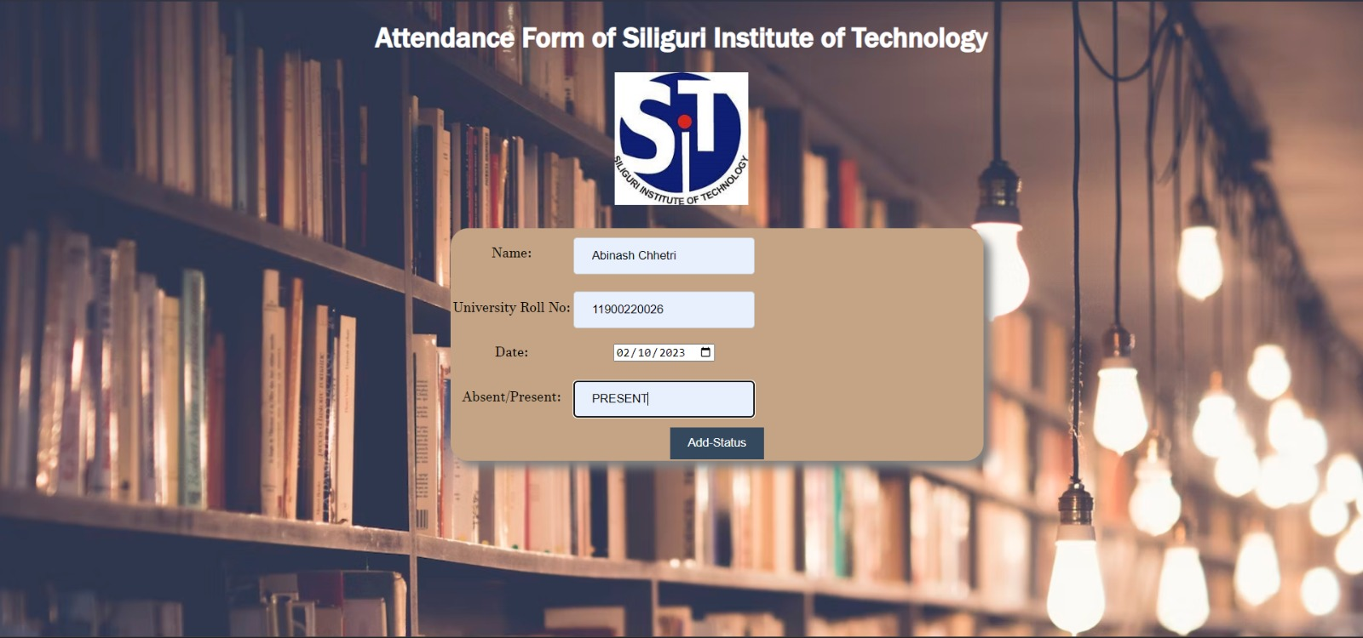
So, after filling the required details , we click on add status button, which finally submits the attendance sheet and stores the data into the database we created

Slide 5
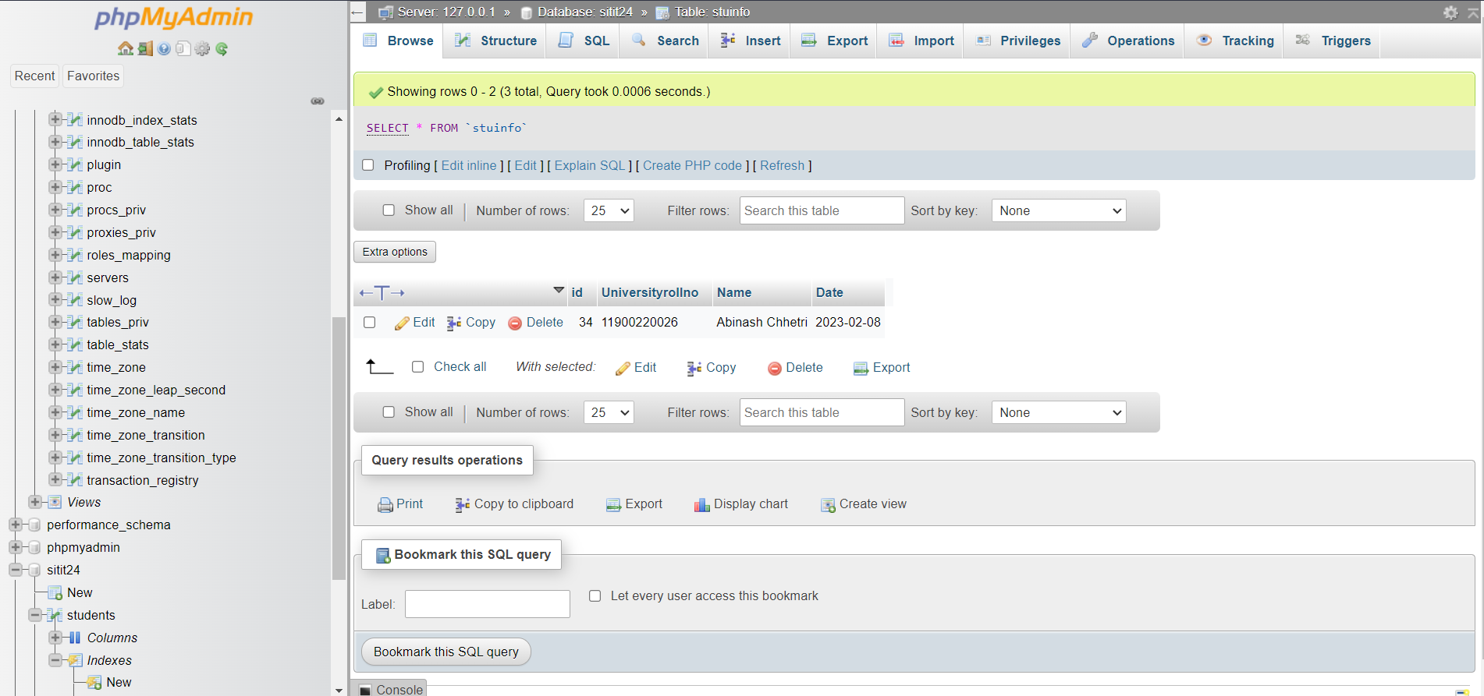
Now this is the database we created, and we can see the same data is replicated in the database.
Database

Slide 6

That’s all Thank You

