Slide 1
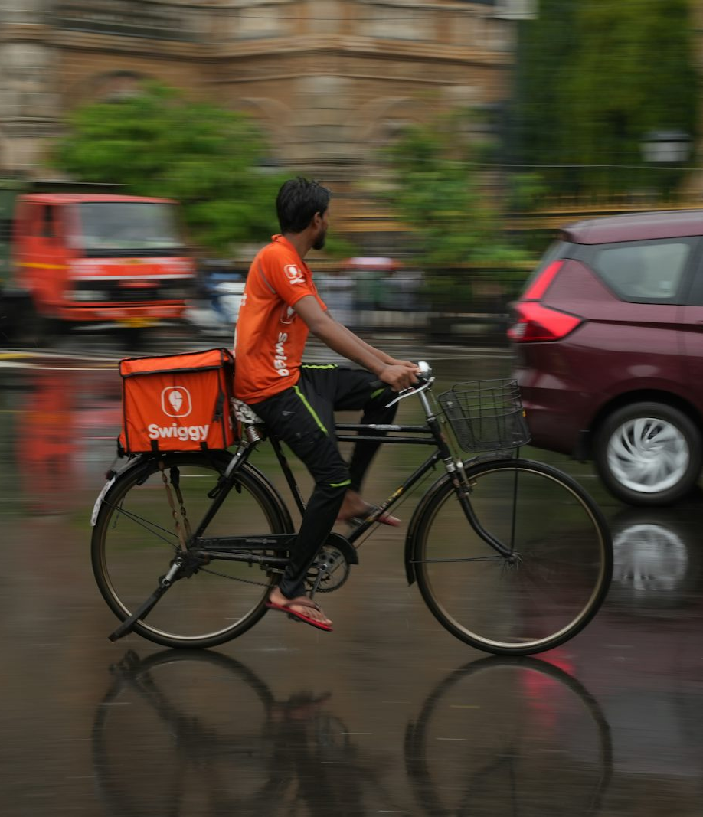
GIGSHIELD
Income protection
when disruption
stops the ride
A company-sponsored parametric cover prototype for gig delivery riders
Presented By-
ANKUSH KUMAR – 24BAI1531
Photo: Avinash Narnaware / Unsplash

Slide 2
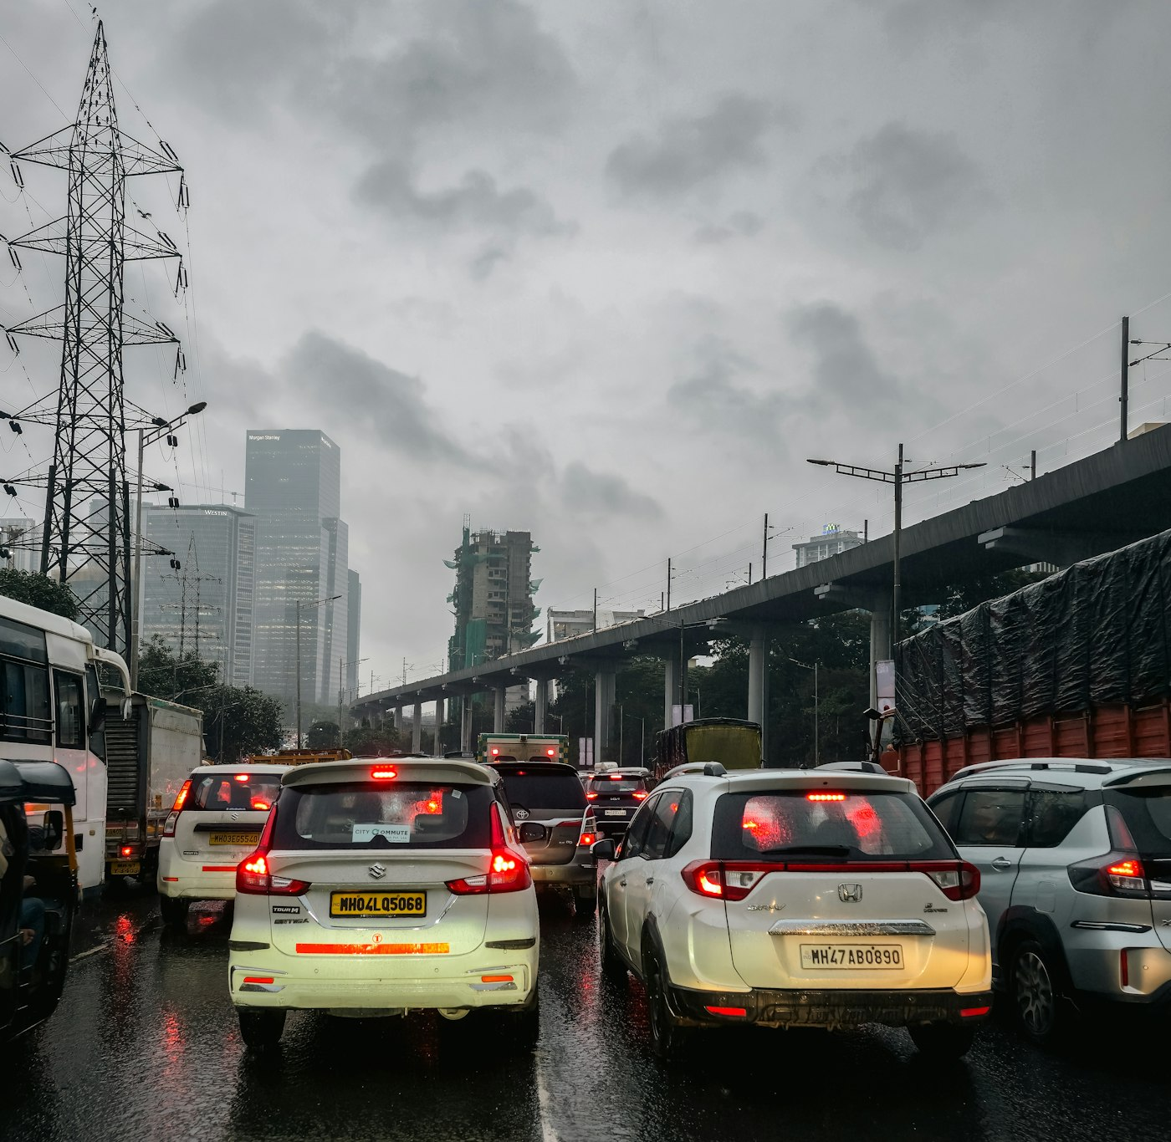
GIGSHIELD / PROJECT PRESENTATION
The income gap when a delivery is disrupted
Rain, flooding and civic restrictions can interrupt work that is paid task by task.
INDIA · ESTIMATED GIG WORKFORCE
1.2 Cr.
workers in 2025–26
A delivery that cannot be completed may mean earnings lost for that shift.
The protection question
Can a company-backed cover respond quickly to a verified disruption, while leaving uncertain cases open for review?
Photo: Zoshua Colah / Unsplash
GigShield · company-sponsored disruption cover ·
02

Slide 3
GIGSHIELD / PROJECT PRESENTATION
Related work · social protection for platform workers
Research describes the protection challenge; GigShield prototypes one narrow operational response.
STUDY / FOCUS
CONTRIBUTION
SCOPE LIMIT
GIGSHIELD CONNECTION
NITI Aayog
India’s Booming Gig and Platform Economy (2022)
Estimates India’s gig workforce and discusses the need to extend social security as platform work grows.
National-level labour-market view; does not specify a per-delivery weather claim workflow.
Sets the context for a company-sponsored rider benefit.
ILO · ISSA · OECD
Social protection for gig and platform workers (2023)
Reviews approaches and country experience for extending adequate, sustainable social protection to platform workers.
Policy and system-level guidance; not a rider-facing disruption verification implementation.
Informs the coverage model and the need for auditable review.
Literature implication
A practical prototype should connect the sponsor, worker, disruption evidence and decision process in one traceable flow.
GigShield · company-sponsored disruption cover ·
03

Slide 4
GIGSHIELD / PROJECT PRESENTATION
Related work · parametric insurance and basis risk
Fast index-based decisions reduce claim friction, but an imperfect trigger can miss a worker’s actual loss.
RESEARCH
FINDING / FEATURE
LIMITATION FOR THIS USE CASE
Clement et al.
Global review of basis risk (2018)
Reviews how index-to-loss mismatch affects product performance and demand.
A weather trigger may not match a localized, ride-specific interruption; the reviewed evidence is largely agricultural.
Chen et al.
Neural-network index design (2024)
Uses nonlinear weather-to-loss modeling to reduce basis risk in an agricultural index-insurance setting.
Requires suitable historical loss and weather data; the study models crop losses, not delivery work or civic events.
Design response in GigShield
Match evidence to a specific ride’s zone and time; preserve manual review when evidence is absent.
GigShield · company-sponsored disruption cover ·
04

Slide 5
GIGSHIELD / PROJECT PRESENTATION
Project gaps and objectives
To translate the research context into a bounded, testable software prototype.
01
Sponsor-led coverage
Let the delivery company own the plan and daily limit; riders register under that company.
02
Ride-level verification
Compare reported disruption with evidence for the ride’s zone and time window.
03
Fair handling of uncertainty
Auto-approve verified cases; route unmatched or flagged cases to an administrator.
04
Traceable decisions
Show evidence, weather snapshot, payout calculation and claim status in the interface.
Scope:
Weather/civic income interruption only · company buys coverage · prototype payouts are not money transfers
GigShield · company-sponsored disruption cover ·
05

Slide 6
GIGSHIELD / PROJECT PRESENTATION
Coverage model · company buys, rider benefits
A B2B2C structure keeps policy setup and payout limits with the sponsoring company.
1. SPONSOR
2. ENROLLMENT
3. TRIGGER
4. OUTCOME
Company
Rider
Disruption
Decision
Creates a coverage plan and sets the daily payout ceiling.
Registers under the company and a service region; no rider premium.
A completed delivery is interrupted by weather or civic conditions.
Evidence supports approval or sends the claim to admin review.
Daily cap logic:
Approved payout = min(claimed amount, remaining rider/day cap)
GigShield · company-sponsored disruption cover ·
06
Notes:
Business model preserved in code: companies have active CoveragePlan rows; riders register with company_id and zone_id. The payout_per_day plan rate is enforced as a remaining daily limit by backend/app/services/coverage_cap.py. It is not a rider-purchased policy.

Slide 7
GIGSHIELD / PROJECT PRESENTATION
Methodology · evidence-to-decision pipeline
A deterministic sequence makes each outcome explainable and keeps uncertain claims reviewable.
1
2
3
4
5
Claim submitted
Evidence match
Weather signal
Decision
Payout cap
Ride ID · disruption type · description · requested amount
Check zone/type and whether an event overlaps ride time
For weather claims, query current conditions at pickup coordinates
Verified + active plan → approve; no match or no plan → manual review
Apply remaining daily cap; record a prototype payout entry
Important distinction
Admin traffic analysis is a separate workflow; its results do not feed the claim approval decision.
GigShield · company-sponsored disruption cover ·
07

Slide 8
GIGSHIELD / PROJECT PRESENTATION
Architecture · web client, API and evidence services
The existing stack stays lightweight: Next.js at the edge, FastAPI for decisions, SQLAlchemy for persistence.
INTERFACES
REST API
DECISION SERVICES
DATA SOURCES
Next.js 14
React · Tailwind
FastAPI
Claim engine
SQLAlchemy
Rider + admin JWT
Claims · rides · plans
Analytics · admin CRUD
Evidence matching
Weather service
Daily payout cap
Credibility + frequency checks
PostgreSQL
Rider portal
Admin console
Leaflet route map
External signal:
OpenWeatherMap current-weather endpoint · optional and failure-tolerant · live map tiles via Leaflet
GigShield · company-sponsored disruption cover ·
08

Slide 9
GIGSHIELD / PROJECT PRESENTATION
Application modules
Three product surfaces share a common claim and coverage engine.
01
02
03
Rider workspace
Admin operations
Shared services
Company and region registration
Company and plan management
Role-separated JWT sessions
Simulated delivery history
Regions and employee seeding
Credibility and frequency flags
Ride detail and claim submission
Claim evidence and route map
Current weather lookup
Income protection and claim history
Approve / reject manual reviews
Daily caps and payout records
Admin-only disruption fixtures and full evidence detail keep the rider-facing flow focused.
GigShield · company-sponsored disruption cover ·
09

Slide 10
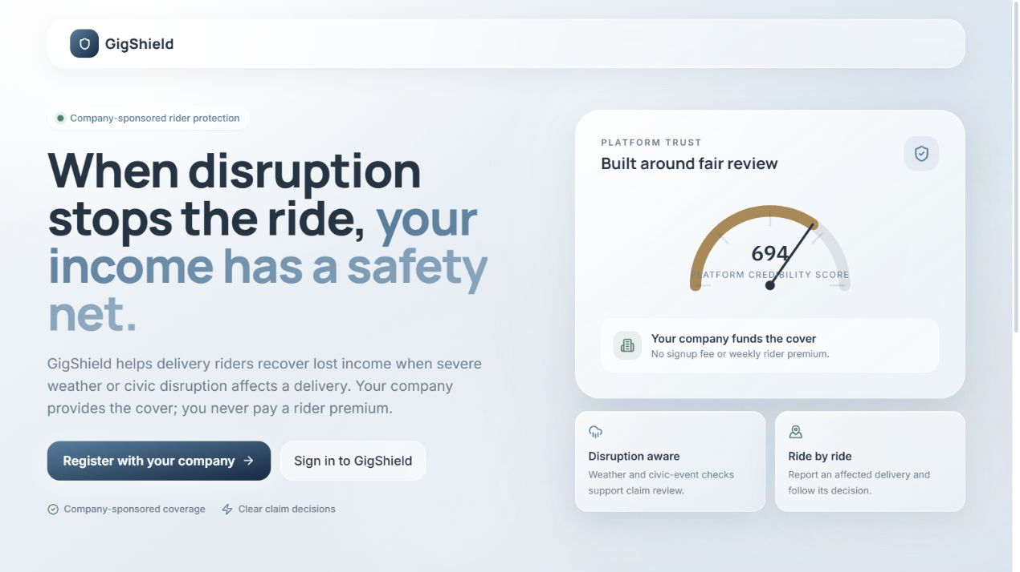
GIGSHIELD / PROJECT PRESENTATION
Prototype snapshot · Homepage
Public landing page for company-sponsored rider cover
GigShield · company-sponsored disruption cover ·
10

Slide 11
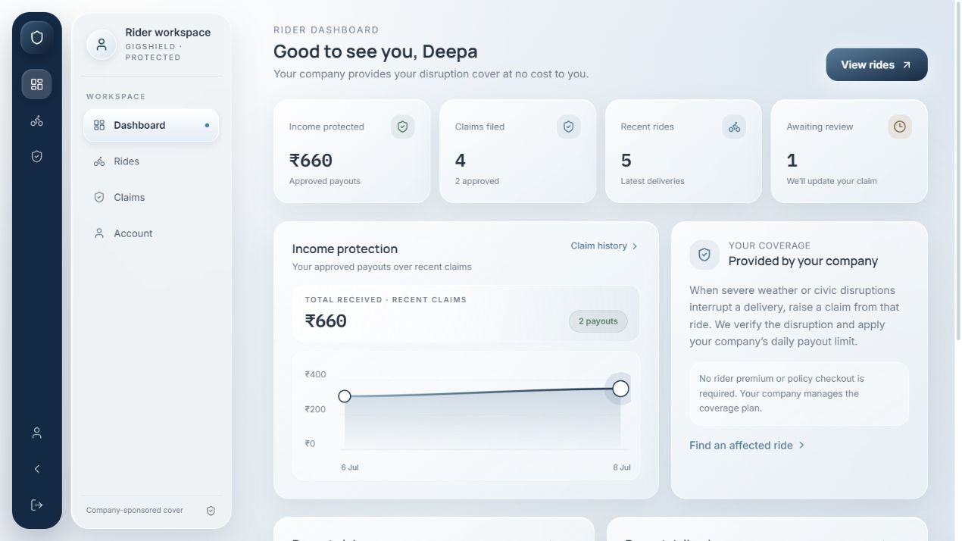
GIGSHIELD / PROJECT PRESENTATION
Prototype snapshot · Rider dashboard
Riders track protected income, claims, and recent deliveries
GigShield · company-sponsored disruption cover ·
11

Slide 12
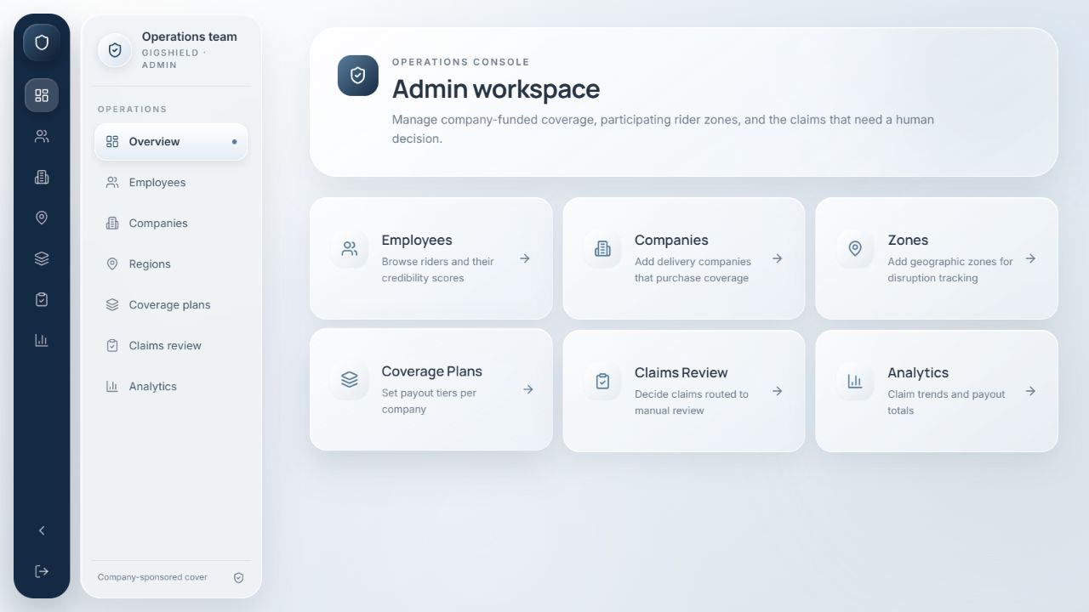
GIGSHIELD / PROJECT PRESENTATION
Prototype snapshot · Admin dashboard
Admins manage company-funded coverage and review claims
GigShield · company-sponsored disruption cover · prototype
12

Slide 13
GIGSHIELD / PROJECT PRESENTATION
Implementation timeline · repository milestones
The visible Git history spans about 10 weeks; commit dates show milestone activity, not full-time effort.
30 JUL
19 AUG
30 AUG
05 SEP
13 SEP
08 OCT
Repository start
Full-stack base
Claim flow
Operations
Backend refinement
Demo polish
Initial commit and project documentation
Frontend, backend and database connected
Simulated rides and first end-to-end claim path
Admin, payouts, credibility and analytics
Coverage rules, fraud flags and evidence detail
Visual refinement and project documentation
First repository commit: 30 Jul 2026 · latest commit: 09 Oct 2026 (c9c0516) · working-tree changes reviewed 10 Oct 2026
GigShield · company-sponsored disruption cover ·
13

Slide 14
GIGSHIELD / PROJECT PRESENTATION
Implemented outcomes and evidence
The prototype demonstrates the complete sponsor-to-claim path without implying production readiness.
4
14
2
13
starter regions
simulated rides / run
separate login roles
smoke-test cases
Chennai Central · Mumbai
Tambaram · Coimbatore
Named Chennai locations
with route coordinates
Rider JWT and admin JWT
with guarded admin routes
Attempted health and admin-auth checks; app startup stalled before pytest returned results.
Observed system behaviors:
Evidence-linked auto-approval · manual-review queue · daily payout cap · admin claim detail and route map · simulated payout record
GigShield · company-sponsored disruption cover ·
14

Slide 15
GIGSHIELD / PROJECT PRESENTATION
End-to-end project workflow
Company-funded cover connects rider activity, disruption evidence and a transparent claim decision.
01 Sponsor coverage
02 Rider enrollment
03 Delivery activity
04 Claim submitted
Company creates a plan
and sets the daily limit
Rider joins the company
and selects a service region
Completed rides store
time, route and fare
Rider selects a ride,
disruption and amount
08 Payout + history
07 Decision branch
06 Risk guardrails
05 Evidence + cover
Approved amount is capped;
payout entry is recorded
Eligible claims auto-approve;
uncertain cases go to admin
Frequency and ride anomalies
can request human review
Match disruption to ride time;
confirm company coverage
ADMIN-ONLY ANALYTICS
Traffic records → train Random Forest → analyze selected employee rides → save assessments
This traffic-analysis lane is separate from the claim decision. Six saved claim checkpoints show review progress to the rider.
GigShield · company-sponsored disruption cover ·
15

Slide 16
GIGSHIELD / PROJECT PRESENTATION
Claim decision paths and test outcomes
The outcome depends on evidence, active company coverage, payout limits and review signals.
SCENARIO
SYSTEM OUTCOME
EFFECT ON APPROVAL
Evidence matches ride + active plan
Automatic approval, subject to risk review
Payout is limited to the remaining daily cap
No matching disruption evidence
Manual review
No automatic payout; admin checks the claim
Evidence matches but no active plan
Manual review
Coverage must exist before an amount is payable
Repeated filing or elevated ride anomaly
Manual review if otherwise approvable
Flag prompts review; it does not auto-reject
A claim already exists for the ride
HTTP 409 duplicate response
A second claim cannot be created
TEST RUN
Selected pytest health + admin-auth checks were interrupted after app startup stalled; no pass/fail results were produced. The rows above summarize the current decision rules, not a completed integration run.
GigShield · company-sponsored disruption cover ·
16

Slide 17
GIGSHIELD / PROJECT PRESENTATION
References and visual credits
Research sources and implementation details used in this presentation.
01
NITI Aayog. (2022). India’s Booming Gig and Platform Economy: Perspectives and Recommendations on the Future of Work. niti.gov.in · estimate: 7.7M gig workers in 2020–21.
02
ILO, ISSA & OECD. (2023). Providing adequate and sustainable social protection for workers in the gig and platform economy. ilo.org.
03
Clement, K.Y. et al. (2018). A global review of basis risk in index insurance. International Journal of Disaster Risk Reduction, 28, 845–853. doi:10.1016/j.ijdrr.2018.01.001.
04
Chen, Z. et al. (2024). Managing Weather Risk with a Neural Network-Based Index Insurance. Management Science, 70(7), 4306–4327. doi:10.1287/mnsc.2023.4902.
05
GigShield source repository. AnkushKr836/GigShield, local HEAD c9c0516 plus working-tree changes, reviewed 10 October 2026.
06
OpenWeatherMap. Current Weather API documentation. openweathermap.org/current.
GigShield · company-sponsored disruption cover ·
17

